Slide 1
Deep learning basics
Lecture 4
Changho Suh
Oct. 20, 2020
TexPoint fonts used in EMF.
Read the TexPoint manual before you delete this box.: AAAAAAAAAAAAAAAAAAAA

Slide 2
Deep learning and optimization
TexPoint fonts used in EMF.
Read the TexPoint manual before you delete this box.: AAAAAAAAAAAAAAAAAAAA

Slide 3
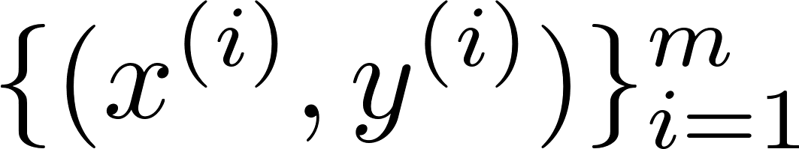
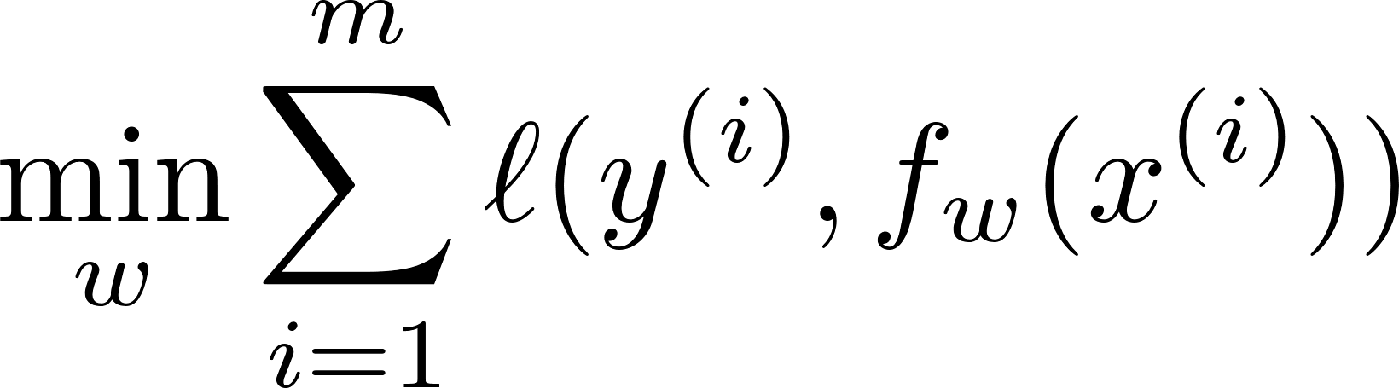
Recap: Day 1’s lectures
Studied: What machine learning means:
Design an interested function using
Formulated: An optimization problem.

Slide 4
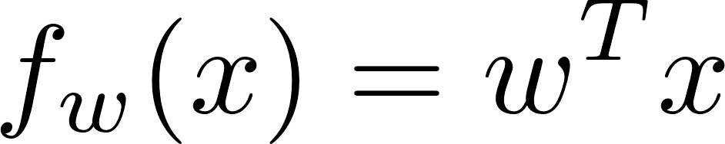
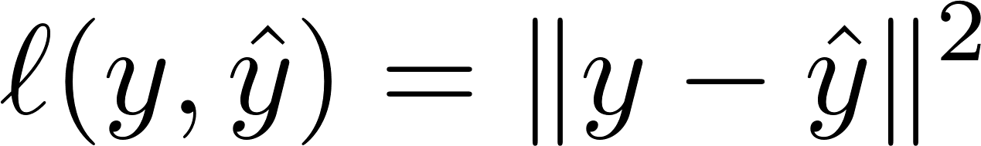
Recap: Least Squares
Employ: Perception w/ linear approximation
A squared-error loss:

Slide 5
Recap: Scikit-learn coding
from sklearn.datasets import load_iris
from sklearn.model_selection import train_test_split
X,y=load_iris(return_X_y=True)
X_train,X_test,y_train,y_test=train_test_split(X,y,test_size=0.2)
from sklearn.linear_model import RidgeClassifier
Model_LS = RidgeClassifier(alpha=0)
Model_LS.fit(X_train,y_train)
Model_LS.predict(X_test)
Model_LS.score(X_test,y_test)

Slide 6
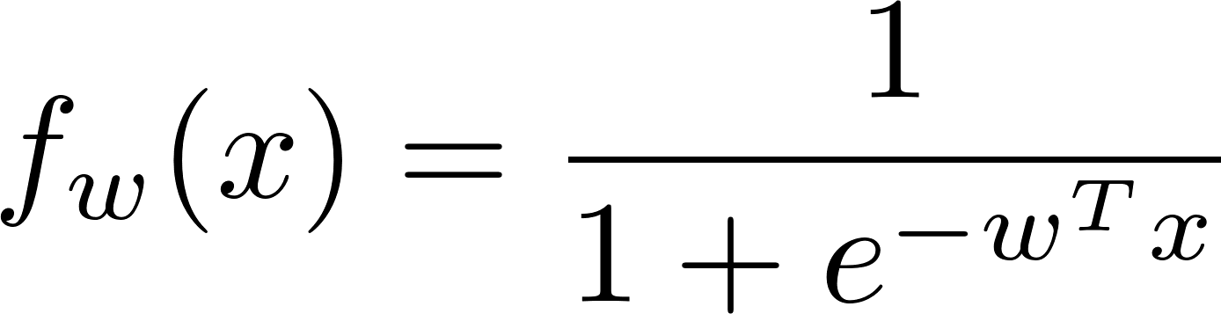


Recap: Logistic regression
Employ: Perception w/ logistic function approximation
Cross entropy loss:

Slide 7
Recap: Scikit-learn coding
from sklearn.datasets import load_iris
from sklearn.model_selection import train_test_split
X,y=load_iris(return_X_y=True)
X_train,X_test,y_train,y_test=train_test_split(X,y,test_size=0.2)
from sklearn.linear_model import LogisticRegression
Model_LR = LogisticRegression(penalty=‘none’)
Model_LR.fit(X_train,y_train)
Model_LR.predict(X_test)
Model_LR.score(X_test,y_test)

Slide 8
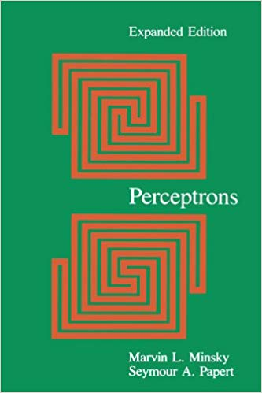

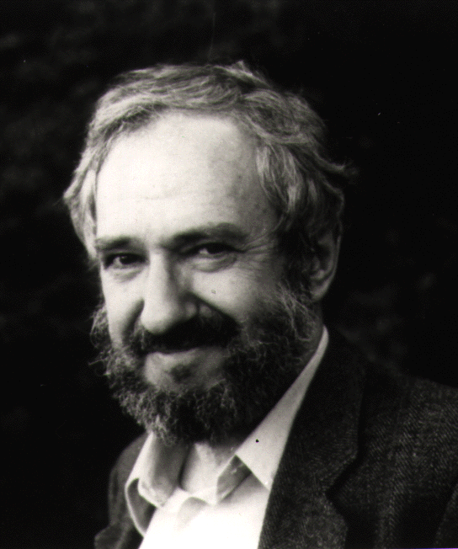
AI boomed in 1960s but …
Marvin Minsky
Seymour Papert
‘69
Demonstrated limitations of the perceptron architecture.
→ Led to the AI winter!

Slide 9



AI revived in 2012
Alex Krizhevsky
Ilya Sutskever
Geoffrey Hinton
Won the ImageNet competition in 2012!
Demonstrated: Deep neural networks can achieve human-level recognition performances!
Anchored the start of deep learning revolution!

Slide 10
Overview of today’s lectures
Will investigate deep neural networks (DNNs) and an advanced technique.
Specifically we will:
1.
Study the architecture of DNNs;
2.
Formulate a corresponding optimization problem;
Explore an efficient way of solving the problem;
3.
Study one advanced technique: Generalization tech.
4.

Slide 11
Focus on Lecture 4
Will investigate deep neural networks (DNNs) and an advanced technique.
Specifically we will:
1.
Study the architecture of DNNs;
2.
Formulate a corresponding optimization problem;
Explore an efficient way of solving the problem;
3.
Study one advanced technique: Generalization tech.
4.

Slide 12










Terminologies
Recall: Perceptron architecture
no layer btw input/output layers
activ.
input layer
output layer
→ Called: Shallow neural networks

Slide 13
Deep neural networks
Say: A neural network is deep if it has at least one layer btw input/output layers.
hidden layer
Definition: A deep neural network is a network that contains hidden layer(s).
Convention: L-hidden-layer network
= (L+1)-layer network

Slide 14






DNN architecture
activ.
input layer
hidden layer
output layer

Slide 15


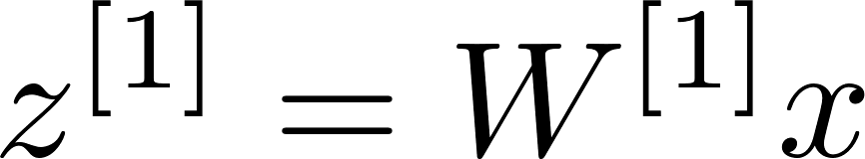
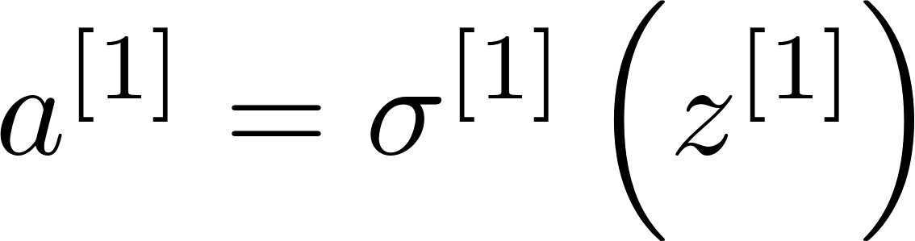


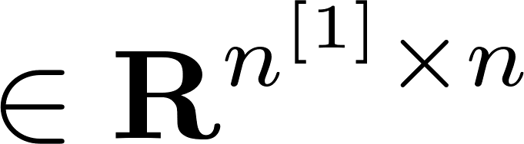
DNN architecture
component-wise function
input layer
hidden layer
output layer

Slide 16
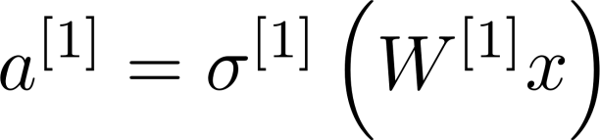

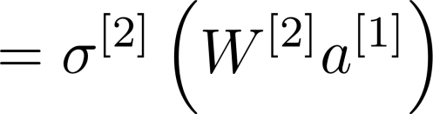

DNN architecture
input layer
hidden layer
output layer

Slide 17

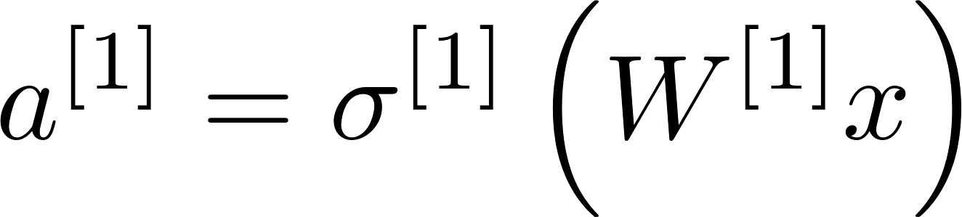


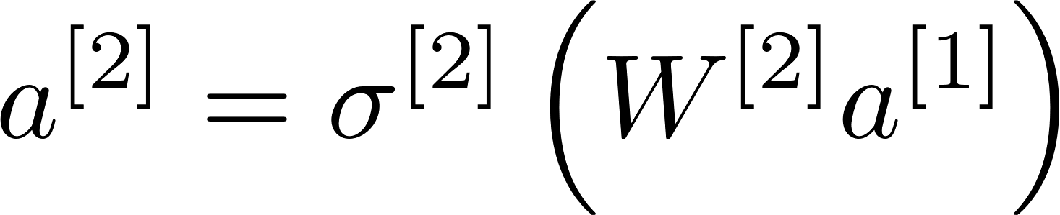
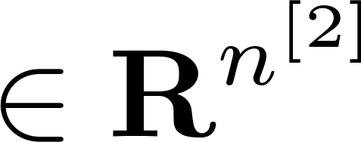

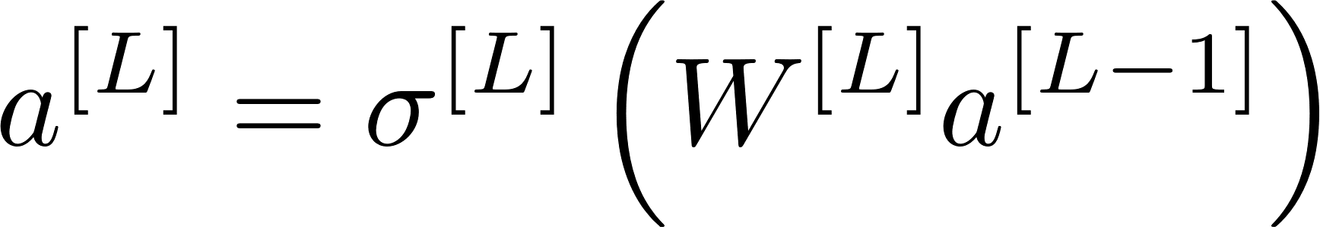


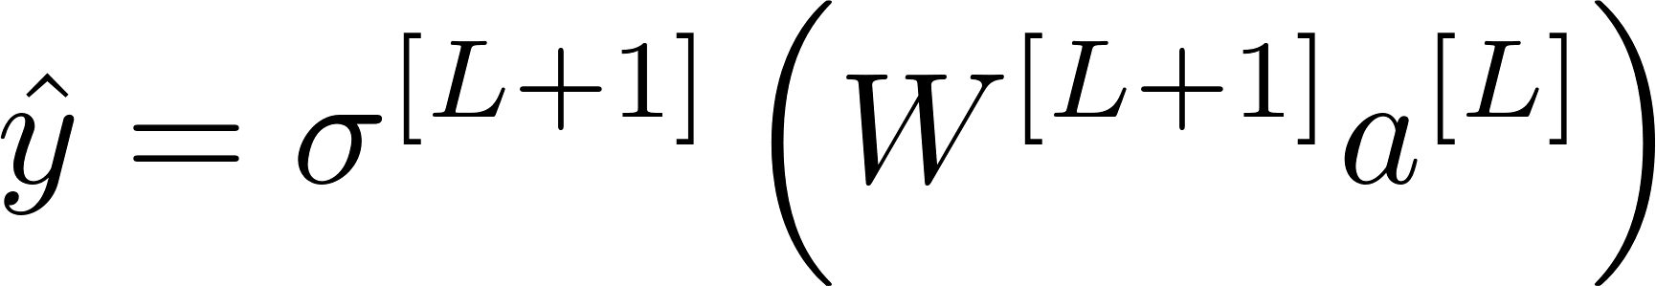

DNN architecture: L hidden layers

Slide 18
DNN-based optimization
TexPoint fonts used in EMF.
Read the TexPoint manual before you delete this box.: AAAAAAAAAAAAAAAAAAAA

Slide 19
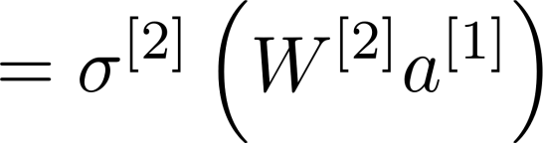
Optimization

Slide 20
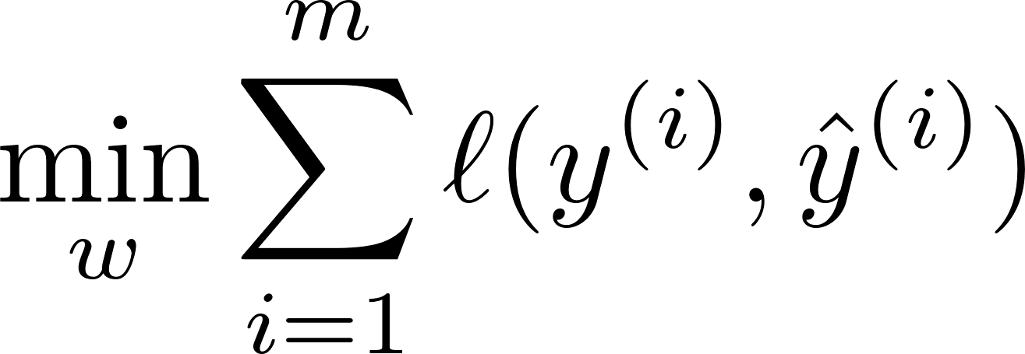
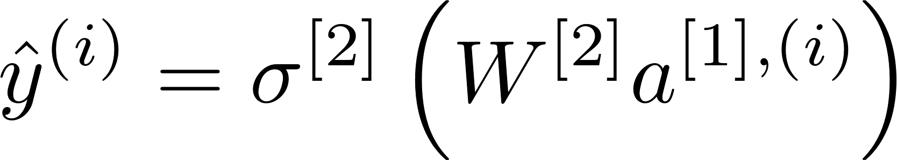
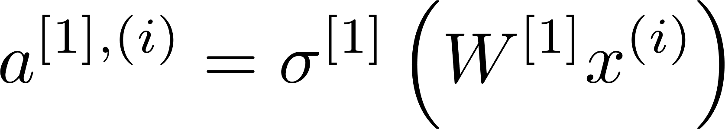
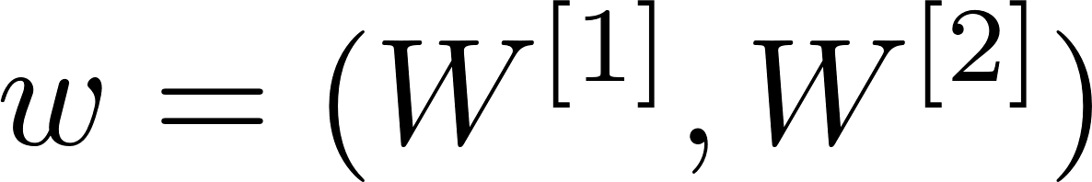
Optimization

Slide 21
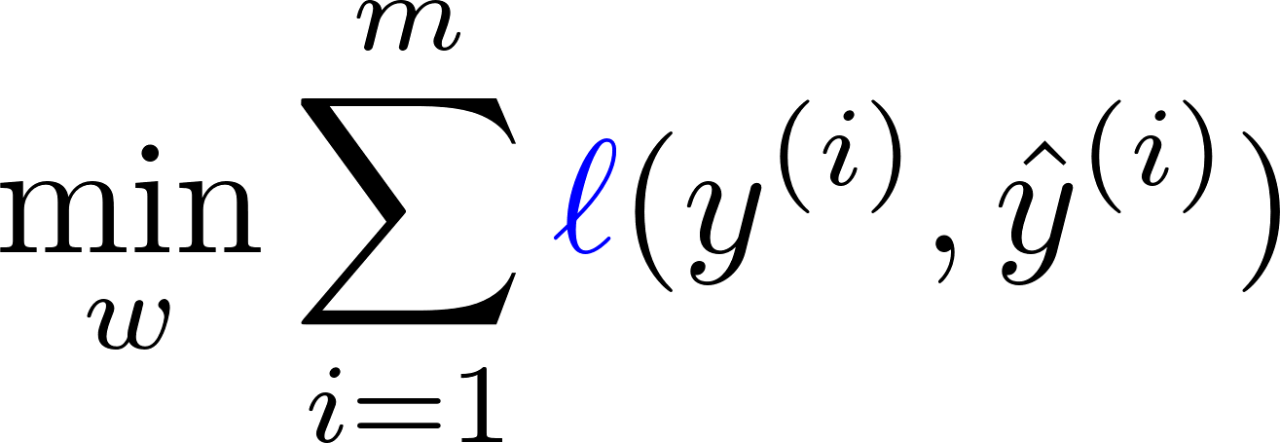
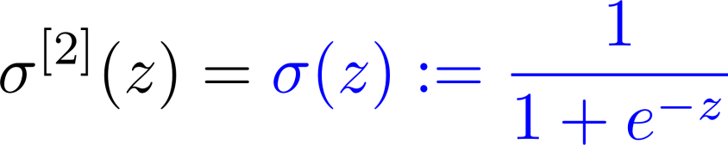
How to choose a loss function?
Use a logistic function for
Use cross entropy loss.

Slide 22
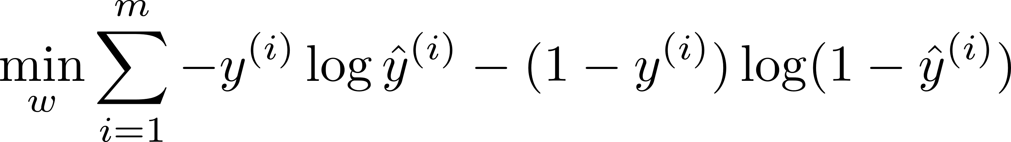
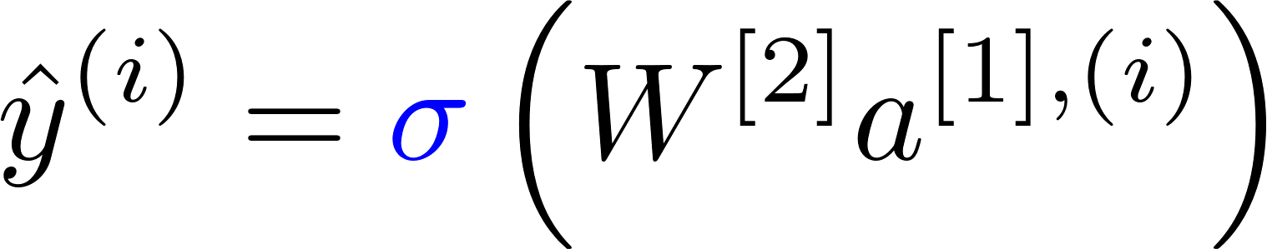
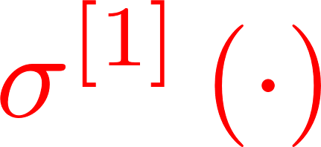
Optimization
How to choose ?

Slide 23








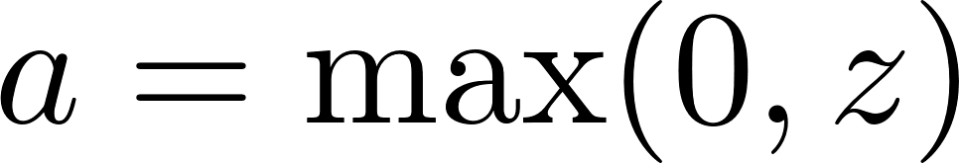
Widely-used activation function
Operation at a neuron in the hidden layer:
ReLU
Rectified Linear Unit

Slide 24
A common rule of thumb in the past
Use the logistic function only at the output layer.
Use the tanh* function at all hidden layers.
Many empirical results have demonstrated:
This rule yields better or equal performances than another way taking logistic at all places.
*See Appendix for details on tanh function.

Slide 25
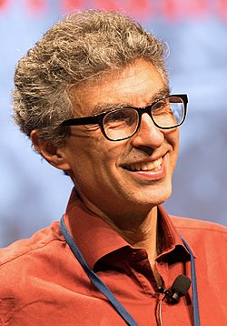
ReLU became prevalent since 2011
In 2011, Yoshua Bengio together with his group members showed:
ReLU enables faster and more effective training of DNNs.
Empirically confirmed by numerous practitioners on many datasets.
Hence, ReLU now acts as a default activation function in hidden layers.
Yoshua Bengio 2011

Slide 26
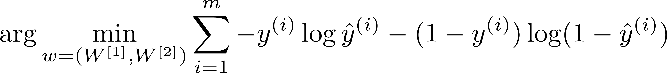
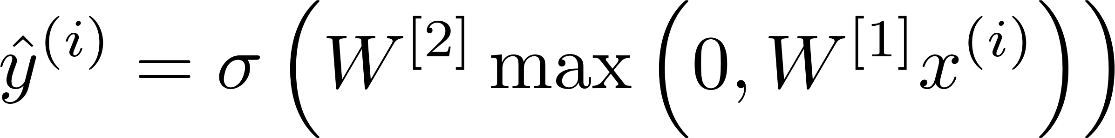
Convex vs. non-convex?
Turns out: Objective function is non-convex.

Slide 27


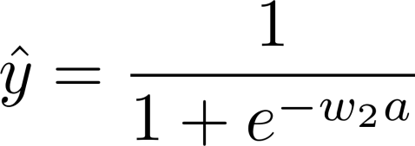


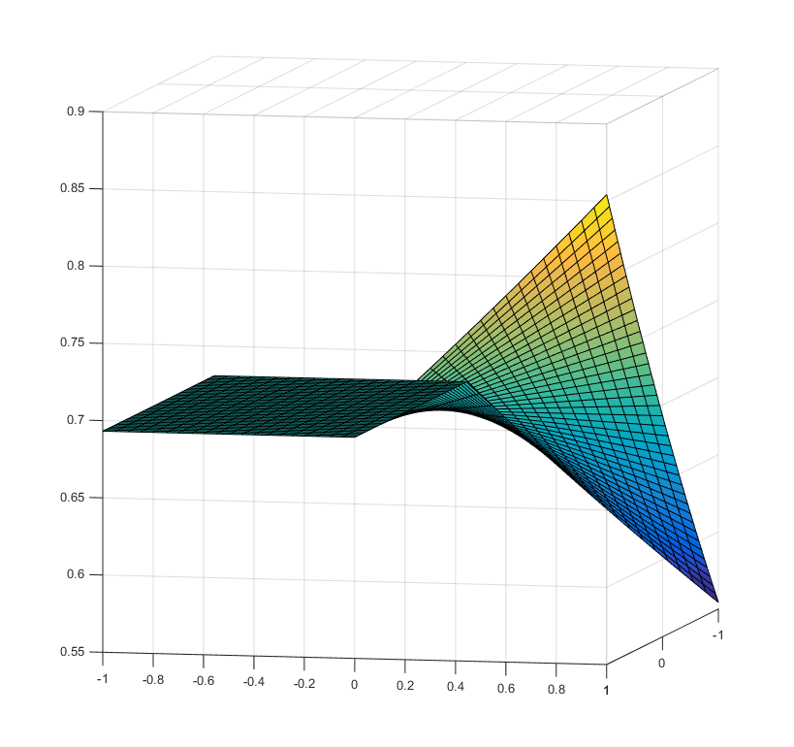


A simple case
non-convex

Slide 28


A way to handle such non-convex problem?
Observation (by many practitioners):
Experimental results revealed that in most cases:
Any local minimum is the global minimum!
saddle
global

Slide 29
Suggests a good way
Any local minimum is the global minimum!
Find any stationary point (gradient =0) and then take it as a solution.
Saddle points are unstable, so difficult to converge to.
How to find a stationary point then?
Via gradient descent!

Slide 30
Look ahead
Will explore details on gradient descent.

Slide 31
Appendix:
tanh function
TexPoint fonts used in EMF.
Read the TexPoint manual before you delete this box.: AAAAAAAAAAAAAAAAAAAA

Slide 32
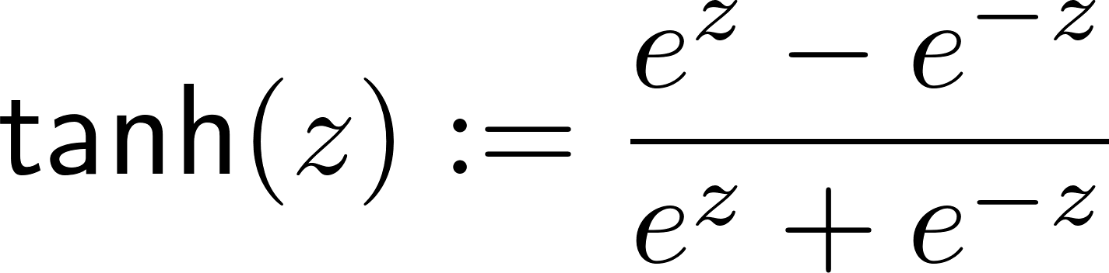
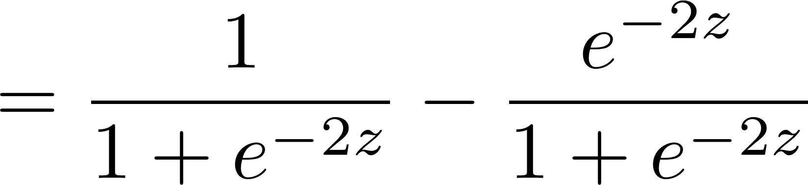
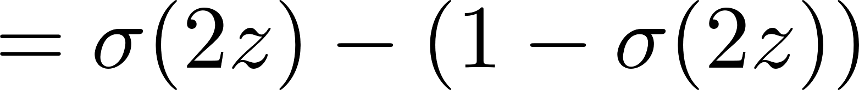

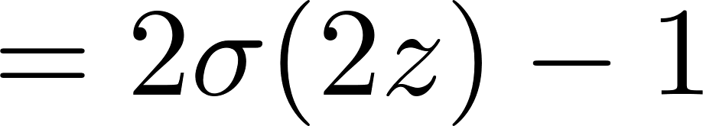

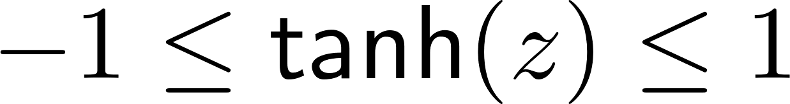

tanh function

