Slide 1
Advanced techniques (1/2)
Lecture 6
Changho Suh
Oct. 20, 2020
TexPoint fonts used in EMF.
Read the TexPoint manual before you delete this box.: AAAAAAAAAAAAAAAAAAAA

Slide 2
Generalization techniques
TexPoint fonts used in EMF.
Read the TexPoint manual before you delete this box.: AAAAAAAAAAAAAAAAAAAA

Slide 3
Outline
Will investigate generalization techniques:
1. Data augmentation
2. Early stopping
3. Dropout

Slide 4
Data augmentation
Idea: Artificially generate diverse data by perturbing original data.
This way: Can make model resilient to unseen data.
Hence: Can improve generalization capability.

Slide 5




Data augmentation for image data
original
rotation
mirroring
cropping

Slide 6
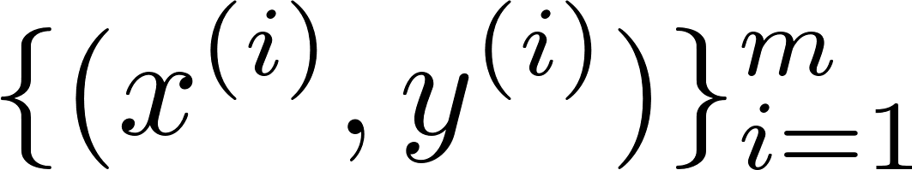
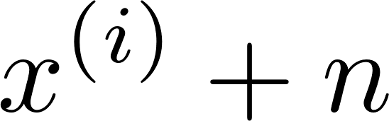
Data augmentation for generic data
Original data:
1.
Add random noise:
random noise
2.
Mixup original data
3.
Generate fake data using Generative Adversarial Networks (GANs)

Slide 7
Early stopping: Motivation
loss
train loss
# of epochs
Large # of epochs: More overfitting to train sets.

Slide 8
Early stopping: Idea
loss
validation loss
train loss
stop here!
# of epochs
To avoid overfitting: Rely on validation loss.
Check in PS.
Notes:
EarlyStopping(monitor='val_loss', mode='min', verbose=1, patience=50)

Slide 9




Dropout
For each training step and per example: Randomly remove neurons independently across them.
Notes:
layer = tf.keras.layers.Dropout(.2, input_shape=(2,))

Slide 10

Dropout
Dropout rate: p (e.g., 0.5)

Slide 11
Dropout
Dropout rate: p (e.g., 0.5)

Slide 12
Dropout
Dropout rate: p (e.g., 0.5)
Generate this partial NN per step and example.

Slide 13
Why dropout works?
Experience many smaller NNs.
Can interpret the resulting NN as an averaging ensemble of all these smaller NNs.
Not overfit to a particular NN; hence generalize better.
Check in PS.

Slide 14
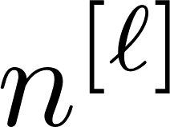
Other advanced techniques
1.
Data organization (train/validation/test sets)
2.
Weight initialization:
Xavier’s, He’s
3.
Techniques for training stability
Adam optimizer;
learning rate decay
Batch normalization
4.
Hyperparameter search:
# L of layers, # of hidden neurons, activation, learning rate, betas, batch size, # epochs, regularization factor, dropout rate, …
5.
Cross validation

Slide 15
Look ahead
Will explore the advanced techniques.
Will embark on convolutional neural networks.

