Slide 1
Advanced techniques (2/2)
Lecture 7
Changho Suh
Oct. 21, 2020
TexPoint fonts used in EMF.
Read the TexPoint manual before you delete this box.: AAAAAAAAAAAAAAAAAAAA

Slide 2
Data organization and
weight initialization
TexPoint fonts used in EMF.
Read the TexPoint manual before you delete this box.: AAAAAAAAAAAAAAAAAAAA

Slide 3
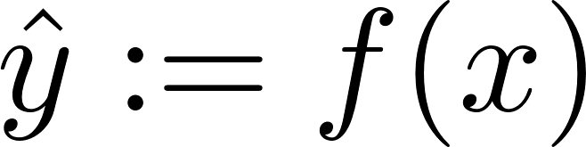



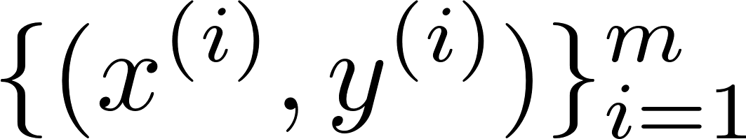
Recap: Machine learning
machine
Perceptron
parameterization
No activation + squared-error loss: Least Squares
Logistic act. + cross entropy loss: Logistic regression
Algorithm: Gradient descent

Slide 4
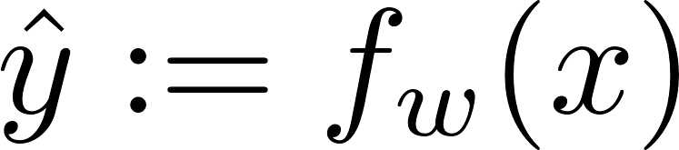
Recap: Deep neural networks
machine
DNN
Rule of thumb: ReLU (@hidden); Logistic (@output)
Cross entropy loss
Algorithm: Gradient descent
via backprop
Adam optimizer

Slide 5
Recap: TensorFlow coding
import tensorflow.keras as keras
from keras.datasets import mnist
(X_train, y_train),(X_test, y_test) = mnist.load_data()
X_train, X_test = X_train/255.0, X_test/255.0
Model_NN = keras.models.Sequential()
Model_NN.add(keras.layers.Flatten(input_shape=(28,28)))
Model_NN.add(keras.layers.Dense(128,activation=‘relu’))
Model_NN.add(keras.layers.Dense(10,activation=‘softmax’)
Model_NN.compile(optimizer=‘sgd’, \ loss=‘sparse_categorical_crossentropy’, metrics=[‘acc’])
Model_NN.fit(X_train, y_train, epochs=10)
Model_NN.predict(X_test)
Model_NN.evaluate(X_test, y_test)
*See Appendix for details on softmax activation.

Slide 6
Question
How to improve model performance?
Investigated one way via generalization techniques.

Slide 7
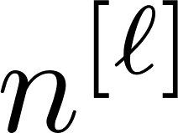
Outline of today’s lectures
Will explore other techniques for improvement.
1.
Data organization (train/validation/test sets)
2.
Weight initialization:
Xavier’s, He’s
3.
Techniques for training stability
Adam optimizer;
learning rate decay;
batch norm
4.
Hyperparameter search:
# L of layers, # of hidden neurons, activation, learning rate, betas, batch size, # epochs, regularization factor, dropout rate, …
5.
Cross validation

Slide 8
Focus of Lecture 7
Will explore other techniques for improvement.
1.
Data organization (train/validation/test sets)
2.
Weight initialization:
Xavier’s, He’s
3.
Techniques for training stability
Adam optimizer;
learning rate decay;
batch norm
4.
Hyperparameter search:
# L of layers, # of hidden neurons, activation, learning rate, betas, batch size, # epochs, regularization factor, dropout rate, …
5.
Cross validation

Slide 9
Train vs. validation vs. test sets
Data seen during training:
train set
validation set
Role: training model parameters
Role: validating the goodness of a trained model
(hyperparameter search)
Data unseen during training:
test set

Slide 10
How to split train/val/test sets?
Two important factors to consider:
1.
Scale of # examples
2.
Data distribution

Slide 11


Scale of # examples
A deciding factor for the split ratio.
Small scale:
train:val:test = 60:20:20
Middle:
80:10:10
Large:
98:1:1
Ultra-large:
99.9:0.05:0.05

Slide 12
Data distribution
val set dist. ~ test set dist.
~ target dist.
Easy to implement in Tensorflow.
Check in PS.
Notes:
StratifiedkFold

Slide 13
Weight initialization
TexPoint fonts used in EMF.
Read the TexPoint manual before you delete this box.: AAAAAAAAAAAAAAAAAAAA

Slide 14


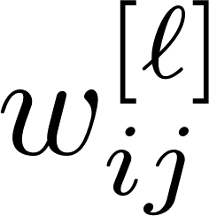
Xavier’s initialization: Motivation
layer
layer
random initialization?

Slide 15
Xavier’s initialization: Motivation
layer
layer
Turns out: With random initialization, a dynamic range of signals is boosted as the network gets deeper.
random initialization?

Slide 16
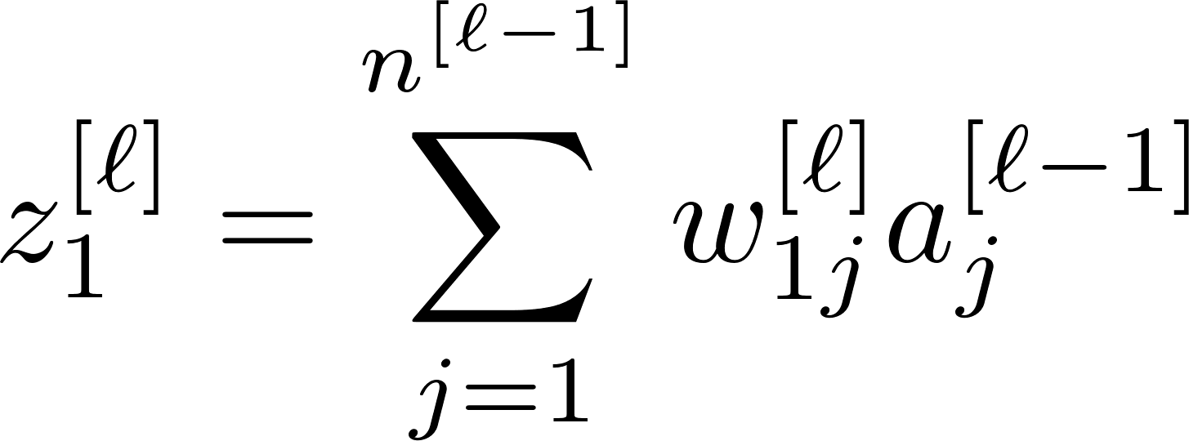
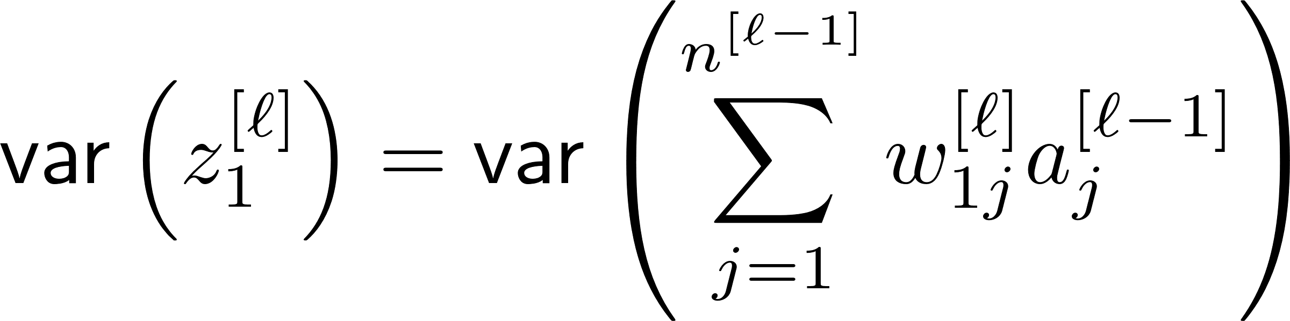
Xavier’s initialization: Motivation
To see this “exploding problem”, consider:
A dynamic range of signals can be quantized via:

Slide 17
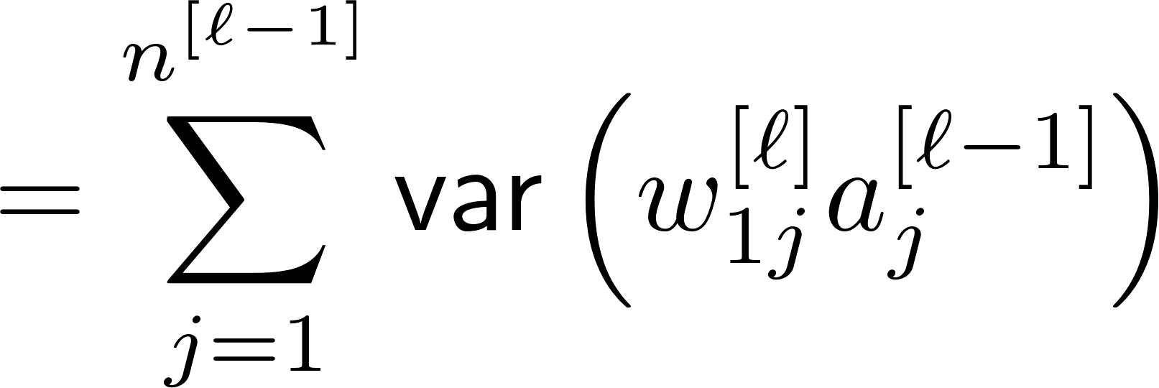

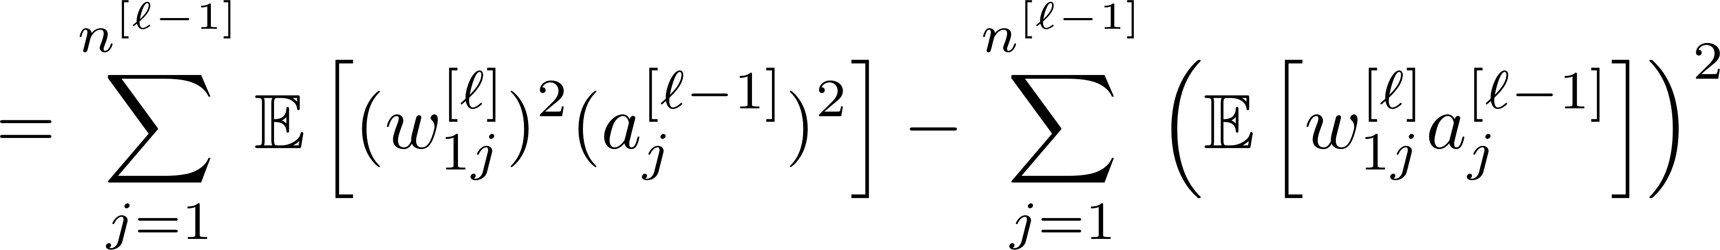
Variance computation
Assumption:
(i) weights independent
(ii) input independent
(iii) weights/input ind.
(iv) zero mean

Slide 18
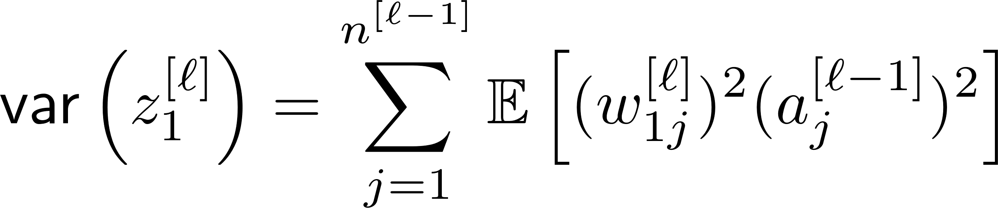
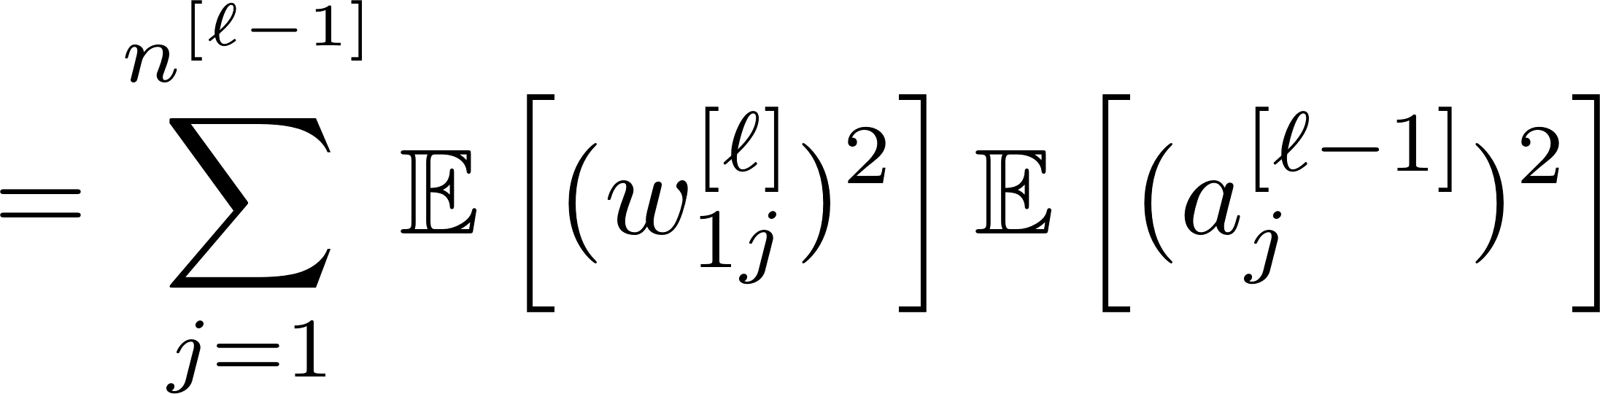
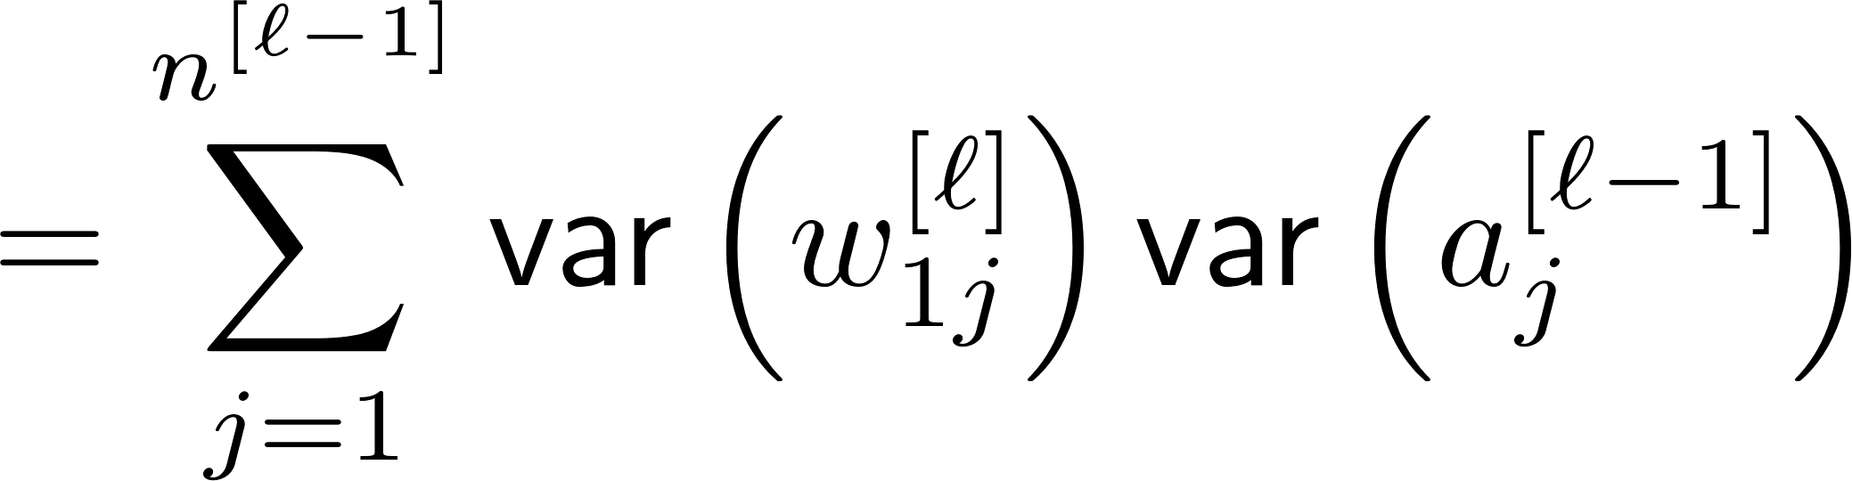
Variance computation
Assumption:
(i) weights independent
(ii) input independent
(iii) weights/input ind.
(iv) zero mean

Slide 19
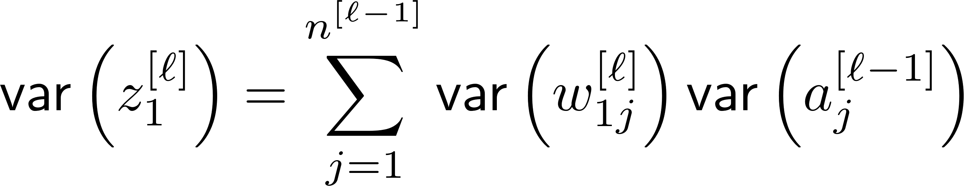
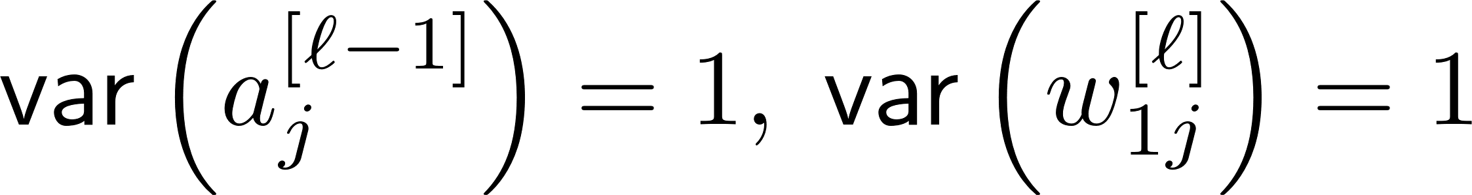
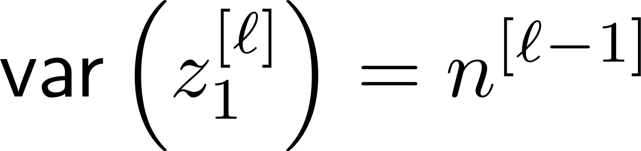
Exploding problem
Suppose:
Then:
As the network gets deeper, explode!

Slide 20
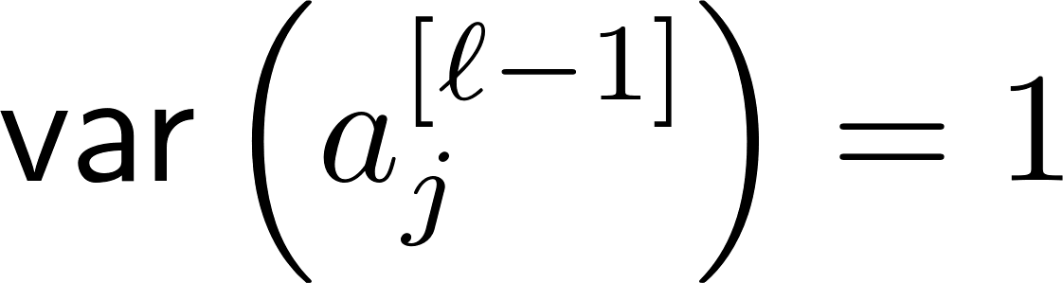
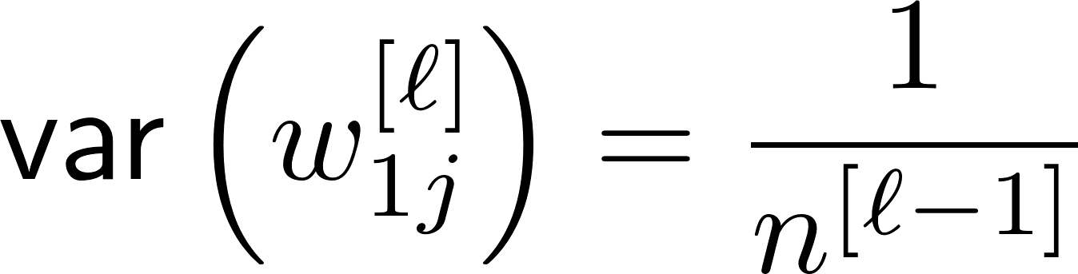
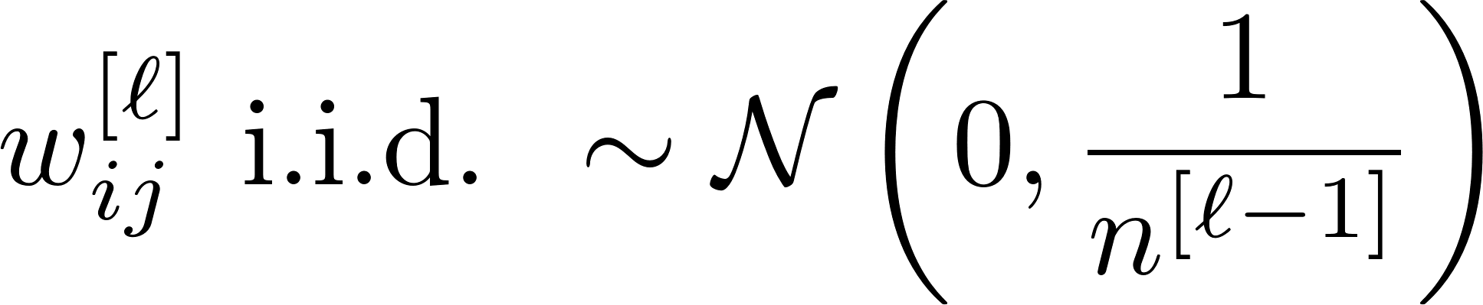
Xavier’s initialization
Suppose:
Idea:
Set

Slide 21
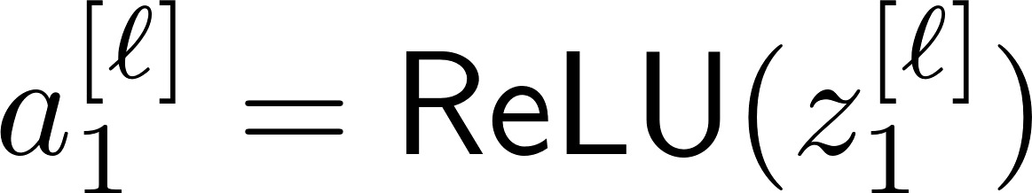
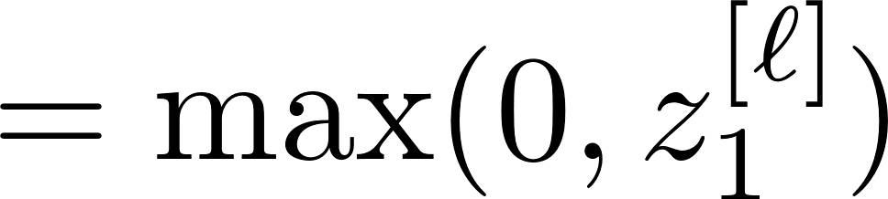
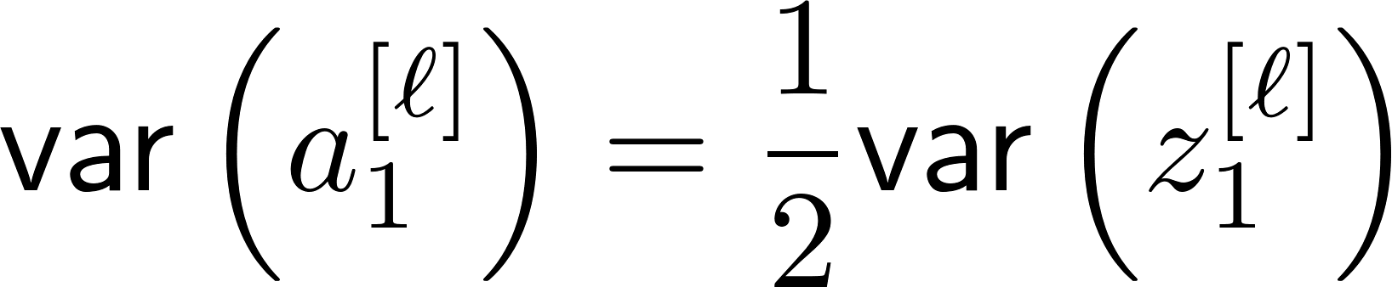
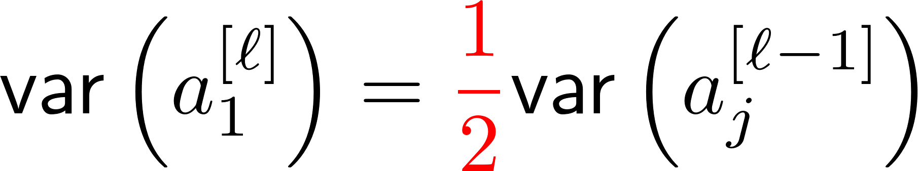
He’s initialization: Motivation
Xavier’s initialization

Slide 22
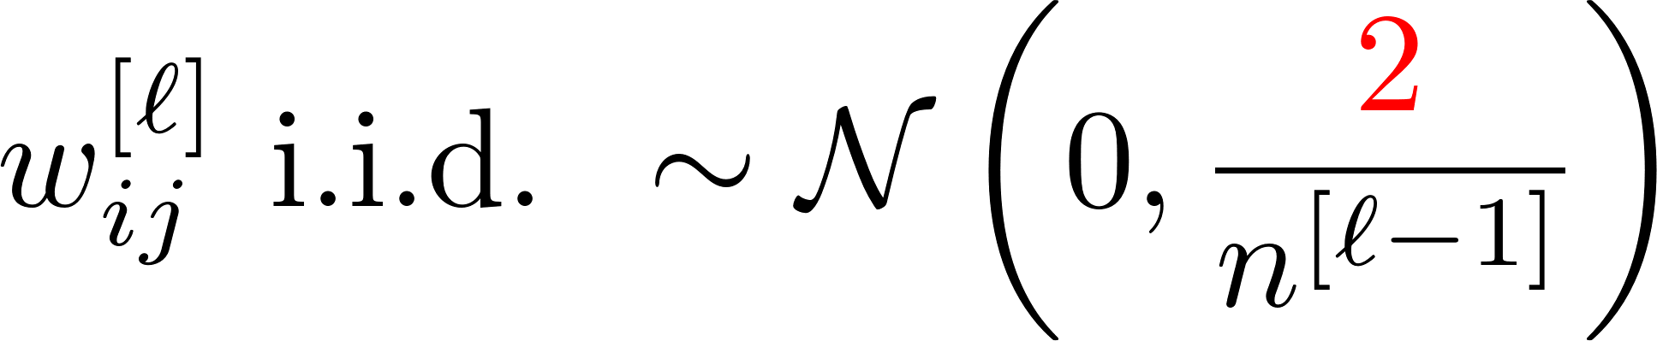
He’s initialization
Will do Tensorflow implementation in PS.

Slide 23
Look ahead
Will study techniques for training stability.

Slide 24
Appendix:
Softmax activation
TexPoint fonts used in EMF.
Read the TexPoint manual before you delete this box.: AAAAAAAAAAAAAAAAAAAA

Slide 25

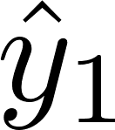


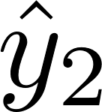
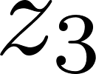
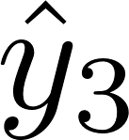

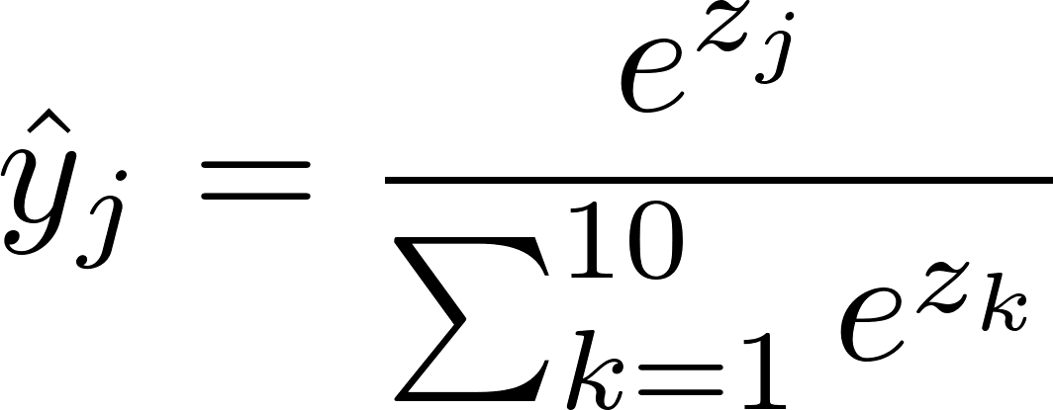
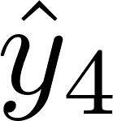
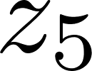
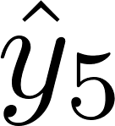
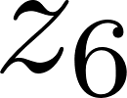
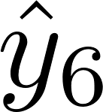
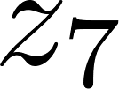
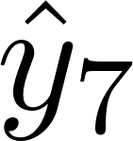
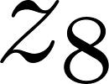
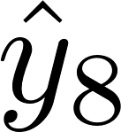
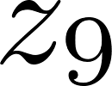
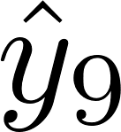
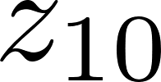
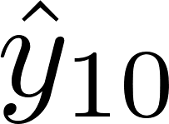
Softmax activation for output layer
output layer
softmax
10 classes

Slide 26
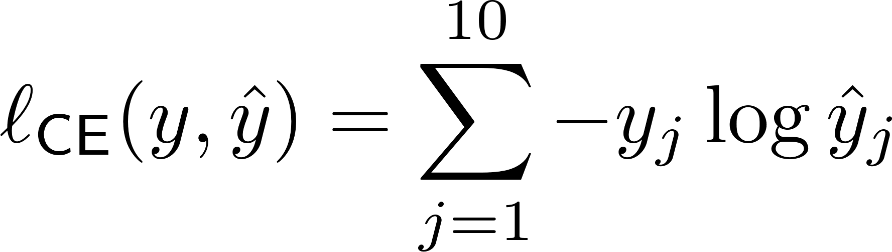
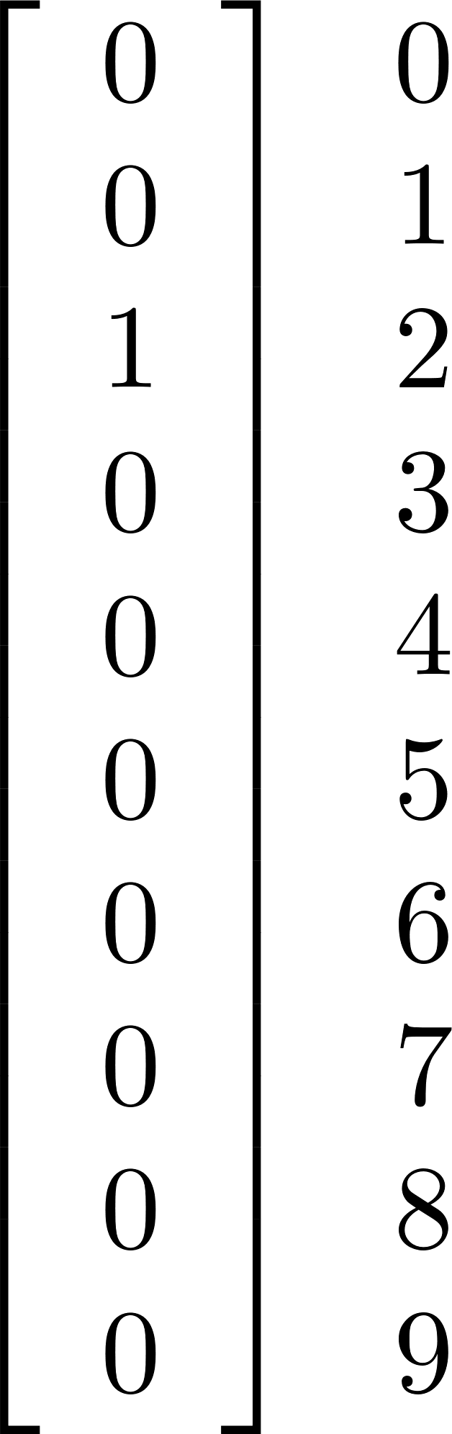
Loss function for maximizing likelihood
Turns out: The loss function is again cross entropy loss.
one-hot vector
(label=2)

