Slide 1
Advanced techniques (2/2)
Lecture 8
Changho Suh
Oct 21, 2020
TexPoint fonts used in EMF.
Read the TexPoint manual before you delete this box.: AAAAAAAAAAAAAAAAAAAA

Slide 2
Techniques for training stability
Hyperparameter search (1/2)
TexPoint fonts used in EMF.
Read the TexPoint manual before you delete this box.: AAAAAAAAAAAAAAAAAAAA

Slide 3
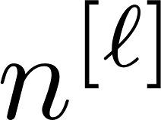
Outline
1.
Techniques for training stability
Learning rate decay
Batch normalization
2.
Hyperparameter search
# L of layers, # of hidden neurons, activation

Slide 4
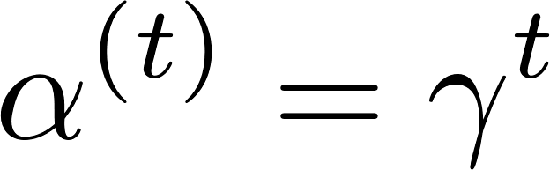
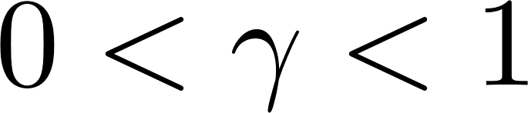
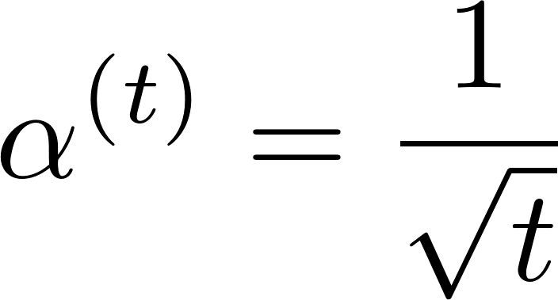
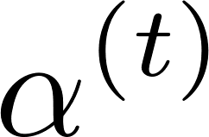








Learning rate decaying
Three popular choices:
1.
2.
3.
epoch

Slide 5
Batch normalization: Motivation
Turns out: Different signal scalings across distinct layers incur training instability.
One prominent way to address this:
Batch normalization

Slide 6
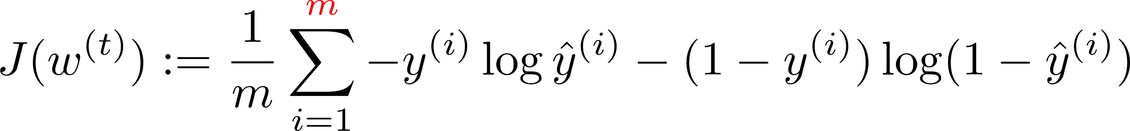

Batch
Recall the cost function used for gradient descent:
Issue: Computationally heavy for a large m.
Hence: In practice, use a chunk of examples, called a batch.
batch1
batch2
batch3
…
examples

Slide 7

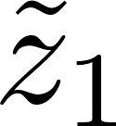

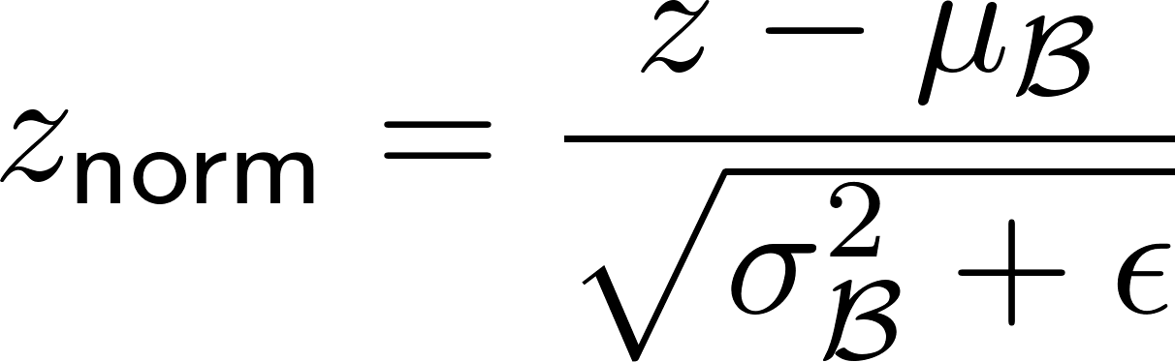
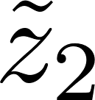
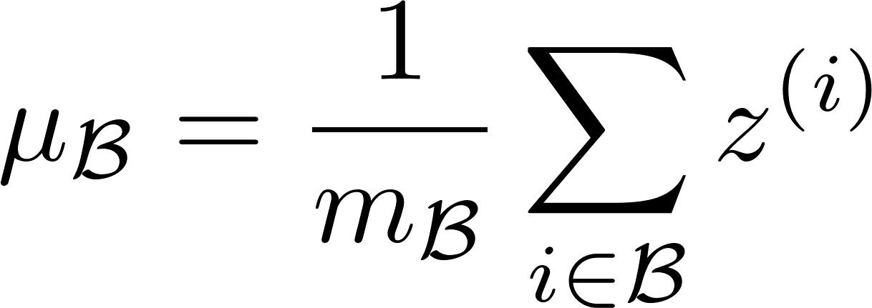
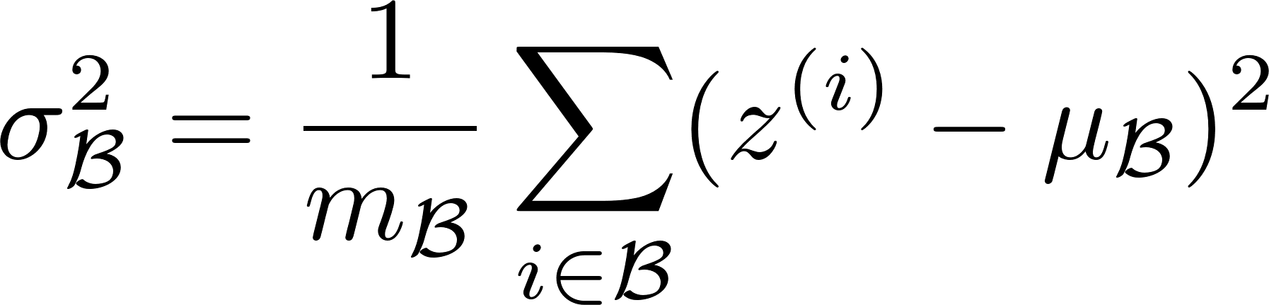
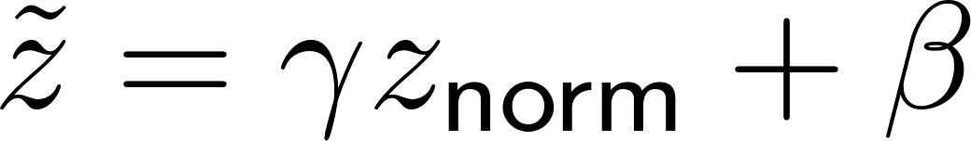

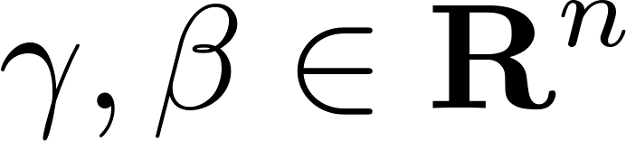
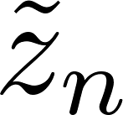
Batch normalization
A hidden layer
BN
1. Normalization
component-wise
2. Customized scaling
(learnable parameters)
Check how to implement in PS.

Slide 8
Hyperparameter search
TexPoint fonts used in EMF.
Read the TexPoint manual before you delete this box.: AAAAAAAAAAAAAAAAAAAA

Slide 9
# of layers
Just begin with a single hidden layer.
Gradually (linearly) ramp up # of hidden layers until not overfitting.
Here use the same number of hidden neurons for all hidden layers.
Set the number of hidden neurons around one half of the number of input neurons.

Slide 10
# of layers vs. loss
loss
train loss
?
# of layers

Slide 11

# of layers vs. loss
loss
validation loss
?
train loss
# of layers

Slide 12
# of hidden neurons
Two approaches:
1.
Fewer neurons for deeper layers
2.
Same size for all hidden layers:
Linearly increase the size until not overfitting.

Slide 13
Activation functions
A default setup:
Hidden layers:
ReLU
Output layer:
Softmax for multi-class classification

Slide 14
Look ahead
1. Remaining hyperparameters:
learning rate, betas, batch size, # T of epochs, regularization factor, dropout rate, …
2.
Cross validation

