Slide 1
Advanced techniques (2/2)
Lecture 9
Changho Suh
Oct. 21, 2020
TexPoint fonts used in EMF.
Read the TexPoint manual before you delete this box.: AAAAAAAAAAAAAAAAAAAA

Slide 2
Hyperparameter search and
cross validation
TexPoint fonts used in EMF.
Read the TexPoint manual before you delete this box.: AAAAAAAAAAAAAAAAAAAA

Slide 3
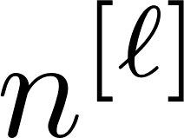
Outline
1.
Hyperparameter search:
# L of layers, # of hidden neurons, activation, learning rate, betas, batch size, # T of epochs, regularization factor, dropout rate, …
2.
Cross validation

Slide 4
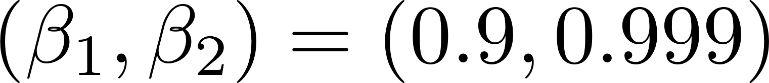
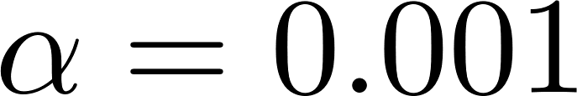
Optimizer
A default use: Adam.
Default parameters:
Two approaches for a choice of the learning rate:
1.
Learning rate decaying
2.
Fixed (e.g., )

Slide 5

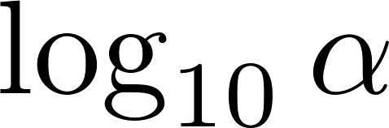
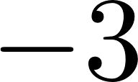
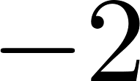
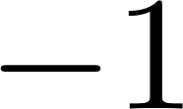





How to choose a fixed
Do not use a linear-scale grid search.
Try random values and then do a fine search around the good choices.
Grid scale for the fine search:
Log scale

Slide 6
Batch size
A common choice: Power of two.
4, 8, 16, 32, 64, 128, 256

Slide 7

# of epochs
Choose according to early stopping:
loss
validation loss
train loss
# of epochs

Slide 8
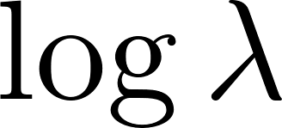
Regularization factor
Log-scale search:
loss
training loss
validation loss

Slide 9
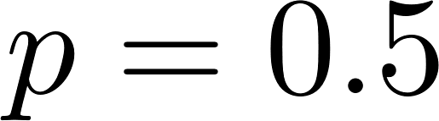
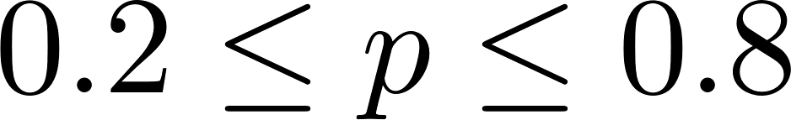
Dropout rate
A typical choice:
A good range:

Slide 10
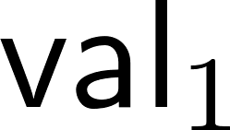
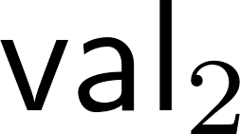
Cross validation
Obtaining a reliable validation loss via averaging:
Example: 4-fold cross validation
val
train
train
train
test
→ Compute a validation loss, say
Take the 2nd partition for val:
train
val
train
train
test
→ Compute a corresponding loss:

Slide 11
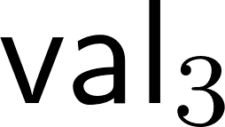
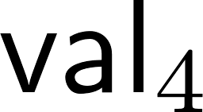
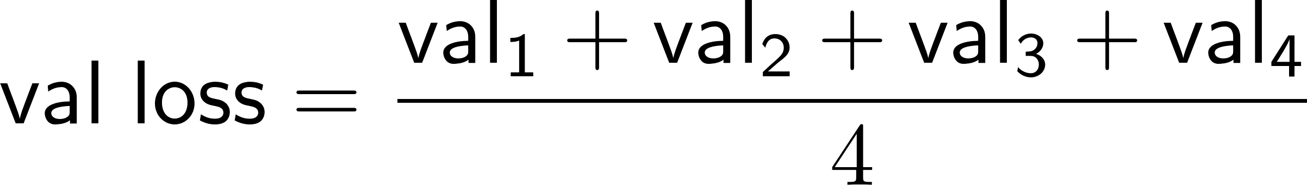
Cross validation
val
train
train
train
test
train
val
train
train
test
train
train
val
train
test
train
train
train
val
test
Take the average over the 4 losses:
Choose a hyperparameter that minimizes the average loss.

Slide 12
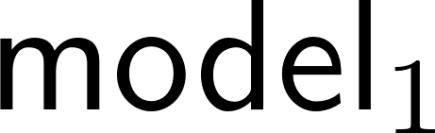
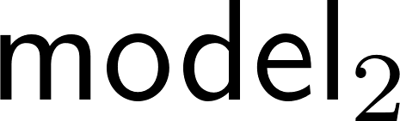
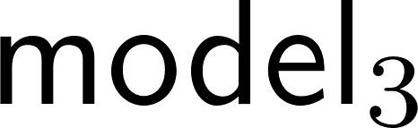
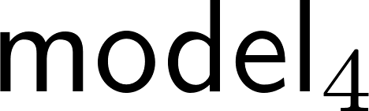
A final model w.r.t. the best hyperparameter?
val
train
train
train
test
train
val
train
train
test
train
train
val
train
test
train
train
train
val
test
Which one to take between the four models?
A final model is the one trained based on:
train
train
train
train
test

Slide 13
What is next?
One important question:
Can DNNs be specialized?
CNNs: Image data
RNNs: Text/audio data (language) and any sequential data

Slide 14
Outline of Day 4’s lectures
Focus on CNNs.
Specifically we will:
1.
Investigate how CNNs were developed;
2.
Study the two key building blocks;
Conv layer
Pooling layer
3.
Discuss popular CNN architectures.

