Slide 1

Korean Film
Guide for Selecting Successful Movie
Group 7
H.Shinil
J.Juwon
K.Minkyu

Slide 2
Outline
Introduction
Preliminary Findings
EDA
Challenges & Conclusion
→ What is our data?
→ Data Cleaning
→ Time Series Graph
→ Where we got it
from?
→ Basic Bar Plots
& Interpretation
→ Linear Regrssion
→ What is the size of the dataset?
→ how is the data organized?

Slide 3
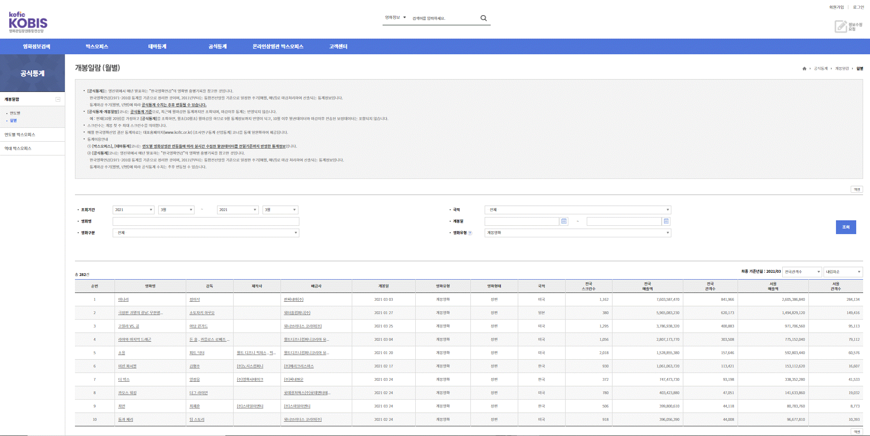
Introduction
- Collected from KOBIS
- Imported as EXCEL file
- Transform to CSV file and usually use it in real analysis
General content of
movie DATA
Sales information
of movie DATA
영화명 | 영화명 (영문) | 제작연도 | 제작국가 | 유형
장르 | 제작상태 | 감독 | 제작사 | 감독
제작사 | 수입사 | 배급사 | 개봉일 | 영화유형
영화형태 | 국적 | 전국 스크린 수 | 전국 매출액 | 전국 관객 수
서울 매출액 | 서울 관객 수 | 장르 | 등급 | 영화구분
Raw Data → 81,809 rows × 25 columns
→ Row shows the attribute values of each film
Access: Data is open to anyone interested in this topic.
25 columns in raw data

Slide 4

Preliminary Findings; Data Cleaning
영화명 |  | Nationality
National Total Screens | National Box Office | National Audience
Genre | Rating | Artistic
영화명 | 개봉일 | 국적
전국 스크린 수 | 전국 매출액 | 전국 관객 수
장르 | 등급 | 영화구분
Name | Release_Date | Nationality
Total_screens | Box_office | Audience
Genre | Rate | Artistic
< Selected 9 Columns>
< Variables name changed to English >
1. Omit rows the NA values exist
↓
2. Change the column names to English
↓
3. Omit columns which are Duplicate and Not used in our anlysis
↓
4. Convert type of the columns ‘Audience’,
‘Box office’, ‘Total screen’ to numerical value
↓
5. Skip rows with all 0s in Box Office, Audience, and Total_screens
Also, Change the format of the film's release date to '1900-01-01' !!

Slide 5
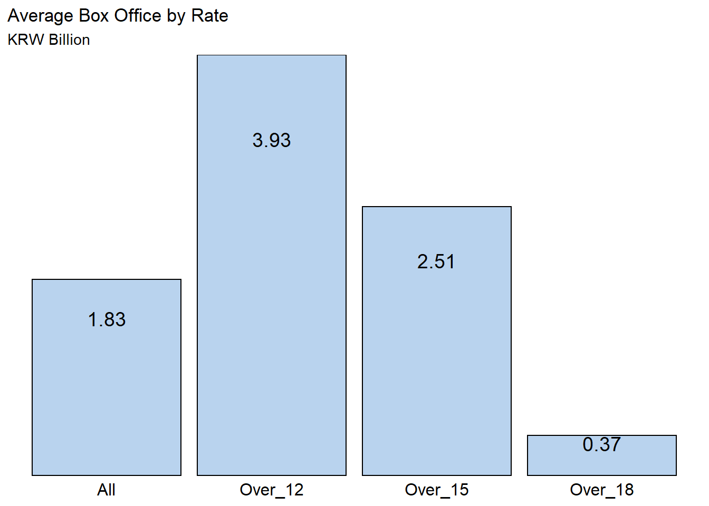
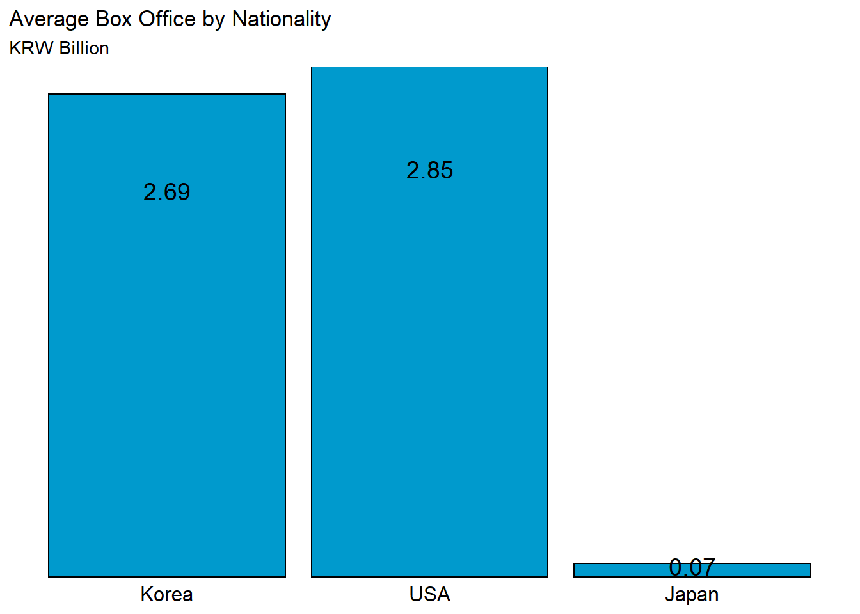
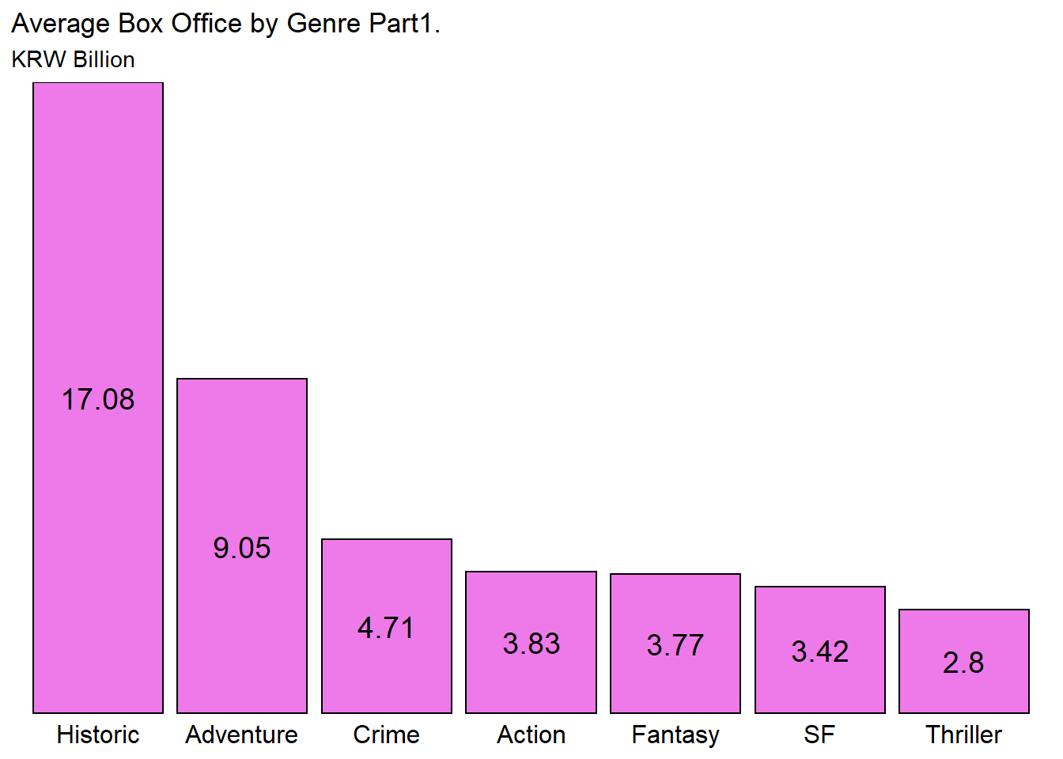
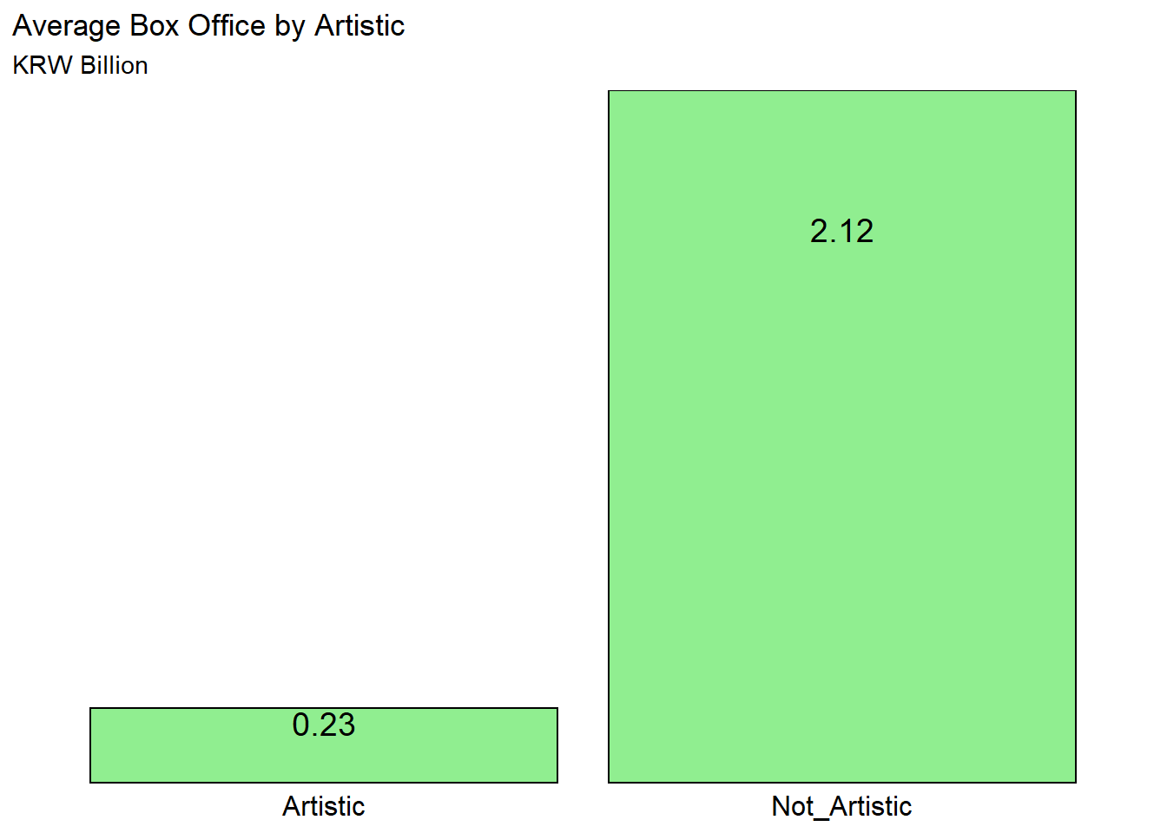
Preliminary Findings;Basic Interpretation
Avg. Box Office
By Rate
(KRW Billion)
By Nationality
3.93
Over
12
2.85
USA
2.69
Korea
2.51
Over
15
0.37
Over
18
1.83
All
0.07
Japan
Historic
By Genre
By Artistic
Adventure
2.12
Not
Artistic
Crime
Action
17.08
Fantasy
4.71
SF
0.23
Artistic
3.83
3.77
Thriller
9.05
3.42
2.80

Slide 6
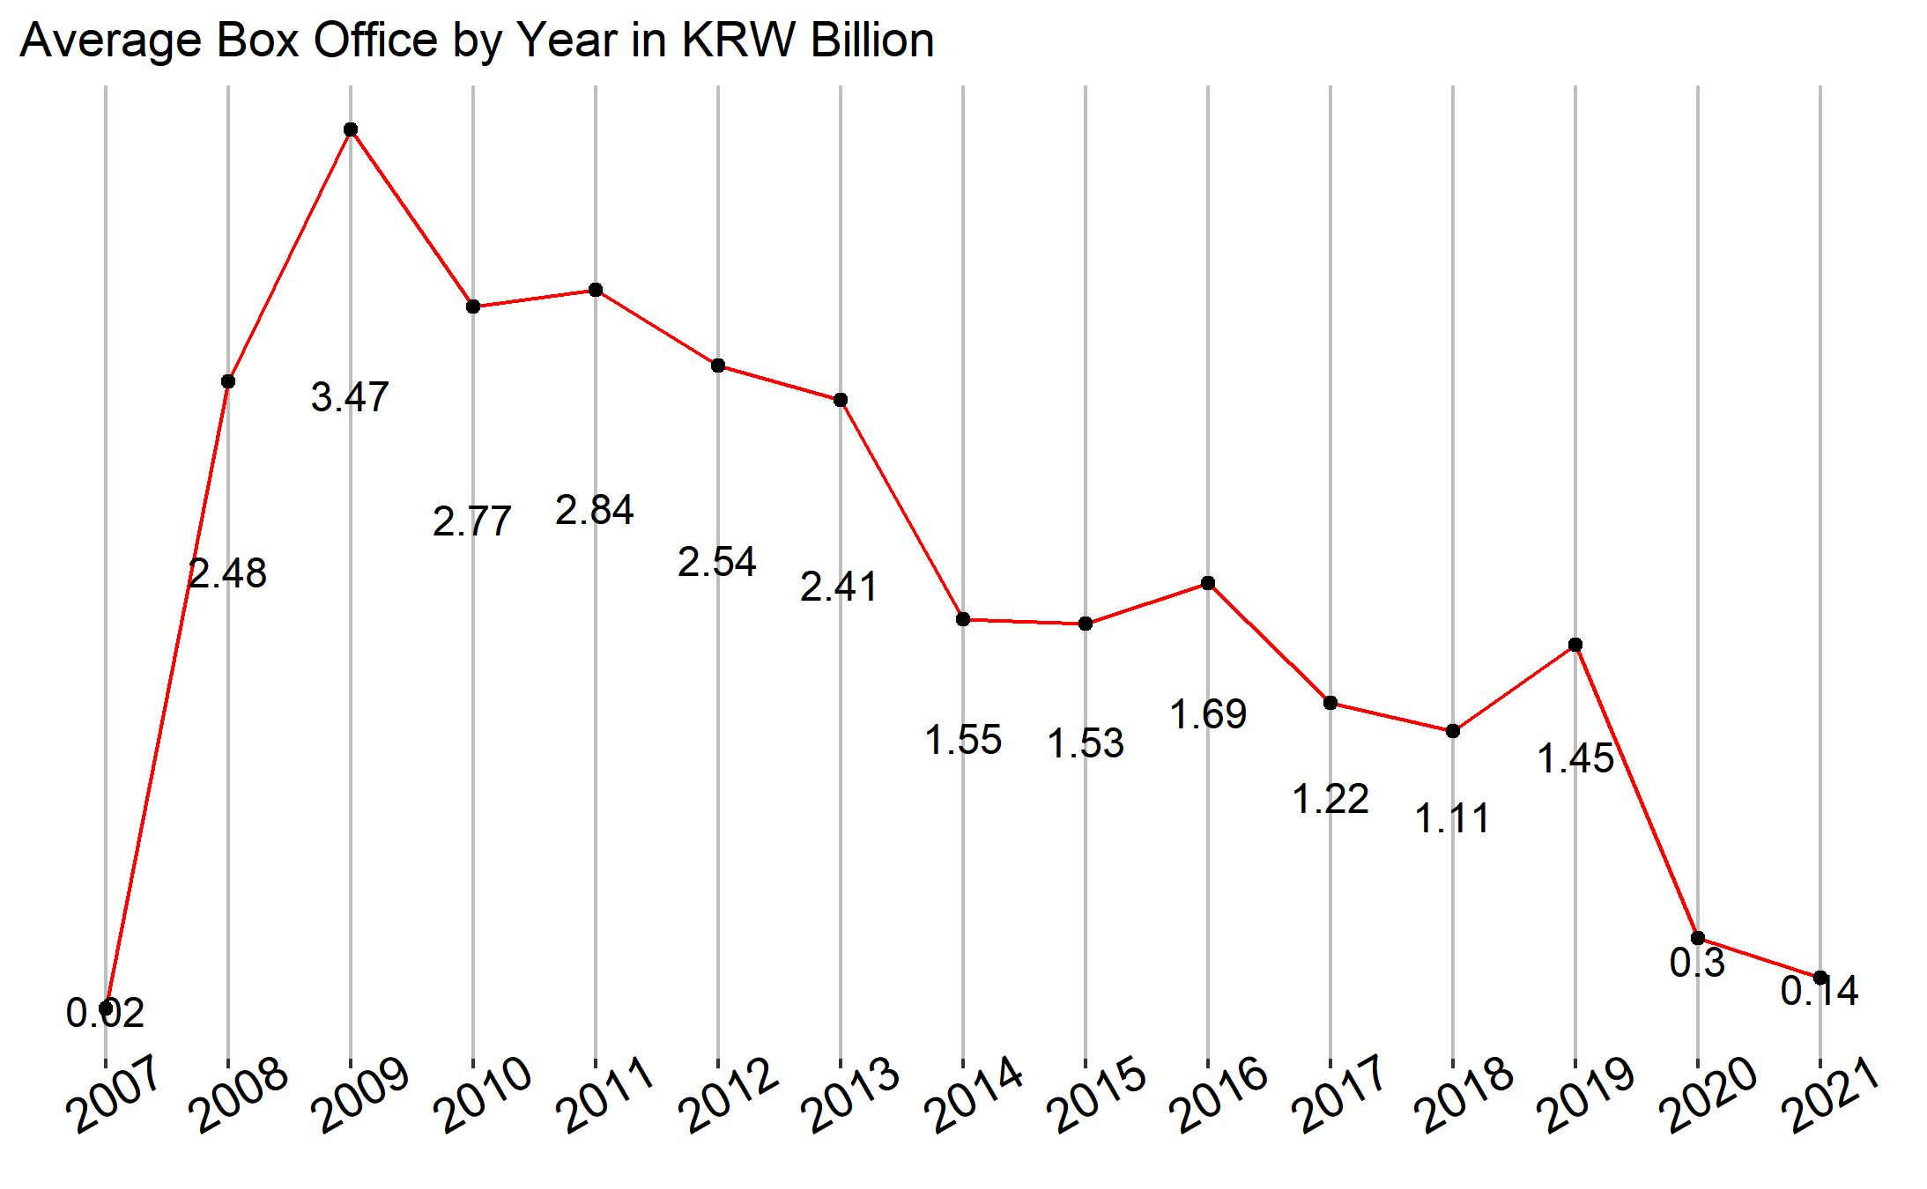
EDA: Box Office's Time Series Visualization
코로나
Draw time series graph to see the factors influenced the box office
?
?!

Slide 7
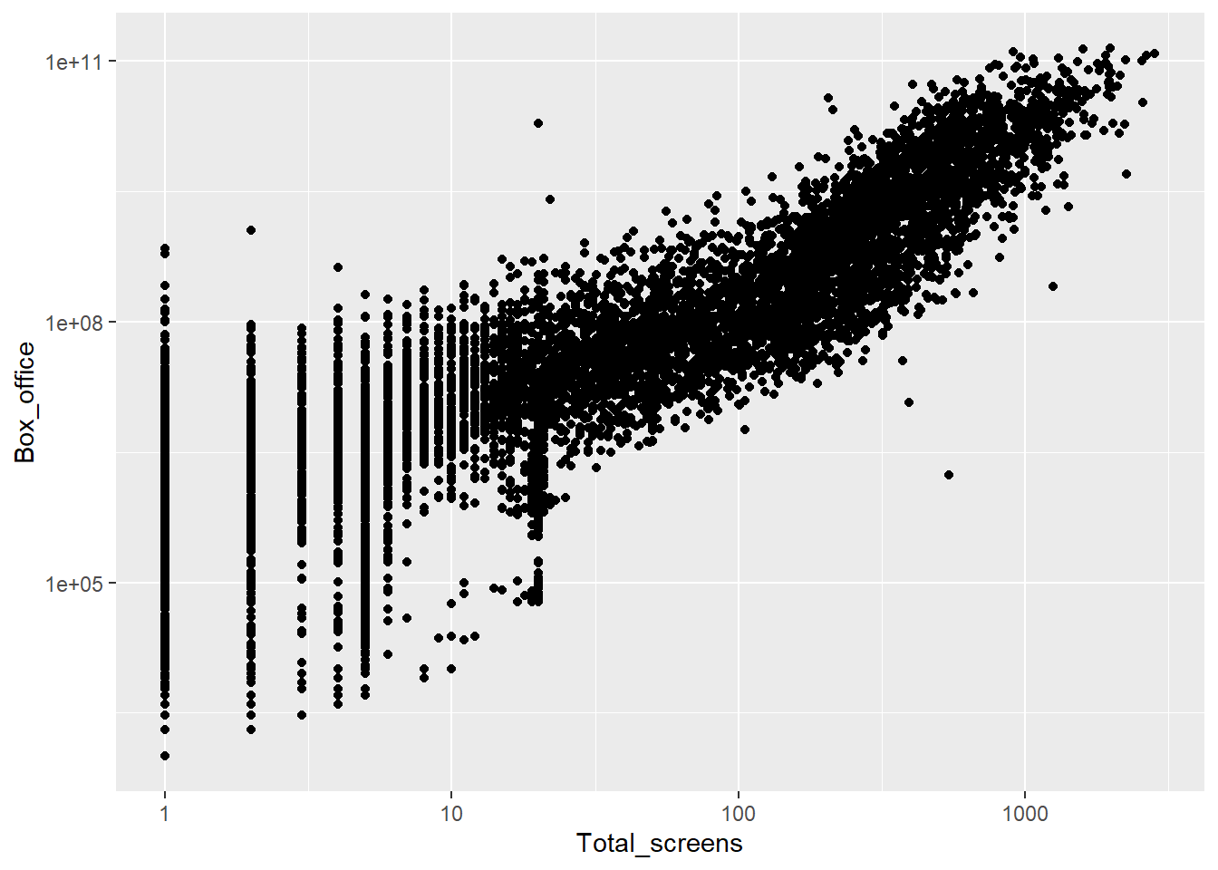
EDA: Linear Regression
Regression to find out which factors affect ‘ Box office' the most
?
The extent
to which it affects
the 'Box office' of the film

Slide 8
lm(formula = Box_log10 ~ Aud_log10 + screen_log10 + All + Over_12 +
Over_15 + Over_16 + Over_18 + SF + Family + Play + Horror +
Documentary + Drama + Romans + Musical + Mystery + Crime +
Historic + Western + Erotic + Thriller + Animation + Action +
Adventure + War + Comedy + Fantasy + USA + Japan + Korea +
Artistic + Not_artistic, data = df_regression)
Significance | Independent variables
0.1% level | Audience_log10, Number of Screen_log10 Over_12, Over_15 Play, Musical, Erotic Japan, Korea Artistic
1% level | Documentary
5% level | USA

Slide 9
Challenges
Replace the number of films by nationality with 'table function'.
Graph insightful
found the basis through discussions among team members.
Choosing which rows contain 'NA' and '0' to erase

Slide 10
Conclusion
- Collecting Korean movie data from KOBIS and Doing serious data cleaning
- In EDA, We conducted two major analyses.
- First, two main features can be identified in time series graphs!
1. Impact of smartphone led to a steady decline in the box office since 2009.
2. Covid-19 damaging the film industry in 2020 and 2021
- Second, Linear regression was performed!
- Regression for elements affecting the Box office.
- We look at the p-value and found a statistically significant element.
If you anguish about what movie to distribute, consider as follows:
1. Movies that can make inroads into OTT, so people can enjoy those everywhere
2. Choose a movie that has statistically powerful features

Slide 11

Thank You

