Slide 1
P-Chord: Formally Verified Distributed Hash Table using P
CS3551: Advanced Topics in Distributed Information Systems
Derrick Hicks Shinwoo Kim
{ddh32,shinwookim}@pitt.edu
Department of Computer Science
University of Pittsburgh
Fall 2024

Slide 2
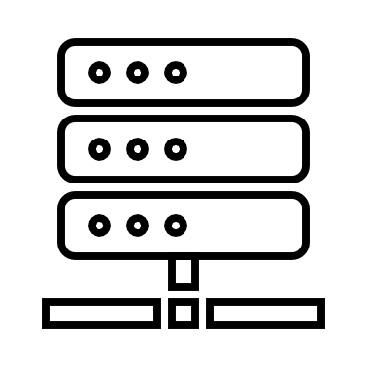
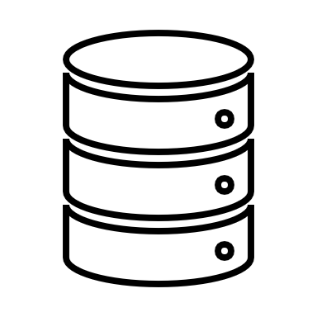

The LOOKUP Problem
GET(“CAT_VIDEOS.mp4”)
The Internet
POST(“CAT_VIDEOS.mp4”, [data])
Figure Credit: Wyatt Lloyd’s COS 418 Lecture Slides (Princeton)

Slide 3
Hash Tables
Hash Tables are essential building blocks in modern software systems
Python’s built-in dictionary(dict)
C++’s map(std::map)¹
Everything in JavaScript except the “seven primitives”
Provides O(1) look-up²
Idea: Expand this concept to be internet-scale
Technically, std::map is a Balanced Search Tree; but the std::unordered_map is based on a Hash Table
Assuming an ideal deterministic hash function f

Slide 4
Distributed Hash Table (DHT)
An abstraction of hash table in a distributed setting
Use cases: Peer-to-peer file-sharing, Large-scale storage management, Web Mirroring …
Benefits: Decentralized, Scalable, Efficient, and Dynamic
key = hash(data)
IP_addr = dht.lookup(key)
POST(IP_addr, key, data)
…
data = GET(IP_addr, key)
Nodes can fail, new nodes can join

Slide 5
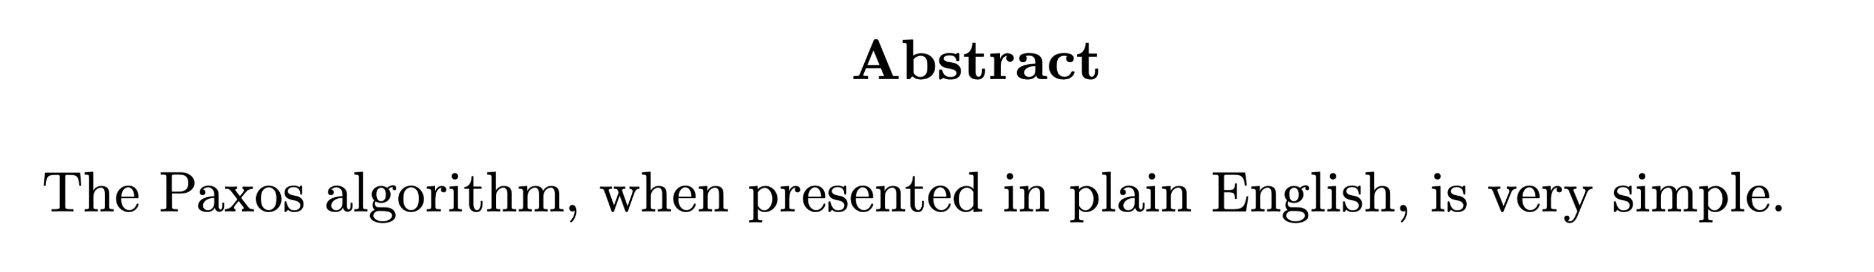
However, Implementing correct distributed protocols is notoriously difficult.
Formal verification attempts to address this issue
But critics have said that verification can easily become detached from the implementation
And cause too much overhead

Slide 6
P Programming Language
Traditional approach to developing a reactive system:
Implementation in Java, C#, C.
Analysis by modeling in formal framework like Maude, K, Coq.
P’s approach: unified framework for both implementation and modeling
Systems (and environment) as state machines interacting via events
Built-in model checking for proving properties
Generates executable C# code that can integrate with other software
Used by Microsoft in Windows 8 USB stack

Slide 7
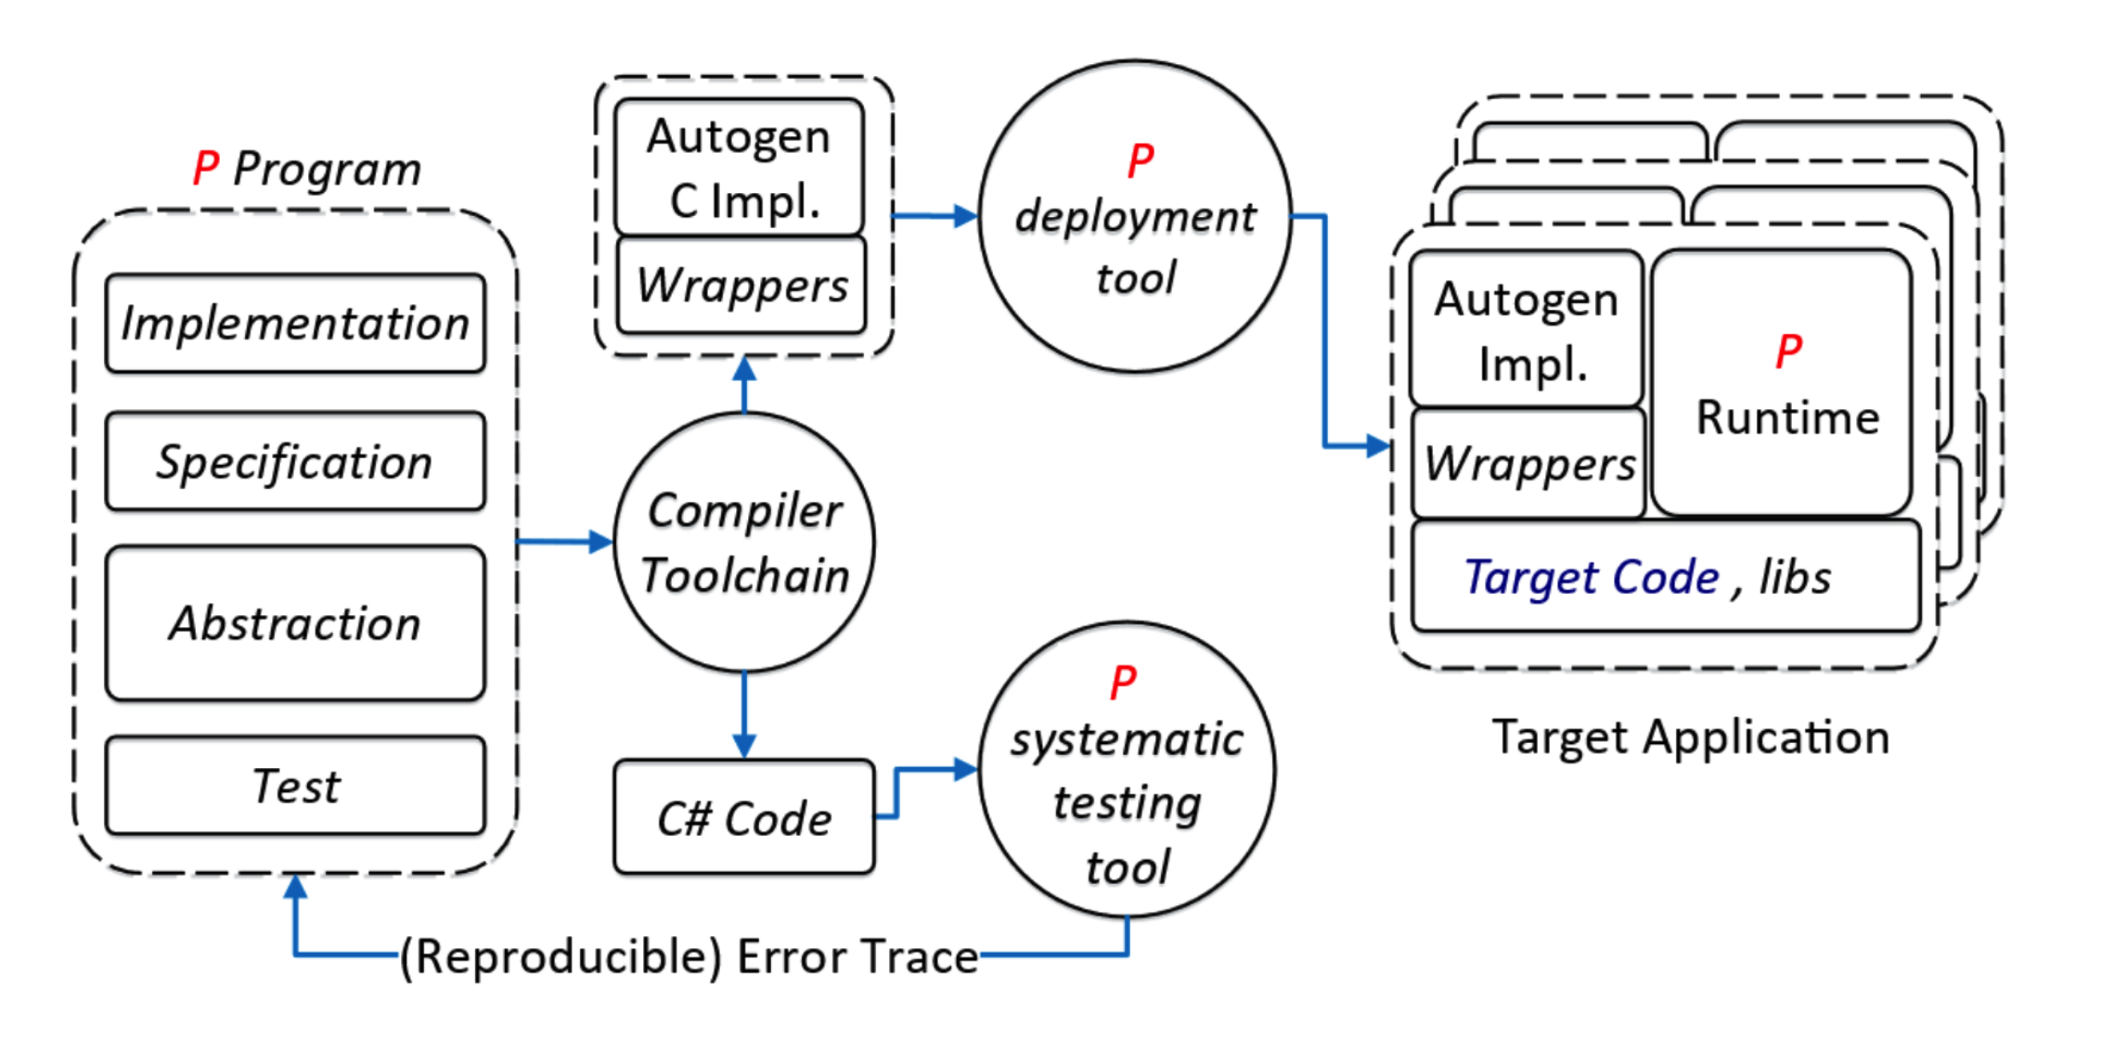
P Programming Language

Slide 8
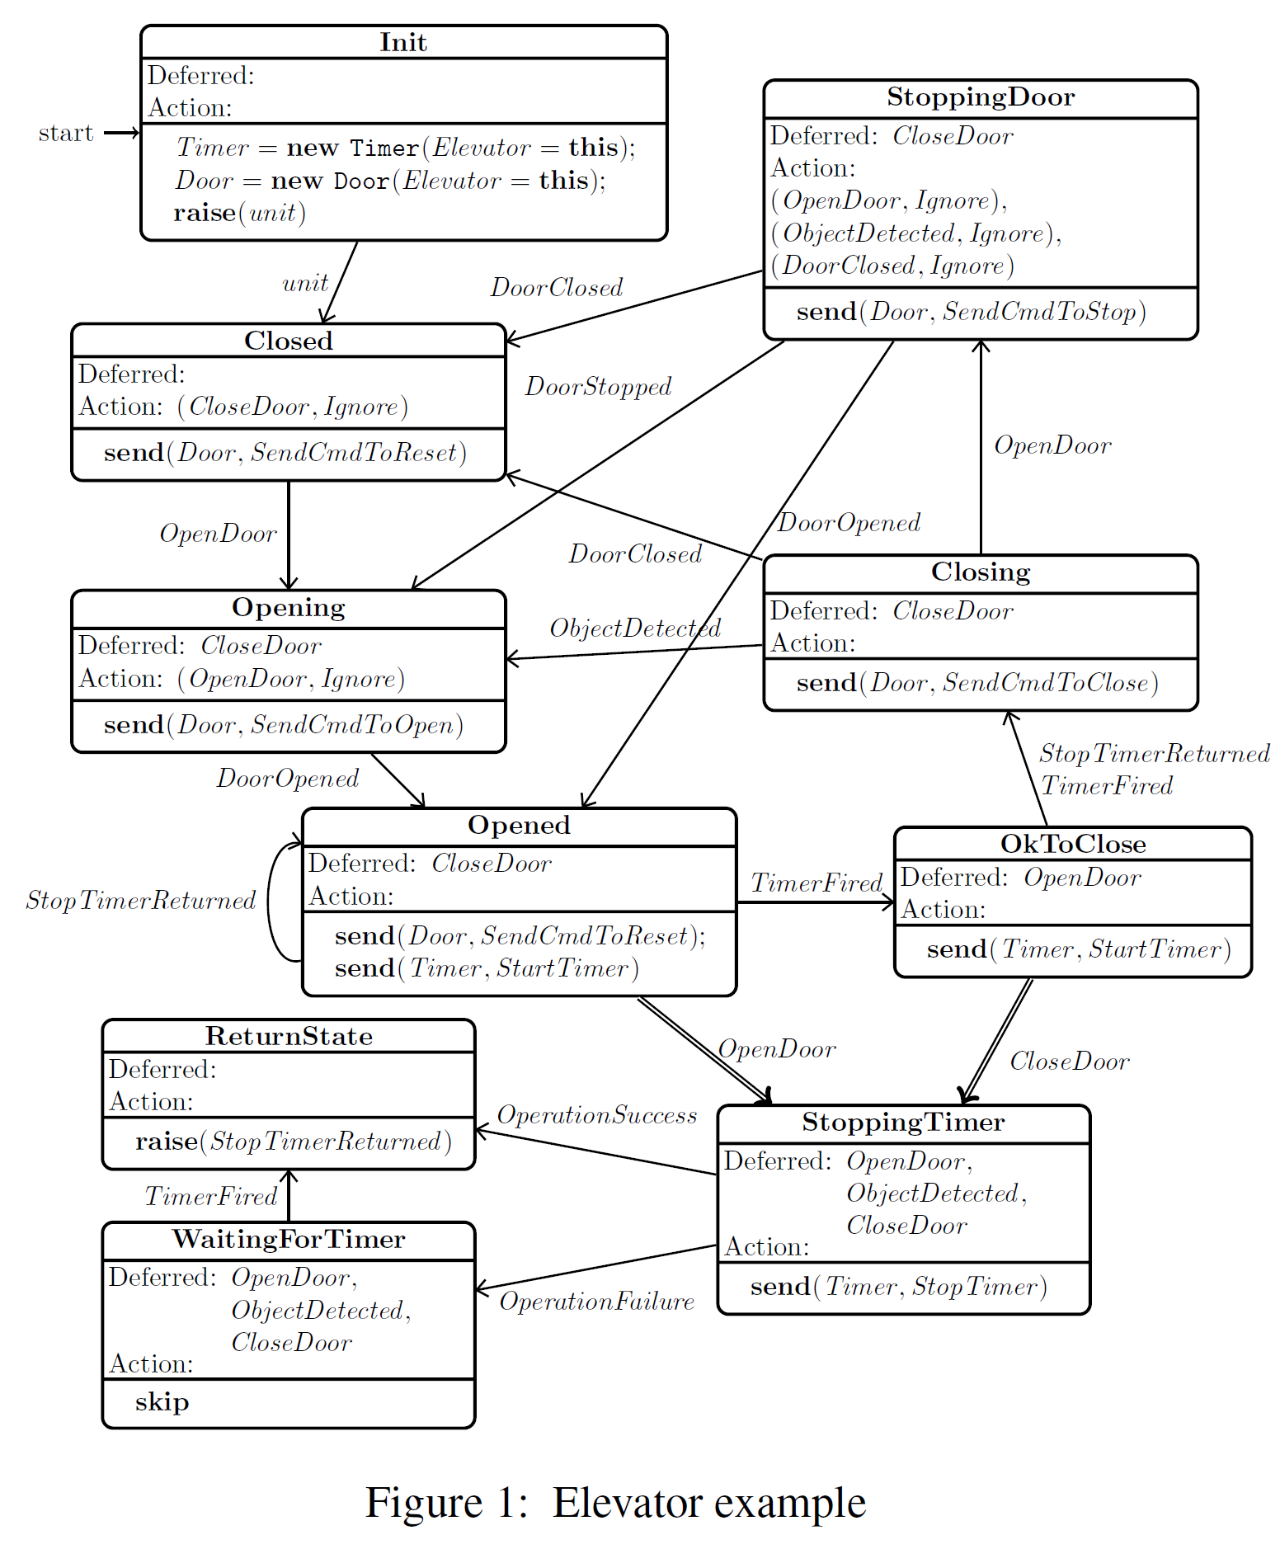
Systems as state machines
Event
States

Slide 9
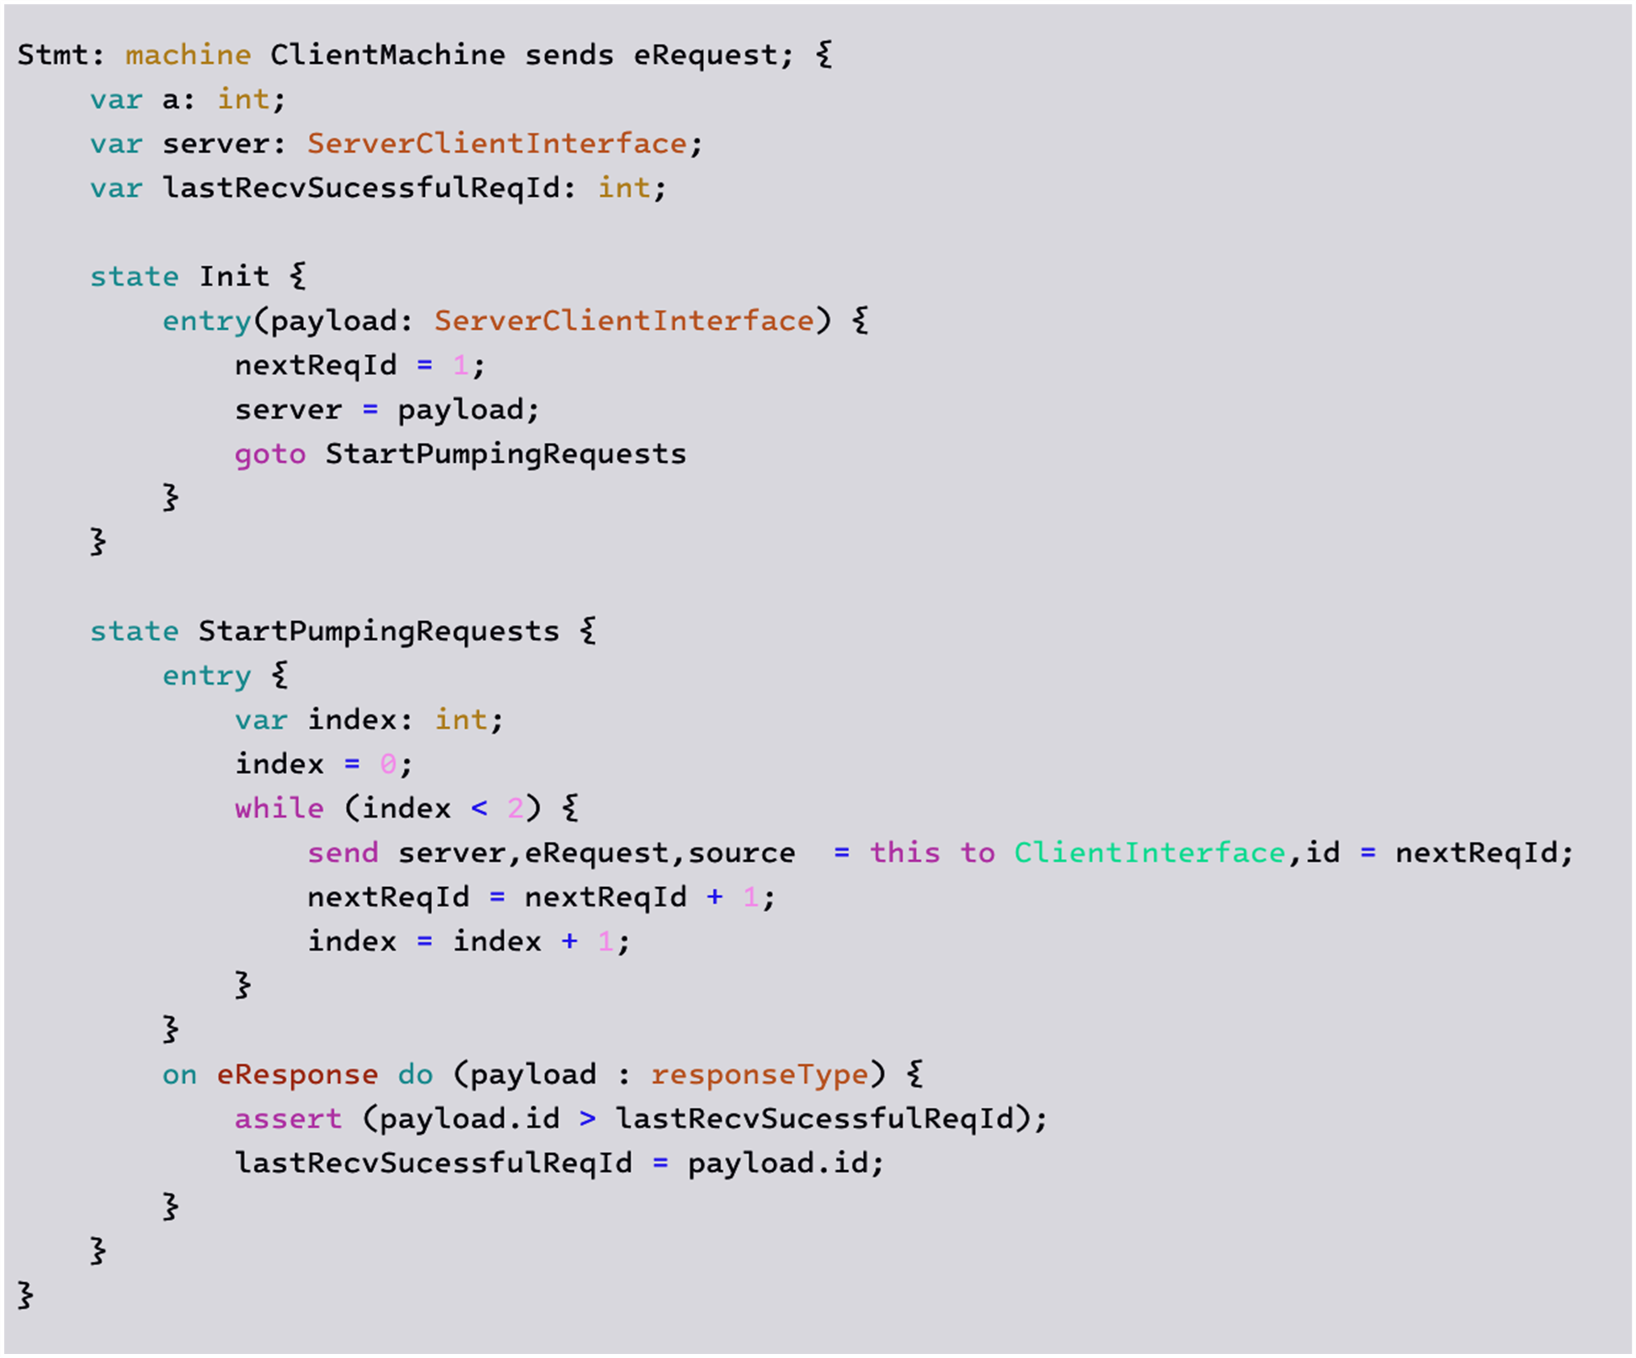
Systems as state machines
Global State
States
State Transition
Invariants
Event Handler

Slide 10
Original Project Goals
Goal: Implement Content Addressable Network (CAN) using the P Language
1
E
B
C
A
D
dim #2
0
1
dim #1

Slide 11
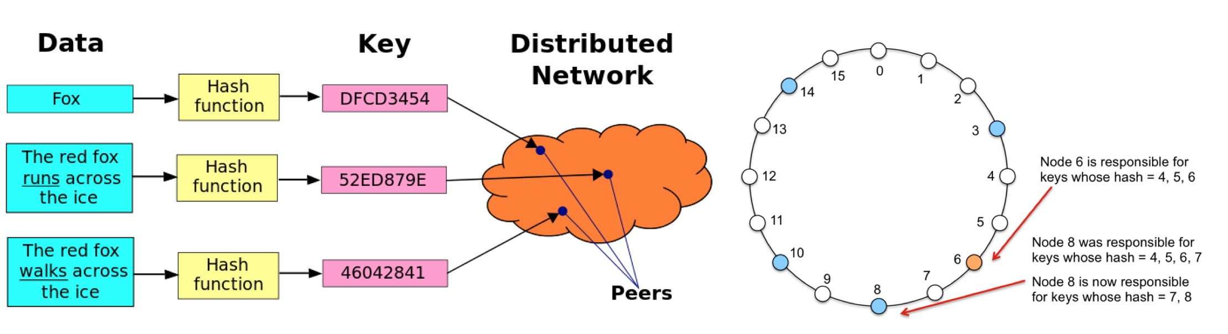
Revised Project Goals
Goal: Implement Chord using the P Language

Slide 12
Revised Project Goals
Goal: Implement Chord using the P Language
From “Chord: A scalable peer-to-peer lookup service for Internet applications” [SIGCOMM 2001]
Why?
Not much recent work on content addressable networks, but chord is still seeing interest
Received SIGCOMM Test-of-Time Award
Some from researchers working in formal verification
“Reasoning about Identifier Spaces: How to Make Chord Correct” [IEEE 2017]
“Verification of the Chord protocol with TLA+” [UiT Thesis]
A lot simpler to construct correctness criterions
Although there are still challenges
Notes:
Our project is about building this new system…which derrick will describe next.

Slide 13
Constructing Chord Protocol

Slide 14
Chord Design
The Chord protocol organizes nodes into a structured ring topology, where each node is responsible for managing a subset of keys, up to and including its own identifier.
Every node maintains a successor, which is responsible for managing the keys in the interval (n,successor].
A lookup request is forwarded through the ring to successive nodes until it reaches the node responsible for the target key. In the worst case, this process requires O(n) hops.
To optimize lookup efficiency, Chord typically employs a finger table with m entries, enabling logarithmic lookup times for a network with up to 2^{m} nodes. However, this optimization will not be implemented in our project
Credit: Jørgen Aarmo Lund’s thesis on “Verification of the Chord protocol with TLA+”

Slide 15
Chord Design
Nodes can dynamically join or leave the network.
When a node leaves, it transfers its keys to its successor node.
Conversely, when a node joins, it retrieves the keys within its assigned interval from its successor.
As nodes join, the successor may need to be adjusted to ensure that each nodes acts as the successor for one node only.
Each node maintains a reference to its predecessor, and periodically poll their successor's predecessor to determine if a better successor exists
Additionally, nodes will notify their successor to confirm they are a potential predecessor.
Credit: Jørgen Aarmo Lund’s thesis on “Verification of the Chord protocol with TLA+”

Slide 16
Fault-tolerant Chord
In real-world scenarios, servers are susceptible to failure, and if a node cannot communicate with its successor, then a node may no longer be able to forward queries to other nodes.
To combat this, each node tracks the next r successor nodes, whenever a node can no longer communicate with its immediate successor, it removes that node from its list of successors.
Credit: Jørgen Aarmo Lund’s thesis on “Verification of the Chord protocol with TLA+”

Slide 17
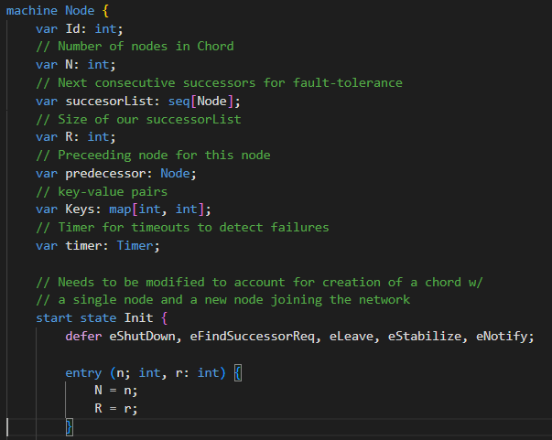
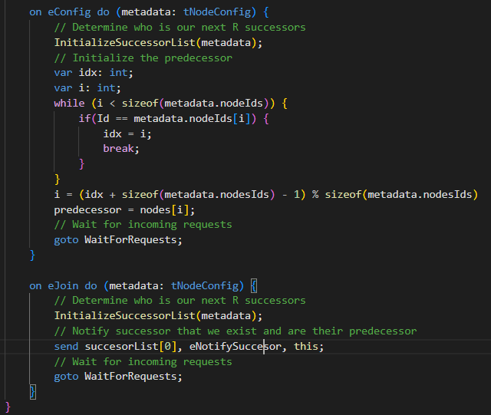
P Program - Init
Credit: Jørgen Aarmo Lund’s thesis on “Verification of the Chord protocol with TLA+”

Slide 18
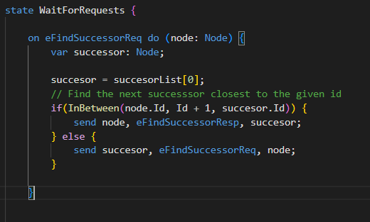
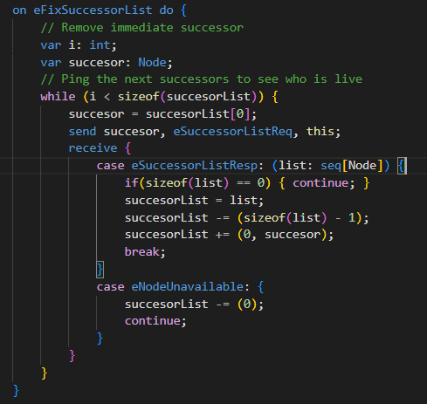
P Program - WaitingForRequests
Credit: Jørgen Aarmo Lund’s thesis on “Verification of the Chord protocol with TLA+”

Slide 19
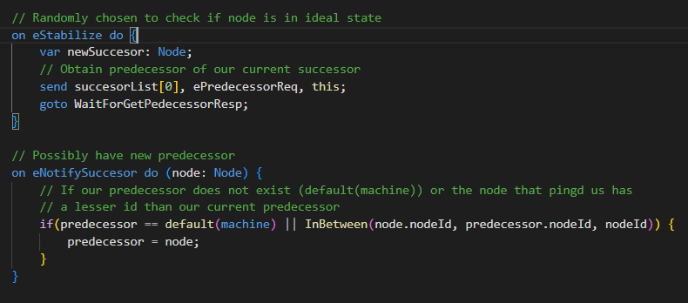
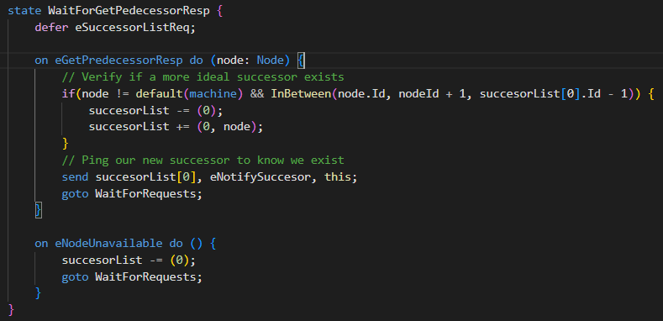
P Program - Stabilize & Notify
Credit: Jørgen Aarmo Lund’s thesis on “Verification of the Chord protocol with TLA+”

Slide 20
Constructing Correctness Properties

Slide 21
Chord Requirements
The original Chord paper makes many claims about the protocol and its guarantees
Some of them have been questioned (at least in its original iteration)
See Using Lightweight Modeling to Understand Chord [IEEE 2013]
Some are not necessarily relevant to correctness
E.g., Probabilistic and quantitative claims regarding space-time complexity
Credit: Jørgen Aarmo Lund’s thesis on “Verification of the Chord protocol with TLA+”

Slide 22
Chord Requirements
Type Safety
At no point should the protocol permit nodes to have successors linking to invalid destinations.
Deadlock Freedom
There should always be at least one node so that the protocol can proceed.
Network Safety
The protocol should not allow actions that partition the network or leave it in a state where it cannot become ideal.
Network Liveness
After all nodes have finished joining, the protocol should eventually have arranged the network into an ideal state.
Credit: Jørgen Aarmo Lund’s thesis on “Verification of the Chord protocol with TLA+”

Slide 23
Correctness Properties
(AtLeastOneRing). There must be a ring, which means there must be a non-empty set of ring members.
(AtMostOneRing). There must be no more than one ring, which means that from each ring member, every other ring member is reachable by following the chain of successors.
(OrderedRing). On the unique ring, the nodes must be in identifier order.

Slide 24
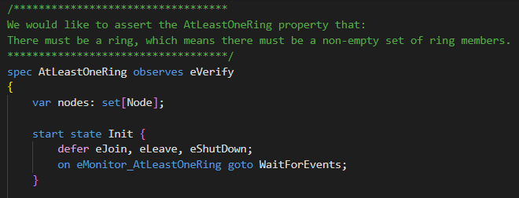
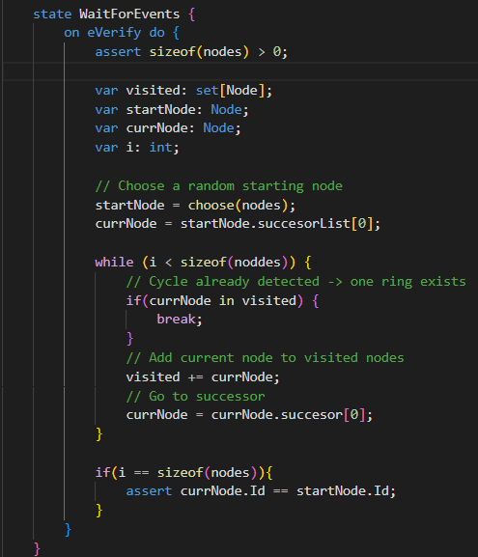
spec AtLeastOneRing

Slide 25
Lessons Learned
Formal verification requires thinking about systems as state machines which may not be intuitive
Unlike TLA/other approaches, both the spec and the executable code are written in P
So, the system needs to be thought of in terms of state machines and their interactions from an implementation perspective
Coming up with a precise correctness criterion is hard
Too narrow: doesn’t capture the correctness requirements
Too wide: hard to prove & guarantee
“P” is not a good programming language name
Terrible SEO, impossible to search for information on-line
(Some) researchers are not good at documenting code
P documentation is “perpetually out-of-date” [HackerNews]

