Slide 1
Formally Verified Content Addressable Network using P
CS3551: Advanced Topics in Distributed Information Systems
Derrick Hicks Shinwoo Kim
{ddh32,shinwookim}@pitt.edu
Fall 2024

Slide 2
Internet-Scale Hash Tables
Hash Tables are essential building blocks in modern software systems
Python’s built-in dictionary: dict
C++’s Map: std::map¹
JavaScript all objects except the “seven primitives”
Internet-scale distributed hash tables
Equally valuable to large-scale distributed systems?
Peer-to-peer systems
Large-scale storage management
Web Mirroring?
…
[1] Technically, std::map is a Balanced Search Tree; but the std::unordered_map is based on a Hash Table

Slide 3
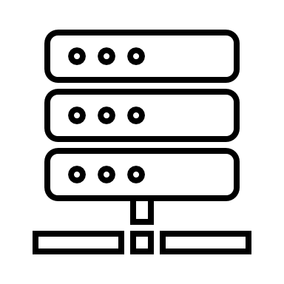
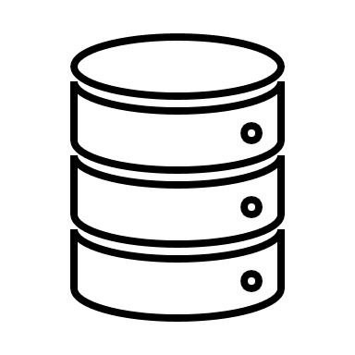
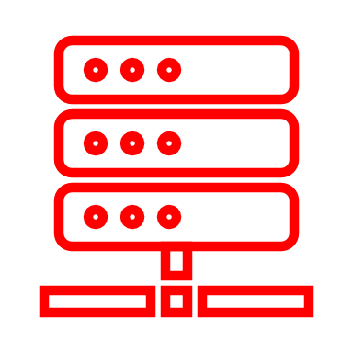

Distributed Hash Tables
<k,v>
<k,v>
<k,v>
<k,v>
<k,v>
<k,v>
<k,v>
<k,v>
<k,v>
<k,v>
Insert (k1, v1)

Slide 4
Content Addressable Network
Based on a “Virtual Cartesian Coordinate Space”
Partitioned amongst all participating nodes
Where each node “owns” a zone in the space
Existing nodes may exit; new nodes may join

Slide 5
Content Addressable Network
1
Cartesian Space

Slide 6
Content Addressable Network
1
2
Cartesian Space

Slide 7
Content Addressable Network
1
2
3
Cartesian Space

Slide 8
Content Addressable Network
1
2
3
4
Cartesian Space

Slide 9

Content Addressable Network
Node_{I}.insert(K,V)
I
→ x_{k} = h_{x}(K)
→ y_{k} = h_{y}(K)
Cartesian Space
Notes:
Provides
Slightly more complex because routing, zone-reassignments, multiple dimensions, nodes exiting

Slide 10
Formally Verified CAN using P
Goal: Implement Content Addressable Network (CAN) using the P Language
Content Addressable Network: distributed hash table that uses d-dimensional cartesian space to associate each node
Same API as dictionary: insert(key, value); retrieve(key)
But “internet-scale”
“A Scalable Content-Addressable Network” SIGCOMM’ 01
P Language: state-machine-based programming language for formally modeling and specifying complex distributed systems

Slide 11
P Programming Language
Traditional approach to developing a reactive system:
Implementation in Java, C#, C.
Analysis by modeling in formal framework like Maude, K, Coq.
P’s approach: unified framework for both implementation and modeling
Systems as state machines
Built-in model checking
Generates executable C# code that can integrate with other software
Used by Microsoft in Windows 8 USB stack

Slide 12
Formally Verified CAN using P
Goal: Implement Content Addressable Network (CAN) using the P Language
Impact
Provide an implementation of a CAN-based distributed hash table (DHT) that has been proved for correctness.
Gain improved understanding of correctness properties of Content Addressable Networks.
Gain better understanding of formal verification using P.
Evaluation
Model checking
Export C# code and compare against other implementations.

Slide 13
Current Progress
Set-up P Development Environment
Using devcontainers and GitHub code spaces
Learn P
Finished P Tutorial
Client-Server
Two Phase Commit
Failure Detector
Shared Memory
Deep-dive into CAN paper
Essentially, wrapping up planning phase

Slide 14
Timeline
Write P Specifications for CAN
Write P Models for CAN
Write P Tests for Evaluation
Goal: Thanksgiving
Export C# Code & Evaluate
Goal: Early December
Goal: End of November
Goal: End of Semester
Time Permitting

