Slide 1
_{CS 0441}
Recitation Review
^{Homework Set 1}
Shinwoo Kim

Slide 2
1.1 #4
What is the negation of each of these propositions?
Janice has more Facebook friends than Juan.
Quincy is smarter than Venkat.
Zelda drives more miles to school than Paola.
Briana sleeps longer than Gloria.

Slide 3
1.1 #8
Suppose that Smartphone A has 256 MB RAM and
32 GB ROM, and the resolution of its camera is 8 MP;
Smartphone B has 288 MB RAM and 64 GB ROM, and
the resolution of its camera is 4 MP; and Smartphone C
has 128 MB RAM and 32 GB ROM, and the resolution
of its camera is 5 MP. Determine the truth value of each
of these propositions.
b) Smartphone C has more ROM or a higher resolution
camera than Smartphone B.
c) Smartphone B has more RAM, more ROM, and a
higher resolution camera than Smartphone A.
d) If Smartphone B has more RAM and more ROM than
Smartphone C, then it also has a higher resolution
camera.

Slide 4
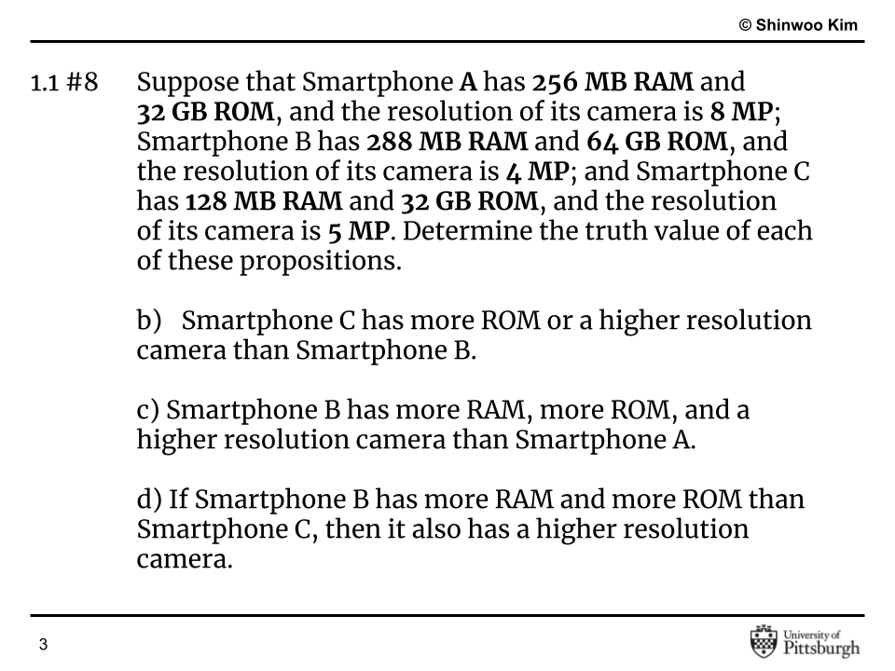

Slide 5
1.1 #12e
Let p and q be the propositions “The election is decided”
and “The votes have been counted,” respectively. Express
each of these compound propositions as an English sentence.
¬q → ¬p

Slide 6
1.1 #16c
Let p, q, and r be the propositions
p: You get an A on the final exam.
q: You do every exercise in this book.
r: You get an A in this class.
Write these propositions using p, q, and r and logical connectives (including negations).
To get an A in this class, it is necessary for you to get
an A on the final.

Slide 7
1.1 #28a
Write each of these propositions in the form “p if and
only if q” in English.
For you to get an A in this course, it is necessary and sufficient that you learn how to solve discrete mathematics problems.

Slide 8
1.1 #30b
State the converse, contrapositive, and inverse of each of
these conditional statements.
b) I go to the beach whenever it is a sunny summer day.

Slide 9
1.1 #34d
Construct a truth table for each of these compound propositions.
(p ∧ q) → (p ∨ q)

Slide 10
1.1 #36e
Construct a truth table for each of these compound propositions.
(p ⊕ q) ∨ (p ⊕ ¬q)

Slide 11
1.2 #2
You can see the movie only if you are over 18 years old or you have the permission of a parent.
Express your answer in terms of
m: “You can see the movie,”
e: “You are over 18 years old,”
p: “You have the permission of a parent.”

Slide 12
1.2 #4
To use the wireless network in the airport you must pay the daily fee unless you are a subscriber to the service.
Express your answer in terms of
w: “You can use the wireless network in the airport,”
d: “You pay the daily fee,”
s: “You are a subscriber to the service.”

Slide 13
1.2 #10
Are these system specifications consistent?
Whenever the system software is being upgraded, users cannot access the file system.
If users can access the file system, then they can save new files.
If users cannot save new files, then the system software is not being upgraded.

