Slide 1


Week 6 Recitation
CS 0441: Discrete Structures for Computer Science October 7, 2022
Section 17064 - Fridays 4 PM
TA: Shinwoo Kim
https://sites.pitt.edu/~shk148/CS0441-2231/
Department of Computer Science
School of Computing & Information
University of Pittsburgh

Slide 2

Before we begin,
Do you have any questions?

Slide 3
Office Hours
> Monday 10 AM - 12 PM in 5712 Sennott Square
> Tuesday 10 AM - 11:30 AM in 5712 Sennott Square
> Wednesday 11 AM - 12 PM Virtual
See Canvas for Zoom link
By Appointment (In-Person or Virtual)
Online Scheduler or E-mail me
See Canvas for most up-to-date Info
Pages > TA Office Hours
More help available: Peer Tutoring, Math Assistance Center(MAC)
You ARE allowed to go Office Hours for another TA
Including Dr. Garrison's TAs. (See #TA-info)

Slide 4
On Canvas:
Homework 4 Posted
DUE: October 12 11:59 PM ET
Sec 2.1 #s 2, 4(a), 10 (c)(d)(e), 16, 28, 34(b), 42(a)
Sec 2.2 #s 4, 12, 20(a), 30(a)
Homework 5 Posted
DUE: October 19 11:59 PM ET
Sec 2.3 #s 2(c), 4(a)(b), 6(b), 8(g)(h), 16(c), 22(b), 30(b)
Sec 2.4 #s 2(d), 4(d), 6(d), 8, 10(c), 14(d), 16(b), 18(a), 34(a)
Final Homework before Exam
Reference Sheet Submission
To be posted soon
DUE: TBA; Before Exam

Slide 5
Soon: The Mid-Term Exam
October 19th during Lecture
Only 12 days from Today!!!
Problems similar to Homework
Similar in difficulty & style
Use your homework when studying!
Check answers with TA during Office Hours
Approximately 10 - 20 questions
Reference Sheet allowed
No page limit
Definitions, Rules of Inferences, etc. allowed
No Truth Tables, Paraphrasing, or Examples
Will submit before Exam
If you have questions, check with TA or Prof
Notes:
How do you feel about the Exam?

Slide 6
Common Mistakes on Chapter 1
Bad Presentation of Work
Omitting steps, work
Not stating conclusion, ‘premise’
Incorrectly translating English statements into symbolic form.
Many errors of this type.
Difficulties with the use of the word “or” in English (inclusive and exclusive versions)
Mistaking conditional statement with conjunction. To say that B will happen if A happens is quite different from saying that A and/or B will happen.
Mistaking p → q with q → p.
I will go to the movie if I finish my homework
I will go to the movie only if I finish my homework.
Incorrectly negating compound statements without using De Morgan’s laws.
Notes:
in effect saying, for example, that
¬(p ∨ q) is logically equivalent to ¬p ∨ ¬q , or that ¬(p ∧ q) is logically equivalent to ¬p ∧ ¬q . For example,
if it is not true that John is over 18 years old or lives away from home, then it is true that he is not over 18
years old and (not or ) he does not live away from home. The correct statements are that ¬(p ∨ q) is logically
equivalent to ¬p ∧ ¬q , and that ¬(p ∧ q) is logically equivalent to ¬p ∨ ¬q . This mistake is a general instance
of assuming that every operation distributes over every other operation, here that negation distributes over
disjunction (or conjunction).

Slide 7
Common Mistakes on Chapter 1
Incorrectly writing the symbolic form of a universal statement as ∀x(A(x)∧B(x)) instead of ∀x(A(x) → B(x)).
“Every odd number is prime”
is ∀x(O(x) → P(x)), not ∀x(O(x) ∧ P(x)).
As a rule of thumb, universal quantifiers are usually followed by conditional statements.
Incorrectly writing the symbolic form of an existential statement as ∃x(A(x) → B(x)) instead of ∃x(A(x) ∧ B(x)).
“There exists an even number that is prime”
is ∃x(E(x) ∧ P(x)), not ∃x(E(x) → P(x)).
As a rule of thumb, existential quantifiers are usually followed by conjunctions.
Notes:
we are letting E(x) mean “x is even” and P(x) mean “x is prime.”
we are letting O(x) mean “x is odd” and P(x) mean “x is prime.”

Slide 8
Common Mistakes on Chapter 1
Not going back to carefully check the definitions in justifying statements in a proof.
If you are trying to prove something about odd integers, then it is important to correctly use the meaning of that notion
Odd integer is one that can be written as 2k + 1 for some integer k
Failure to change the quantifier when negating a quantified proposition, especially in English.
The negation of the statement: “some cats like liver”
is not the statement that some cats do not like liver
it is that no cats like liver, or that all cats dislike liver.

Slide 9
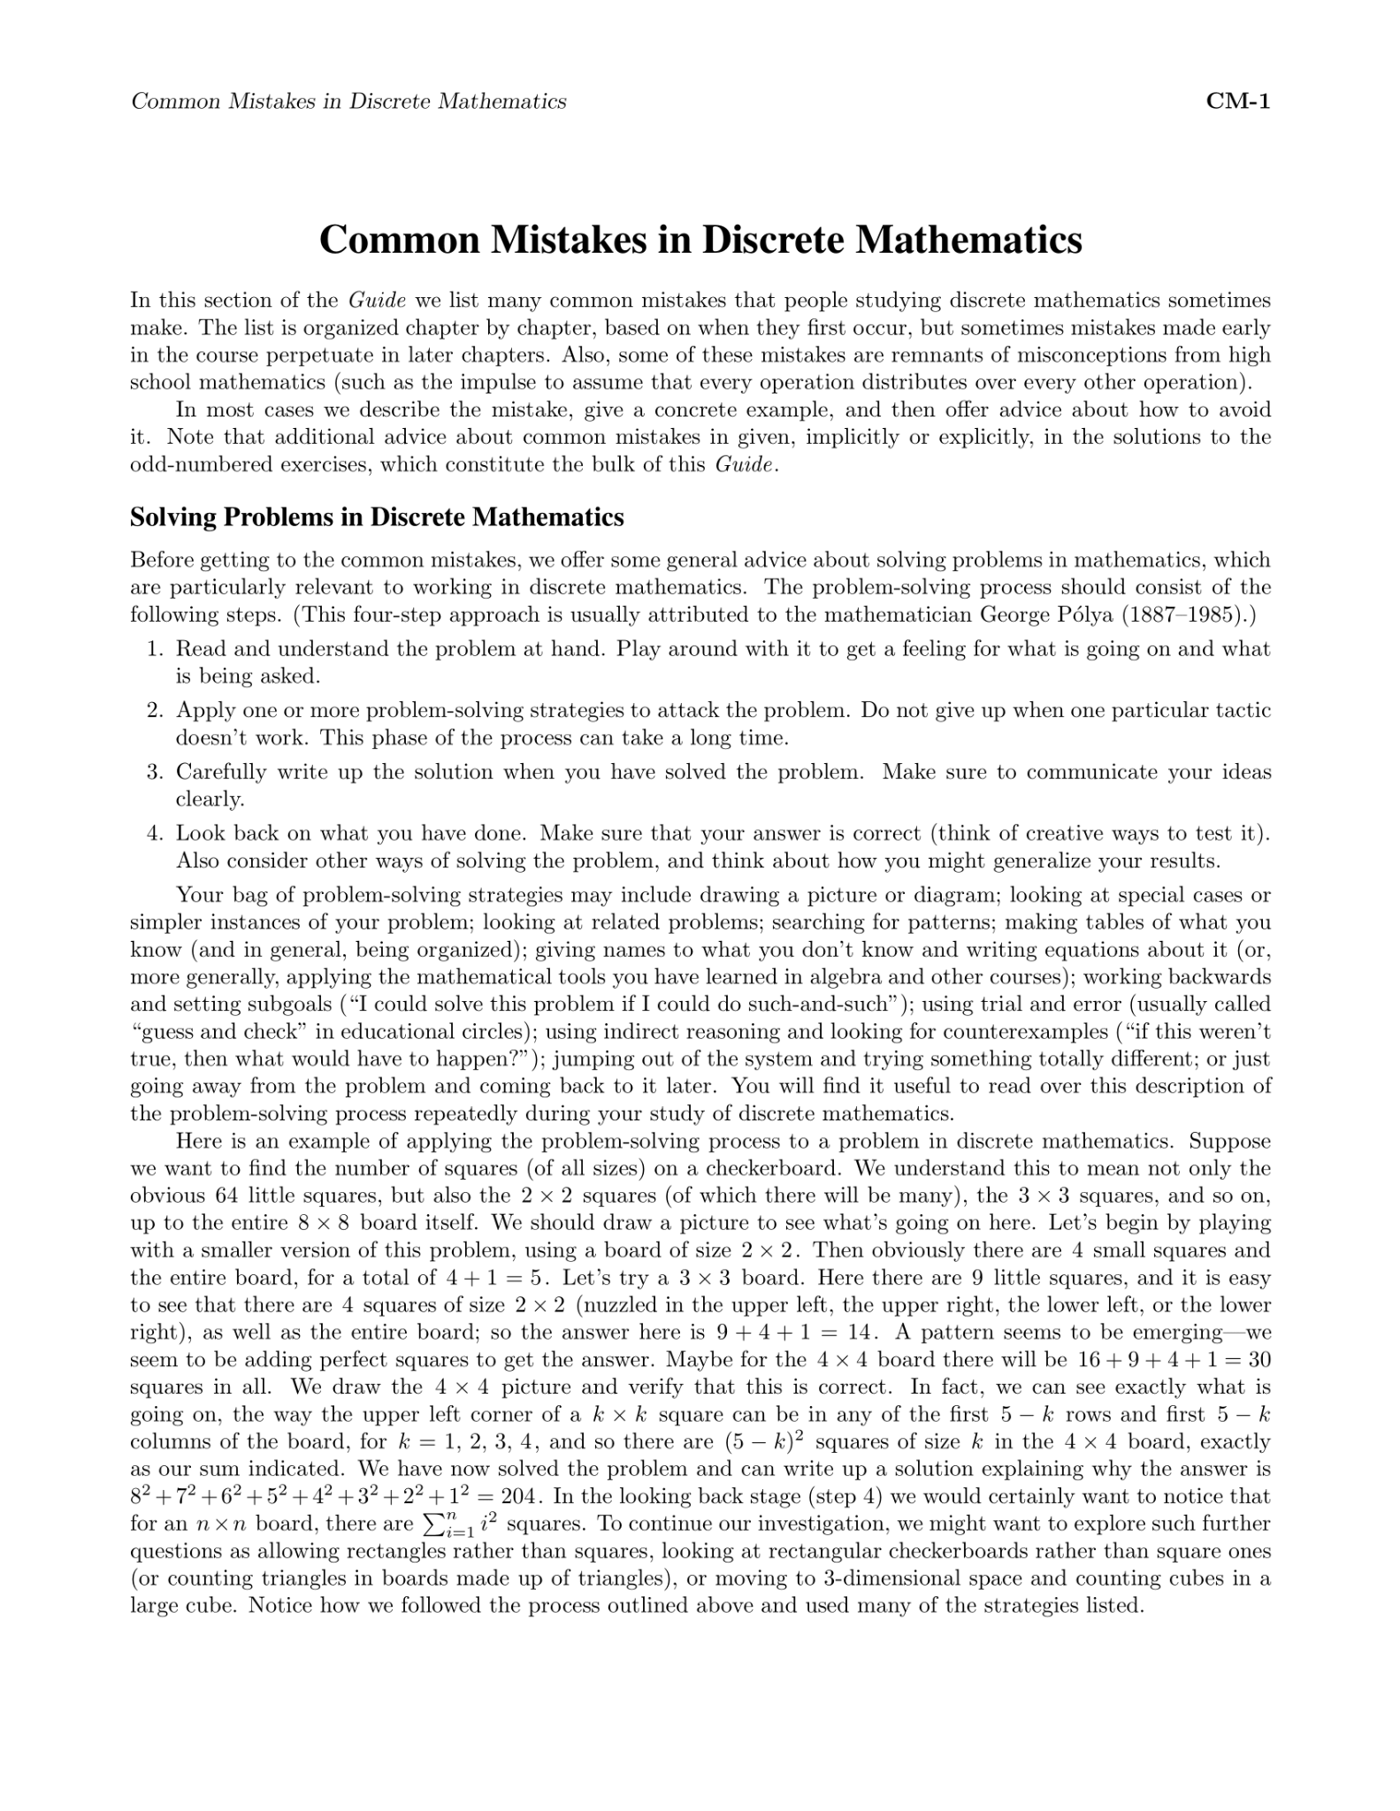
_{The full list of}
Common Mistakes on Chapter 1
This slide will be posted on Discord
Along with full document
Which has a more exhaustive list & more common mistakes
(Adapted from Kenneth Rosen’s Common Mistakes in Discrete Mathematics)
https://highered.mheducation.com/sites/dl/free/0073383090/299355/Rosen_SSG_CommonMistakes.pdf
& Common mistakes I saw in Homework (on this slide)

Slide 10
We have two options…
Go over Homework 4
Due: October 12th, 11:59 PM ET
Today is the only recitation before due!
On Sets, Set Operations
Assuming you’ve looked over the homework
Practice with Proofs
Section 1.7
Practice Problems
Group Work
If we choose (1), I’ll post (2) on Discord.
If we choose (2), it’ll be your responsibility to get help on homework (Office Hours, Discord)

Slide 11
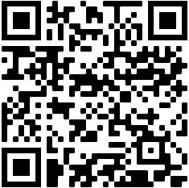
Student Feedback
Please remind me 5 minutes before class ends
https://sites.pitt.edu/~shk148/CS0441-2231/#student-feedback
Tell me:
How can I improve?
What can I do better?
Was anything confusing?
Or really anything…
Form is fully anonymous. I won't collect names, E-mail, or anything that could identify you.
Feedback is always appreciated.

Slide 12
