Slide 1


Homework Set #8 + Final Review
(DUE: DEC 9th, 2022 11:59 PM ET)
CS 0441: Discrete Structures for Computer Science Week 14 Recitation, Nov. 11, 2022
Section 17064 - Fridays 4 PM
Shinwoo Kim
https://sites.pitt.edu/~shk148/CS0441-2231/
Department of Computer Science
School of Computing & Information
University of Pittsburgh

Slide 2

Before we begin,
Do you have any questions?

Slide 3
Tis the season…for finals
Final Exam scheduled to be in-class Wednesday, December 7th during normal lecture period
Final grades should be available on Peoplesoft December 20th (per Univ. Calendar)
NOT FINAL EXAM GRADE!!!
Check and Contact Professor Bonidie about discrepancies ASAP
Last Recitation Today(?)
Unless you want to meet next week (Homework 8 or other questions)
Office Hours per usual til the 7th; No Office Hours during University Finals Week
Or feel free to ask me questions via Discord
Also, see Discord for more practice materials/help/study buddies
If you haven’t already, please complete your OMETs

Slide 4
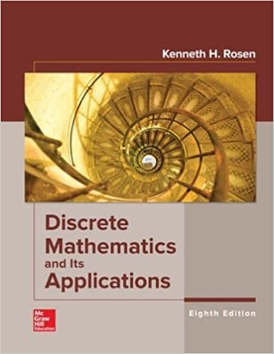
Homework #8
Sec 8.5 # 6, 8
Sec 9.1 # 2(a), 4(c)(d), 6(e)(f)(g), 10, 20, 34(a)(c)(e)
Sec 4.1 # 14(a)(b)(c), 16(c), 28 (a)(b), 34(a)(b)(c)(d)
Sec 4.2 # 2, 6(d), 12, 22 (d)
Sec 4.3 # 4(e)(f), 14, 18(a), 24(b)(c), 32(f)
Sec 10.1 # 2, 4, 6, 8
Sec 10.2 # 2, 4 (using #2 only)
Due: December 9th, 23:59 ET
Good practice for the Final Exam

Slide 5
Inclusion–Exclusion
Section 8.5 #s 6, 8

Slide 6
Q. 8.5.6
Find the number of elements in A1 ∪ A2 ∪ A3 if there are
100 elements in A1, 1000 in A2, and 10,000 in A3 if
a) A1 ⊆ A2 and A2 ⊆ A3.
b) the sets are pairwise disjoint.
c) there are two elements common to each pair of sets
and one element in all three sets.

Slide 7
Q. 8.5.8
In a survey of 270 college students, it is found that 64 like Brussels sprouts, 94 like broccoli, 58 like cauliflower, 26 like both Brussels sprouts and broccoli, 28 like both Brussels sprouts and cauliflower, 22 like both broccoli and cauliflower, and 14 like all three vegetables. How many of the 270 students do not like any of these vegetables?

Slide 8
Relations and their Properties
Section 9.1 #s 2(a), 4(c)(d), 6(e)(f)(g), 10, 20, 34(a)(c)(e)

Slide 9
Q. 9.1.2(a)
List all the ordered pairs in the relation
R = {(a, b) ∣ a divides b} on the set {1, 2, 3, 4, 5, 6}.

Slide 10
Q. 9.1.4(c)(d)
Determine whether the relation R on the set of all people
is reflexive, symmetric, antisymmetric, and/or transitive,
where (a, b) ∈ R if and only if
c) a has the same first name as b.
d) a and b have a common grandparent.

Slide 11
Q. 9.1.6(e)(f)(g)
Determine whether the relation R on the set of all real
numbers is reflexive, symmetric, antisymmetric, and/or
transitive, where (x, y) ∈ R if and only if
e) xy ≥ 0
f ) xy = 0
g) x = 1

Slide 12
Q. 9.1.10
Give an example of a relation on a set that is
both symmetric and antisymmetric.
neither symmetric nor antisymmetric.

Slide 13
Q. 9.1.20
“A relation R is called asymmetric if (a, b) ∈ R implies that (b, a) ∉ R.”
Which relations in Exercise 5 are asymmetric?
a) everyone who has visited a Web page a has also visited Web page b.
b) there are no common links found on both Web page a and Web page b.
c) there is at least one common link on Web page a and Web page b.
d) there is a Web page that includes links to both Web page a and Web page b.

Slide 14
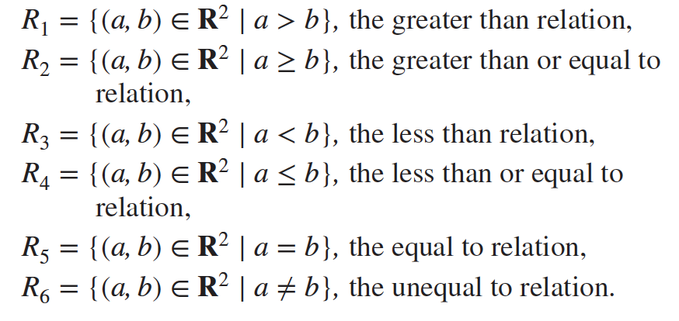
Q. 9.1.34(a)(c)(e)
a) R1 ∪ R3
c) R2 ∩ R4
e) R1 − R2

Slide 15
Divisibility and Modular Arithmetic
Section 4.1 #s 14(a)(b)(c), 16(c), 28 (a)(b), 34(a)(b)(c)(d)

Slide 16
Q. 4.1.14(a,b,c)
What are the quotient and remainder when
a) 44 is divided by 8?
b) 777 is divided by 21?
c) −123 is divided by 19?

Slide 17
Q. 4.1.16(c)
What time does a 24-hour clock read 168 hours after it reads 19:00?

Slide 18
Q. 4.1.28(a,b)
Find a div m and a mod m when
a) a = −111, m = 99.
b) a = −9999, m = 101.

Slide 19
Q. 4.1.34(a-d)
Decide whether each of these integers is congruent to
3 modulo 7.
37
66
−17
−67

Slide 20
Divisibility and Modular Arithmetic
Section 4.1 #s 14(a)(b)(c), 16(c), 28 (a)(b), 34(a)(b)(c)(d)

Slide 21
Q. 4.1.14(a,b,c)
What are the quotient and remainder when
a) 44 is divided by 8?
b) 777 is divided by 21?
c) −123 is divided by 19?

Slide 22
Q. 4.1.16(c)
What time does a 24-hour clock read 168 hours after it reads 19:00?

Slide 23
Q. 4.1.28(a,b)
Find a div m and a mod m when
a) a = −111, m = 99.
b) a = −9999, m = 101.

Slide 24
Q. 4.1.34(a-d)
Decide whether each of these integers is congruent to
3 modulo 7.
37
66
−17
−67

Slide 25
Integer Representation & Algorithms
Section 4.2 #s 2, 6(d), 12, 22 (d)

Slide 26
Q. 4.2.2
Convert the decimal expansion of each of these integers
to a binary expansion.
321
1023
100632

Slide 27
Q. 4.2.6(d)
Convert the binary expansion of each of these integers to
an octal expansion:
(101 0101 0101 0101)₂

Slide 28
Q. 4.2.12
Convert (1 1000 0110 0011)₂ from its binary expansion to its hexadecimal expansion.

Slide 29
Q. 4.2.22(d)
Find the sum and product of each of these pairs of numbers. Express your answers as a base 3 expansion.
(120021)₃, (2002)₃

Slide 30
Primes & Greatest Common Divisors
Section 4.3 #s 4(e)(f), 14, 18(a), 24(b)(c), 32(f)

Slide 31
Q. 4.3.4(e)(f)
Find the prime factorization of each of these integers.
e) 289
f ) 899

Slide 32
Q. 4.3.14
Which positive integers less than 12 are relatively prime
to 12?

Slide 33
Q. 4.3.18(a)
We call a positive integer perfect if it equals the sum of its positive divisors other than itself.
a) Show that 6 and 28 are perfect.

Slide 34
Q. 4.3.24(b, c)
What are the greatest common divisors of these pairs of
integers?
b) 2 ⋅ 3 ⋅ 5 ⋅ 7 ⋅ 11 ⋅ 13, 211 ⋅ 39 ⋅ 11 ⋅ 1714
_{c) 17, 1717}

Slide 35
Q. 4.3.32(f)
Use the Euclidean algorithm to find
gcd(11111, 111111).

Slide 36
Graphs & Graph Models
Section 10.1 #s 2, 4, 6, 8

Slide 37
Q. 10.1.2
What kind of graph (from Table 1) can be used to model a highway system between major cities where
there is an edge between the vertices representing cities if there is an interstate highway between them?
there is an edge between the vertices representing cities for each interstate highway between them?
there is an edge between the vertices representing cities for each interstate highway between them, and there is a loop at the vertex representing a city if there is an interstate highway that circles this city?

Slide 38
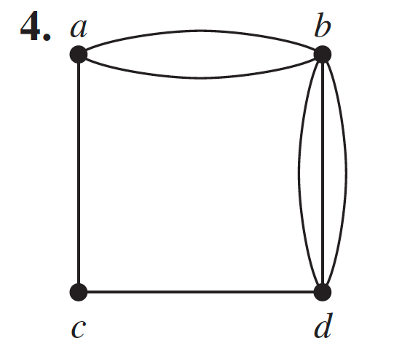
Q. 10.1.4
Determine whether the graph shown has directed or undirected edges, whether it has multiple edges, and whether it has one or more loops. Use your answers to determine the type of graph in Table 1 this graph is.

Slide 39
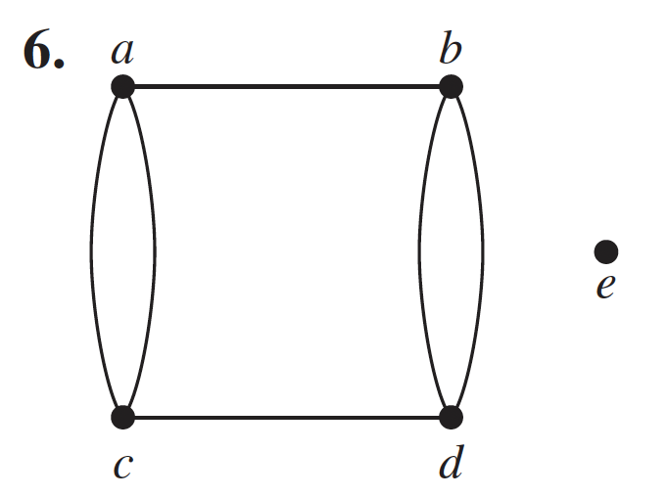
Q. 10.1.6
Determine whether the graph shown has directed or undirected edges, whether it has multiple edges, and whether it has one or more loops. Use your answers to determine the type of graph in Table 1 this graph is.

Slide 40
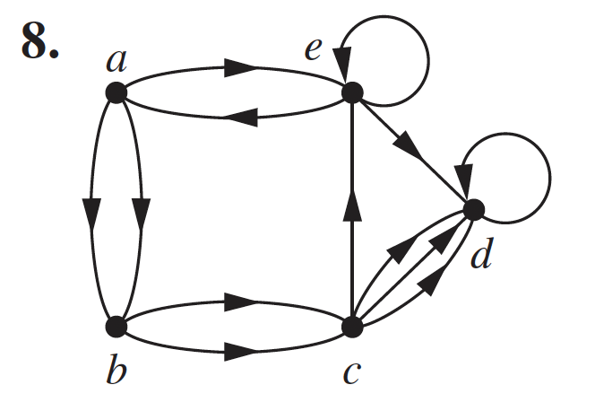
Q. 10.1.8
Determine whether the graph shown has directed or undirected edges, whether it has multiple edges, and whether it has one or more loops. Use your answers to determine the type of graph in Table 1 this graph is.

Slide 41
Graph Terminology & Special Graph Types
Section 10.2 #s 2, 4

Slide 42
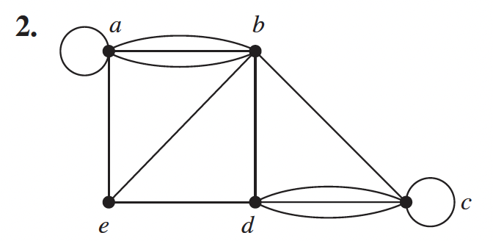
Q. 10.2.2
Find the number of vertices, the number of edges, and the degree of each vertex in the given undirected graph. Identify all isolated and pendant vertices.

Slide 43
Q. 10.2.4 (Use #2 Only)
Find the sum of the degrees of the vertices of the graph and verify that it equals twice the number of edges in the graph.

