Slide 1


Proof by Induction
CS 0441: Discrete Structures for Computer Science
Date TBA
Recitation Section 17064
Shinwoo Kim
https://sites.pitt.edu/~shk148/CS0441-2231/
Department of Computer Science
School of Computing & Information
University of Pittsburgh

Slide 2
We’ve learned a lot of proof methods …
Basic proof methods
Direct proof, contradiction, contraposition, cases, …
Proof of quantified statements
Existential statements (i.e., ∃x P(x))
Finding a single example suffices
Universal statements (i.e., ∀x P(x)) can be harder to prove
One way is to show that the statement holds for an arbitrary case
Sometimes we must truly show the proof for all cases
This could take forever!!!

Slide 3
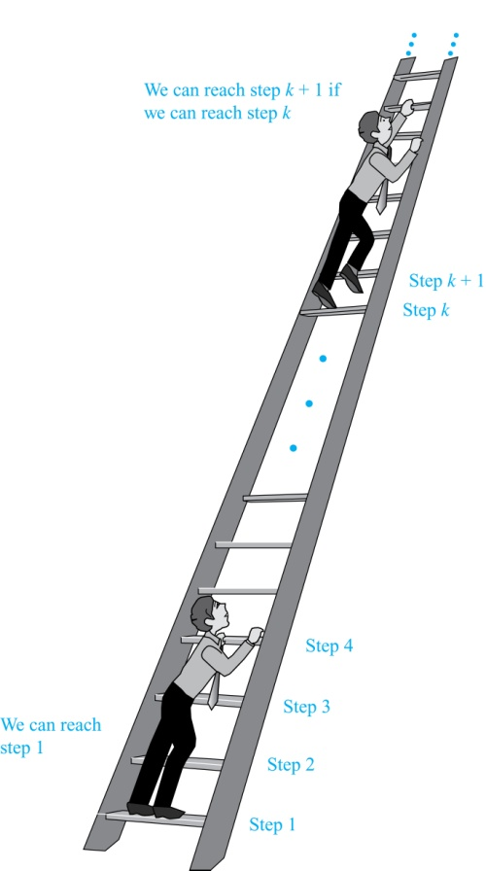
Climbing an Infinite Ladder
Suppose we have an infinite ladder:
We can reach the first rung of the ladder.
If we can reach a particular rung of the ladder, then we can reach the next rung.
From (1), we can reach the first rung.
Then by applying (2), we can reach the second rung.
Applying (2) again, the third rung.
And so on.
We can apply (2) any number of times to reach any particular rung, no matter how high up.

Slide 4
Principle of Mathematical Induction
To prove that P(n) is true for all positive integers n, we complete these steps:
Basis Step: Show that P(1) is true.
Inductive Step: Show that P(k) → P(k + 1) is true for all positive integers k.
To complete the inductive step, assuming the inductive hypothesis that P(k) holds for an arbitrary integer k, show that must P(k + 1) be true.
Back to our Infinite Ladder :
Basis Step: By (1), we can reach rung 1.
Inductive Step: Assume the inductive hypothesis that we can reach rung k. Then by (2), we can reach rung k + 1.
Hence, P(k) → P(k + 1) is true for all positive integers k.
We can reach every rung on the ladder.

Slide 5
Using Mathematical Induction
Mathematical induction can be expressed as the rule of inference
[ P(1) ∧ ∀k(P(k) → P(k + 1)) ] → ∀n P(n),
where the domain is the set of positive integers.
Note, In a proof by mathematical induction, we don’t assume that P(k) is true for all positive integers!
We show that if we assume that P(k) is true, then P(k + 1) must also be true.
Proofs by mathematical induction do not always start at the integer 1.
In such a case, the basis step begins at a starting point b where b is an integer. I.e., We show P(b) instead of P(1).
Mathematical Induction works because of the well-ordering property.
See Section 5.2, Appendix 1 for a detailed explanation of why induction proofs work.

Slide 6
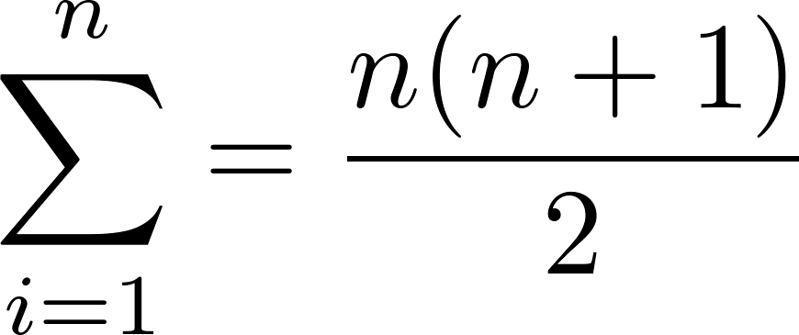
Example: Proving Summation Formulas via Induction
Show that:
Basis Step?
Inductive Step?

Slide 7
Example: Proving Inequalities via Induction
Show that: n < 2^{n} for all positive integers n.
Basis Step?
Inductive Step?

