Slide 1


Homework Set #6 Review
(DUE: NOV 4th, 2022 11:59 PM ET)
CS 0441: Discrete Structures for Computer Science Week 9 Recitation, Sep. 27, 2022
Section 17064 - Fridays 4 PM
Shinwoo Kim
https://sites.pitt.edu/~shk148/CS0441-2231/
Department of Computer Science
School of Computing & Information
University of Pittsburgh

Slide 2

Before we begin,
Do you have any questions?

Slide 3
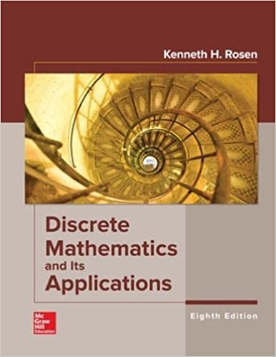
Homework #3
Sec 6.1 #s 4, 12, 22(a)(b)(c), 26(b), 46
Sec 6.2 #s 2, 4, 18
Sec 6.4 #s 3, 5, 13(d)(e)
Sec 6.5 #s 6, 10(e), 15(c) 32, 52
Due: November 4th, 23:59 ET
We’ll look at it today and next Friday

Slide 4
The Basics of Counting
Section 6.1 #4, 12, 22(a)(b)(c), 26(b), 46

Slide 5
Q. 6.1.4
A particular brand of shirt comes in 12 colors, has a male version and a female version, and comes in three sizes for each sex. How many different types of this shirt are made?

Slide 6
Q. 6.1.12
How many bit strings are there of length six or less, not counting the empty string?

Slide 7
Q. 6.1.22 (a)(b)(c)
How many positive integers less than 1000:
are divisible by 7?
are divisible by 7 but not by 11?
are divisible by both 7 and 11?

Slide 8
Q. 6.1.26(b)
How many strings of four decimal digits end with an even digit?

Slide 9
Q. 6.1.46
How many ways are there to seat four of a group of ten people around a circular table where two seatings are considered the same when everyone has the same immediate left and immediate right neighbor?

Slide 10
The Pigeonhole Principle
Section 6.2 #2, 4, 18

Slide 11
Q. 6.2.2
Show that if there are 30 students in a class, then at least two have last names that begin with the same letter.

Slide 12
Q. 6.2.4
A bowl contains 10 red balls and 10 blue balls.A woman selects balls at random without looking at them.
How many balls must she select to be sure of having at least three balls of the same color?
How many balls must she select to be sure of having at least three blue balls?

Slide 13
Q. 6.2.18
How many numbers must be selected from the set {1,3,5,7,9,11,13,15} to guarantee that at least one pair of these numbers add up to 16?

Slide 14
Binomial Coefficients and Identities
Section 6.4 # 3, 5, 13(d)(e)

Slide 15
Q. 6.4.3
Find the expansion of (x + y)⁶.

Slide 16
Q. 6.4.5
How many terms are there in the expansion of
(x + y)¹⁰⁰ after like terms are collected?

Slide 17
Q. 6.4.13(d)(e)
Use the binomial theorem to find the coefficient of xªy^{b} in the expansion of (2x³ − 4y²)⁷, where
d) a = 12, b = 6.
e) a = 18, b = 2.

Slide 18
Generalized Permutations and Combinations
Section 6.5 #6, 10(e), 15(c), 32, 52

Slide 19
Q. 6.5.6
How many ways are there to select five unordered elements from a set with three elements when repetition is allowed?

Slide 20
Q. 6.5.10(e)
A croissant shop has plain croissants, cherry croissants, chocolate croissants, almond croissants, apple croissants, and broccoli croissants.
How many ways are there to choose two dozen croissants with at least five chocolate croissants and at least three almond croissants?

Slide 21
Q. 6.5.15(c)
How many solutions are there to the equation
x₁ + x₂ + x₃ + x₄ + x₅ = 21,
where x_{i}, i = 1, 2, 3, 4, 5, is a nonnegative integer such that 0 ≤ x1 ≤ 10?

Slide 22
Q. 6.5.32
How many different strings can be made from the letters in MISSISSIPPI, using all the letters?

Slide 23
Q. 6.5.52
How many ways are there to distribute five distinguishable objects into three indistinguishable boxes?

Slide 24
Student Feedback for this week
Similar to last week, you’ll have time at the end to fill out the feedback form
Someone please remind me 5 minutes before the end
https://sites.pitt.edu/~shk148/CS0441-2231/#student-feedback
Please tell me:
How can I improve?
What can I do better?
Was anything confusing?
Or really anything…
Form is fully anonymous. I won't collect names, E-mail, or anything that could identify you.
Feedback is always appreciated.

