Slide 1

Shiva
Advances in ELF Binary Encryption
Shaun Clowes
(shaun@securereality.com.au)
Neel Mehta
(nmehta@iss.net)

Slide 2
The Encryptor’s Dilemma:
To be able to execute, a program’s code must eventually be decrypted

Slide 3
A Losing Game
Thus binary encryption is fundamentally an arms race.
The encryptors cannot win.
  Just make life hard for the attackers

Slide 4
Encryption Keys
If the encrypted executable has access to the encryption keys for the image:
  By definition a solid attack must be able to retrieve those keys and decrypt the program
To reiterate, binary encryption can only slow a determined attacker

Slide 5
Our Aim
Introduce some novel new techniques.
Advance the state of the art:
  Unix executable encryption technology trails Windows dramatically
Promote interest in Reverse Engineering on Unix platforms

Slide 6
Really a losing game
By describing the details of our encryptor in this speech we're making it dramatically easier to attack
We'll release an encrypted version of the encryptor today
  Source release in 3 months
We expect generic attacks will exist by then

Slide 7
What’s the point?
An encryptor can be used to:
  Prevent trivial reverse engineering of algorithms
  Protect setuid programs (with passwords)
  Hide sensitive data/code in programs

Slide 8
Standard Attacks
A good encryptor will try to deter standard attacks:
  strace – System Call Tracing
  ltrace – Library Call Tracing
  fenris – Execution Path Tracing
  gdb – Application Level Debugging
  /proc – Memory Dumping
  strings – Don’t Ask

Slide 9
Deterring Standard Attacks
strings
  Encrypting the binary image in any manner will scramble the strings

Slide 10
Deterring Standard Attacks
ltrace, strace, fenris and gdb
  These tools are all based around the ptrace() debugging API
  Making that API ineffective against encrypted binaries would be a big step towards making them difficult to attack

Slide 11
Deterring Standard Attacks
/proc memory dumping
  Based on the idea that the memory image of the running process must contain the unencrypted executable
  A logical fallacy
  A good encryptor will invalidate it

Slide 12
Countermeasures
The majority of attacks against encrypted executables (excluding static analysis) can be detected by the running program
Unless the attacker notices and prevents it, the program can take offensive action

Slide 13
Layers
Static analysis is significantly harder if the executable is encrypted on more than one level
The layers act like an onion skin
The attacker must strip each layer of the onion before beginning work on the next level

Slide 14
(Un) Predictable Behavior
Efforts to make encryptor behavior differ from one executable to another are worthwhile
The less generic the methodology, the harder it is to create a generic unwrapper

Slide 15
Shiva
The encyptor we'll present today tries to implement all of the defences we’ve described so far
Our encryptor is designed to encrypt ELF executables on Linux machines

Slide 16
Other (public) ELF Encryptors
Burneye – Scut
  Multi layer encryption
  Strong password encryption
  “Host Key” encryption
  Entire executable decrypted to memory
ELFcrypt – JunkCode
  Simple executable wrapper and obfuscator

Slide 17
Shiva v0.95
Currently encrypts dynamic or static Linux ELF executables
Does not handle shared libraries (yet)

Slide 18
Encryptor / Decryptor
Development of an ELF encryptor is really two separate programs
Symmetrical operation

Slide 19
Encryptor
Normal executable, which performs the encryption process, wrapping the target executable

Slide 20
Decryptor
Statically-linked executable, which performs decryption and handles runtime processing
Embedded within the encrypted executable
Self contained
  Cannot link with libc etc.

Slide 21
Shiva ELF Abstraction API
Represent any ELF executable as a structure in memory
Allows for easy manipulation of ELF executables within encryptor, not relevant for decryptor

Slide 22
Dual-process Model (Evil Clone)
Slave process (main executable thread) creates a controller process (the clone)
Inter-ptrace (functional and anti-debug)

Slide 23
x86 Assembly Byte-Code Generation
Allows for the generation of x86 assembly byte-code from within C (a basic assembler)
Pseudo-random code generation, pseudo-random functionality

Slide 24
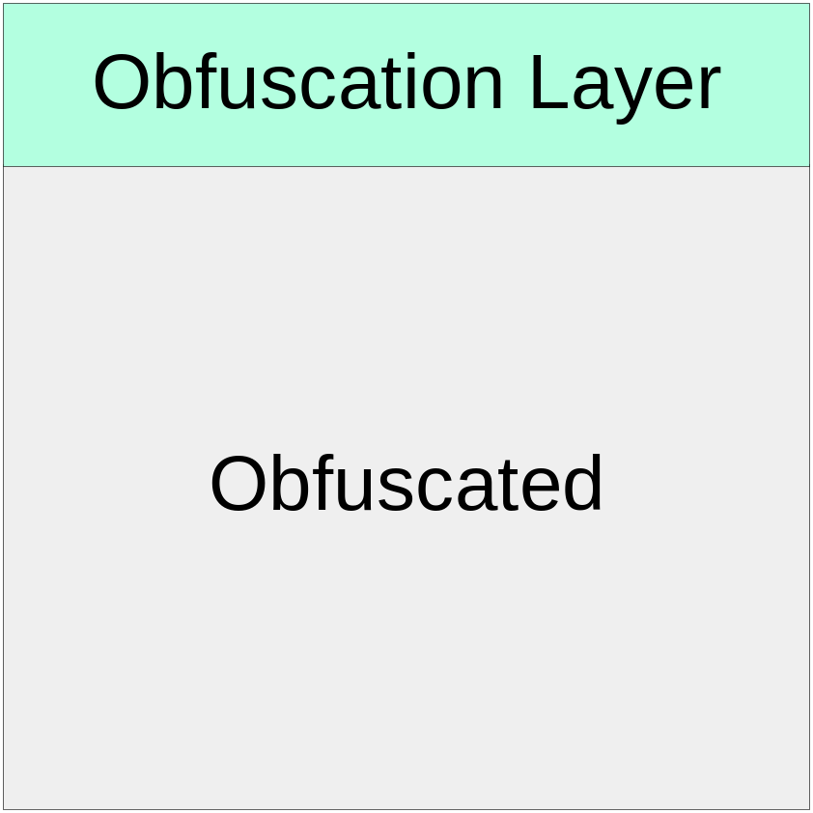
Encryption Layers – Layer 1

Slide 25
Initial Obfuscation Layer
Intended to be simple, to evade simple static analysis
Somewhat random, generated completely by in-line ASM byte-code generation

Slide 26
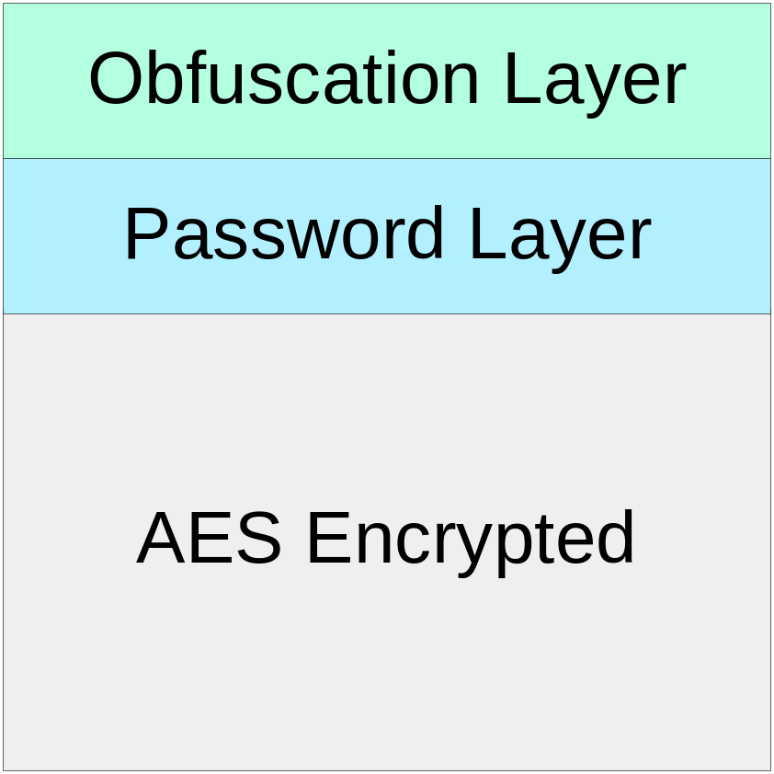
Encryption Layers – Layer 2

Slide 27
Password Layer
Optional
Wrap entire executable with 128-bit AES encryption
Key is SHA1 password hash, only as strong as the password

Slide 28
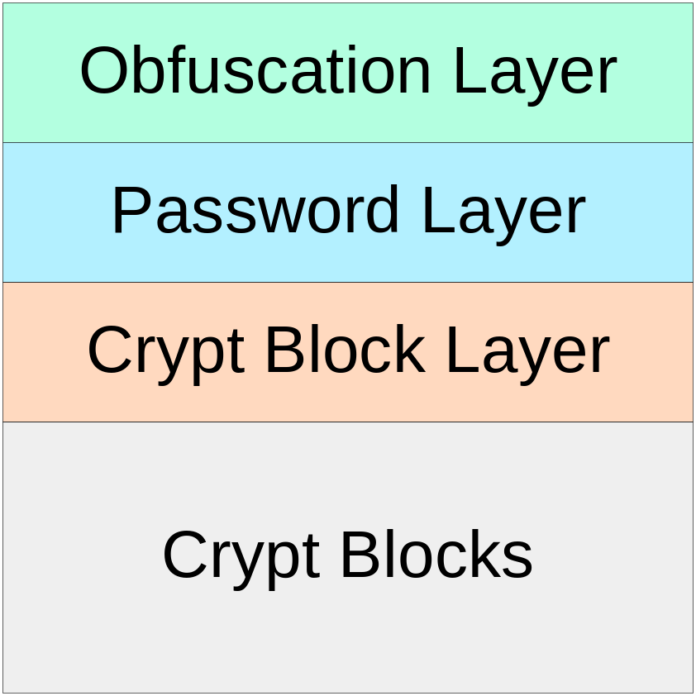
Encryption Layers – Layer 3

Slide 29
Crypt Blocks
Two important types – immediate map, map on-demand
Controller process handles map on-demand blocks
Random unmap
  Only small portion of executable decrypted at any time
Instruction length parsing – necessary to create map on-demand blocks

Slide 30
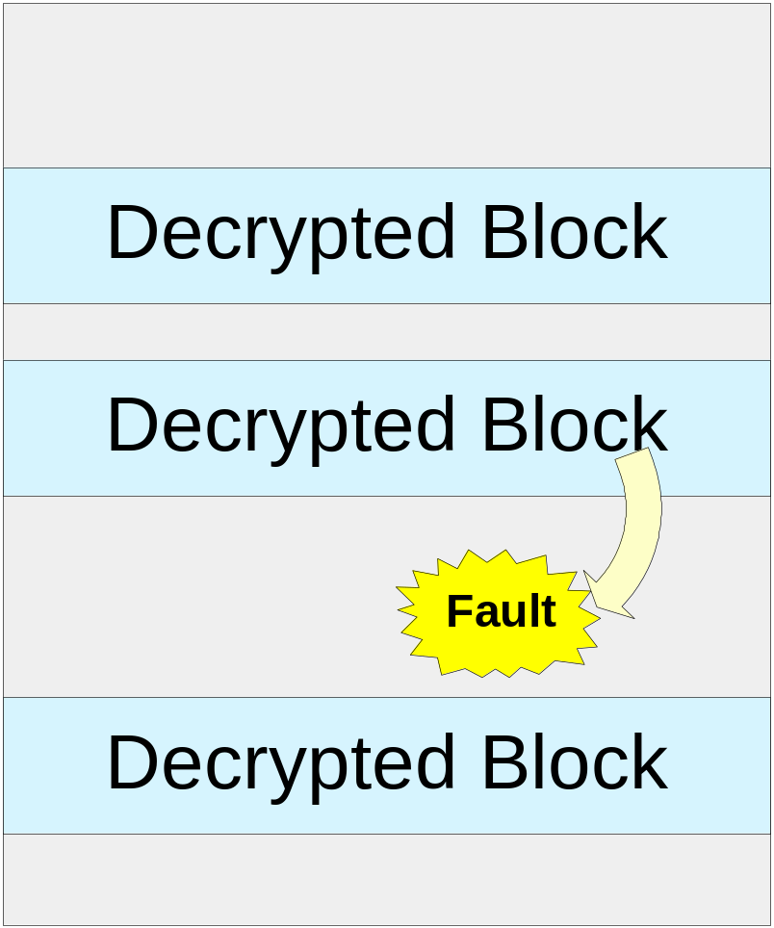
Crypt Block Mapping

Slide 31
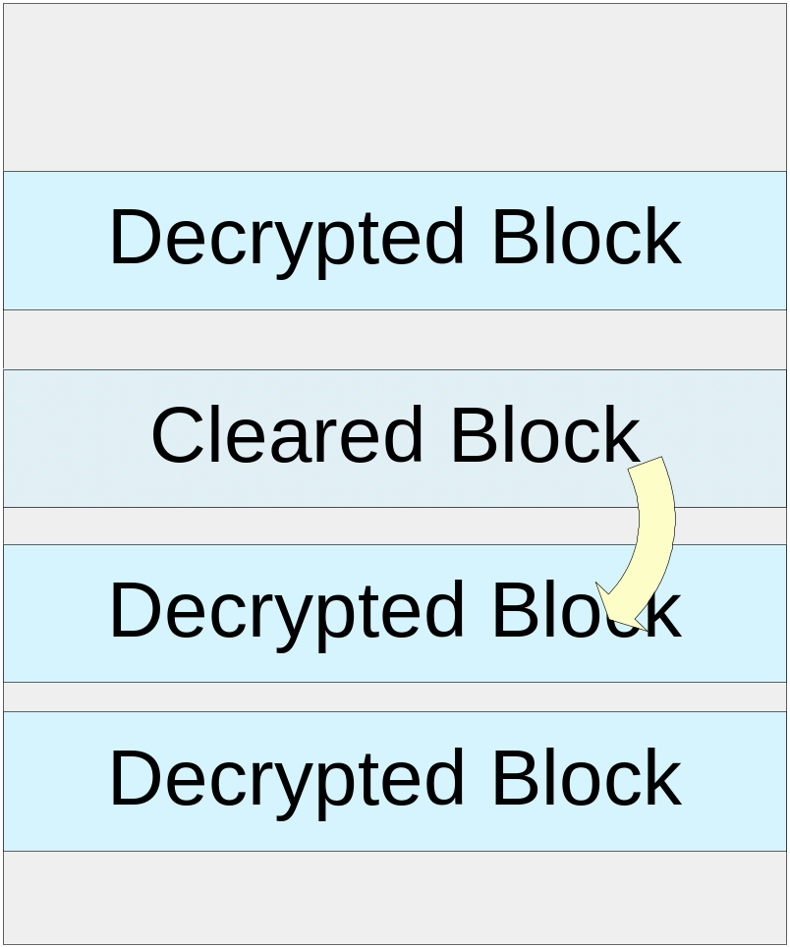
Crypt Block Mapping

Slide 32
Crypt Block Encryption
Block content encrypted with strong algorithm
  Guess
Code to generate keys made pseudo-randomly on the fly (asm byte-code)
  Keys are never stored in plain text
Tries to bind itself to a specific location in memory (and other memory context)

Slide 33
Dynamically Linked ELF’s
Decryptor interacts with system’s dynamic linker
Decryptor must map dynamic linker itself, and then regain control after linker is done

Slide 34
Anti-debugging/disassembly
Inherent anti-debugging provided by dual-ptrace – link verified
Catch tracing:
  Check eflags
  Check /proc/self/stat

Slide 35
Anti-debugging/disassembly
Timing and SIGTRAP
Simple SIGTRAP catch
JMP into instructions – common anti-disassembly trick

Slide 36
Problems Encountered, Solutions
Clone, ptrace, and signals
Fork processing
Exec processing
Life without libc
  Simple implementations of malloc etc

Slide 37
Current Limitations
Can’t handle vfork(), threads
Can’t encrypt static executables that call fork()
On Linux, exec() fails if the calling process tries to exec a setuid program
Section Headers
Nothing that can’t be solved by the next release ☺

Slide 38
Other work in progress:
Burneye 2 - Scut
Divides programs into blocks at compile-time, decrypts one block at a time
Determines decryption keys based on code-flow constraints of the original program
Larger binaries; execute slower; must be statically linked

Slide 39
Future Direction
Ports to other OS’s/Architectures
Support for shared libraries
Advanced anti-debugging
Advanced manipulation of assembly byte-code (branch instructions, relocation of static data)
Adapting when people break it

Slide 40

End of Presentation
Thanks for listening
Questions?

