Slide 1
DANKE Free your stuff
Android, iOS app Software Requirement Specification (SRS)

Slide 2
Revision
Name | Date | Remarks
Anik | 31/1/2015 | Added UI of all screen and description of login and start screen

Slide 3
Introduction
We have many things, which need to be thrown since they are no use to us. But those things can be useful to others. So we want to create an application for android and iPhone so that the app can made communication with donator and receiver.
The applications name is “Danke-Free Your Stuff”. Our main goal is to make the communication with those donator and needy.

Slide 4
Overall Description
Products Perspective:
Since in Google play and iTunes there are no application like that we hope we can make a good reputation trough the application. Our application will be a new era of the generation.
Product Function:
Through the app, donator will share which he want to give a needy, from which location needy can collect it and other information. Also the needy can communicate with donator through the application. So the main functionality of this app is to create an application and a server side so that we can store the data and show it to the client.

Slide 5
Our Goal
Give and Need.
Give: People give their unnecessary things without throwing it on trash can.
Need: People desperately look for something without costing money.
In both case they will entry in the app.
What does he want? What does he give?
Main problems in the concept:
1. People could not find out which in available. They could not ask his neighbors what is your unnecessary household items ?
2. It is not easy to find people who really need my unnecessary items like old pillow, used backpack etc.
3. There are no category wise items, for example I really want to collect old book. How could i find old book from thousands of Give request?
4. Without map location of provider's home/rode side trash point, how could i collect the items? I must know the map right!
5. I need up to date information.
So we have to solve those problems through app....

Slide 6
App Functionality
1. Donator will choose the stuff what he want to give.
2. He will give a location from where needy can collect.
3. Donator can share photo of the stuff.
4. Donator can share the post through facebook.
5. Donator can choose the needy.
6. needy can request to get it.
7. when donator choose the needy,,, needy will get notification.

Slide 7
UI with functionality

Slide 8
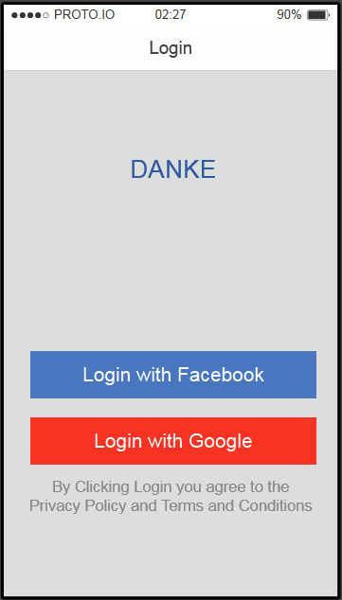
Login Screen
Login screen ui/layout design
Login with facebook
Login with Google
Screen Functionality
Localization

Slide 9
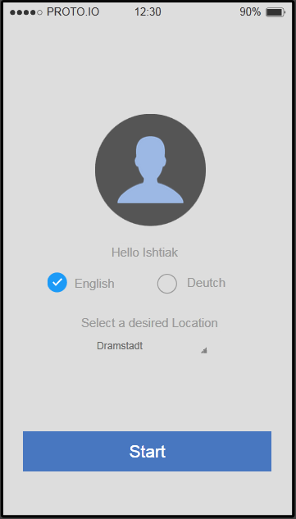
Start Screen
Start Screen layout design
Save data in server/database
Screen functionality
Localization support

Slide 10
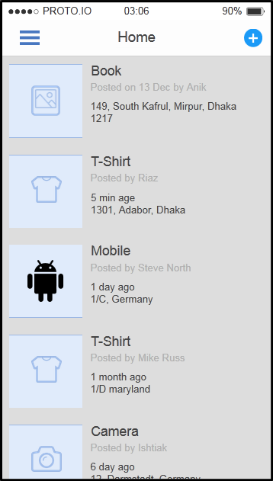
Home Screen
Fetch data from web server
Show data in a table using lazy loading
Address,post time,and distance should be included
Add button for new post

Slide 11
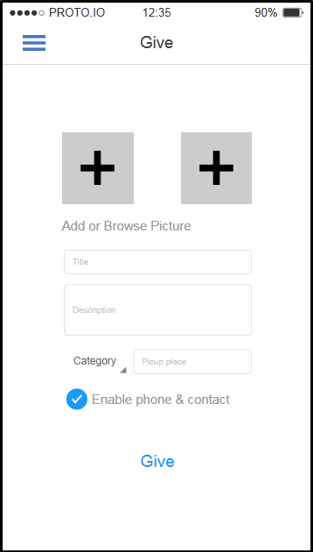
Give Screen
The things which need to be provided for a post:-
Pictures of item
Title
Short description
Category
Enable phones and contact which will open contact info of the user.

Slide 12
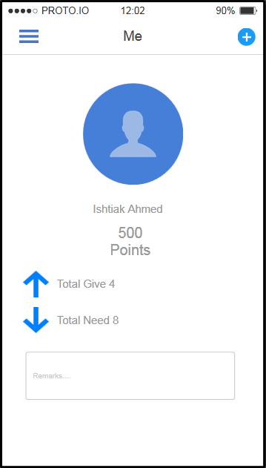
Me Screen
For every successful give donator will get some bonus points.
This screen will give info about user.

Slide 13
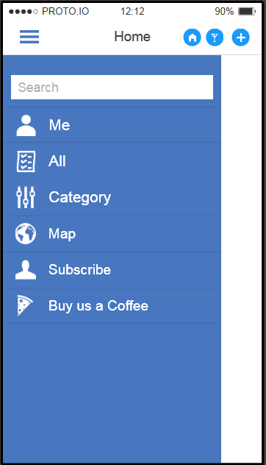
Side Navigation
Search will fetch data from the webserver
“Me” will take to “ME” screen
User can chose category and that will give him that type of data. So when user choose category a request will go to webserver and data will shown in home screen
Map functionality(Anik you write it.I don’t get it)
Subscribe will send a mail to us with his email id.We will provide update.
Buy us a Coffee will provide him a payment gateway by which he can pay us. Paypal is better.

Slide 14
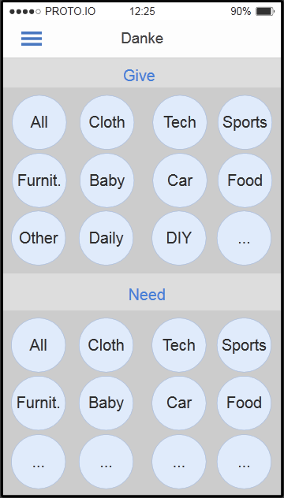
Give & Need Screen
Category for which can be chosen single or multiple.

