Slide 1
Water Quality Monitoring System
Presented by
S.Shiny Gladis

Slide 2
BLOCK DIAGRAM
Input Module
OUTPUT MODULE
POWER SUPPLY
BREAD BOARD
ARDUINO UNO
NODE MCU
JUMPERS
GRAVITY ANALOG pH SENSOR
DS18B20 TEMPERATURE SENSOR
SOIL MOISTURE SENSOR
DISPLAY DEVICE(MOBILE)

Slide 3
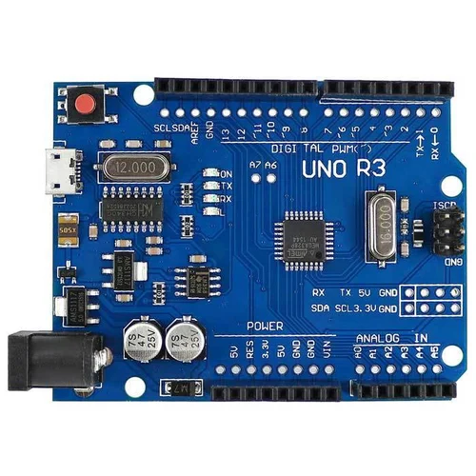
Arduino UNO
Data Collection
Data Processing
Data Logging
Wireless Communication
Automation
User Interface:
Low-Power Mode

Slide 4
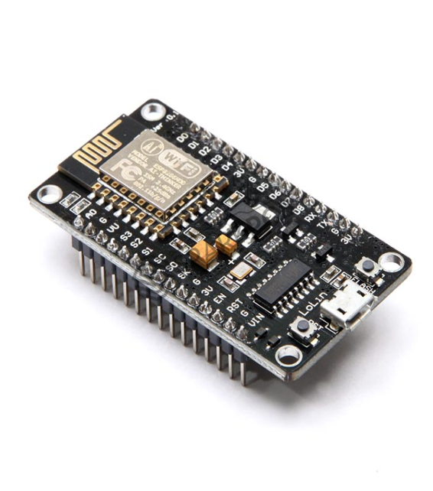
Node MCU
Sensor Interface
Data Collection
WirelessCommunication
Data Logging
Remote Monitoring
Real-time Alerts

Slide 5
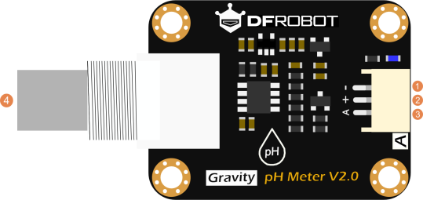
Gravity Analog pH sensor
Analog Output
High Accuracy
Easy to Use
Calibration
Wide Applications

Slide 6
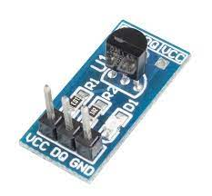
DS18B20 temperature sensor
Calibration
Temperature Measurement
Data Logging and Analysis
Environmental Monitoring
Energy Efficiency
Early Warning System

Slide 7
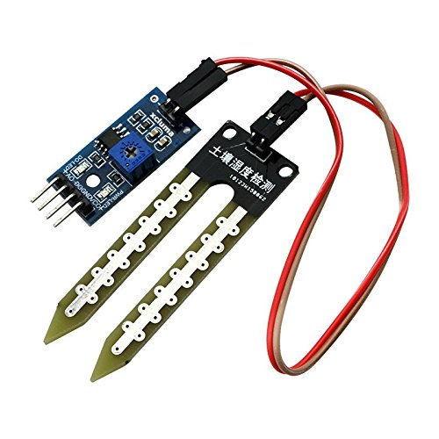
Soil Moisture Sensor
Groundwater Monitoring
Flood Monitoring
Irrigation Management
Watershed Monitoring
Wetland
Aquatic Ecosystem Monitoring
Erosion Control
Water Conservation in Landscaping
Remote Sensing

Slide 8
Power supply
Low-Power Components:
Choose sensors, microcontrollers, and communication modules that are energy-efficient. Low-power components extend the system's battery life significantly, reducing the frequency of battery replacements or recharging.

Slide 9
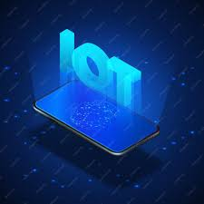
DISPLAY DEVICE
An android app is developed using the MIT app inverter tool.
This app provides a feature to visualize,monitor and analyze via mobile.

