Slide 1


Domain adaptive visual object detection
Haihang Huang S273677
Feihong Shi S274816
Jinzhuo Chen S274294
Mingfang Li S274553

Slide 2
Outline
1 Object Detection
2 SSD
3 Domain Adaptation
4 Adversarial Feature Alignment
5 Experiment Conclusion

Slide 3
Section-1 Object Dectecion

Slide 4
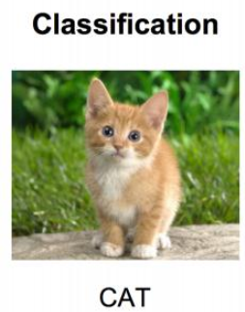
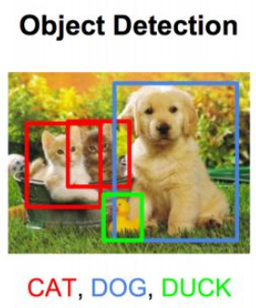
How to perform object detection
Object detection is a task to localize instances of particular object classes in an image.
Popular algorithms can be divided into two categories:
- two-stage, based on Region Proposal R-CNN algorithm (R-CNN, Fast R-CNN, etc.), they are
- one-stage algorithms such as Yolo and SSD

Slide 5
Section-2 SSD

Slide 6
Single Shot MultiBox Detector
Main design concept:
Use multi-scale feature maps for detection
Use convolution for detection
Priori box

Slide 7
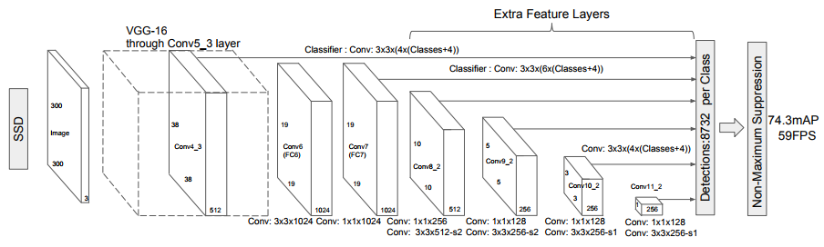
SSD architecture
SSD uses VGG16 as the basic model, and then adds a new convolutional layer on the basis of VGG16 to obtain more feature maps for detection.

Slide 8
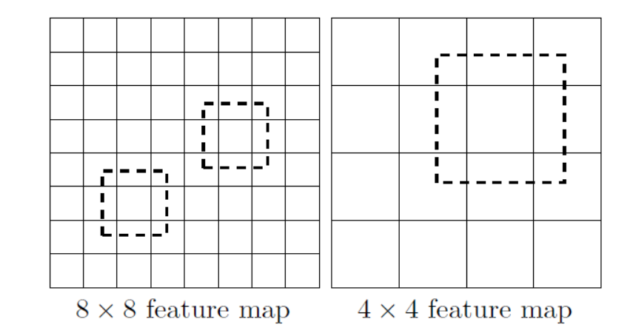
Multi-scale feature maps
SSD extracted different feature maps for detection ,A relatively large feature map is used to detect relatively small targets, while a small feature map is responsible foe detecting large targets.

Slide 9
Convolutional predictors
Different from Yolo's last fully connected layer.
SSD uses convolution to extract detection results from different feature maps

Slide 10
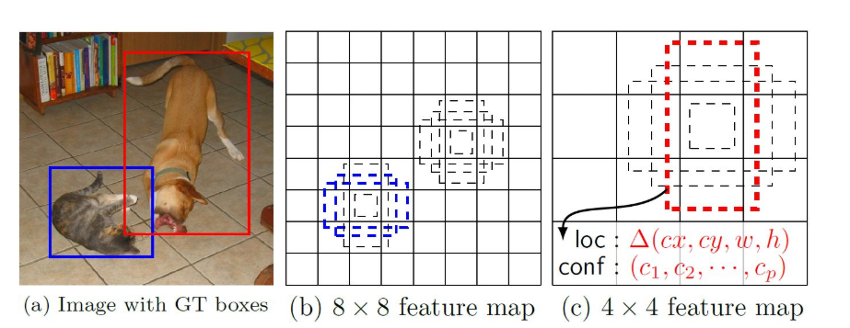
Priori box
Each unit set different scales or aspect ratios priori boxes, As shown in the figure and each unit uses 4 different a priori boxes.

Slide 11
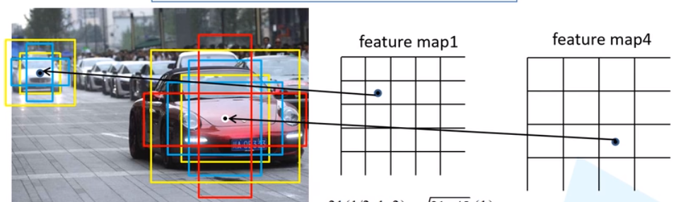
Priori box
For conv4_3, conv10_2 and conv11_2, it only associate 4 default boxes at each feature map location. For all other layers, we put 6 default boxes
Scale = [ (30,60) (60,111) (111,162) (162,213) (213,264)]
Aspect = [(1,2,.5) (1,2,.5,3,1/3) (1,2,.5,3,1/3) (1,2,.5,3,1/3) (1,2,.5) (1,2,.5)]

Slide 12
Baseline
SSD300 trained on PascalVOC 2007 and 2012
We set batch-size = 16 to fit in GPU memory
Evaluation was carried out on the Clipart1k dataset
mAP 26.54 was achieved

Slide 13
Section-3 Domain Adaptation

Slide 14
Domain Adaptation
The data distribution of different domains is different, which results in poor performance at the Target Domain.
Three main approaches:
Discrepancy-based
Adversarial-based
Reconstruction-based

Slide 15
Domain Transform
What: The process of moving data from one kind domain(source) to another kind domain(target)
How: We use the CycleGAN to transform the data from Nature Style(VOC) to another Style(Clipart)
Why: Because the style of the two datasets are different, it affects the performance of model. We transform one dataset’s style to another dataset’s style.

Slide 16
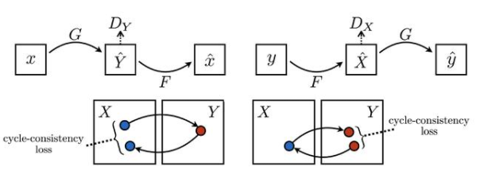
What is CycleGAN

Slide 17
Steps of training DT model
Step1: Using the SSD, that trained on VOC dataset, as our basic model(Baseline model).
Step2: Using CycleGAN to transform the VOC dataset
Step3: The baseline model is fine-tuned using the transformed VOC dataset

Slide 18
Section-4 Adversarial Feature Alignment

Slide 19
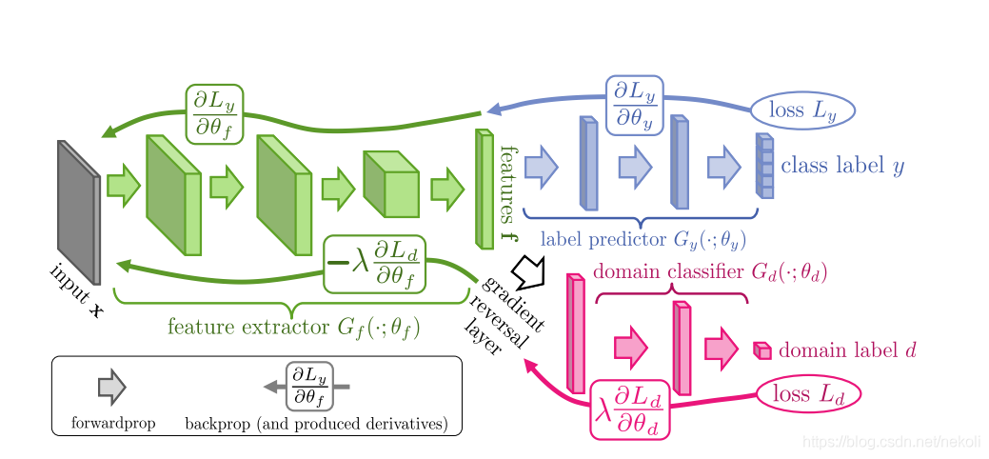
An alternative strategy of Domain Adaptation Adversarial feature alignment
Domain classifier component (2 conv, 10 FC )
Minimize the source domain classification error and maximize the domain classification error.

Slide 20
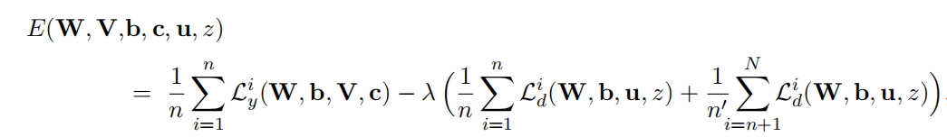
GRL
Overall, it is a minimization problem.
multiplies it by −λ in front of the domain classification error.
After 500 iterations GRL will decrease the performance.
By test, in our model the best value for λ is 0.7

Slide 21
Section-5 Experiment Conclusion

Slide 22
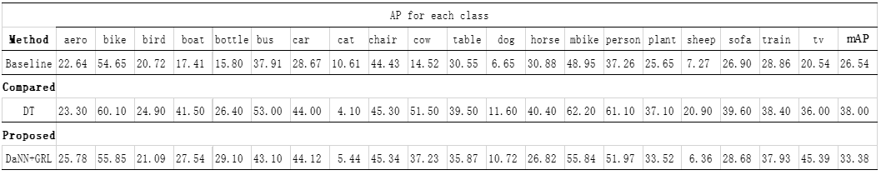
Conclusion comparison

