Slide 1

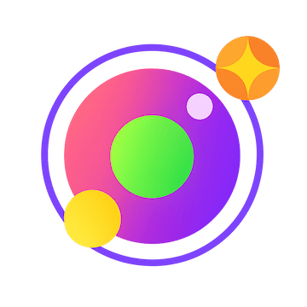
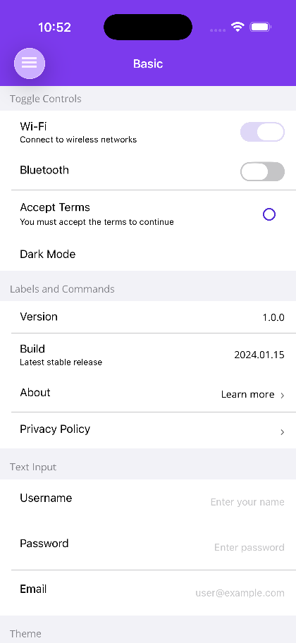
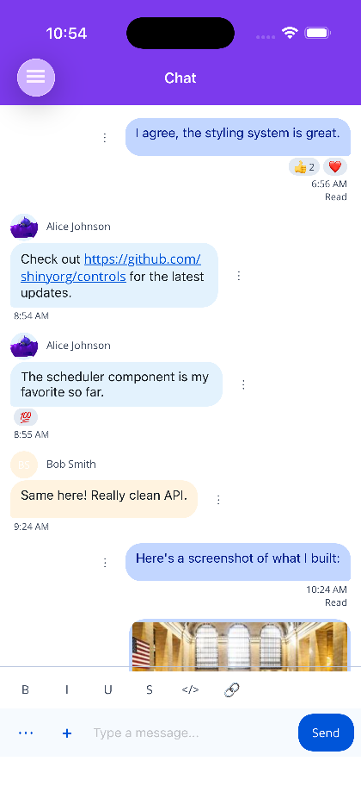

SHINY.NET
The hard parts
of your app,
Everything the platform makes hard: Bluetooth, background jobs, push, location, a document database, speech and AI, an HTTP server that runs inside your MAUI app, 67 UI controls, and plenty more. Thirty-plus libraries that own the platform code, the permissions and the background execution — so your time goes to the app your users actually asked for.
40M+
30+
67
AOT
NuGet downloads
libraries
UI controls
trim-clean
shinylib.net · built and maintained by ShinySoft Technologies
Notes:
Shiny is a suite of 30+ independent .NET libraries. The pitch in one line: the platform-specific plumbing every app needs is already written, tested and shipping in production apps with 40M+ NuGet downloads. Everything here runs on .NET 9+, is AOT and trimming clean, and is MIT licensed.

Slide 2



WHY SHINY
Three things you stop writing
Every Shiny library owns the same three burdens end to end, on every platform it supports — so the same C# you write once behaves the same everywhere.
The platform code
The permissions
Background execution
One C# API over CoreBluetooth and Android BluetoothGatt, HealthKit and Health Connect, EventKit and the Android calendar provider. No #if ANDROID ladders in your view models.
Runtime prompts, Info.plist keys and manifest entries handled for you — declared once in your .csproj and generated at build, surfaced at runtime as a single AccessState.
Jobs, transfers, GPS and geofences that keep running when the app is off screen, using each platform’s real background APIs and surviving restarts.
Everything runs on .NET 9 and later, is AOT and trimming clean, and ships as independent NuGet packages — take one library or take the suite.
Notes:
This is the through-line for the whole deck. Every library in the catalog earns its place by taking on the same three burdens. If a team is writing #if ANDROID blocks, hand-editing Info.plist, or fighting WorkManager and BGTaskScheduler, that is the work Shiny removes.

Slide 3









THE CATALOG
Thirty-plus packages, nine problem areas
Grouped by the problem they solve, not by the platform they run on.
Foundation
Hardware & Connectivity
Device Data
Architecture, hosting, Mediator, DI, source generators
BLE, GPS, OBD, discovery, Wi-Fi, screen capture
Music, health, contacts, calendars
AI & Intelligence
Background & Delivery
MAUI App
Conversation, speech, face, voice, documents
Jobs, transfers, local and push notifications
Shell navigation, hosting, config, permissions
UI Controls
Data & Storage
Server & Cloud
67 controls for MAUI and Blazor, one theme contract
Document DB, spatial, data sync, key/value stores
Embeddable HTTP server, push dispatch, Aspire
Notes:
The agenda for the rest of the deck. Nine groups, walked in this order. Nothing here is all-or-nothing — each group is a set of separate NuGet packages, so a team can adopt exactly one and never see the rest.

Slide 4



REACH
One suite, every .NET target
The same packages run on the phone in a pocket, the desktop on a bench, the browser tab and the server rack.
iOS
Android
Mac Catalyst
macOS
Windows
Linux
Blazor WASM
ASP.NET Core
AOT & trimming clean
Independent packages
Open source
Source generators replace reflection, so a route or a contract that cannot bind fails your build rather than your deployment.
Reference only what you use. No god-package, no transitive surprises, no framework lock-in.
MIT-licensed on GitHub, maintained by the same people who ship production apps on it every day.
Not every library supports every target — but where a platform has the capability, Shiny exposes it through the same interface.
Notes:
Worth stressing that this is not a mobile-only suite. Mediator, Document DB, serialization and the HTTP server all run server-side, which means the same contracts and the same storage API on both ends of a system.

Slide 5

App Builder & templates
Architecture: services, delegates, observables
SECTION 01
Hosting models — MAUI, native, manual
Foundation
Mediator
The concepts, tooling and cross-cutting libraries every Shiny app is built on — whatever it targets.
Dependency Injection & Reflector
Serialization & Localization generators
Notes:
Section one. Everything in Foundation is optional on its own but assumed by everything else — this is where the hosting model and the source generators live.

Slide 6






SECTION 01 · FOUNDATION
Start here
Source generation instead of reflection, one hosting call instead of platform boilerplate.
App Builder
Architecture
Hosting Models
Mediator
An interactive wizard that generates the boilerplate, packages and configuration for your project.
Services, delegates and observables — the core concepts underpinning the whole ecosystem.
MAUI, native or manual hosting. One call wires lifecycle, DI and background services.
The mediator pattern for every .NET app — source-generated, AOT-ready, middleware-driven.
Dependency Injection
Reflector
Serialization
Localization Generator
Attribute-driven registration with source generation. Tag your classes, generate your registrations.
Source-generated property access that eliminates reflection for AOT-safe, high-performance code.
Every JsonSerializerContext behind one AOT-safe ISerializer. Mark it, and it auto-registers.
Strongly-typed classes generated from your .resx files. No more typo-prone string lookups.
AI Skills · every Shiny library ships an AI coding-assistant skill for Claude Code and GitHub Copilot
Notes:
Foundation is the part people underestimate. The source generators (DI, Reflector, Serialization, LocalizeGen) are what make the rest of the suite AOT-safe — no reflection at runtime means no trimming surprises when you flip on full AOT for an iOS release build.

Slide 7
SPOTLIGHT
Mediator
A mediator built for all .NET apps — mobile, desktop and server. Add offline support, caching, validation or resiliency with a single attribute.
Request
Middleware
Handler
Works where you already are
.NET MAUI & Blazor
Attributes on the contract — the handler never knows the middleware is there.
View-model wiring, connectivity broadcasts and lifecycle-aware handlers.
Offline caching
Memory & storage cache
ASP.NET Core
Contracts published straight out as HTTP endpoints, with OpenAPI.
Validation
Resiliency & retry
Uno Platform & Prism
Timed & performance logging
Replay streams
The same contracts across every client shell you ship.
Microsoft.Extensions.AI
User error handling
Refresh timers
Requests and commands exposed as AI-callable tools with generated schemas.
Dapper & DocumentDb
Data access handlers without a repository layer to maintain.
Notes:
Mediator is the piece that most often becomes the backbone of an app. The key idea: middleware is declared as attributes on the contract, so offline caching or retry policy is a one-line change on a request type and the handler stays untouched. Source-generated, so it works under full AOT.

Slide 8

GETTING STARTED
One line wires the whole thing up
UseShiny() handles every Android lifecycle callback, iOS delegate method and Windows integration. No platform-specific boilerplate.
public static class MauiProgram
{
public static MauiApp CreateMauiApp() =>
MauiApp.CreateBuilder()
.UseMauiApp<App>()
.UseShiny() // all lifecycle, all platforms
.ConfigureServices(svc =>
{
svc.AddGps<MyGpsDelegate>();
svc.AddJob(typeof(SyncJob));
svc.AddBluetoothLE();
svc.AddNotifications<MyDelegate>();
})
.Build();
}
No #if platform ladders
Register services once. Shiny resolves the native implementation per target.
Permissions declared once
MSBuild generates the Android manifest and iOS Info.plist entries from your .csproj.
Delegates, not callbacks
Background events resolve a DI-injected delegate class — even after a cold start.
Notes:
Demo point: this is the entire integration surface for most apps. UseShiny() is the only platform wiring; everything after it is ordinary service registration. Each Add* call brings its own background handling, permission requirements and platform implementations with it.

Slide 9
Bluetooth LE, client and peripheral
GPS, geofencing and OBD
SECTION 02
mDNS, SSDP and WS-Discovery
Hardware & Device Data
Wi-Fi and screen recording
Talk to the radios, sensors and local network — and to the data stores the OS already owns.
Music, health, contacts and calendars
Notes:
Section two. Two related groups: the radios and sensors on one side, the OS-owned data stores on the other. Both are places where the native APIs differ wildly between platforms.

Slide 10






SECTION 02 · HARDWARE & CONNECTIVITY
Radios, sensors and the local network
One API across iOS, Android, Windows, macOS and beyond.
Bluetooth LE
BLE Hosting
GPS & Geofencing
OBD
Full BLE client — scanning, connection management, GATT services and background operations.
Advertise your device as a BLE peripheral with custom GATT services.
Foreground and background location tracking with geofence monitoring.
On-board diagnostics over BLE with extensible commands and custom transports.
Network Discovery
Wi-Fi
Screen Recording
Battery-aware by design
mDNS/DNS-SD, SSDP/UPnP and WS-Discovery — find printers, cameras, IoT and your own app.
Enumerate and connect to networks, manage known networks, control the device hotspot.
Capture the device screen with the platform’s native recorder.
Scanning, tracking and background work use each platform’s power-managed APIs and restore themselves after a reboot or an app kill.
Notes:
BLE is the library Shiny is best known for — a full client with proper connection state management, plus BLE Hosting to act as a peripheral. Network Discovery covers all three protocols that matter in practice, which is why it turns up in printer, casting and ONVIF camera integrations.

Slide 11




SECTION 02 · DEVICE DATA
The data the OS already owns
Music, health, contacts and calendars behind one cross-platform API — with permissions handled for you.
Music Library
Health Data
Query tracks, browse by genre, decade or playlist, and play music straight from the device library.
Apple HealthKit and Android Health Connect unified — 12 metrics including steps, heart rate, blood pressure and sleep.
Contact Store
Calendar Store
Device contacts with full CRUD, LINQ queries translated to native predicates, and MAUI permission classes.
Calendars and events on iOS, Mac Catalyst, macOS, Android and Windows. IQueryable<CalendarEvent> pushes the calendar id and date window into the native fetch; attendees, reminders, availability and iOS 17 write-only access included.
All four expose Shiny’s AccessState permission model, and all four are available as AI tools.
Notes:
These four wrap the OS data stores that are otherwise painful: HealthKit vs Health Connect have completely different shapes, and EventKit vs the Android calendar provider even more so. The LINQ providers matter — a query is translated into the native fetch rather than pulling everything into memory and filtering in C#.

Slide 12
AI Conversations — chat, voice, hands-free
Speech-to-text and text-to-speech
SECTION 03
Face and speaker recognition
AI & Intelligence
Document scanning and extraction
Conversation, speech and on-device recognition — with the heavy lifting kept off the UI thread.
AI tools across the whole suite
Notes:
Section three. Two halves: the intelligence libraries themselves, then the AI tool generation that runs across the entire suite.

Slide 13





SECTION 03 · AI & INTELLIGENCE
The intelligence layer
On-device where it matters, pluggable providers where it helps.
AI Conversations
Speech
Face Intelligence
Microsoft.Extensions.AI chat completions plus speech recognition, text-to-speech, wake word and audio feedback — text, voice and hands-free behind one IAiConversationService.
Speech-to-text, text-to-speech, audio capture and playback with pluggable cloud providers — Azure AI Speech and ElevenLabs.
ArcFace embeddings with nearest-neighbour vector search. A dependency-free core, swappable ONNX embedder and vector stores, plus MAUI controls for live recognition and guided enrollment.
Voice Intelligence
Document Intelligence
Privacy by default
Face and voice biometrics, card numbers and document fields are processed on the device. Capture stays inside your app, so it works with any audio or camera pipeline you already have — and CVVs are never read, PANs never logged.
Speaker recognition on the same architecture: ECAPA/CAM++ voiceprints, cosine-distance matching and enrollment that checks level, clipping, SNR and agreement before storing.
VisionKit, ML Kit and Vision behind one IDocumentScanner — plus on-device extraction of receipts, invoices, AAMVA licences, ICAO passports and Luhn-validated cards.
Notes:
Face and Voice Intelligence share one architecture: a dependency-free core with swappable ONNX models and vector stores, so you can start with the bundled models and replace them without touching your code. The enrollment wizards refuse bad samples up front, which is what makes recognition accuracy usable in the field.

Slide 14

POWERED BY MICROSOFT.EXTENSIONS.AI
Your app, callable by an agent
Turn contracts, services, routes and data into AI-callable tools — source-generated, AOT-safe function calling across mobile, desktop, web and server.
AI Conversations
Shell Navigation
Mediator
Dependency Injection
Chat, speech and wake word behind one interface.
Generated AITools let an agent discover and hit your routes.
Requests and commands as AIFunctions with generated schemas.
Tag a service interface, get reflection-free tools registered.
Document DB
Health
Contacts
Calendar
Vector search, structured filters and auto-embed on insert.
Read steps, heart rate and sleep; log workouts on opt-in.
Search the address book; create and update on write opt-in.
List calendars and search events in a date window.
Read-only by default.
Writes are opt-in, per operation.
Reminders
Location
Music
List pending reminders, schedule and cancel them.
Read-only GPS awareness, distance and travel estimates.
Search the library, control playback, manage playlists.
Notes:
This is the slide to linger on for an AI-curious audience. The tools are generated from code you already wrote — attributes on a Mediator contract, a tagged service interface, a Shell route — so there is no separate tool-definition layer to keep in sync. Everything is AOT-safe, and device-data tools are read-only until you opt in per operation.

Slide 15
Background jobs that survive restarts
Resumable HTTP transfers
SECTION 04
Local and push notifications
Background, Delivery & MAUI
Shell navigation and MAUI hosting
Work that keeps running when your app is off screen, and the plumbing that holds a MAUI app together.
Configuration and MSBuild permissions
Notes:
Section four. The two groups most MAUI teams reach for first: work that outlives the foreground, and the app scaffolding around it.

Slide 16


SECTION 04 · BACKGROUND & DELIVERY
When the app is not on screen
Scheduled work, transfers and the notifications that bring users back.
Background Jobs
HTTP Transfers
Local Notifications
Push Notifications
Periodic and one-shot tasks that survive app restarts, with platform-aware scheduling and battery optimization.
Resumable background uploads and downloads with progress monitoring, Azure Blob Storage support and foreground service integration.
Rich local notifications with channels, scheduling triggers and platform-specific customization.
Native, Firebase and Azure Notification Hub providers behind one delegate model on the device.
Delegates, not callbacks
Every background event resolves a DI-injected delegate class, so your handler gets its dependencies even when the OS starts the app cold, minutes after the user closed it. Sending from a backend is covered separately by Shiny Push (Server) — APNs, FCM and Web Push through one API.
Notes:
Background work is where cross-platform frameworks usually break down, because iOS and Android disagree about almost everything. Shiny normalises the scheduling model and, critically, handles the cold-start case: the OS can launch your process just to deliver a geofence crossing or a completed download, and your delegate still gets constructor-injected dependencies.

Slide 17



SECTION 04 · MAUI APP
The plumbing that holds an app together
Navigation, hosting, configuration and permissions — without the magic strings.
Shell Navigation
MAUI Hosting
No more magic strings
Opinionated Shell navigation with source-generated routes, strongly-typed parameters and proper ViewModel lifecycle management.
Modular app configuration with IMauiModule, static service access and platform lifecycle dispatch.
Routes, parameters and permissions are all generated at build time from what you declared. A renamed page or a missing manifest entry becomes a compiler error, not a crash report from a customer.
Configuration
MSBuild Permissions
Already have a project?
Platform preference bundles, JSON configuration and remote configuration built for mobile apps.
Declare permissions once in your project file; MSBuild generates the Android manifest and iOS Info.plist entries.
The App Builder generates the packages, hosting call and registrations for what you pick — paste it into an existing app.
Notes:
Shell navigation is the standout: routes and their parameters are source-generated, so navigating to a page is a typed call rather than a string URL, and ViewModel lifecycle events actually fire when you expect them to. Those same generated routes are what the AI navigation tools are built from.

Slide 18
Flagship: TableView, Scheduler, ChatView, DataGrid
Office: real .xlsx, .docx and .pptx editing
SECTION 05
Collections, layout, input and media
UI Controls
Status, feedback and desktop controls
67 native controls for .NET MAUI and Blazor out of one design system — no WebViews, no per-platform forks.
One shared theme token contract
Notes:
Section five. The largest single group by package count, and the easiest to demo — the docs site has a live gallery for every control shown here.

Slide 19
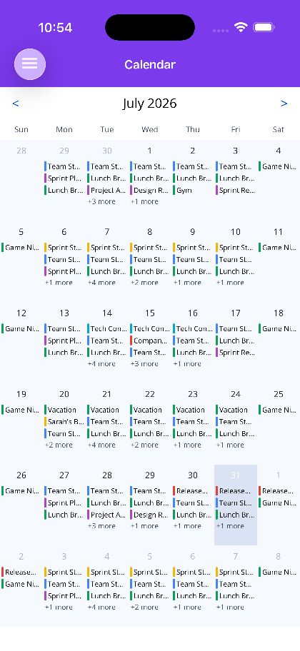
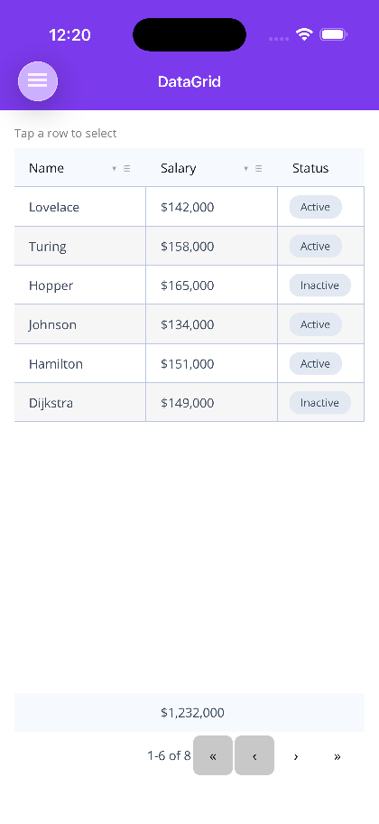







SECTION 05 · UI CONTROLS
67 controls, two hosts, one theme contract
Native .NET MAUI and Blazor components out of the same design system.
Flagship
TableView · Scheduler · ChatView · DataGrid · ImageEditor · CameraView
Office
Spreadsheet · Document & Slide viewers and editors · Notebook
Collections & Grids
DataGrid · TreeDataGrid · VirtualizedGrid · StaggeredGrid · Carousel
Layout & Overlays
AppLayout · Flyout · Modal · Sheet · Wizard · Timeline · Ribbon · FAB
Input
TextEntry · AutoComplete · Pickers · Sliders · SecurityPin · SignaturePad
Display & Media
CameraView · MediaElement · Markdown · Mermaid · Barcodes · Keyframe
Status & Feedback
Toast · Dialogs · Progress · Skeleton · Splash · Badge · Feedback
Desktop
Tray icon · Docking · File drop · On-screen keyboard
Theming — a shared token contract with Basic, Ocean, Material, Terminal and Aurora packs, plus a Theme Creator.
Notes:
One package per host — Shiny.Controls.Maui and Shiny.Controls.Blazor — but one design system and one set of theme tokens across both. Nothing is a WebView wrapper: the MAUI controls are native handlers, the Blazor ones are real components. The screenshots here are the same Scheduler and DataGrid rendered on iOS.

Slide 20
SECTION 05 · OFFICE DOCUMENTS
Open, render and edit real Office files
A virtualized SkiaSharp surface shared verbatim by both hosts, over a document kernel with a transactional undo stack and a formula engine. Edits are surgical on the OOXML — an untouched file saves byte-identical.
Spreadsheet
Document Viewer
Slide Viewer
Real .xlsx with a formula engine, virtualized rendering and cell-level editing.
Render .docx faithfully on MAUI and Blazor from the same kernel.
Render .pptx decks, slide by slide, with the shared drawing surface.
Document Editor
Slide Editor
Notebook
Edit .docx with a transactional undo stack and surgical OOXML writes.
Author and edit .pptx slides on the same document kernel.
A OneNote-style unbounded page you write anywhere on, with a pressure-sensitive pen.
Notes:
This is not an Office interop wrapper and it does not shell out to anything — it is a document kernel plus a SkiaSharp rendering surface, so it works offline, on device, on every target. The byte-identical round-trip matters for regulated workflows: opening a file and saving it without edits does not rewrite the OOXML.

Slide 21
Document DB across 11 backends
Spatial queries and bidirectional sync
SECTION 06
An embeddable HTTP/1.1, 2 & 3 server
Data, Server & Cloud
Tunnelling, gRPC, MCP and WebDAV
Lightweight data libraries that run everywhere .NET does — and server-side .NET that runs inside a phone.
Backend push and .NET Aspire
Notes:
Section six. This is where the suite stops being a mobile story — the same libraries run in the services behind the app.

Slide 22



SECTION 06 · DATA & STORAGE
No ORM, no overhead
AOT-compatible data libraries that run everywhere .NET does.
Document DB
Spatial
Store and query .NET objects as JSON documents — full CRUD, LINQ-style querying, projections, aggregates, composite JSON indexes and transactions.
A dependency-free spatial database on SQLite R*Tree indexing with custom geometry algorithms. Ship pre-built datasets or build your own geospatial queries.
Vector / ANN search with auto-embed
Temporal history & point-in-time reads
Data Sync
Orleans grain persistence & reminders
Spatial and geo queries
Bidirectional JSON record sync — a persistent outbox, cursor-based inbox deltas, coalesced batching, tombstones, conflict resolution and platform-tier transports.
Multi-tenancy & global query filters
Change feeds and AI tool integration
Full AOT and trimming support.
Stores
A cross-platform key/value abstraction over Preferences, Secure Storage and Local/Session Storage.
Notes:
Document DB is the flagship here: a JSON document store with one API over eleven backends, so the same model and query code runs against SQLite on a phone and PostgreSQL on a server. Data Sync sits on top for offline-first apps — outbox, inbox, conflict resolution — using each platform's real background transport.

Slide 23
SECTION 06 · DOCUMENT DB
One API, eleven backends
The same documents, queries and indexes whether they live on a phone, in a browser tab or in a managed cluster.
SQLite
SQLCipher
LiteDB
IndexedDB
Embedded, everywhere
Encrypted at rest
Pure .NET, embedded
Blazor WebAssembly
DuckDB
CosmosDB
MongoDB
SQL Server
Analytics & vss vectors
Azure, DiskANN vectors
Atlas vector search
2025 native vectors
PostgreSQL
MySQL
Oracle
Same code on all of them
pgvector
Managed or self-hosted
Enterprise estates
Vector / ANN search across pgvector, SQL Server 2025, Cosmos DiskANN, Mongo Atlas, DuckDB vss and sqlite-vec — with LLM-callable tool functions, structured filters and auto-embed on insert through Microsoft.Extensions.AI.
Notes:
The practical value is migration and tiering: prototype on SQLite, move to PostgreSQL or Cosmos without rewriting data access, or run SQLite on device and the same schema on the server. Vector search is provider-native where the backend supports it, rather than a bolt-on index Shiny maintains itself.

Slide 24
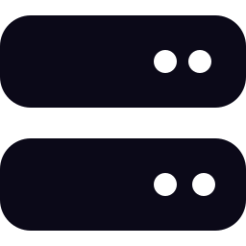


SECTION 06 · SERVER & CLOUD
A web server that fits inside a phone app
ASP.NET Core is heavyweight and does not run on .NET MAUI. This does.
HTTP Server
Tunnelling
Reach a server embedded in a phone app from the internet — SSH remote forwarding, zero-account quick tunnels, or Azure Relay.
A dependency-light, fully AOT/trim-clean HTTP/1.1, HTTP/2 and HTTP/3 server. Nothing is discovered by reflection, so a route that cannot bind fails your build rather than your deployment.
Protocol add-ons
Routing & middleware
DI scopes
gRPC & gRPC-Web, Model Context Protocol and WebDAV — plus Mediator handlers and DocumentDb types as endpoints.
Typed endpoints
Static files
Web & Blazor Hosting
WebSockets
Server-Sent Events
ASP.NET infrastructure modules for common server-side patterns, and the Blazor equivalent.
Sessions & OpenAPI
CORS, rate limiting, IP filters
Runs on MAUI, desktop, server and container alike.
Push (Server)
Send to APNs (.p8/ES256), FCM and Web Push (VAPID) through one API — targeting, topics and dead-token pruning.
Notes:
The HTTP server is the most surprising library in the suite. It is a real HTTP/1.1, HTTP/2 and HTTP/3 stack small enough to embed in a MAUI app — used for on-device APIs, local device pairing, MCP servers and offline-first sync endpoints. Because endpoints are generated at compile time, an unbindable route is a build error.

Slide 25

SECTION 06 · .NET ASPIRE
First-class Aspire integrations
Model the awkward parts of a distributed app as ordinary Aspire resources.
Orleans
Gluetun VPN
Tunnelling
Simplified Orleans hosting — streamlined AppHost configuration, Silo setup and client wiring. A fully orchestrated cluster in minimal code, with Document DB available as grain storage, reminders, clustering and grain directory.
Model a Gluetun VPN container as a first-class Aspire resource, then route other containers through the tunnel with a single method call — with full Docker Compose publish support.
Give a project or container a public address for webhooks, OAuth redirects and demos — quick tunnels with no account, SSH, the Shiny relay, Azure Relay, Cloudflare or ngrok, surfaced as a connection string.
The same Shiny libraries your mobile app uses — Mediator contracts, Document DB, serialization — run unchanged in the services behind it.
Notes:
These are quality-of-life integrations for teams already on Aspire. The tunnelling one solves a daily annoyance — getting a webhook or OAuth redirect back to a local machine — and the URL arrives as an ordinary connection string, so nothing downstream knows it is a tunnel.

Slide 26

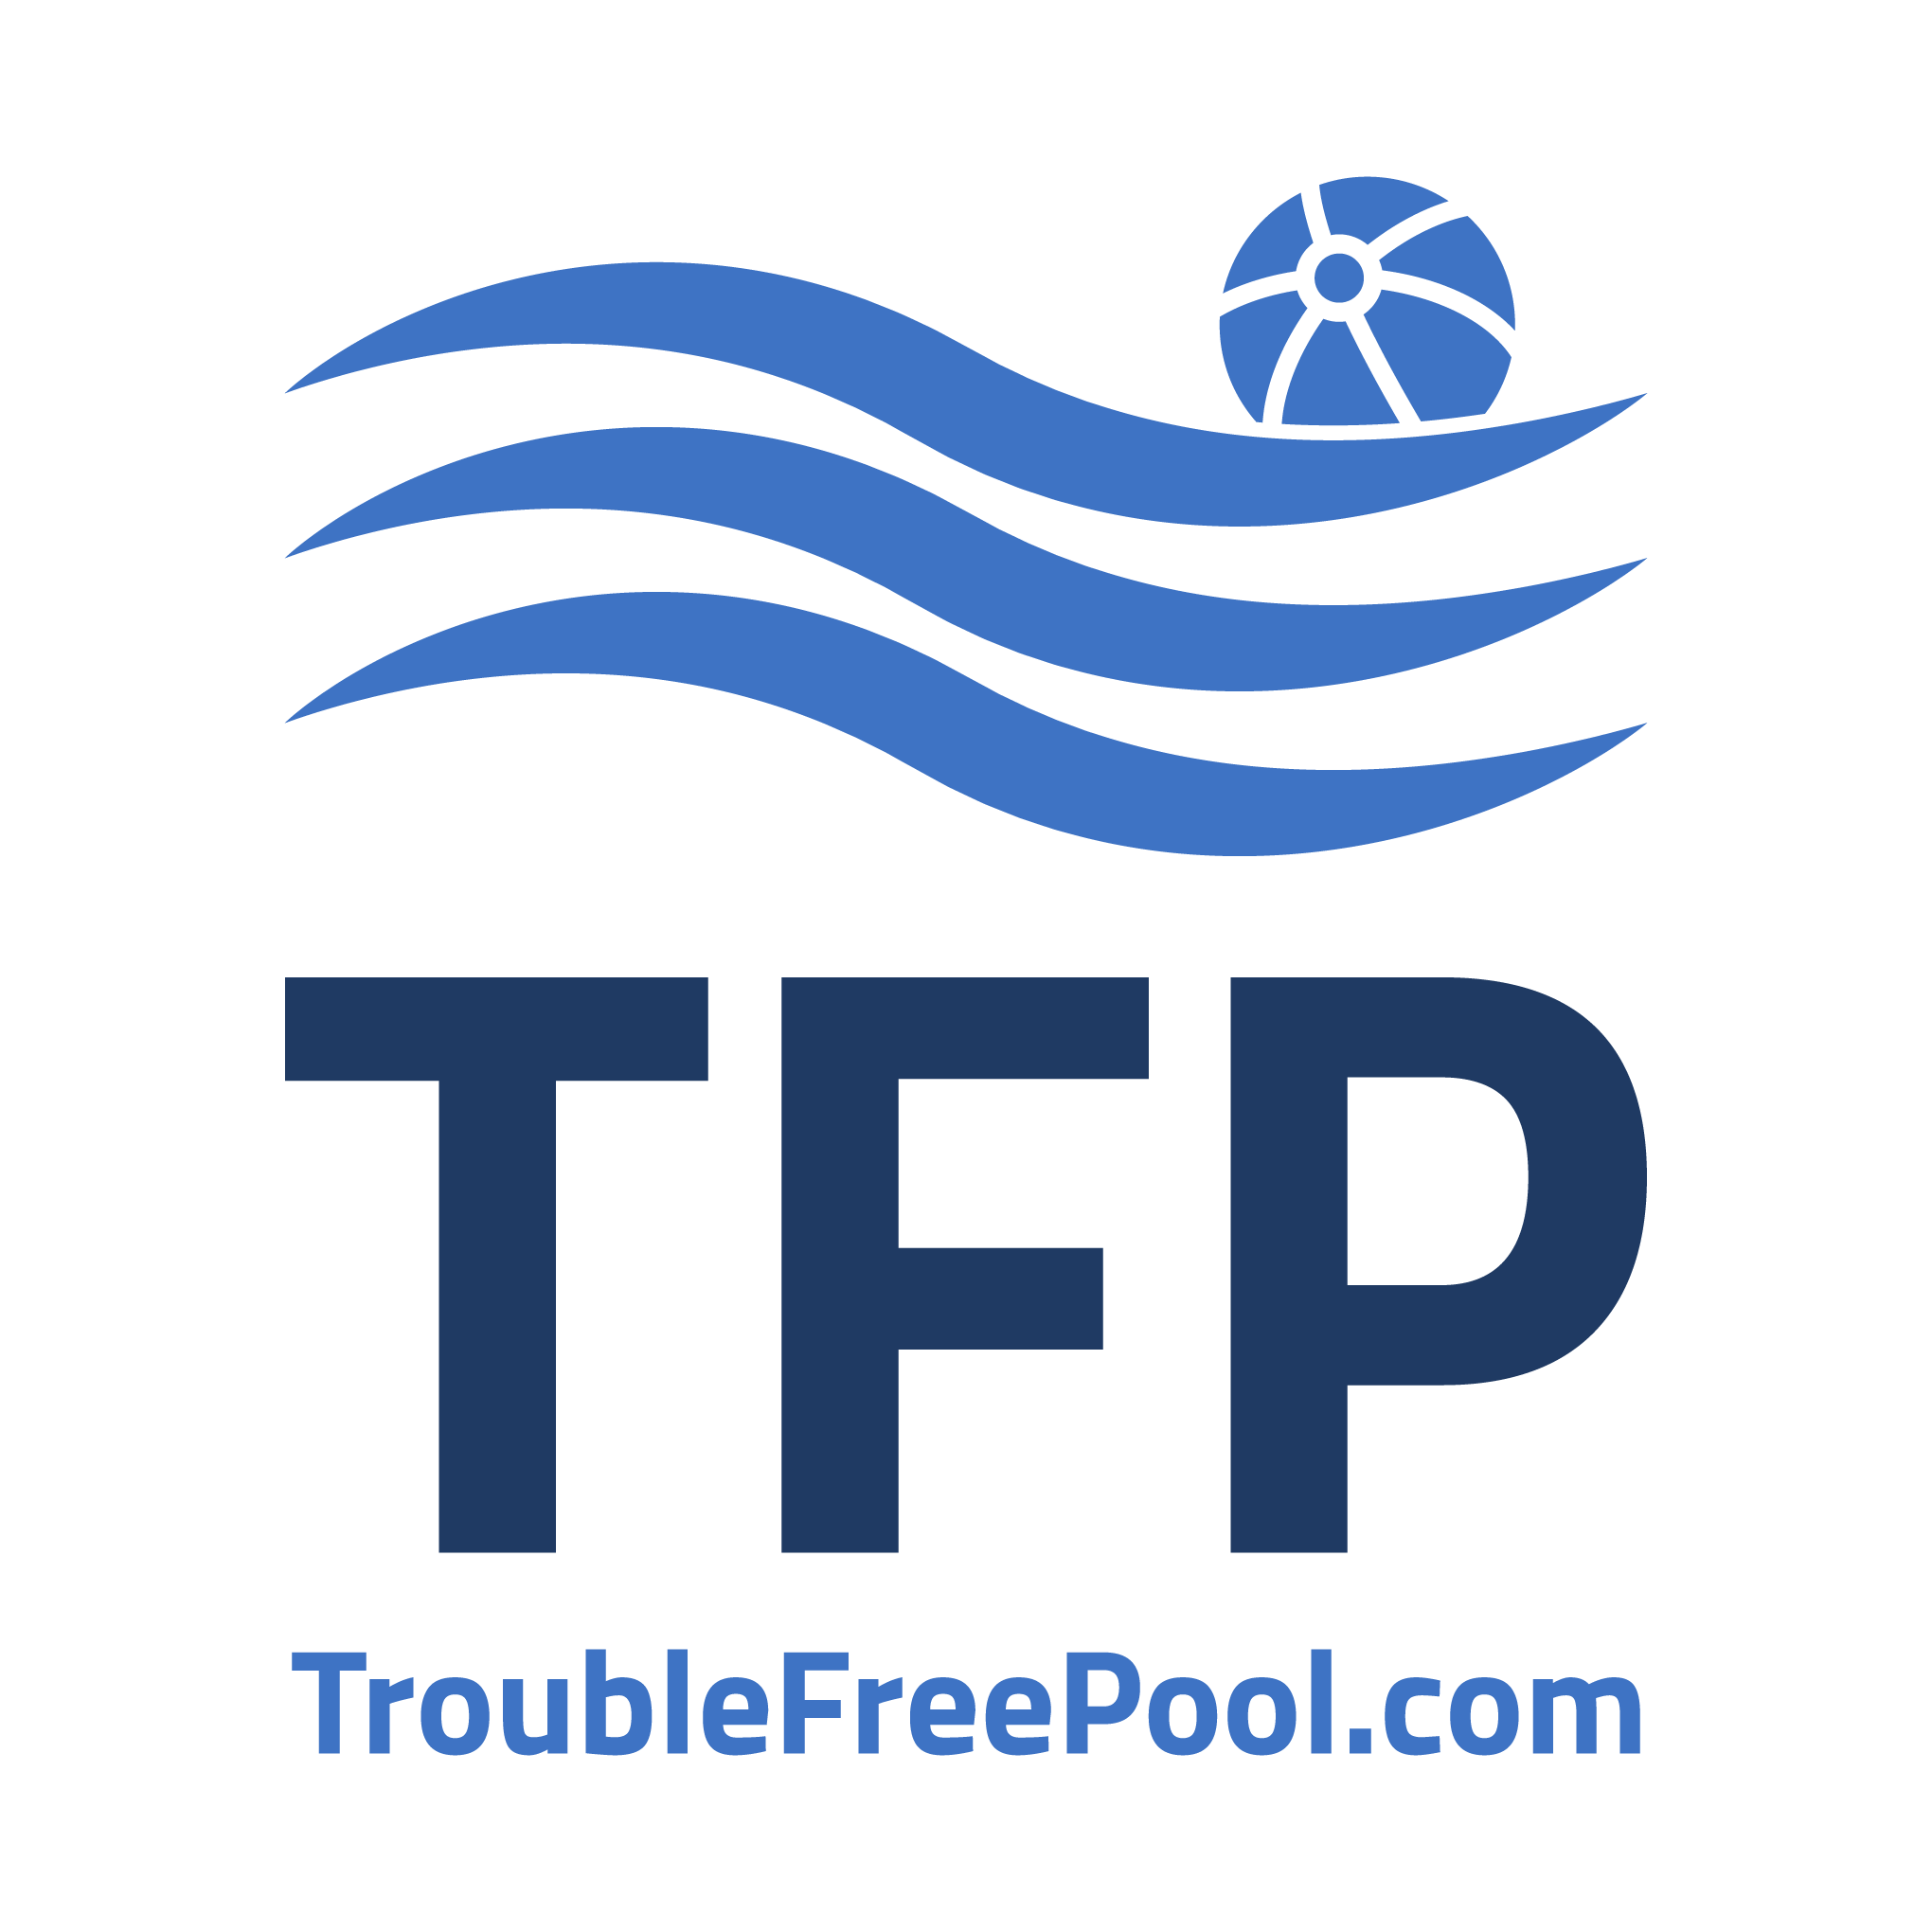

TRUSTED IN PRODUCTION
Shipping in real apps, for years
Three of the teams building products on Shiny today.
Boat launch scheduling for drystack marinas — iOS, Android and web since 2016
Pool care for hundreds of thousands of pool owners
Cellular trail cameras, feeders and land management tools
“Shiny isn’t just a tool for SpeedyDock; it’s a cornerstone of our mobile app development.”
“If you’re building a .NET MAUI app and you’re not using Shiny, you’re making your life harder than it needs to be.”
“What would have been months of platform-specific work across iOS and Android gets reduced to clean, shared code we can build on with confidence.”
Travis Wolfe · CEO, SpeedyDock
Jonathan Dick · CEO PoolMath, Principal Manager, Microsoft .NET MAUI
Tommy Baggett · Principal Software Architect, Moultrie
40M+ NuGet downloads and counting — built and maintained by ShinySoft Technologies, the consulting shop that ships on it.
Notes:
Worth naming the maintenance story: Shiny is the open-source foundation of ShinySoft's consulting work, so the people who maintain the libraries also ship production apps on them. Bugs get fixed by the maintainer rather than filed into a queue.

Slide 27
GET STARTED
Pick a library.
Or take the whole suite.
App Builder
Pick your libraries; get the packages, hosting call and registrations generated for you.
Shiny.Templates
Every package is independent, MIT-licensed and on NuGet. Start with the App Builder to generate a project, or drop a single library into the app you already have.
dotnet new templates for MAUI, ASP.NET and Blazor projects, pre-wired.
AI Skills
Install the skill for each library so Claude Code or Copilot writes it correctly.
shinylib.net
Full documentation, samples, release notes and the interactive control gallery.
shinylib.net · github.com/shinyorg · shinysoft.biz
Notes:
Close on the low-commitment path: the App Builder produces a working configuration in a couple of minutes, and every library is a separate package so trying one costs nothing. The AI skills are the fastest way for a team already using Claude Code or Copilot to get idiomatic Shiny code from day one.

Slide 28
BRAND
The palette
Three hues, in three variants. The pastels come straight off the logo; the vivid variants hold their colour where the pastels wash out, and brighten again on dark.
Logo
Vivid — on light
Vivid — on dark
Straight off the mark
Saturated for contrast
What this deck draws with
Purple
Purple Vivid
Purple Vivid
#9A81EA --shiny-purple
#6A3DF0 --shiny-purple-vivid
#9B7BFF --shiny-purple-vivid
Green
Green Vivid
Green Vivid
#91F5AD --shiny-green
#0FBF7A --shiny-green-vivid
#2BE5A0 --shiny-green-vivid
Lime
Lime Vivid
Lime Vivid
#CFFA12 --shiny-lime
#A6D900 --shiny-lime-vivid
#CFFA12 --shiny-lime-vivid
Surfaces & type — the dark canvas this deck and the social card share
Ink
Card
Card raised
Hairline
Deep
Muted
#0B0918
#19143C
#221A52
#2E2665
#2A1580
#AFA8CE
Slide / card ground
Panel on ink
Lifted panel
Borders
Section divider ground
Body copy on ink
Defined as CSS custom properties in src/styles/custom.css — the vivid tokens swap value between light and dark, so everything built on them follows the theme automatically.
Notes:
The three logo hues are the whole palette. The pastels are the literal logo colours but they wash out on white, so every accent on the site uses the vivid variants instead. Those are defined as CSS variables that change value between light and dark mode, which is why one rule covers both themes.

Slide 29





BRAND
The gradients
Purple to green to lime, at a handful of fixed angles. The three-stop ramp is the signature — it runs under the header, through the wordmark and across the social card.
Brand ramp
110°
#9B7BFF → #2BE5A0 55% → #CFFA12
Site title, header underline, hero headline, social card rule
Headline ramp
96°
#9B7BFF → #2BE5A0 62% → #CFFA12
Social-card headline ("already solved.")
Menu button
118°
#7C4DFF → #2BE5A0
Mobile menu button (dark); 6A3DF0 → 0FBF7A on light
Primary CTA
112°
#6A3DF0 → #0FBF7A 78% → #A6D900
Primary buttons
Purple → lime
135°
#9B7BFF → #CFFA12
App Builder quick-nav tile
PowerPoint cannot fill text with a three-stop gradient, so the ramp is rasterized to PNG at build time and placed as art — which is why it matches the site exactly.
Notes:
The three-stop ramp is the one people recognise. Angle matters — 110 degrees for the site title and header, 96 for the social card headline. The two-stop variants are for smaller surfaces where a third stop would read as mud at that size.

Slide 30
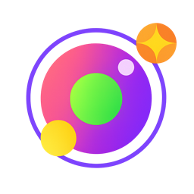



BRAND
The marks
The Shiny mark, and the ShinySoft lockups behind it. Dark artwork sits on a white plate; the rest goes straight onto ink.
Shiny mark
ShinySoft mark
ShinySoft lockup
ShinySoft lockup — dark
logo.svg · logo-mark.png
shinysoft-mark.png
shinysoft-logo-light.png
shinysoft-logo-dark.png
Primary. Use the SVG on the web; the PNG everywhere else.
The company behind Shiny, without the wordmark.
Full wordmark. Dark artwork — for light grounds.
Full wordmark, reversed out for dark grounds.
logo.mp4 is the animated mark used on the site. logo.svg is the vector source, but only browsers render its gradients correctly — use logo-mark.png anywhere else.
Notes:
Two brands sit side by side. Shiny is the open-source library suite; ShinySoft Technologies is the consulting company that builds and maintains it. Use the Shiny mark for the libraries and the ShinySoft lockup when the company is the subject.

Slide 31
BRAND
The words
One headline, one lede, and the short lines that carry the rest.
HEADLINE
LEDE
The hard parts of your app,
Everything the platform makes hard: Bluetooth, background jobs, push, location, a document database, speech and AI, an HTTP server that runs inside your MAUI app, 67 UI controls, and plenty more.
The second half carries the brand ramp — always. Never set the whole line in gradient, and never set it flat.
Thirty-plus libraries that own the platform code, the permissions and the background execution — so your time goes to the app your users actually asked for.
SHORT LINES
.NET libraries for mobile, desktop, web & server
Positioning line — social card eyebrow
From back end to front end
Homepage platform rail
Free & open source
Social card pill
MIT licensed
Social card footer
A suite of powerful .NET libraries for mobile, desktop, and server applications
Meta description
shinylib.net · built and maintained by ShinySoft Technologies
Deck footer
Notes:
The lede is deliberately open-ended — it names examples, not the catalogue, so it does not go stale every time a library ships. Keep it that way when you rewrite it. The headline is fixed: the first half plain, the second half in the gradient.

