Slide 1

Music Decade Prediction
Shahriar Hooshmand, Shiny Patel, Joel Pepper

Slide 2


Background
Music data mining becoming increasingly more prevalent due to companies such as Spotify and Shazam
Waveforms can be segmented into numerous features such as pitch, tempo and loudness, as well as contrived metrics like “danceability” and “energy”
Machine learning analysis of these features is of great interest to the industry for determining things like target market demographics and suggested songs lists
http://static.echonest.com/enspex/images/logo.png
http://static.echonest.com/enspex/images/spotify.png

Slide 3
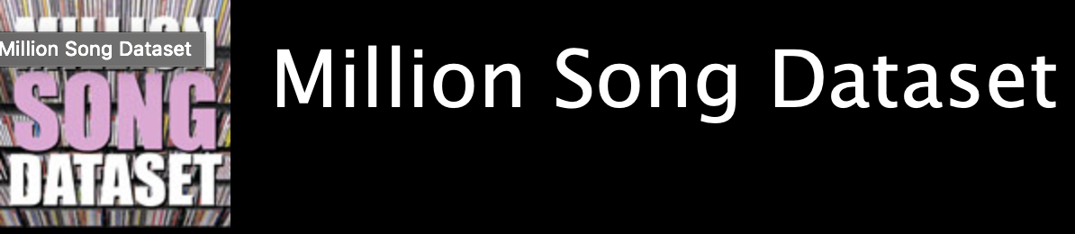
Dataset
Columbia’s Labrosa laboratory maintains software to segment audio as well as a premade dataset of 1 million entries with the following features of interest:
Bar and beat starts, danceability, energy, key, loudness, section starts, timbre, tatums and tempo
Also includes metadata such as artist, song title and year
Many features are arrays of values in temporal space, makes direct analysis somewhat difficult
Code for generating dataset has lost functionality (6-8 year old code, many of API’s used have gone defunct)
Could rewrite to use updated API’s, but would be non trivial
*https://labrosa.ee.columbia.edu/millionsong/

Slide 4
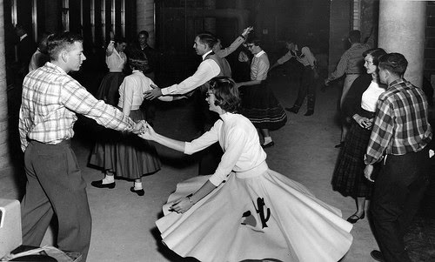


Problem Formulation
Our project focused on the classification of songs by the decade in which they were released
Split classes up by decade, as performing classification by discrete years unsurprisingly warranted very poor results
10 classes, 1920’s – 2010’s
515345 songs within the Million Song DB have years associated with them
https://www.timeoutdubai.com/sites/default/files/tod/styles/full_img/public/images/2018/01/09/2017_Moes_on_the_5th_dubai_base_1.jpg?itok=TyeLFSy3
https://sites.google.com/site/50sflashback/_/rsrc/1353371375812/home/events/sock-hops---haley-shearer/sock%20hop.jpg

Slide 5
Overall Methodology
Did cross validation and feature selection with multiple types of classifiers
Used the following types of classifiers as implemented by the sklearn python library:
Neural network
Adaboost with decision stumps
Multiclass SVM
Since many of the features were variable length arrays, we took the mean squared displacement of their values
Used GridSearchCV from sklearn to optimize metaparameters such as loss type, number of classifiers and learning rate

Slide 6
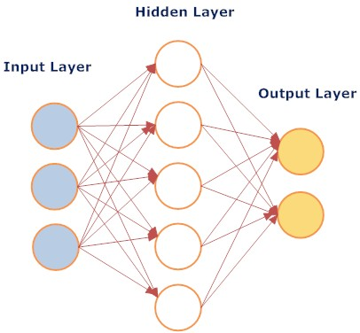
Neural Network Analysis
Stochastic gradient based optimizer
by Kingma et.al
Tolerance for optimization: 1e-4
Activation : Logistic sigmoid
Parameter Tuning:
Number of layers and nodes
L2 regularization term
Learning rate
Criterions:
Number of Epochs
Training error
Cross-validation error
Schematic of NN

Slide 7
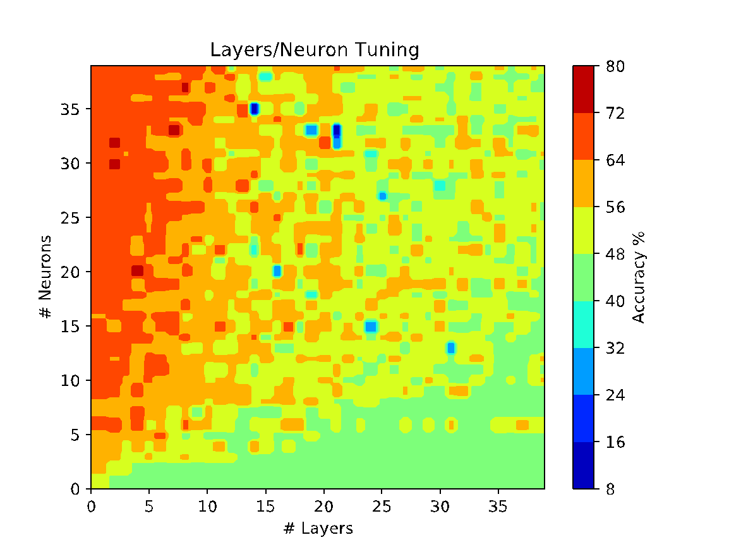
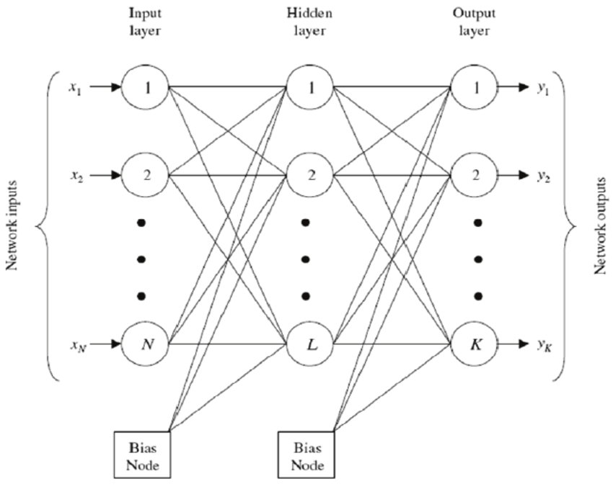
Parameter Tuning: Layers and Nodes
Dataset size: 515,345
Toy Dataset for PT: 500
Optimum parameters:
2 layers with 39 neurons
1-40 Nodes
1-40 Layers

Slide 8
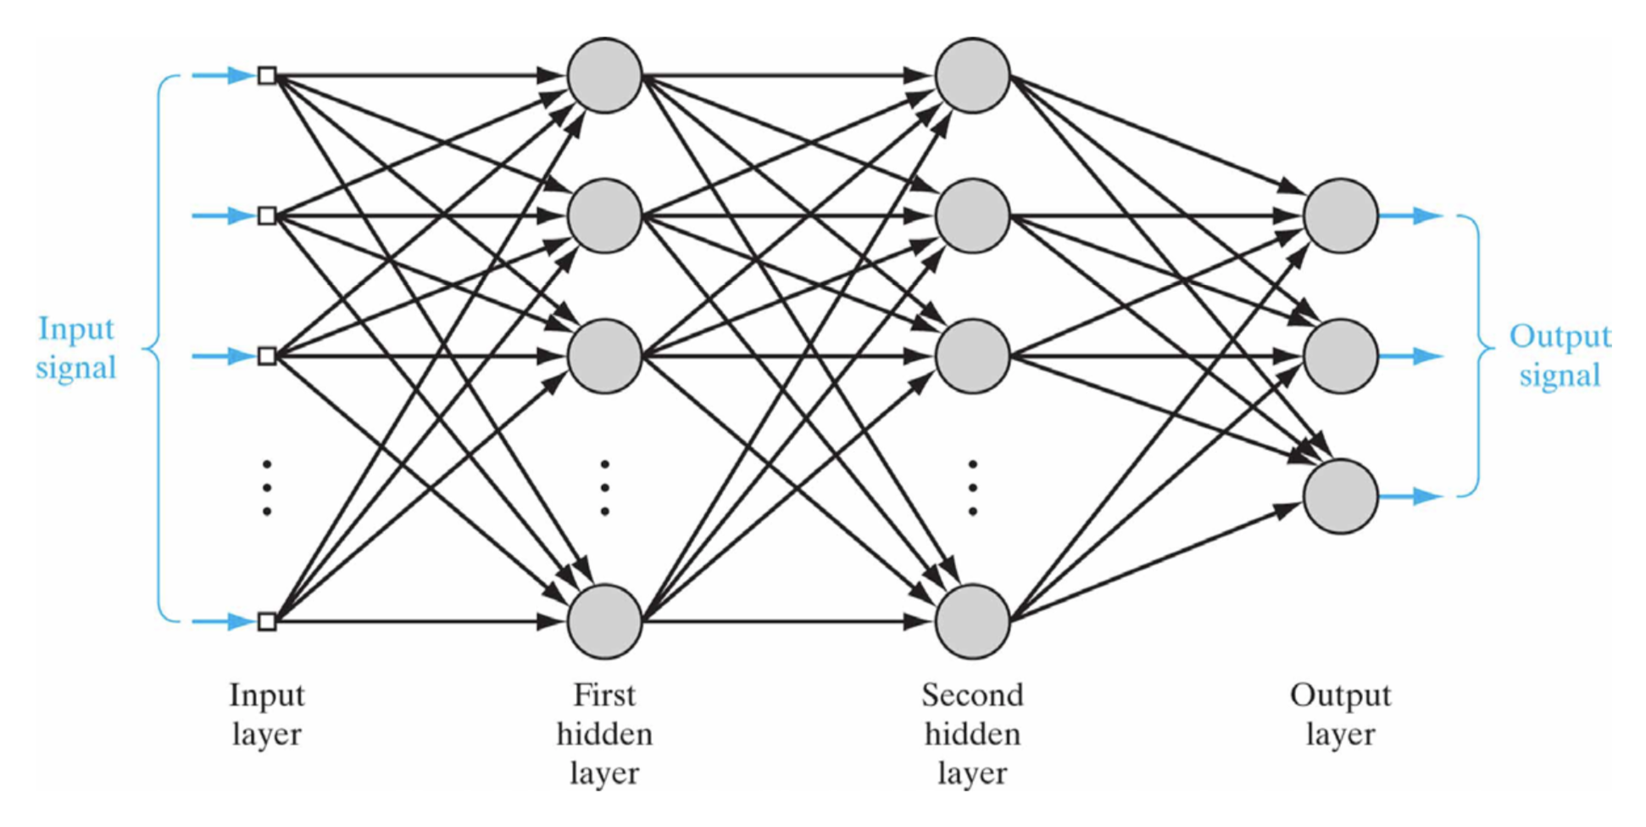
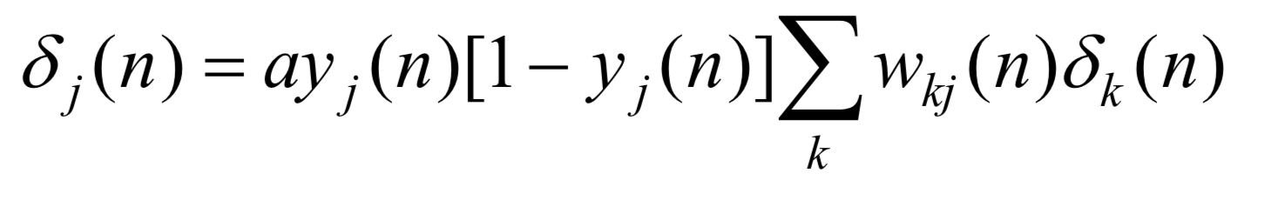
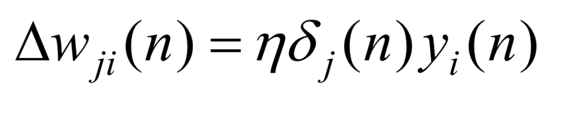
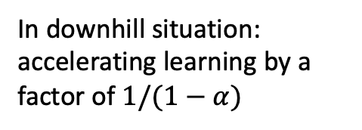
Parameter Tuning: Learning Rate and Momentum
Back propagation Algorithm
Helps ease of oscillating weights due to large learning rate
Back-prop gradient
Weight update
Gradient descent hyperparameter
Momentum
Weight update (previous time step)
Weight update (current)
Courtesy to Prof. Deliang Wang and Prof. Jeremy Morris

Slide 9
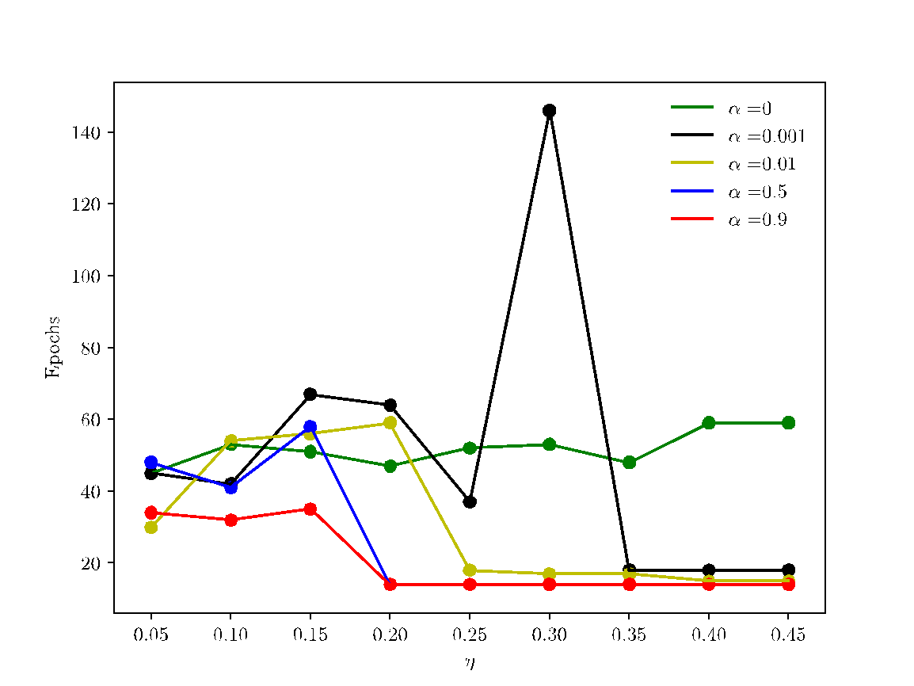
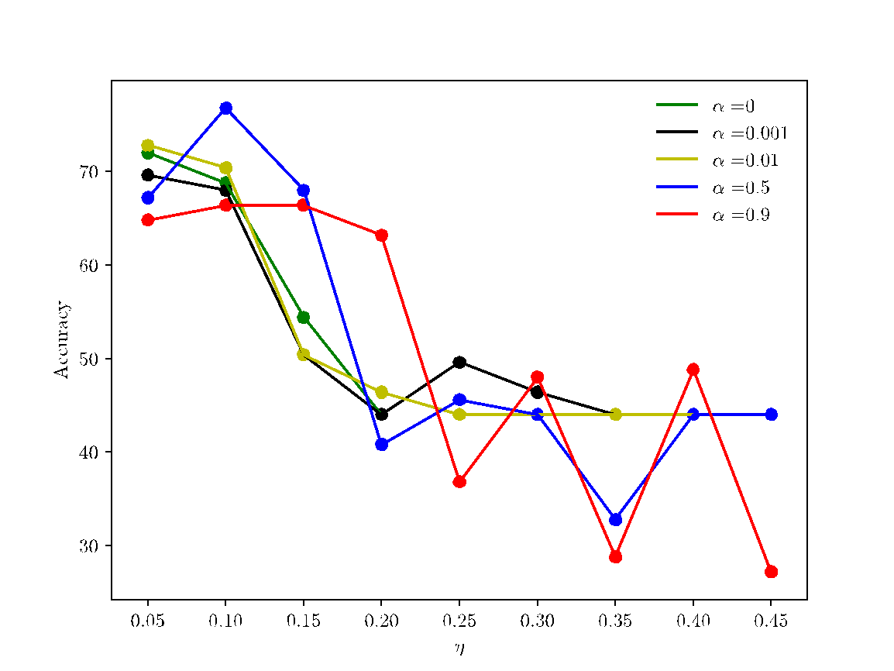
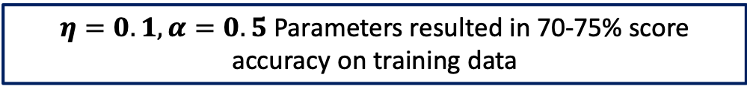
Parameter Tuning
Optimizing over Epochs
Optimizing over training accuracy

Slide 10
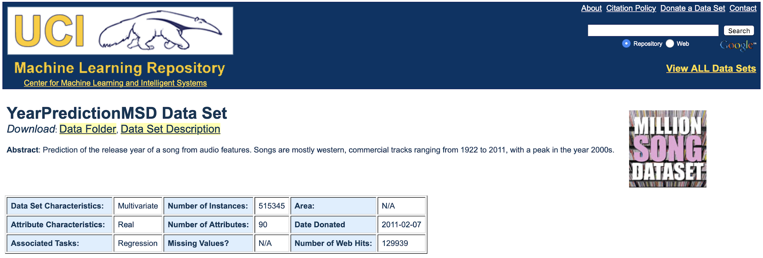


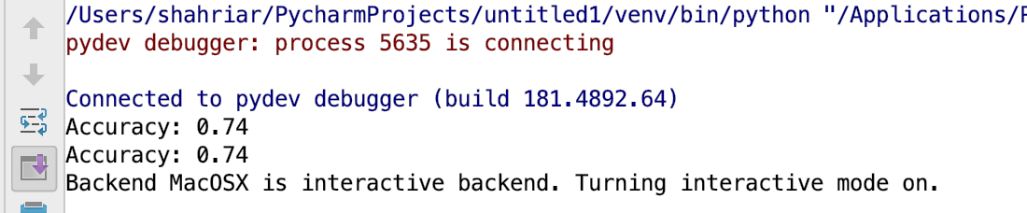
Model Accuracy
Cross-validating settings: Train on 75% of data and test on 25% unseen data
2 Layer with 39 Neurons in each and learning rate of 0.1 with regularization parameter of 0.5
With the accuracy of 74%, the decade of each song can be predicted

Slide 11
SVM
Design choices
Dataset size: 515345 songs
UCI recommended splits (to avoid producer effect)
Training set: first 463715 songs
Validation set (for parameter tuning): subset of training set (500 songs)
Test set: last 51630 songs
SVM: Linear SVC
implements 1 vs rest; preferred over 1 vs 1
similar results for significant less running time

Slide 12
SVM Parameter-Tuning
C: powers of 2 in range [-4, 8)
Max iterations: 1e6
Scoring metric: accuracy
k: 3
Squared hinge loss (primal) vs hinge loss (dual)
 | -4 | -3 | -2 | -1 | 0 | 1 | 2 | 3 | 4 | 5 | 6 | 7
loss=sq_hinge dual=False | .42 | .42 | .44 | .45 | .44 | .44 | .44 | .44 | .44 | .44 | .44 | .44
loss=hinge dual=True | .38 | .37 | .41 | .41 | .42 | .42 | .42 | .42 | .42 | .43 | .43 | .43

Slide 13
SVM Detailed Classification Report
Accuracy (on entire test data): 56%
Total running time: ~8 min
 | precision | recall | f1-score | support
1920 | 0.02 | 0.65 | 0.05 | 20
1930 | 0.01 | 0.54 | 0.02 | 13
1940 | 0.02 | 0.49 | 0.05 | 61
1950 | 0.05 | 0.45 | 0.09 | 275
1960 | 0.16 | 0.35 | 0.22 | 1166
1970 | 0.26 | 0.35 | 0.30 | 2396
1980 | 0.36 | 0.44 | 0.40 | 4201
1990 | 0.51 | 0.11 | 0.18 | 12580
2000 | 0.73 | 0.81 | 0.77 | 29885
2010 | 0.00 | 0.00 | 0.00 | 1033

Slide 14
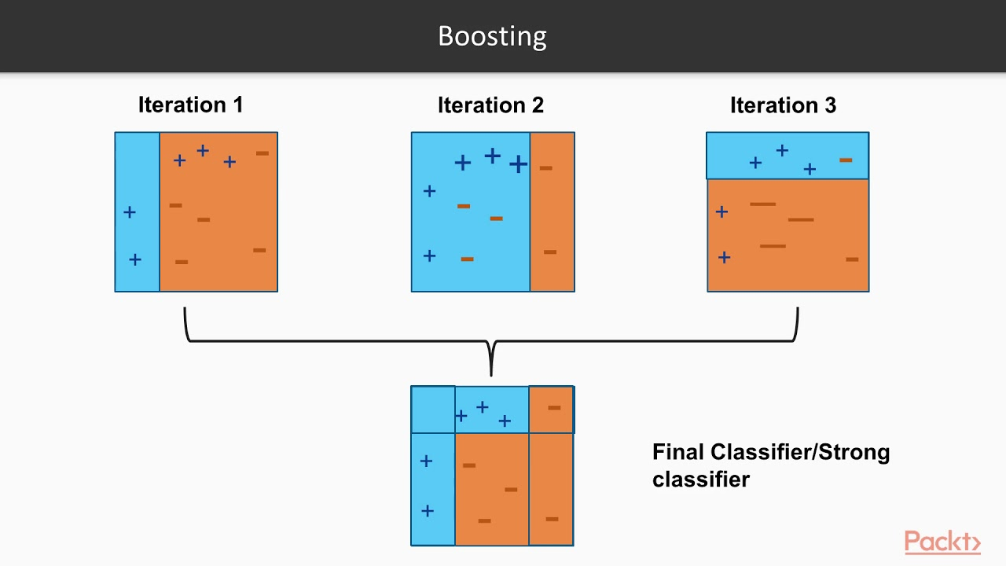
Adaboost
Same design setup as SVM
Results entirely dependent (within 1% accuracy) of the data split, not the number of estimators when doing 500 sample cross validation
Tested with 10, 50, 100, 300, 500 and 1000 classifiers to confirm this
Results ranged from 25% to 62% preliminarily, and were consistently ~40% on larger testing dataset
Classifiers trained on the same data split always resulted in the same classification accuracy
https://i.ytimg.com/vi/BoGNyWW9-mE/maxresdefault.jpg

Slide 15
Results Summary
Feature selection did not significantly improve accuracy
Accuracy of NN (~74%) > SVM (~56%) > Adaboost (~40%)
Best overall accuracy: 74% (NN)
2 hidden layers with 39 neurons per layer

Slide 16
What we learned
Dealing with actual giant databases
Interpreting the available datasets and make the bridge to translate the data to array inputs
Learned how to work with available packages: Scikit
Temporal data is very difficult to work with using the tools covered in class
Recurrent networks that can operate in the time domain would give better results than MSD; future direction

Slide 17
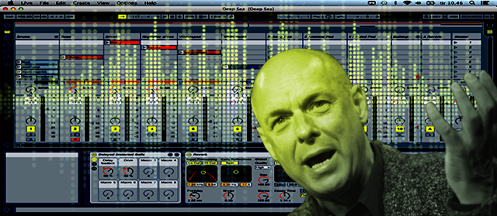
Questions? No Time For Questions.

