Slide 1
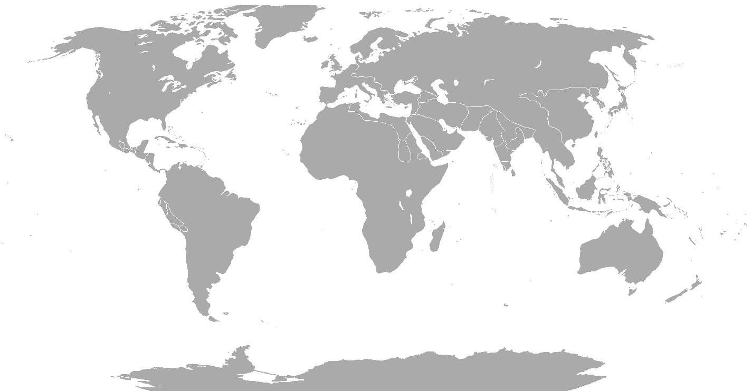
SMK prepares cabinet meetings
CoGs* prepare cabinet meetings? YES, NO or SHARED WITH OTHER BODY
OECD country map:
IS
NO
SE
FI
IE
GB
DK
EE
CA
BE
NL
DE
PO
LV
US
KR
JP
PT
FR
LU
CH
CZ
SK
MX
ES
AT
SI
HU
TR
IT
GR
IL
Disclaimer: Map have been manipulated.
CL
AU
NZ
* Centre of Government: Prime minister's office / Cabinet office…
Source: 2013 OECD Survey on the Organization and Functions of the Centre of Government
FUNf(a)CT
support@funfact.eu • TEL +47 98078172 • www.funfact.eu • Copyright © Funfact AS. All right Reserved. Refer to last page

Slide 2
IS
NO
SE
FI
IE
GB
DK
EE
CA
BE
NL
DE
PO
LV
US
KR
JP
PT
FR
LU
CH
CZ
SK
MX
ES
AT
SI
HU
TR
IT
GR
IL
CL
AU
NZ

Slide 3
IS
NO
SE
FI
IE
GB
DK
EE
CA
BE
NL
DE
PO
LV
US
KR
JP
PT
FR
LU
CH
CZ
SK
MX
ES
AT
SI
HU
TR
IT
GR
IL
CL
AU
NZ

