Slide 1
Mini-Project 3 Deceptive Digit Images
郭柏言
劉建亨
曾皓晨

Slide 2
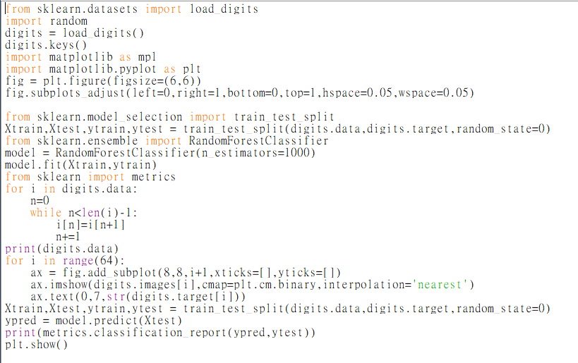
Reference Code

Slide 3
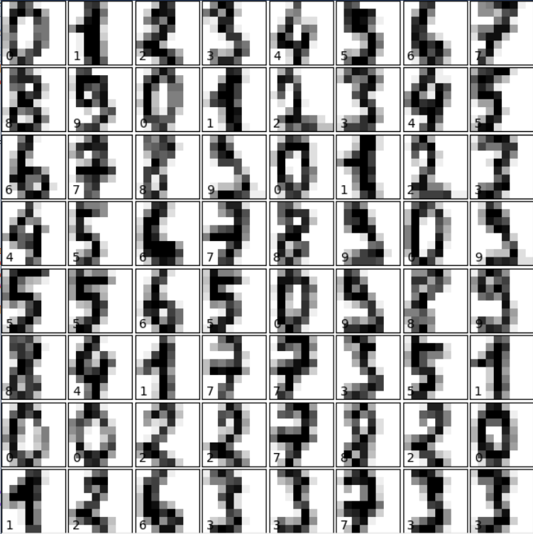
Modified Numbers -hoped to be identifiable

Slide 4
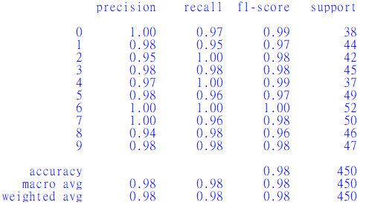
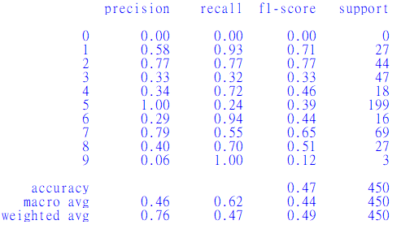
Before after

Slide 5
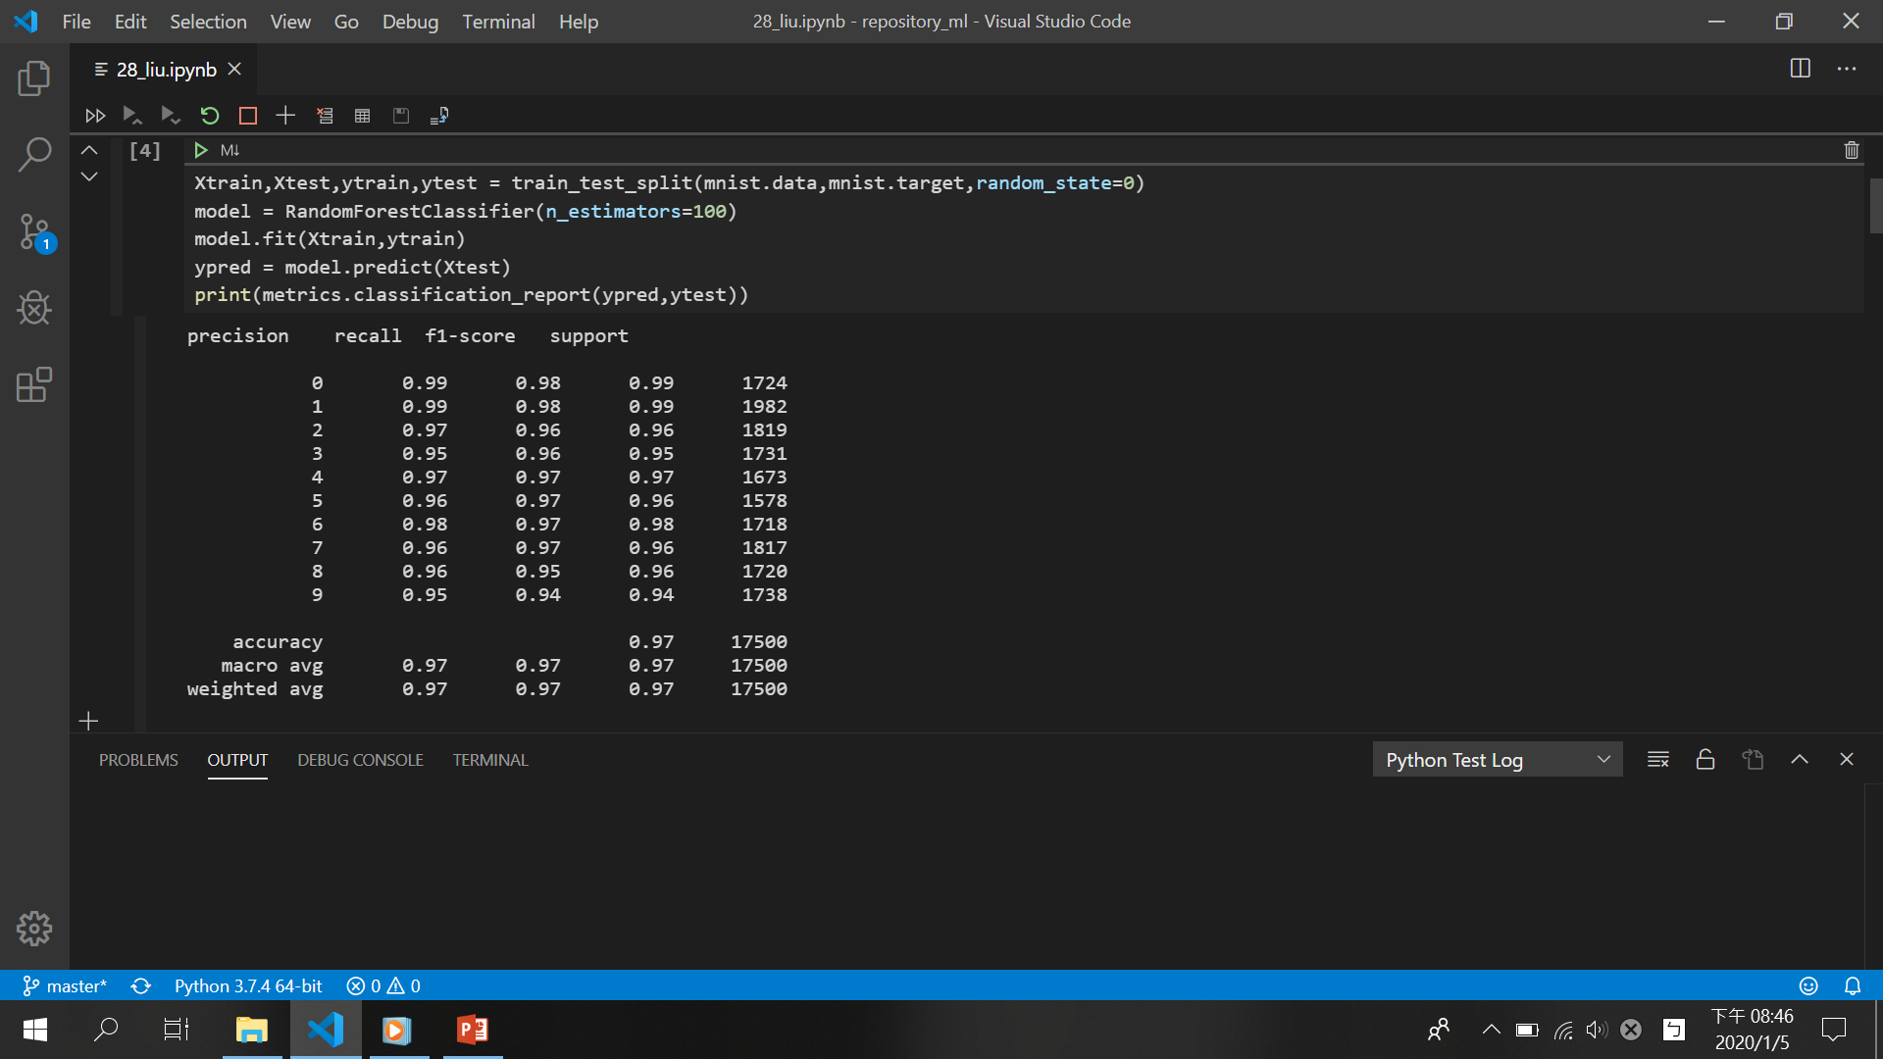

Slide 6
def test_1(n,pic):
pic[n]=0 #blackspot
return pic
test_lis,correctness=test_f(test_1,done=50)
def test_2(n,pic):
pic[n]=int(random.randint(500,1500)*pic[n]/1000) #color change
return pic
test_lis,correctness=test_f(test_2,1,done=25)
def test_3(n,pic):
cross=[n+1,n-1,n+28,n-28,n+29,n-29,n+27,n-27,n+2,n-2,n+56,n-56]
#big black spot
for ele in cross:
try:
pic[ele]=pic[n]
except:
continue
return pic
test_lis,correctness=test_f(test_3,1,start=50,done=51)

Slide 7
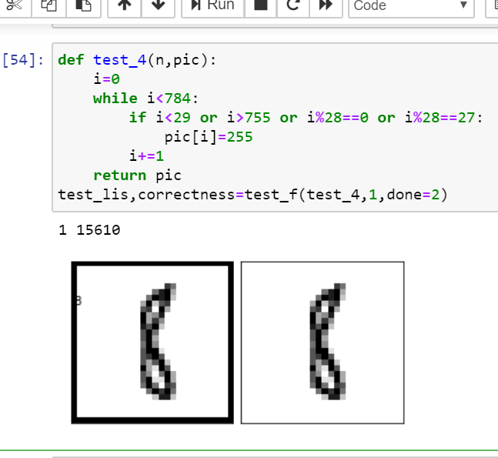
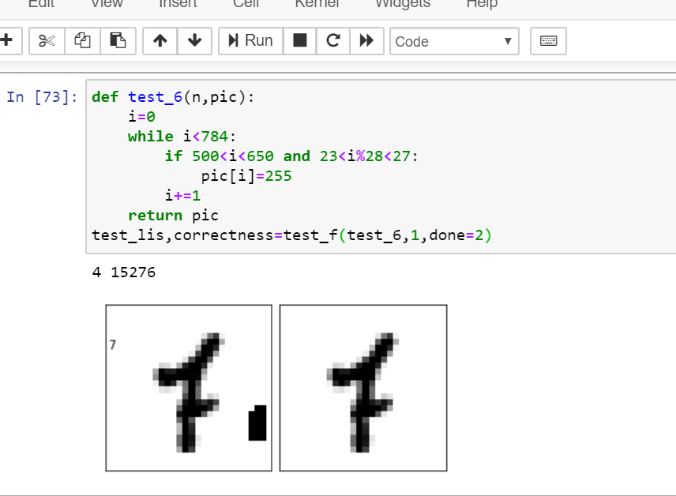

Slide 8
These are all useless!!!!!!!!!!!!!!!!!!

Slide 9
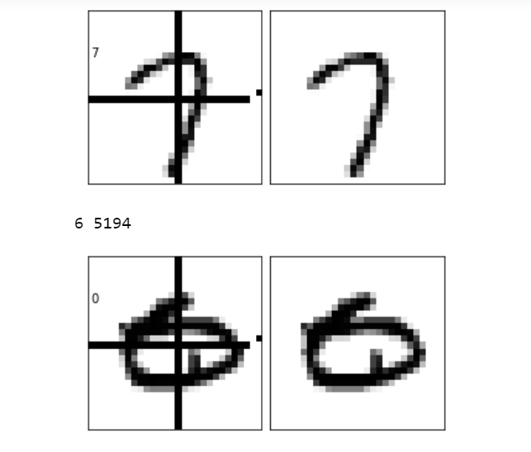
def test_5(n,pic):
i=0
while i<784:
if 390<i<418 or i%28==14:
pic[i]=255
i+=1
return pic
test_lis,correctness=test_f(test_5,1,done=2)
#3% get right to wrong

Slide 10
Problem encountered
Run for too much time → .ipynb
Still run for too much time → don’t start from 1 and done at 784
It still runs for too much time → do SCLD lab at the same time

