Slide 1





Gateway IP
Public IP
Gateway IP
Private IP
Private IP
Node A
Local Firewall
Home
Router
Internet
Home
Router
Local Firewall
Node B
Computer
Computer

Slide 2

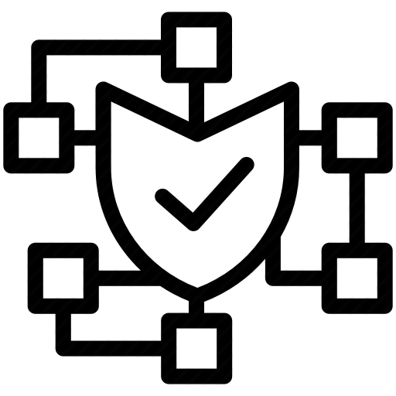


validator
ethereum 2.0
beacon chain
Slasher (optional)
Computer
prysm-architecture.png

Slide 3
ethereum 2.0
validator
beacon chain
Computer
prysm-basic-setup.png

Slide 4

4000:4000
13000:13000
ethereum 2.0
validator
beacon chain
Computer
prysm-basic-docker-setup.png

Slide 5




ETH2 Wallet
validator keystore
private key 1
withdrawal key 1
validator
accounts create
Password
prysm-single-key.png

Slide 6




32 ETH1
Validator deposit contract
(on ETH1 Chain)
+
https://prylabs.net/participate
ETH1 Wallet
==========Raw Transaction Data============
0x200000000000000000000000000000000000006081e9e0000000095bccce6f600000000000000000000000000000000000000000000000…b5fcb
========================================
ETH2 nodes watch for new validator deposits here
ETH2 wallet identifier
ETH1
ETH2
Important! These are your new ETH2 keys. Keep them safe!
private key 1
withdrawal key 1
ethereum 2.0
validator keystore
ETH2 Wallet
Computer
Too complicated…

Slide 7

ETH1 Wallet
32 GöETH
Validator deposit contract
(on ETH1 Chain)
https://prylabs.net/participate
===Raw Transaction Data==
0x2000006081e9e0000000095bccce6f6000000…b5fcb
=======================
Activation may take several hours
validator
accounts create
prysm-eth1-deposit.png

Slide 8
validator keystore
private key 1
withdrawal key 1
ethereum 2.0
private key 2
withdrawal key 2
validator
beacon chain
Computer
Same password
prysm-multiple-keys.png

Slide 9
validator
ethereum 2.0
beacon chain
slasher
(optional)
Computer
prysm-with-slasher.png

Slide 10
UNKNOWN
DEPOSITED
~7.5 Hrs
PENDING
Queue Delay Varies Widely
ACTIVE
Minimum 9 Days Active
No Delay
EXITING
SLASHING
Queue Delay Varies Widely
EXITED
~36 Day withdrawal delay if slashed
~1 Day delay if exiting normally
validator-lifecycle.png

Slide 11


Slide 12


Slide 13




















Slide 14





ethereum 2.0
2.0

