Slide 1

DATA HUB GUIDE
How to add a new project
to the DataHub
A direct onboarding deck for new contributors.
Running example: ALMI ATLAS in the RINA block.
Running example: ATLAS
Block: RINA
Audience: new user
OK
Goal: show which files to create, what to write in the JSON, and how the website turns that data into the left panel, source links, GPS route, and DNV tree.
Data Hub guide - new vessel workflow
1

Slide 2
SUMMARY
This deck follows the real creation order
1
Create the vessel folder
2
Build the dashboard block
3
Register the project
Add a folder in the folder Projects, inside add one folder named JSON/ and raw_DATA/.
Write the block HTML, add the project image, and leave an empty list container for the vessel links.
Add one entry in project-config.js so the generic page knows which JSON file to load.
4
Create the main JSON
5
Map Link and DNV_path
6
Let the page build itself
Write summary and vessel_info. This is the main file the page reads.
Each JSON entry connects a visible value to a raw source file and a DNV location.
The shared scripts generate the left panel, the DNV tree, the downloads, and the GPS route automatically.
Blue slides are build steps. Green slides explain how the JSON controls the website.
BUILD STEP
REFERENCE
Edit files or add content.
Understand what each JSON field does.
Data Hub guide - new vessel workflow
2

Slide 3
BUILD STEP 1
Create the vessel folder before writing any code
Keep the main JSON file in the folder named JSON/ and the raw sources in the folder named raw_DATA.
JSON/
-Projects/
-Example_projects/
-Vessel_name/
-JSON/
>Example.json
-raw_DATA/
>example.pdf
>raw_json_example.json
Store the single main file read by the website. The Get Json button downloads this file.
raw_DATA/
Store the original sources used by Link: PDF, GPS JSON, CSV, or any other raw file.
Why this comes first
The folder structure decides every path used later in project-config.js, in the JSON file, and in the dashboard image path.
Simple rule: create the folder once, then keep every file inside it.
Data Hub guide - new vessel workflow
3

Slide 4
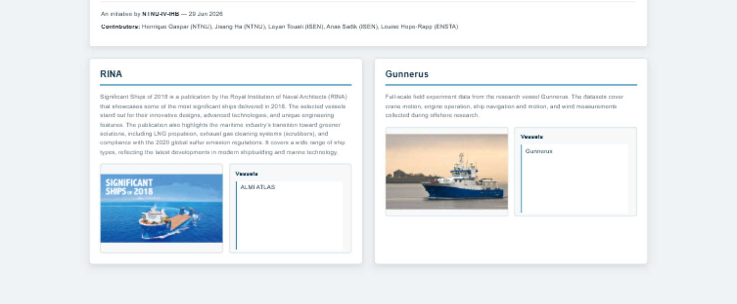
BUILD STEP 2
Create the dashboard block and add the image – /Blocs
This is where the project becomes visible on the home page. Create a new file for the project (ex: Exemple_blocs.html)
<section class="project-card">
<h2>EXAMPLE</h2>
<p class="project-description">
Short project description
</p>
<div class="project-card-content">
<div class="project-image-box">
<img src="Image/EXAMPLE/example.png" alt="EXAMPLE image">
</div>
<div class="project-vessels">
<h3>Vessels</h3>
<div id="example-vessel-links" class="vessel-link-list"></div>
</div>
</div>
</section>
HTML text
Image
Write the title and the project description directly in the block file.
Point the img tag to Image/... The shared CSS keeps the image centered and fixed in size.
Important: the vessel link list stays empty in HTML. JavaScript fills it automatically later.
Data Hub guide - new vessel workflow
4

Slide 5
BUILD STEP 3
How to create a JSON
Keep the structure simple so the same shared scripts can work for every future project this JSON document contains objects and arrays inside each other to represent data..
summary
{
"summary": "ALMI ATLAS is a RINA Significant Ship of 2018. The vessel is presented in the project with key ship data, mapped DNV information, and linked raw sources such as the source PDF and GPS route data.",
"vessel_info": [
{
"Name": "shipbuilder",
"Link": "../raw_DATA/ALMI ATLAS.pdf",
"DNV_path": "/dnv-v2/vis-3-10a/800a/860/861/861.2/861.21/G52/G52.1",
"Value": "Hyundai Samho Heavy Industries Co. Ltd« ,
"location": "hull"
},
{
"Name": "hull_no",
"Link": "../raw_DATA/ALMI ATLAS.pdf",
"DNV_path": "/dnv-v2/vis-3-10a/800a/860/861/861.1/861.11/G51/G51.1",
"Value": "S913",
"location": "hull"
}
]
}
One short paragraph. It appears at the top of the left panel.
vessel_info
You can add multiple groups of this kind one after another to create a list of data representing information about the vessel or the environment
Summary
How to build it
"vessel_info": [
DATA 1
DATA 2
DATA …
]
Data Hub guide - new vessel workflow
6

Slide 6
BUILD STEP 3
Representation of a Data
This is the representation of a data. We can recognize 5 main blocks :
Name : is the label shown to the user
Link : points to the raw source file stored in the project so the user can open or download it
DNV_path : places the same information in the DNV tree on the right if the path is valid
Value :is the visible content on the dashboard
location : decides in which left-side section or accordion the information appears
{
"Name": "shipbuilder",
"Link": "../raw_DATA/ALMI ATLAS.pdf",
"DNV_path": "/dnv-v2/vis-3-10a/800a/860/861/861.2/861.21/G52/G52.1",
"Value": "Hyundai Samho Heavy Industries Co. Ltd",
"location": "hull"
}
Data Hub guide - new vessel workflow
7

Slide 7
BUILD STEP 3
Representation of Link
Due to the fact that data can come from different documents, a value can be connected to different paths.
Case 1 : Only one path
We can write it this way and move to the next key, “DNV_path”.
Case 2 : Multiple paths
We can add the other paths separated by a semicolon “;” and then move to the next key, “DNV_path”.
"Link": "../raw_DATA/ALMI ATLAS.pdf",
"Link": "../raw_DATA/source_a.pdf ;
../raw_DATA/source_b.json ;
../raw_DATA/source_c.csv"
Data Hub guide - new vessel workflow
8

Slide 8
BUILD STEP 4
Register the project once in project-config.js
This is the bridge between the dashboard block, the page URL, and the main JSON file.
{
id: "example_name",
name: "VESSEL_NAME",
dashboardListId: "example-vessel-links",
jsonPath: "Projects/project_Name/vessel_Name/JSON/EXAMPLE.json"
}
id
name
Unique key used in the URL.
Example: project=atlas
Visible name shown in the dashboard and in the details page header.
dashboardListId
jsonPath
Must match the empty list container id inside the dashboard block.
Path to the single main JSON file for this project.
When you add a new vessel or project later, this is usually the only JavaScript file you need to edit.
Data Hub guide - new vessel workflow
5

Slide 9
BUILD STEP 5
Register the block once in dashboard-projects.js
This is to show the block in the main index.html
(function () {
const BLOCK_FILES = [
"Blocs/Rina_blocs.html",
"Blocs/Gunnerus_blocs.html",
"Blocs/Exemple_bloc.html"
];
Path
Just add the path to your html bloc.
Data Hub guide - new vessel workflow
5

Slide 10
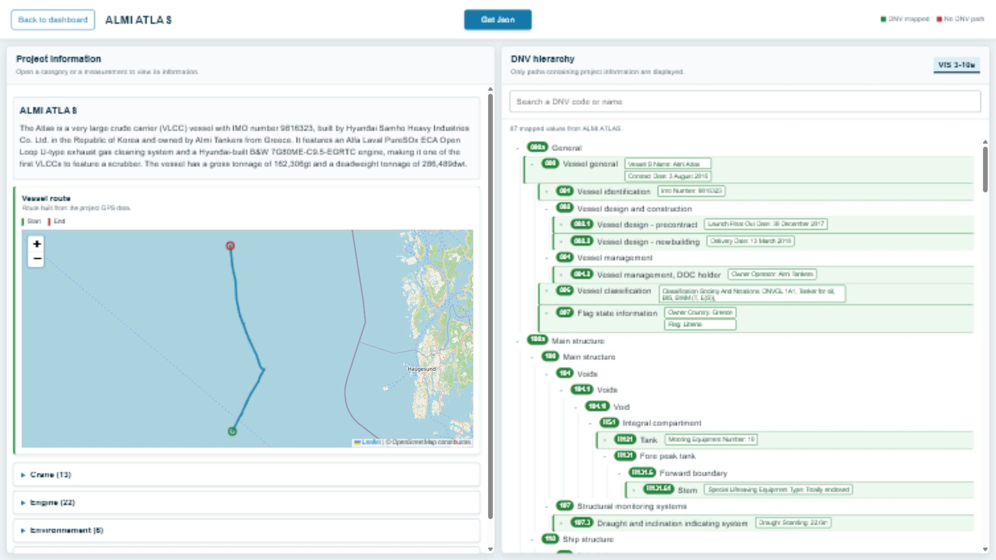
REFERENCE
DNV_path controls the right side and location controls the left side
These two fields connect one JSON object to both parts of the page.
location
Groups the entry in the left accordion. Example: hull, engine, crane, wind.
DNV_path
Places the same entry on the right if the path is valid.
Green tag
Shows the mapped value and keeps the source clickable.
Show in DNV
Scrolls the user to the correct mapped node from the left side.
Data Hub guide - new vessel workflow
9

Slide 11
RESULT
If the JSON is clean, the page builds itself
The shared scripts are generic. The content changes, but the workflow stays the same.
Left side
summary + accordions + source-aware entries
Right side
Filtered DNV tree with only mapped values
Map
GPS route built from the raw file linked in Link
Get Json
Downloads the main JSON file loaded for the project
Data Hub guide - new vessel workflow
10

