Slide 1
MealMind: The Recipe for Smarter Cooking
Project Phase One Overview

Slide 2
The Idea… Why MealMind?
The idea for MealMind came from a familiar everyday problem: staring into the fridge, seeing a bunch of ingredients, and still feeling like there’s nothing to make. We set out to solve that frustration by creating a tool that uses AI to turn those scattered items into smart, personalized meal suggestions.
63% of Americans live paycheck to paycheck, making food budgeting critical.
Over 50% of adults report not having enough time to cook healthy meals
The average household wastes over $1,800/year on unused food.
Avoid waste by optimizing ingredients

Slide 3
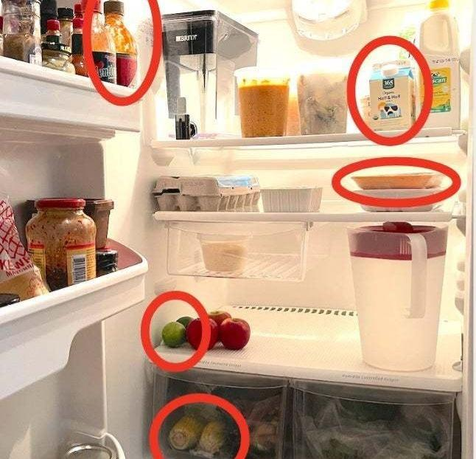
What exactly does it do?
Users interact with MealMind through a clean, responsive web interface. They can create an account or continue as guests. After setting dietary preferences (like vegetarian or keto), users enter their pantry inventory or select available ingredients. MealMind’s AI will process this input and search the web for the most relevant recipes. If a recipe requires one or two extra ingredients, a smart grocery list is automatically generated, including exact quantities and excluding items the user already has. From there, users can browse personalized recipe suggestions, adjust servings, and efficiently plan their meals with AI-powered grocery and cooking support.

Slide 4
How It Works / System Components
Input your ingredients to the simple to use interface
AI-Powered Recipe Discovery - the AI system analyzes the list and searches the web for relevant recipes using your ingredients.
If you recipe requires additional ingredients, the program will automatically generate a grocery list to help users complete the meal with minimal effort

Slide 5
Example of Usage
Example Scenario – “What can I cook tonight?” 1. User logs in (or continues as guest)
2. They selects ingredients they already have:
Eggs, spinach, cheese, onion
3. They’ve set their diet preference to ‘’vegetarian’’
4. The AI quickly returns suggested meals:
Spinach & Cheese Omelette
Vegetarian Frittata
Egg & Veggie Wrap
5. One recipe - Frittata - Needs an extra item: Milk
The app Automatically adds milk to a smart grocery list
6. The grocery list only shows items the user doesn’t already have, making shopping faster and more efficient.

Slide 6


API’s/AI/Advanced Techniques
Spoonacular
Edamam
OpenAI
Web Scraping

Slide 7
Frontend Technology
HTML
CSS

Slide 8
Backend Technology
React
JavaScript

Slide 9
Statement Of Work
Meet the Team! Project Manager : Adam Shipp
Developer : Dakota Bass
Developer : Jesus Gutierrez
Developer : Joseph Frey
The Project Manager will oversee the planning, coordination, and progress tracking of the MealMind project to ensure timely delivery of features and clear communication among team members. In addition to managing team workflows, setting milestones, and leading meetings. Will also assist with light coding tasks, particularly in front-end development and feature testing. The developers will help design and implement core features such as the ingredient input interface, recipe suggestion logic, and smart grocery list generation. They also assist with API integration to enhance recipe variety and accuracy.

Slide 10
Planned Future Work
In the next phase of development, the project manager will continue overseeing progress, organizing team goals, and assisting with front-end development. The development team will focus on building out the backend, selecting and integrating a suitable API for recipe generation, and improving the user interface. Technologies such as HTML, CSS, JavaScript, and React will continue to be used as the foundation. Additional features, including user accounts, personalized meal planning, and smarter ingredient handling, will also be explored as the project evolves.

