Slide 1
Prepping the Ingredients for Smarter Cooking
Project Phase Two Overview

Slide 2
Phase Two Overview
FRONT END: Implement login system: email/password login, new user registration, third-party login (e.g., Google).
The front end also focuses on maintaining a clean, intuitive interface to ensure smooth navigation, particularly when browsing recipes, managing saved items, or accessing personalized content.
BACK END: Begin development of system’s core functionality.
PROJECT MANAGEMENT: Project Timeline/Milestones finalized

Slide 3
Implementing Feedback - Web Scraping
In our previous presentation, we proposed web scraping as the primary method for collecting recipes and related content.
After further discussion and feedback, we’ve chosen to move away from web scraping due to legal, ethical, and reliability concerns.
Instead, we’re shifting to AI-assisted recipe discovery, focusing on publicly available and fair-use-compliant sources.
To ensure accuracy and originality, all content will be manually reviewed and moderated by team members before being added to the platform.

Slide 4
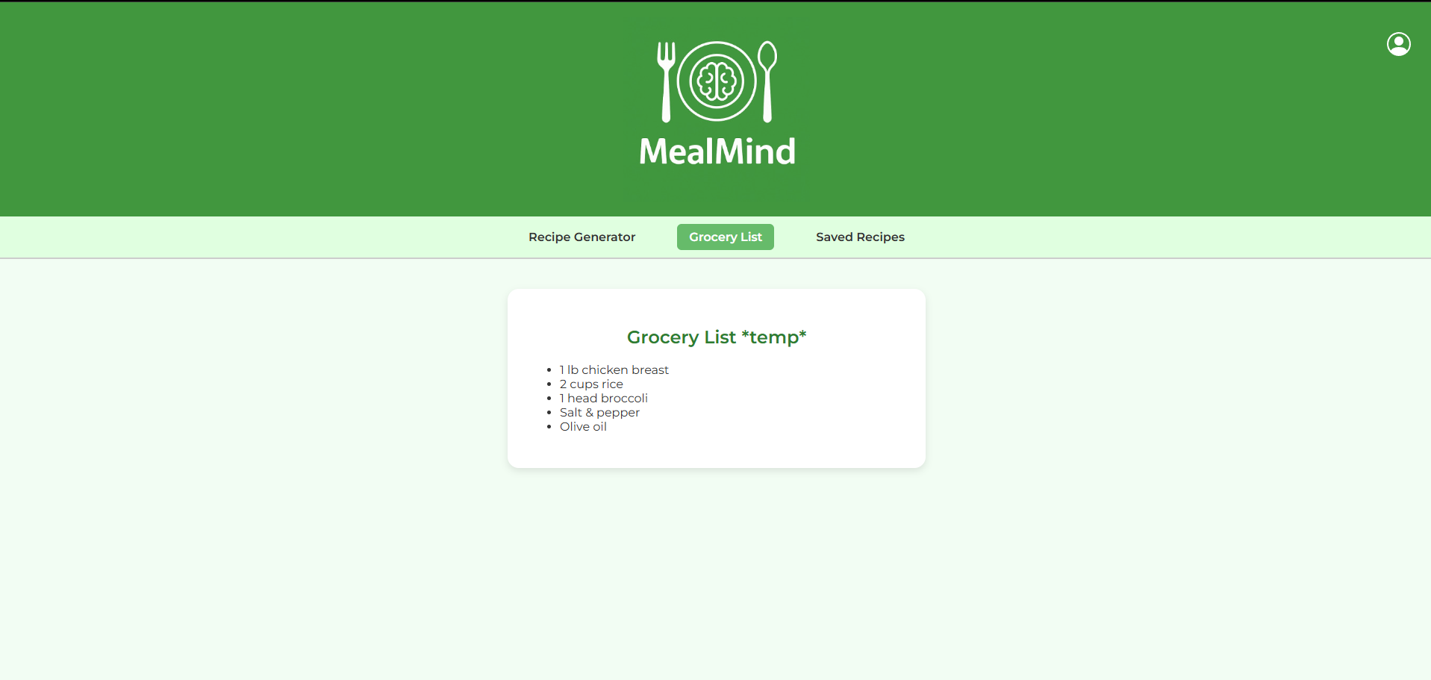
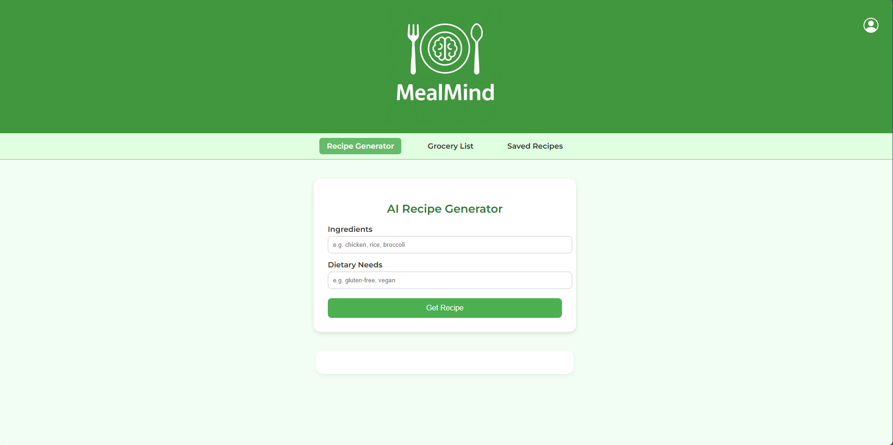
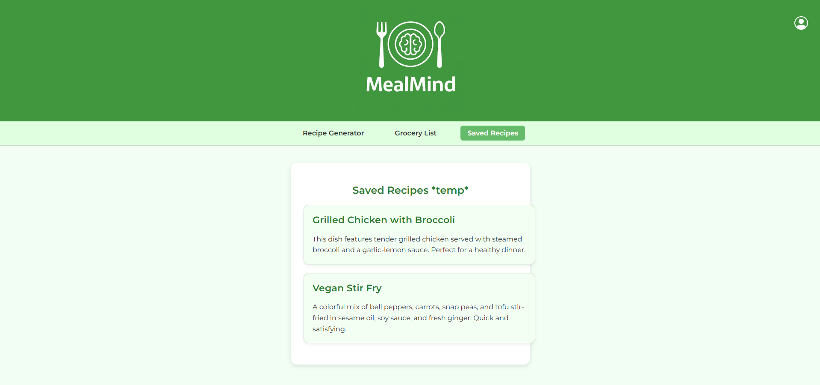
Front End Pictures

Slide 5
Front End Development
The front end development utilized a lot of AI to correctly connect the original concept of an AI created recipe generator. When the work on the project originally began we utilized Chat GPT to create a input and output for the server connected to the Open AI API. Once the foundation was laid we further went and input that code into Chat GPT again to make it aesthetically pleasing this provided the backbone upon which we built the rest of our CSS Styles, However there was much that needed to be done manually such as graphic placement and text margins which the AI just could not get quite right. Once that was done we Asked Chat GPT again to create a tab matching the theme of the style. This lead to us creating and the remaining html files to be further worked on once Backend is implemented.

Slide 6
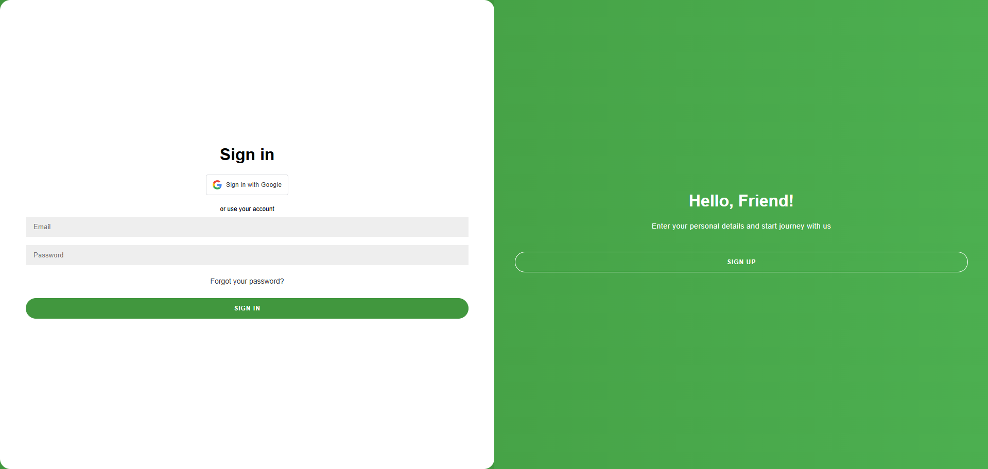
API, GoogleAPI, and other technology
OpenAI
GoogleAPI

Slide 7
Backend Development
There was a bit of an early start on the backend side of the development solely due to the fact that our entire premise is predicated on the idea of an AI generated recipe. In order for the Open AI API to work it has to have a local server running so the Open AI could find us on the web and send us the output. We also had to implement a little javascript backend for the require google login API as well as use Firebase to make everything work.

Slide 8
Errors Encountered
Server would not work! Fix: API key gets auto deleted by open ai if uploaded to git = new key required
Login button stuck inside logo! Fix: Absolute position to top right of html
Login image in correct spot but actual button extends across banner width! Fix: restrain it to the same pixel width and height as image.
Login error: net::ERR_BLOCKED_BY_CLIENT. The request to validate the account was blocked by a browser extension (e.g., ad blocker or privacy tool). Solution: Disabled ad blocker
Login error: Error 400: redirect_uri_mismatch. The login_url set in the JavaScript did not exactly match any URL listed under Authorized redirect URLs in Google Cloud Console. Solution: Added the correct full path URL to the Google Cloud Console.
Login error: HTTP ERROR 405. Google uses a POST request when we use redirect mode, but the local server (Five Server) only supports simple GET requests (like loading pages, not submitting data). Solution: We made sure the Google redirect goes to a page that only expects to be loaded normally — no form submissions or POST handling.

Slide 9
Knowledge Gained
Technical Lessons:
Working with external APIs required strong planning. We learned to read API documentation carefully and manage errors, rate limits, and different response formats
Dynamic DOM manipulation in JavaScript can get messy. We realized the importance of clean, modular JS when updating the UI based on user actions.
CSS layout and responsiveness takes patience. Building a layout that looks good on all devices took multiple iterations and teamwork.
Debugging is part of the journey. From broken API calls to layout issues, each bug helped us learn more about how the web stack works.

Slide 10
Planned Future Work
Before our next presentation on July 22, we plan to finalize the system design by implementing the remaining database features and refining both the front-end and back-end components. We will also continue testing the core functionalities to ensure stability and usability. In addition, we aim to polish the user interface, improve performance, and begin preparing documentation and user support materials. Our goal is to have a functional and visually cohesive version of the app ready for live demonstration.

