Slide 1
VOCATIONAL TRAINING PRESENTATION
College Management System
Using
PYTHON
At
Matrix Computers
Presented by:
Rishita Rathore CSE- 5th sem
Riya Tamrakar SEC – ‘B’

Slide 2
INDEX
Introduction
H/W and S/W requirements
Front-end
Analysis- about project requirements/purpose
Design- Flow Chart
Snapshots
Applications

Slide 3
INTRODUCTION
In the modern world of technology, COMPUTERS are affecting our lives in more ways than we probably are aware of. COMPUTERISED MANAGEMENT , maintaining information of a educational institute, colleges, other the list is endless.
This project specifies all working that is taken by a College Administrator.
If administrator wants any necessary information, he checks the information about a student, marksheet, fee, library etc.
It is difficult to prepare the manual work to store the information about all students ,marksheet etc.
So, this project helps to store those type of information using computerised system.
Some modules of college management system are:
Student Profile
Marksheet
Fee Receipt
Library management

Slide 4
H/W and S/W REQUIREMENT
Software Requirement
Python * versions : 2.7.X, 3.6.X
SQL
Hardware Requirement
RAM - 2 GB
Processor – Intel core I3
Hard Disk - 1 GB

Slide 5
FRONTEND
Python is an interpreted, high-level, general-purpose programming language. Created by Guido van Rossum and first released in 1991, Python's design philosophy emphasizes code readability with its notable use of significant whitespace. Its language constructs and object-oriented approach aim to help programmers write clear, logical code for small and large-scale projects
FEATURES OF PYTHON
Easy to Learn and Use - Python is easy to learn and use. It is developer-friendly and high level programming language.

Slide 6
Expressive Language - Python language is more expressive means that it is more understandable and readable.
Interpreted Language - Python is an interpreted language i.e. interpreter executes the code line by line at a time. This makes debugging easy and thus suitable for beginners.
Cross-platform Language - Python can run equally on different platforms such as Windows, Linux, Unix and Macintosh etc. So, we can say that Python is a portable language
Object-Oriented Language - Python supports object oriented language and concepts of classes and objects come into existence
GUI Programming Support - Graphical user interfaces can be developed using Python.

Slide 7
ANALYSIS – About Project Requirements / Purpose

Slide 8
DESIGN - FLOWCHART
Login Form
Menu
Student Profile

Slide 9
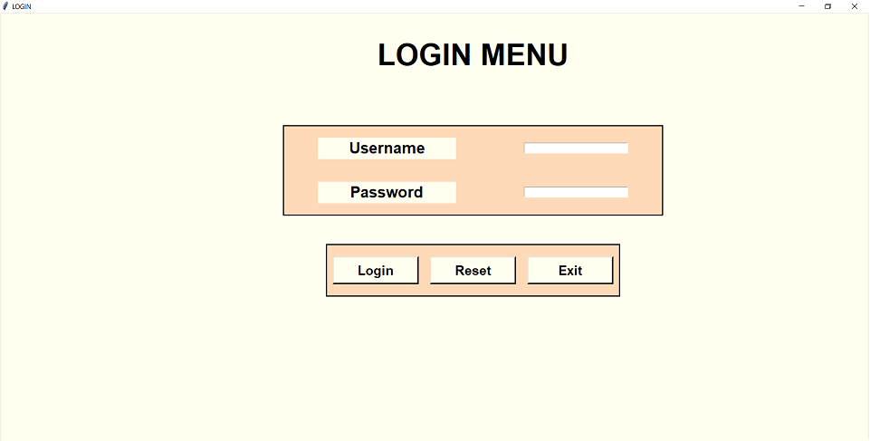
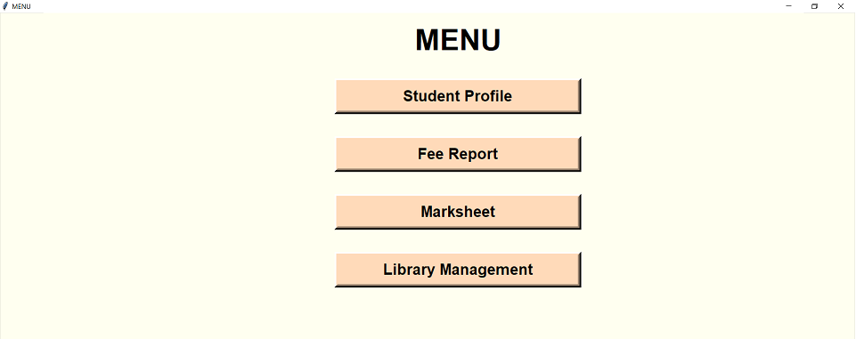
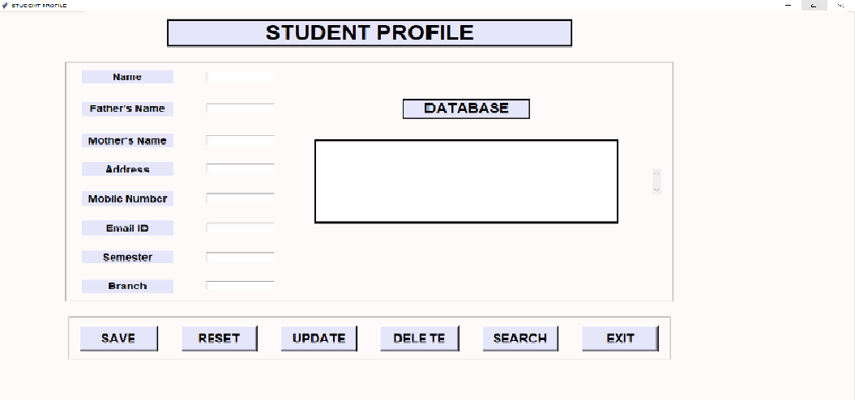
SNAPSHOTS

Slide 10
APPLICATIONS

