Slide 1
N
NEOTERIC PROPERTIES · PROJECT COST CENTER
DRI Dashboard
Feature Overview
How Site DRIs log daily reports and request drawings — end to end.
Daily Progress Report
Drawing Requests

Slide 2
What this covers
Two connected workflows a Site DRI uses every day
01
02
Daily Progress Report
Drawing Requests
One end-of-day form: project, contractor, shift, labour count, and a work-type checklist backed by photo evidence.
Raise a ticket for a missing drawing right from the report — then track it through AGM, GM, and Planning until it's resolved.
Nexora ERP · DRI Dashboard Overview
2

Slide 3
01
Daily Progress Report
One end-of-day form — project, contractor, shift, labour, and photo-backed work-type checklist.

Slide 4
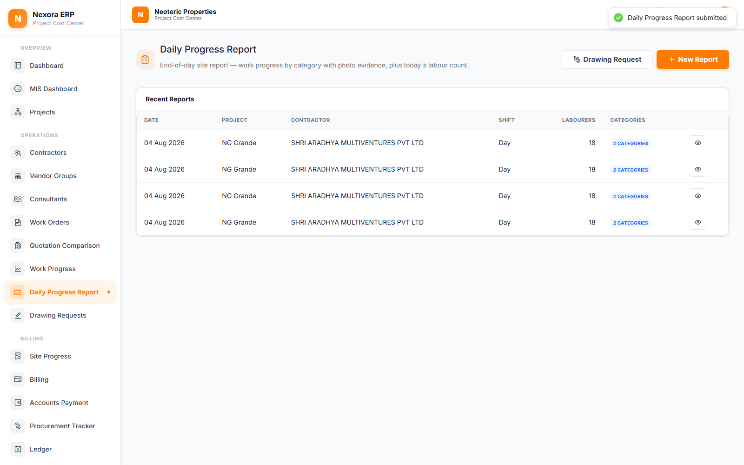
Daily Progress Report — Overview
Replaces two separate paper-style reports with a single, photo-verified daily submission.
One submission per site day
Project, DRI name, date, contractor, shift, and today's labour count — all in one place.
Every report is listed
The Recent Reports table shows what's been logged, by whom, and how many categories were covered.
Raise a Drawing Request inline
A DRI who hits a missing drawing while filling this out can raise it without leaving the page.
Available two ways
Inside the app for logged-in DRIs/Admins, and as a public no-login form for anyone on site.
Nexora ERP · DRI Dashboard Overview
3

Slide 5
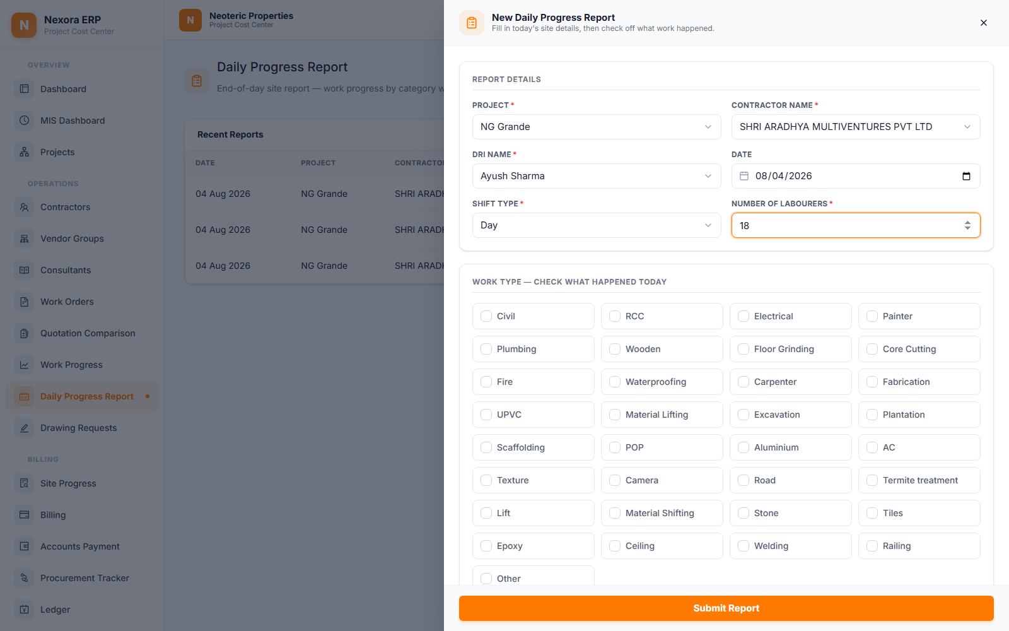
Filling In a Report
Report Details up top, the work-type checklist below — both in one wide, well-spaced drawer.
Project & Contractor
Searchable dropdowns pull from the same live Projects and Contractors lists used across the app.
DRI Name is a dropdown here
Inside the app it's picked from registered site DRIs — the public form uses a free-text field instead.
Shift & labour count
Day or Night shift, plus how many labourers were on site — quick to fill, nothing optional missed.
Date defaults to today
Can't be set in the future, keeping every report tied to a real site day.
Nexora ERP · DRI Dashboard Overview
4

Slide 6

Work-Type Checklist + Photo Evidence
32 real construction categories — check what happened today, then prove it with photos.
Check every category that applied
Civil, Electrical, Plumbing, Waterproofing, and 28 more — a DRI checks exactly what work happened.
5-photo minimum per category
Checking a box opens its own photo slot — at least 5 site photos are required before it counts as covered.
Photos are compressed automatically
Images are resized and compressed client-side so a full day's evidence stays lightweight to submit.
Nothing submits until it's complete
The Submit button validates every checked category has its minimum photos before it goes through.
Nexora ERP · DRI Dashboard Overview
5

Slide 7
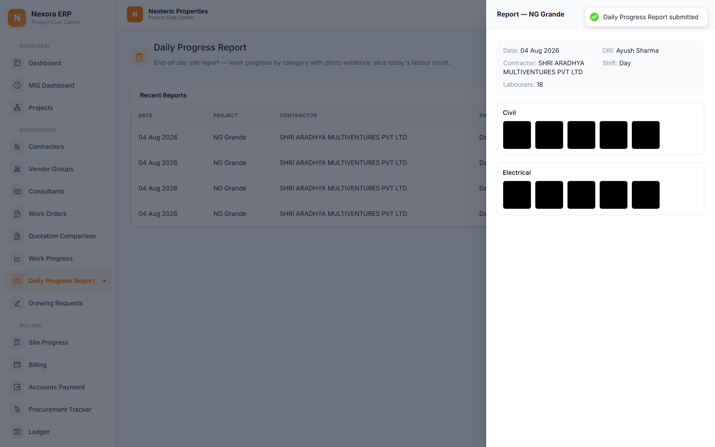
Reviewing a Submitted Report
Every category's photo evidence stays attached to the report, viewable any time.
Full report summary
Date, DRI, contractor, shift, and labour count are all shown together at the top.
Photo evidence, per category
Each checked work type keeps its own gallery of site photos — click through to open full size.
A permanent, auditable record
Once submitted, the report and its photos become part of that project's history.
Nexora ERP · DRI Dashboard Overview
6

Slide 8
02
Drawing Requests
Raise it in seconds on site — track it through AGM, GM, and Planning until it's resolved.

Slide 9
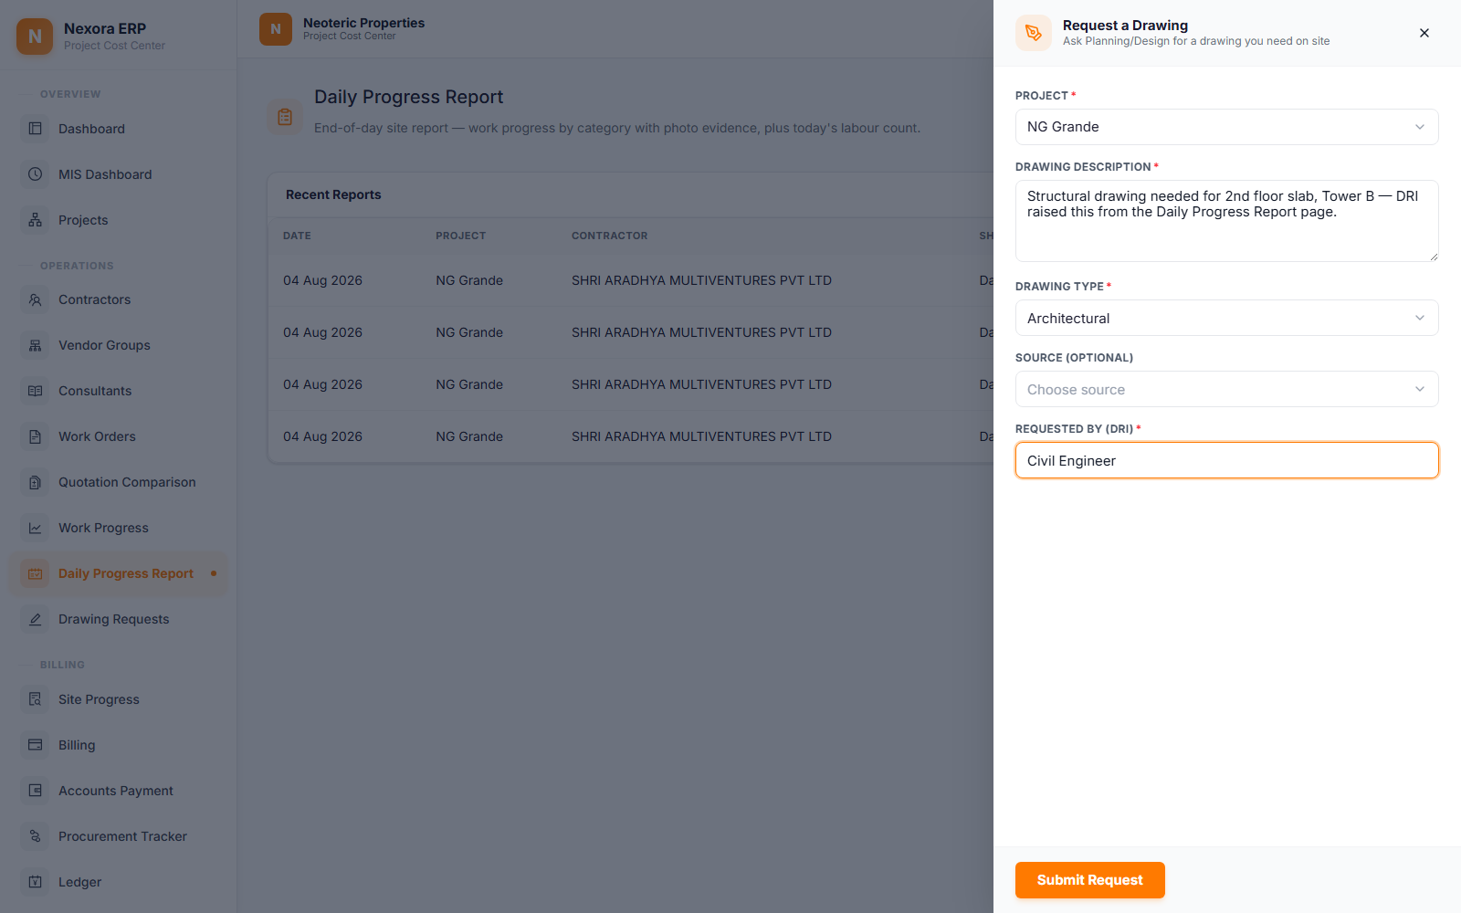
Raising a Request
A DRI stuck without a drawing raises a ticket without ever leaving the Daily Progress Report page.
One button, right where it's needed
"Drawing Request" sits next to "New Report" on the Daily Progress Report page.
Just the essentials
Project, a description of what's needed, drawing type (Architectural / Structural / MEP / Civil…), and requester name.
Auto-numbered on submit
Every request gets its own ticket number (e.g. DR-0003) the moment it's raised.
Also available publicly
A standalone no-login form covers anyone on site without an account.
Nexora ERP · DRI Dashboard Overview
7

Slide 10
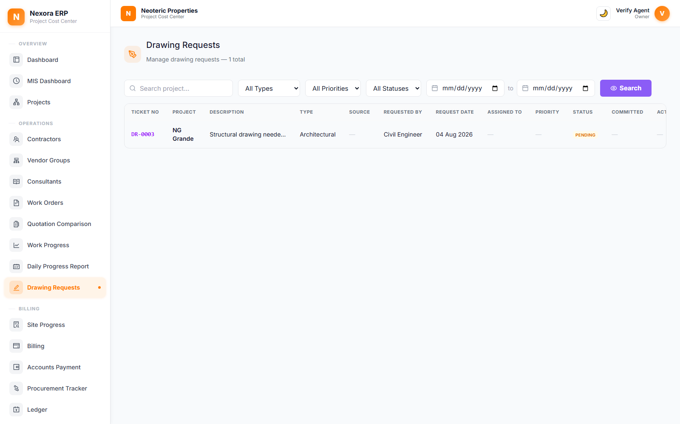
Tracking Every Ticket
One list, searchable and filterable, for everything the site has ever asked Planning/Design for.
Search & filter
By project, drawing type, priority, status, or a date range — find any ticket in seconds.
Status at a glance
Pending, Committed, Completed, or Delayed — colour-coded across the whole list.
Everything in one row
Ticket No, requester, assigned owner, priority, committed date, and actual completion — no digging required.
Nexora ERP · DRI Dashboard Overview
8

Slide 11
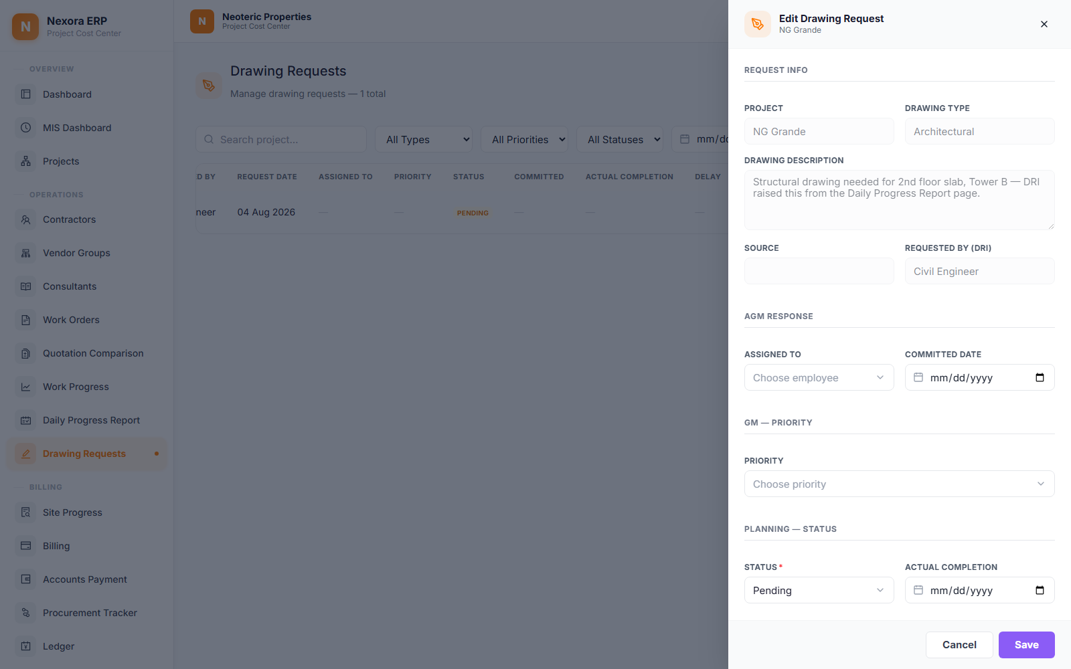
The Full Ticket Lifecycle
Four short stages carry a request from raised to resolved — each owned by a different role.
AGM Response
Assigns the ticket to someone and commits a target date.
GM — Priority
Sets how urgently it needs to move.
Planning — Status
Updates progress through to an actual completion date.
Verification
Planning and the project team both confirm it's genuinely resolved.
Nexora ERP · DRI Dashboard Overview
9

Slide 12
One dashboard, two connected workflows
Daily Progress Reports build the site's photographic record. Drawing Requests keep Planning and the site in sync.
Thank you
Nexora ERP · DRI Dashboard Overview
10

