Slide 1

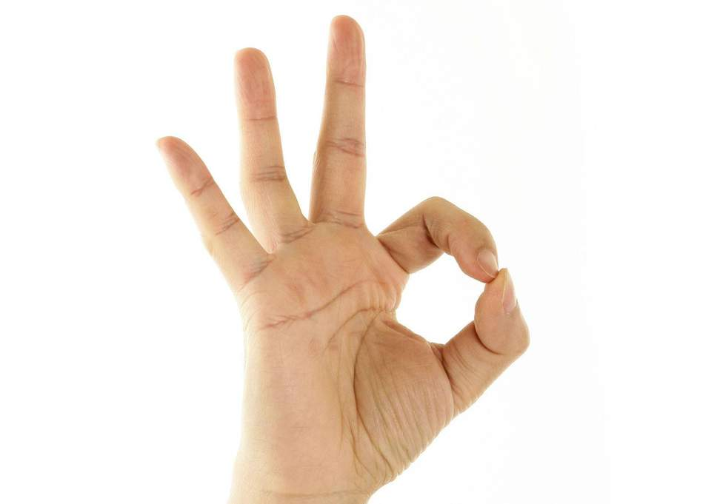
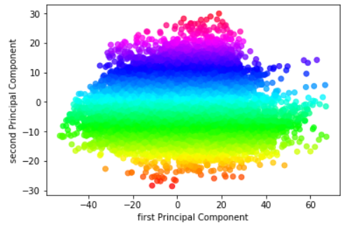
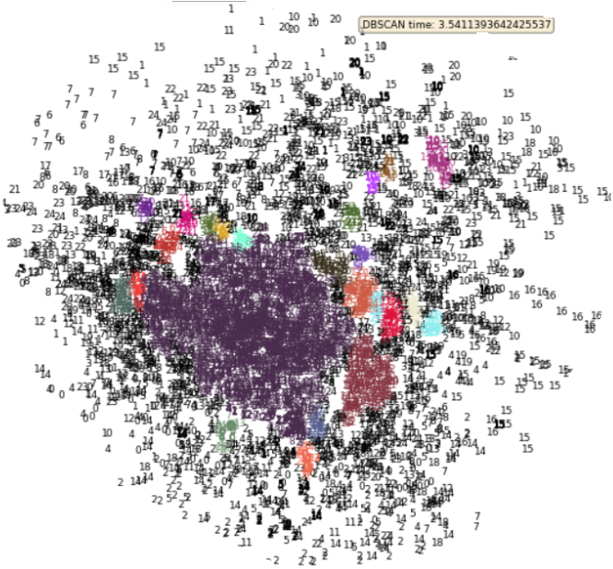
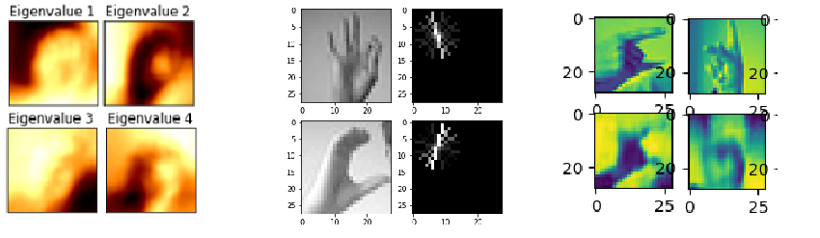
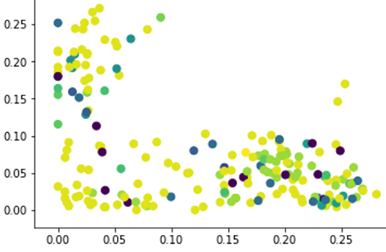
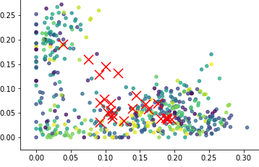
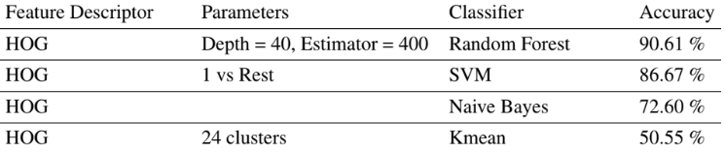
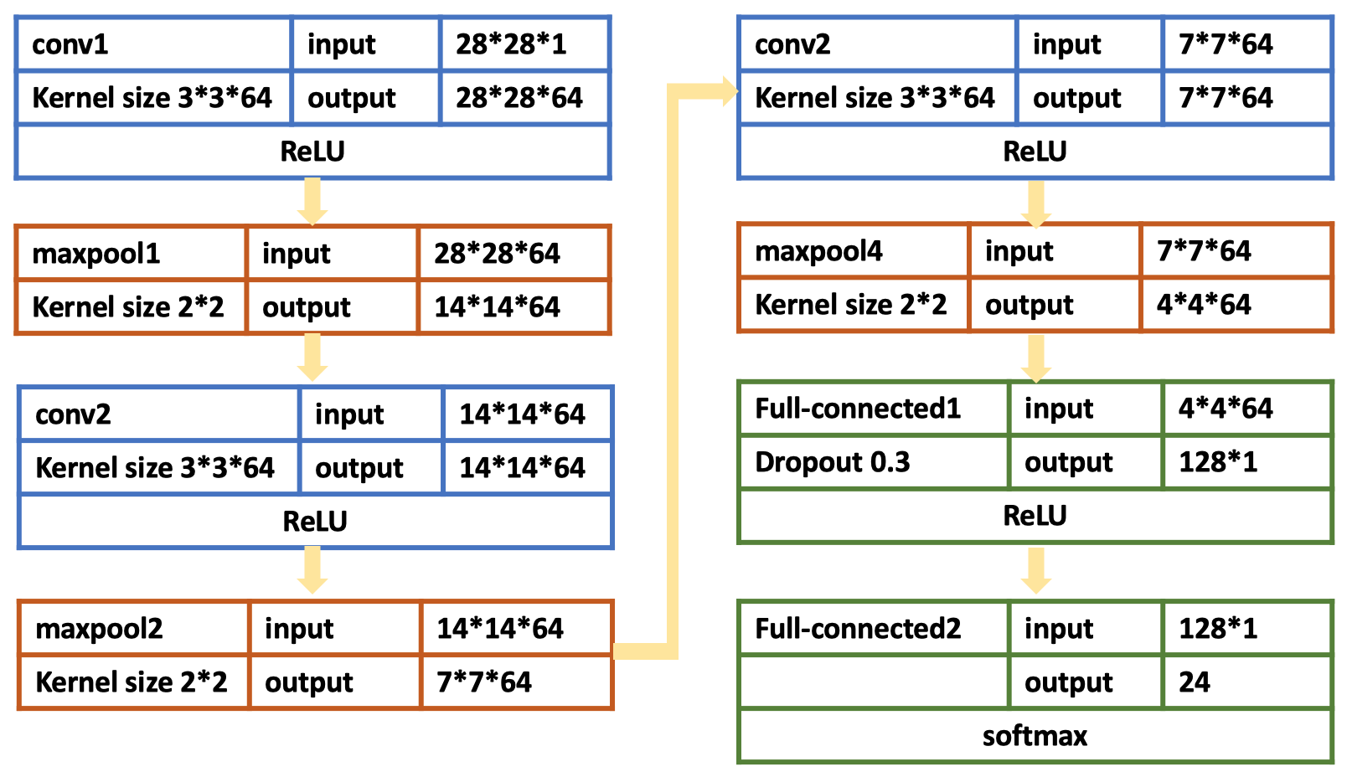
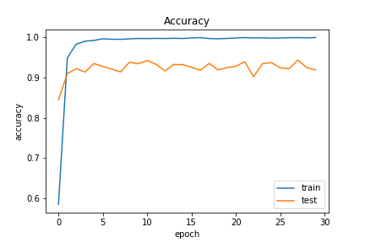
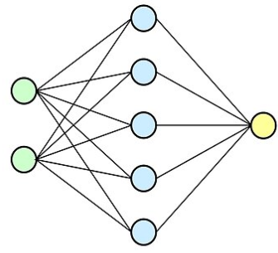
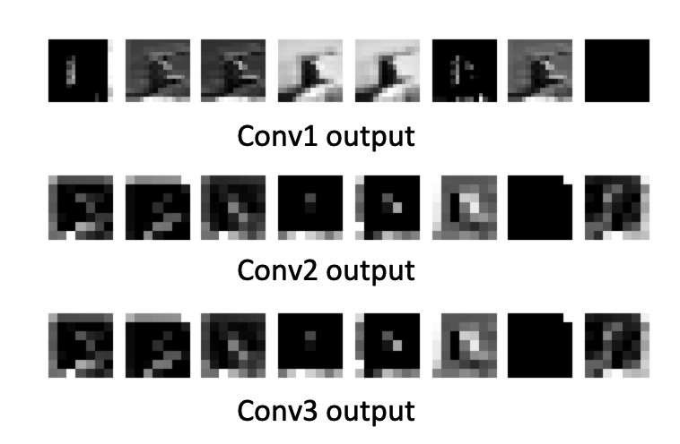
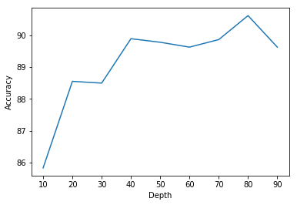
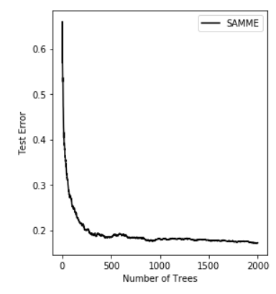
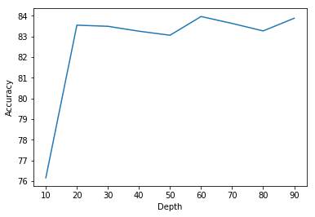
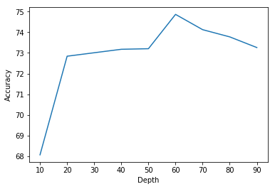
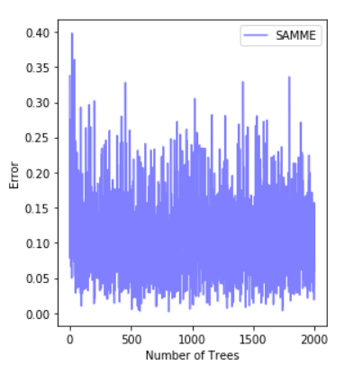
Comparing Supervised and Unsupervised learning in American Sign Language Recognition
Archana Anand, Shipra Behera, Yuchen Zhang
Professor Claire Monteleoni
Objective
Comparison of supervised and unsupervised learning performance for American Sign language recognition. There has been a lot of ongoing work in this area, particularly involving neural networks. We will investigate different supervised and unsupervised techniques for the automatic recognition of signs and evaluate their accuracies over the 24-signs.
Clustering Algorithms
Feature Extractor/Descriptor
PCA+DBSCAN:
There are 43 clusters when we used PCA compared to 0 cluster when no dimension reduction methods were used
Graph of PC1 vs PC2 of Data set
83.40%
Random Forest
74.86%
PCA
82.9%
AdaBoost(SAMME)
36.60%
82.9%
SVM
63.31%
K-means and GMM with HOG:
24 clusters
We look at the labels of the clusters to understand what label each cluster corresponds to. Then we take an unlabeled data point, see into which cluster it fits best, and assign it a label.
HOG
Auto Encoder
K-mean
HOG
GMM
We can see that HOG is a good descriptor for object detection, and good performance can be achieved with Random Forest and linear SVM. One can expect even better performance with kernel SVM, if the computational complexity is not considered.
Supervised Learning Algorithms
Conclusion
Neural Network performs best, it can classify image data without any dimension reduction. Test accuracy reaches 94.33%
For different classification or
Clustering algorithms, the best
feature extraction method
may vary. In general,
supervised classification
Algorithm performs better
than unsupervised clustering
in our project. Based on the experiment results, HOG performs better than other two feature extraction methods. Neural Network performs best, it can classify image data without any dimension reduction. The test accuracy reaches 94.33%.
Random Forest test accuracies over PCA, HOG and Convolutional Autoencoder
Variation of test error over number of trees for AdaBoost SAMME classifier
References
Classifier | Feature Descriptor | Accuracy
Neural Net | None | 94.33%
Random Forest | HOG | 90.61%
SVM | HOG | 86.67%
AdaBoost | PCA | 82.90%
Naive Bayes | HOG | 72.60%
[1] Garcia, B. & Viesca, S.A. (2016) Real-time American Sign Language Recognition with Convolutional Neural Networks.
[2] S. Ameen, S. Vadera, A convolutional neural network to classify american 530 sign language fingerspelling from depth and colour image
[3] Zheng L, Lian B, Jiang A. (2017) Recent Advances of Deep Learning for Sign Language Recognition.
[4] https://www.kaggle.com/datamunge/sign-language-mnist

