Slide 1
PROJECT #16
Skin Lesion Type
Classification
Using Texture & Colour Features — SVM · Random Forest · XGBoost
HAM10000 Dataset
Member 1 Data & Preprocessing | Member 2 Feature Engineering & Modelling | Member 3 Evaluation & Deployment
Data Science Project — 2025

Slide 2
Problem Statement & Motivation
10,015
Why this matters
Dermoscopy images
Skin cancer is the most common cancer globally — early detection is critical for survival
Dermatologists use the ABCD rule (Asymmetry, Border, Colour, Diameter) — we mimic this computationally with handcrafted features
Goal: classify 7 lesion types from images without deep learning, making the system interpretable and lightweight
Clinically meaningful: a model must perform well on rare, high-risk classes (melanoma, BCC) not just the majority class
Dataset: HAM10000 — 10,015 dermoscopy images from the ISIC archive with expert-verified diagnoses
7
Lesion categories
67%
Class imbalance (nevi)
0
Deep learning used
Skin Lesion Classification — Project #16
2 / 10

Slide 3
Dataset Overview — HAM10000
Majority class
Nevi
6,705 images (67%)
Rarest class
Derm.
115 images (1.1%)
Image size
128×128
Resized from original
Solution
SMOTE
Applied to train set only
Skin Lesion Classification — Project #16
3 / 10

Slide 4
Data Preprocessing — Stage 3
MEMBER 1 LEAD
Metadata Cleaning
Outlier Detection in Metadata
Null value check
57 NaNs fixed
Age distribution check
age: 57 missing (0.6%) | path: 0 | dx: 0
Range: 5 – 85 years | Mean: ~52 | IQR: 35–65
Drop rows with missing age using dropna(subset=['age'])
Duplicate image IDs
No rows removed
Some lesions have multiple images — lesion_id repeats
Retain all rows; lesion_id is informational only and dropped from features
0–20
20–40
40–60
60–80
80+
No extreme outliers — values within clinical range (5–85 yrs). No capping needed.
Sex encoding
No NaN leakage
Shape feature outlier removal
Values: 'male', 'female', 'unknown' → 3 unique categories
border_irregularity can spike to 50+ for poorly segmented images
Map male→0, female→1, unknown→2 using .map().fillna(2).astype(int)
Fix: drop rows where border_irregularity > 15 (hard threshold based on distribution inspection)
Localization encoding
15 dummy cols
GLCM & HSV feature scaling
15 unique body-site strings (abdomen, back, chest, etc.)
GLCM values range 0–1 inherently. HSV histograms are L1-normalised. StandardScaler applied before training to z-score all features and remove scale-based bias.
pd.get_dummies() — one-hot encode into ~15 binary columns
Skin Lesion Classification — Project #16
4 / 12

Slide 5
Image Preprocessing Pipeline — Stage 3
MEMBER 1 LEAD
01
Extract ZIP archives
02
Map image IDs to paths
Two archives: HAM10000_images_part_1.zip & part_2.zip
Iterate both folders, build dict: {image_id → file_path}
Extract to data/part1/ and data/part2/ using zipfile module
Merge path into metadata df via df['path'] = df['image_id'].map(image_path)
Total: 10,015 .jpg images across both folders
Verify: df['path'].isnull().sum() == 0 (no missing paths)
03
Read & resize images
04
Normalise & convert colour space
Load each image with cv2.imread() — returns BGR array
For GLCM: convert BGR→Grayscale via cv2.cvtColor(img, COLOR_BGR2GRAY)
Original sizes vary (450×600 to 600×450 px)
Reduce intensity levels 0–255 → 0–15 for GLCM efficiency
Resize to 128×128 px using cv2.resize() — standard for feature extraction
For HSV: convert BGR→HSV via cv2.cvtColor(img, COLOR_BGR2HSV)
05
Save resized images
06
Validate output
Write all resized images to data/resized/ with original filenames
Count files in data/resized/ — must match 10,015
cv2.imwrite() preserves .jpg format
Spot-check: load 5 random images, confirm shape == (128, 128, 3)
Single source of truth — all feature extraction reads from data/resized/
Check no corrupt files: img is None check inside loop
Output: 10,015 images at 128×128 px | Colour spaces: BGR (shape), Grayscale (GLCM), HSV (colour histograms) | Saved to data/resized/
Skin Lesion Classification — Project #16
5 / 12

Slide 6
Project Pipeline — 10-Stage Data Science Lifecycle
Stage 1–2
Stage 3
Raw
Images
Resize
128×128
Feature
Extraction
Merge
Features
Train/Test
Split
GLCM Texture
(contrast, energy,
correlation, homogeneity)
HSV Colour
(16-bin histograms
per H, S, V channel)
ABCD Shape
(asymmetry,
border irregularity)
SMOTE
Balancing
Standard
Scaler
SVM
(RBF)
Random
Forest
XGBoost
Sensitivity &
Specificity
Feature Group
Comparison
Streamlit
Deployment
README +
PPT + GitHub
Skin Lesion Classification — Project #16
4 / 10

Slide 7
Feature Engineering — Stage 5
MEMBER 2 LEAD
GLCM Texture
HSV Colour Histograms
ABCD Shape Features
8 features per image
48 features per image
2 features per image
Gray-level co-occurrence matrix on grayscale image
Properties: contrast, correlation, energy, homogeneity
Distances: [1, 3] | Angles: 0°, 45°, 90°, 135°
Mean + std per property = 8 values
Captures surface texture patterns in the lesion
Convert BGR image to HSV colour space
16-bin histogram for each channel: Hue, Saturation, Value
Normalised to sum to 1 (L1-norm)
Total: 16 × 3 = 48 features
Captures colour distribution — key for melanoma vs benign
Segment lesion using Otsu thresholding + morphological ops
Asymmetry: pixel-level flip difference normalised by area
Border irregularity: perimeter² / (4π × area) — circularity index
Mimics clinical ABCD dermoscopy criteria directly
Dermatologists use these same criteria for diagnosis
Total feature vector: 58 dimensions per image | No deep learning — fully interpretable handcrafted features
Skin Lesion Classification — Project #16
5 / 10

Slide 8
SMOTE — Handling Class Imbalance
MEMBER 2 LEAD
BEFORE SMOTE
AFTER SMOTE (training set)
How SMOTE works:
Finds k-nearest neighbours of each minority class sample → interpolates new synthetic points between them → equalises all class counts. Applied ONLY to the training set — the test set remains untouched to prevent data leakage.
Skin Lesion Classification — Project #16
6 / 10

Slide 9
Model Training — SVM · Random Forest · XGBoost
MEMBER 2 LEAD
Pipeline: SMOTE-balanced data → StandardScaler (fit on train only) → Three classifiers trained in parallel → .pkl files saved for deployment
SVM (RBF Kernel)
Random Forest
XGBoost
Kernel
RBF (Radial Basis Function)
Estimators
200 decision trees
Estimators
300 boosting rounds
C
10 — regularisation strength
Criterion
Gini impurity
Learning rate
0.05 — conservative, prevents overfit
Gamma
scale — auto from feature variance
Bootstrap
True — bagging reduces variance
Max depth
6 — tree depth limit
Probability
True — needed for confidence scores
n_jobs
-1 — all CPU cores
Eval metric
mlogloss — multiclass log loss
Why this model:
Why this model:
Why this model:
Effective in high-dimensional feature spaces. Maximises margin between classes — robust against overfitting with proper C tuning.
Ensemble of trees reduces variance. Handles non-linearity well and provides feature importance natively.
Gradient boosting focuses on misclassified samples each round. State-of-the-art on tabular/feature-based tasks.
Skin Lesion Classification — Project #16
7 / 10

Slide 10
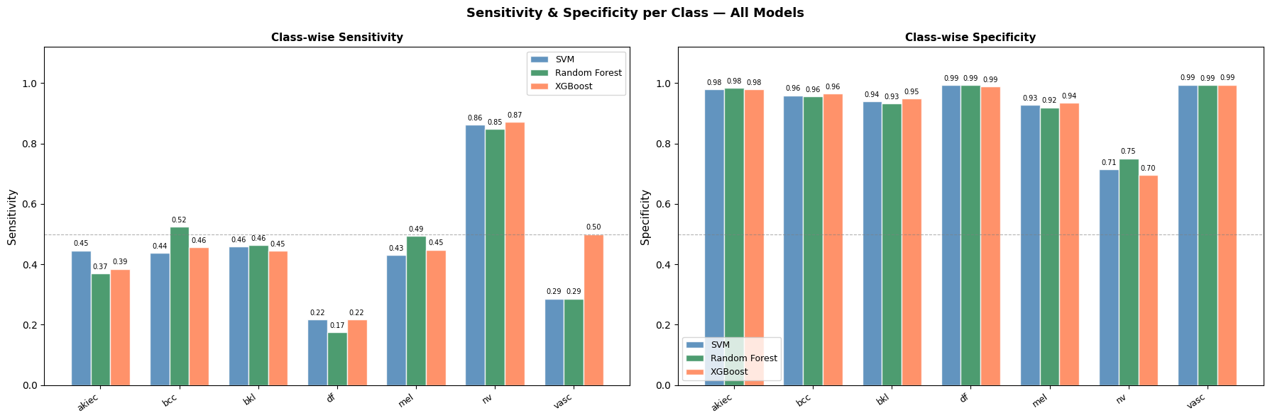
Results — Class-wise Sensitivity & Specificity
member 3 lead
Model | Macro F1 | Precision | Recall | Accuracy
SVM (RBF) | ~0.457 | ~0.509 | ~0.448 | ~71.9%
Random Forest | ~0.455 | ~0.477 | ~0.451 | ~71.9%
XGBoost | ~0.480 | ~0.505 | ~0.475 | ~72.8%
Skin Lesion Classification — Project #16
8 / 10

Slide 11
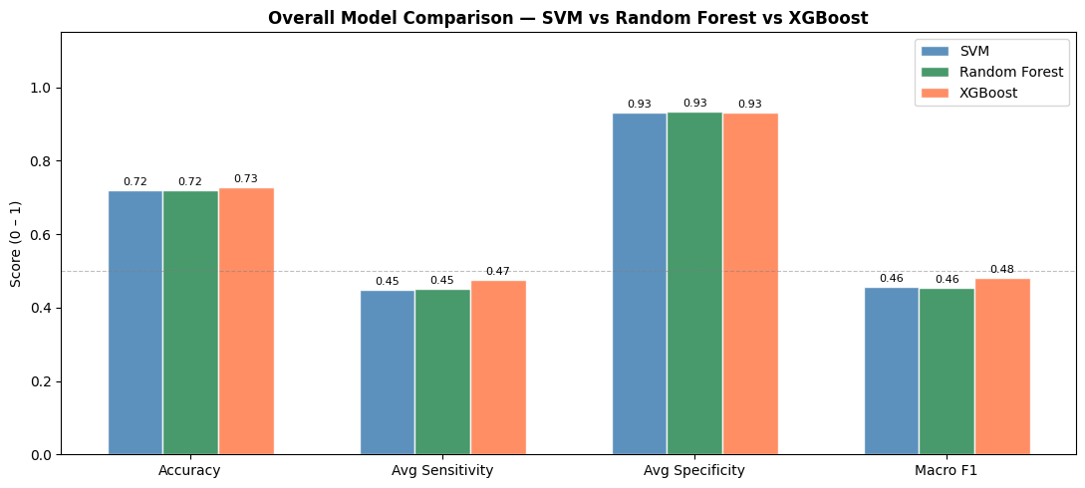
Feature Group Comparison — Clinical Discriminators
member 3 lead
Key Findings
1
HSV colour is the strongest single discriminator — consistent with ABCD criteria where colour variation is a primary melanoma indicator
2
GLCM texture adds significant value — lesion surface roughness differs across benign and malignant types
3
Shape features alone underperform due to segmentation sensitivity — but contribute when combined
4
Combining all three groups gives the best accuracy — feature fusion is essential
Skin Lesion Classification — Project #16
9 / 10

Slide 12
Conclusion
member 3 lead
What we achieved
Classified 7 skin lesion types from images without any deep learning
Extracted 70 handcrafted features: GLCM texture(20), HSV color(48), ABCD shape(2)
SMOTE balanced 7 imbalanced classes — prevented majority-class bias
XGBoost achieved the best macro F1 across all 3 models
HSV colour features are the strongest single clinical discriminator
Full 10-stage data science lifecycle followed end-to-end
Live Streamlit deployment with real-time lesion prediction
GitHub Repo: https://github.com/shiprachoubey540-bit/Skin-Lesion-Type-Classification-Using-Texture-and-Color-Features-with-SVM.git |
Streamlit App: app.py

