Slide 1
A Family of Additive Online Algorithms for Category Ranking
Himanshi Sharma(20172061)
Rajat Agrawal(20172065)
Rishabh Murarka(20172111)
Shipta Golechha(20172053)
( Team - 26 )

Slide 2
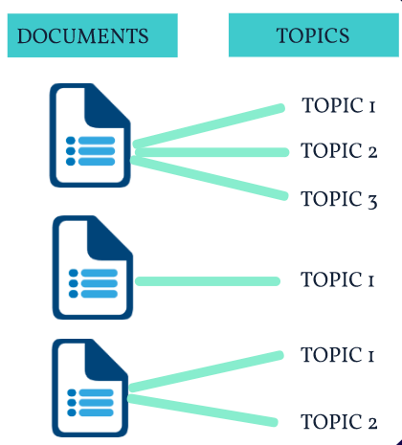

Slide 3
Problem Statement
In this problem we are given access to a stream of documents. Each document is associated with zero or more topics from a predefined set of topics. We denote the set of possible topics by Y and the number of different topics by k (k = |Y| ).
A document is typically associated with more than one topic.
More formally, a document is labeled with a set y belongs to Y of relevant topics.
Given a document, the algorithms we consider return a list of topics ranked according to their relevance. However, the feedback for each document is the set y.

Slide 4
Dataset
We evaluated the algorithms on Reuters - 21578 text corpora from nltk.
The Reuters Corpus contains 10,788 news documents totaling 1.3 million words. The documents have been classified into 90 topics, and grouped into two sets, called "training" and "test".

Slide 5
Notations
S = corpus(set of documents)
T = no. of documents in the corpus
y = set of topics relevant to a particular document
Y = total set of topics corresponding to all the documents
x = vector space model representation corresponding to a particular document

Slide 6
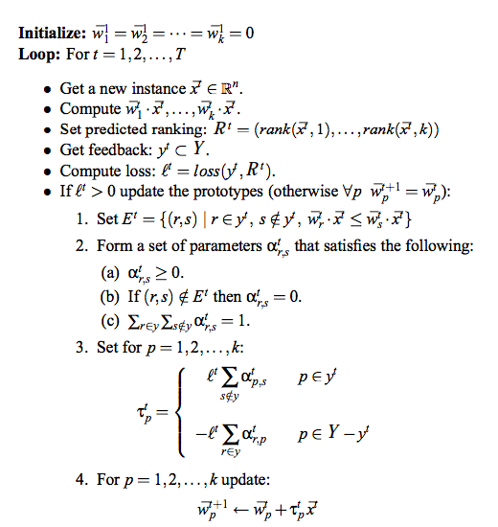
ALGORITHM

Slide 7
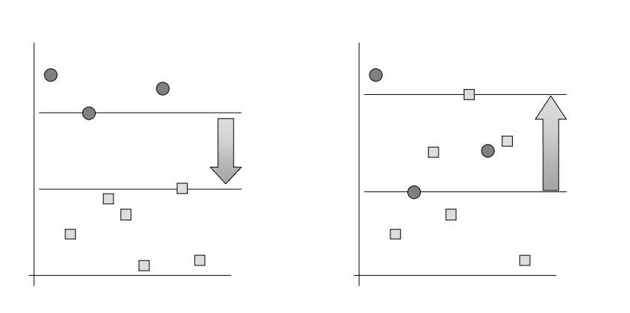
Margin For A Document
We measure the quality of a perfect topic-ranking using the notion of margin.
Margin for a document is defined to be the size of gap between the lowest score among the relevant topics to the highest score among the non - relevant topics.
Perfect Ranking Imperfect Ranking
(Positive Margin) (Negative Margin)

Slide 8
Prototype Update Schemes
UNIFORM UPDATE
MAX UPDATE
MARGIN-PROPORTIONAL UPDATE
RANDOMIZED UPDATE
1
2
3
4

Slide 9
Uniform Update Scheme
The uniform update allocates the same weight for each wrongly ordered pair
(r,s) ∈ E, setting αr,s = 1 / | E | .
In addition, we need to set the weights of all pairs not in the error to 0.

Slide 10
Max Update
Formally, let r be the index of the relevant topic for which wr’.x ≤ wr.x ( r ∈ y ) and similarly s is the index of the non-relevant topic ws’.x ≤ ws.x ( s ∈ y ). Then, αr’s’ is set to 1 and we set the rest of the weights αr,s to zero.

Slide 11
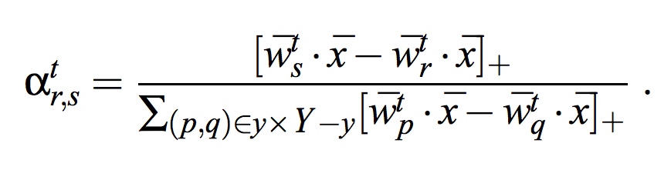
Margin - Proportional Update
In this update, the weight αr,s is proportional to the difference between the inner-products of ̄ x with wr and ws. Then, the margin proportional update is defined to be,

Slide 12
Randomized Update
This update is a randomized version of the uniform update.We choose for each pair ( r,s ) ∈ E a value in [ 0 , 1 ] uniformly at random. We then normalize the weights αr,s so that they sum to one.

Slide 13
RANKING LOSSES
IsErr
ErrSetSize
OneErr
AvgP
maxF1
1
2
3
4
5

Slide 14
IsErr LOSS
It stands for Is-Error. This ranking-loss is simply the indicator of whether the induced ranking is perfect or not.
Formally, IsErr is 1 if | E | > 0 and 0 otherwise.

Slide 15
ErrSetSize LOSS
ErrSetSize measures the size of the error-set | E | for an induced ranking. It is therefore zero if the induced topic ranking is perfect.
In the worst case, when all the relevant topics are ranked below the non-relevant topics, ErrSetSize is | y | ( k -| y | ) .

Slide 16
OneErr LOSS
The OneErr of a single document is defined to be 1 if the top ranked topic is not one of its relevant topics. It is defined to be 0 otherwise.
Formally, OneErr is equal to 1 if ∀r ∈ y : rank(x ̄,r) ≥ 1 and is 0 otherwise. Therefore, the average OneErr of a corpus reflects the fraction of times the top ranked topic was a non-relevant topic.

Slide 17
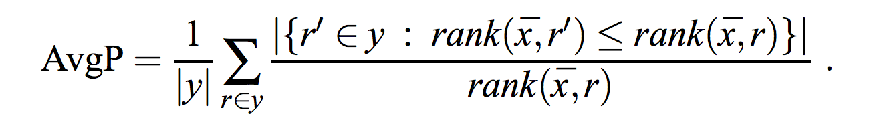
1 - AvgP LOSS
AvgP is an abbreviation of average-precision. AvgP measures the average proportion of relevant topics in a ranked list of topics. The average is taken over all of the positions of the relevant topics in the ranked list and is formally defined as,
We use 1 − AvgP as the ranking-loss for average precision.

Slide 18
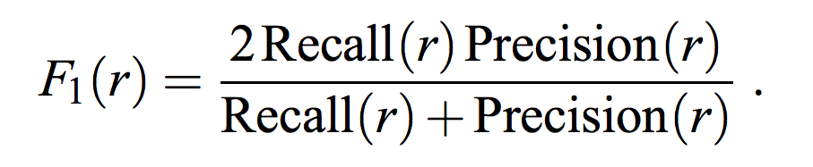
maxF1 LOSS
Given a ranked list of topics, recall-at-r is defined as the fraction of relevant topics down to position r out of the total number of relevant topics for the document. Precision-at-r is the fraction of relevant topics in the top r positions. We denote the two values as Recall(r) and Precision(r). The F1 value at r is defined as,
We use 1 − maxF1 as the ranking-loss for average precision.

Slide 19
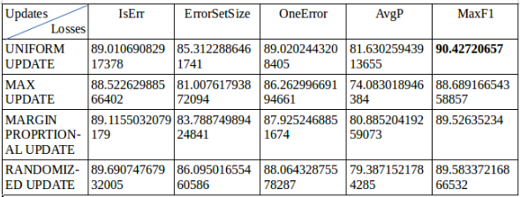
Accuracies for different types of update and loss functions

Slide 20
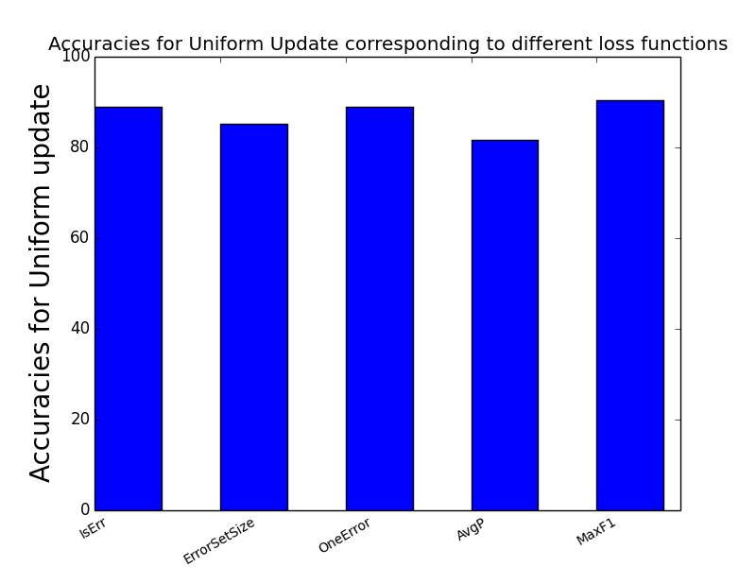
Bar Graph for accuracies of Uniform Update

Slide 21
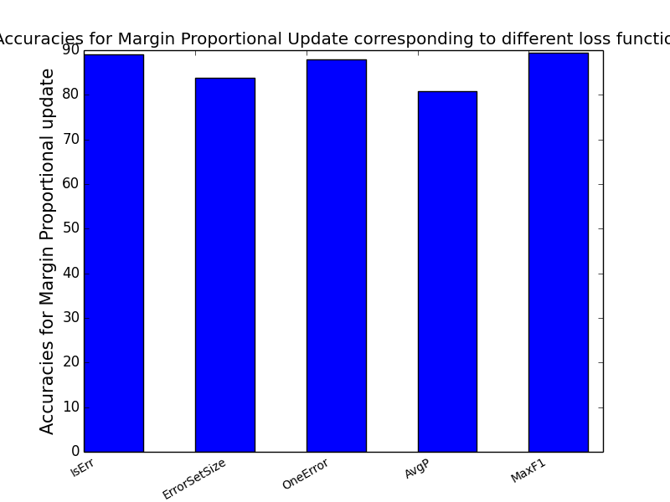
Bar Graph for accuracies of Margin Proportional Update

Slide 22
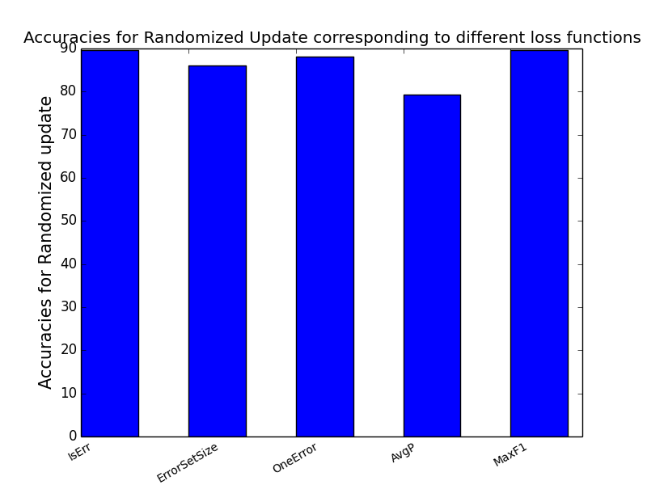
Bar Graph for accuracies of Randomized Update

Slide 23
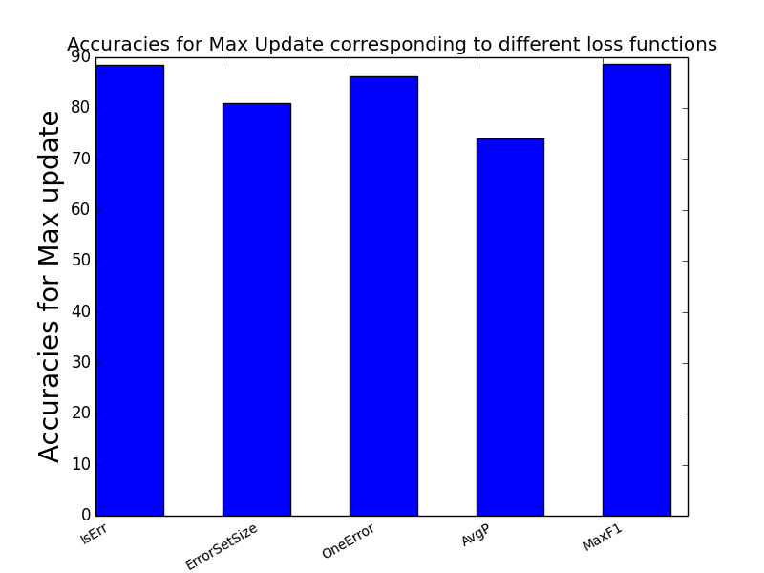
Bar Graph for accuracies of Max Update

Slide 24
THANK YOU

