Slide 1
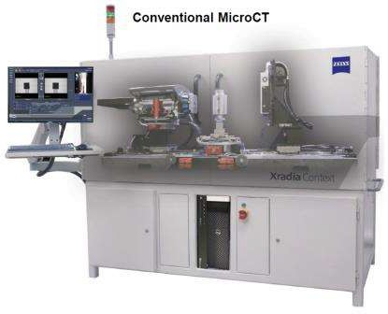
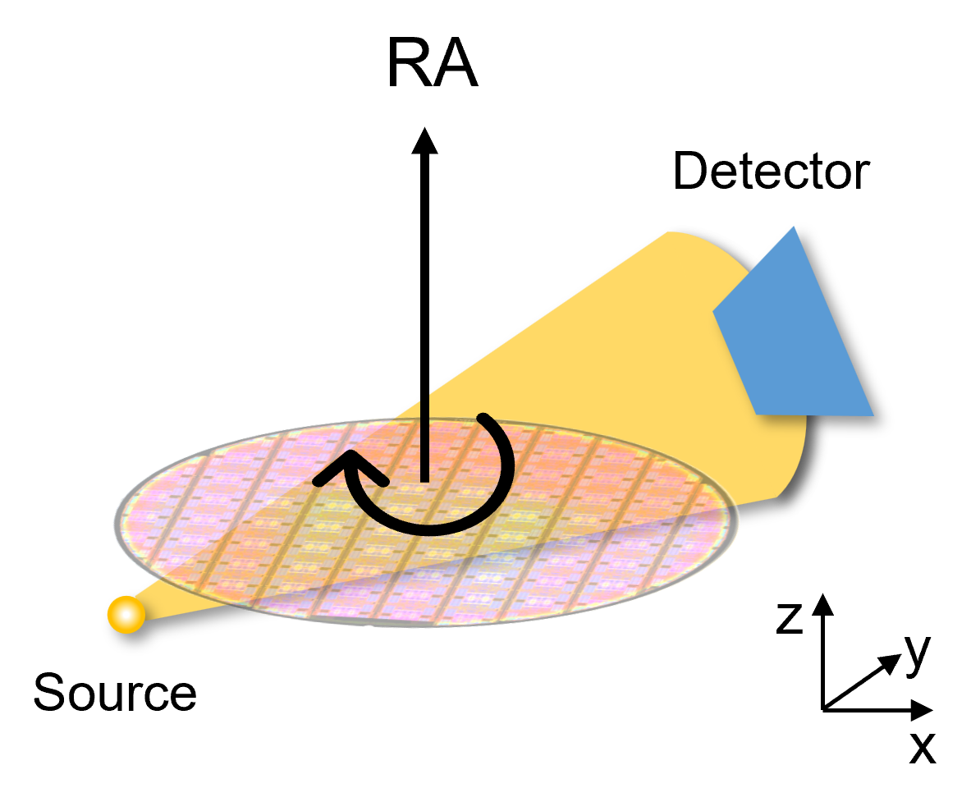
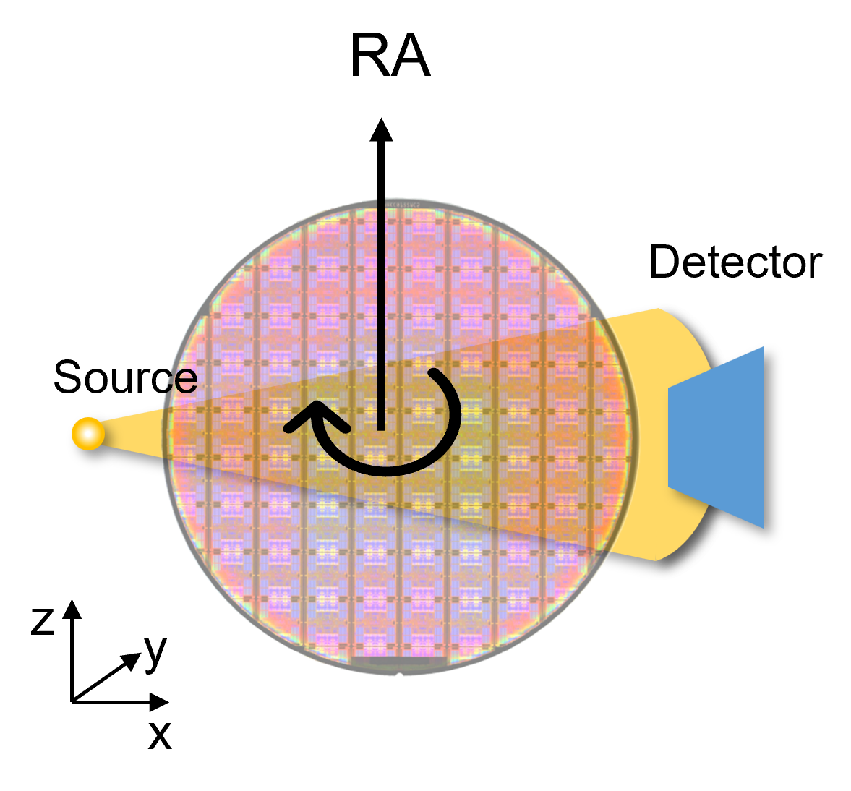
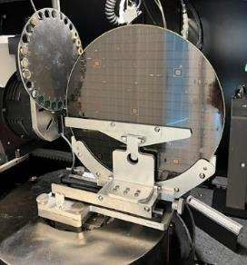
Classical High-Res MicroCT – Xradia Versa
Rotational laminographic CT
Circular trajectory is best for cylindrical object
Laminographic geometry allows for rapid imaging of larger flat samples

Slide 2
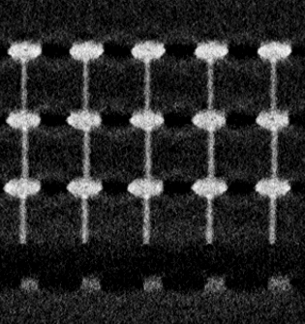

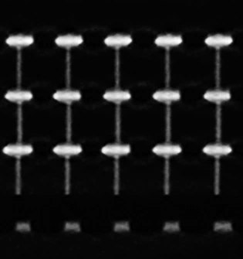
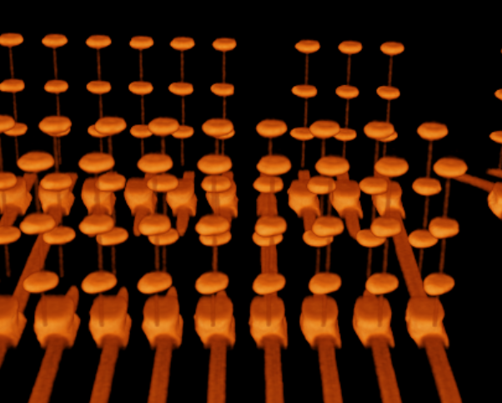
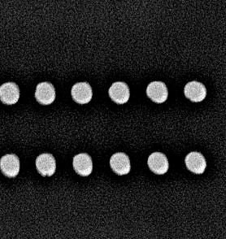
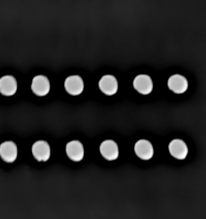
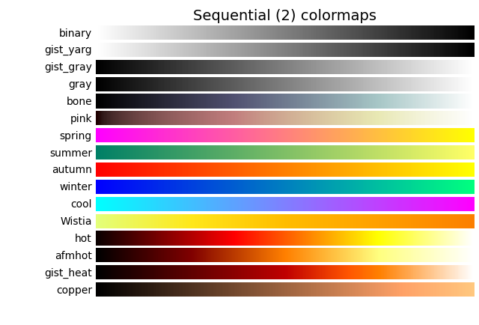
Laminographic computed tomography (LCT)
Results: a DRAM chip with TSVs and microbumps; 2mins scan
Filtered back-projection
ZEISS DeepRecon
Proposed workflow
3D rendering
Sagittal Slice1
Slice1
Slice2
y
z
x
60μm
Transverse Slice2
100μm
Notes:
2 min scan

