Slide 1
IBM University Engagement Project Submission
“Exploring the Power of Agentic AI with IBM Granite and IBM Bob”

Slide 2

Project Tile – [India Travel Agent]
Domain of Project – [Travel & Tourism]
Student Name | Recent Passport Photo | Email ID | Mobile number [WhatsApp]
Iqra tabassum |  | shiqratabassum@gmail.com | 8095316103

Slide 3
Problem Statement -
Problem Statement : Travel Planner Agent
The Challenge
A Travel Planner Agent is an AI-powered assistant that helps users plan trips efficiently and intelligently. It understands user preferences, budget and travel constraints to create personalized travel plans. It can suggest destinations, build itineraries, and recommend suitable travel options, making trip planning easier and more convenient.
The Objective
Understand user travel preferences and budget.
Suggest suitable destinations.
Create personalized travel itineraries.
Recommend transportation and accommodation options.
Provide useful travel information.
Make travel planning faster and easier.

Slide 4
Proposed Solution -
The proposed solution is an AI-powered Travel Planner Agent built using IBM Bob, IBM watsonx.ai, and AI models to help users plan trips efficiently and conveniently.
The system understands user requirements such as destination, travel duration, budget, starting location, interests, and preferences to generate personalized travel plans.
The Travel Planner Agent can:
Suggest suitable destinations based on user preferences and budget.
Create personalized itineraries with day-wise travel plans and activities.
Recommend transportation options such as flights, trains, buses, and local travel.
Suggest accommodation options based on the user's budget and requirements.
Provide travel information such as popular attractions, food, and activities.
Answer travel-related questions through an interactive chat interface.

Slide 5
Technology Used
IBM Bob – AI-assisted project development
IBM watsonx.ai – AI model integration
IBM Granite – Generative AI model
Node.js – Backend development
Express.js – API and server
HTML, CSS & JavaScript – Frontend
REST API – Frontend and backend communication

Slide 6
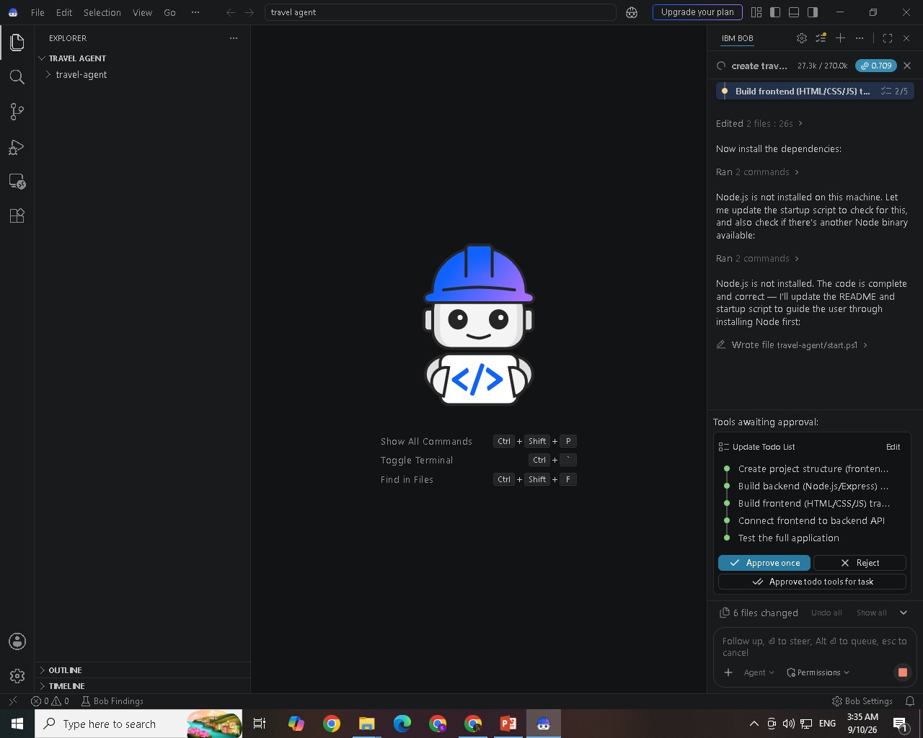
Required Files created using IBM bob -

Slide 7
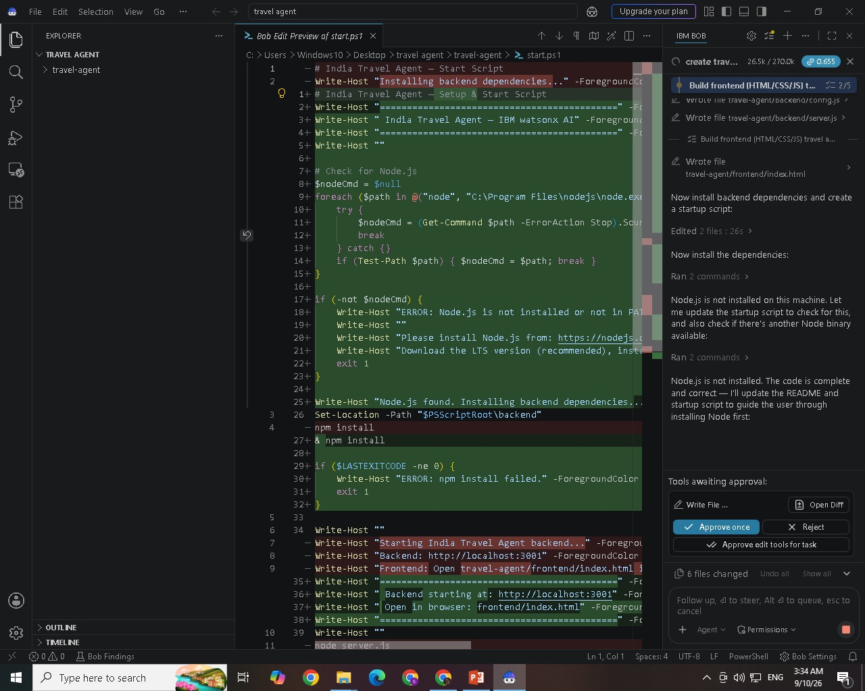
IBM Bob Screenshots:

Slide 8
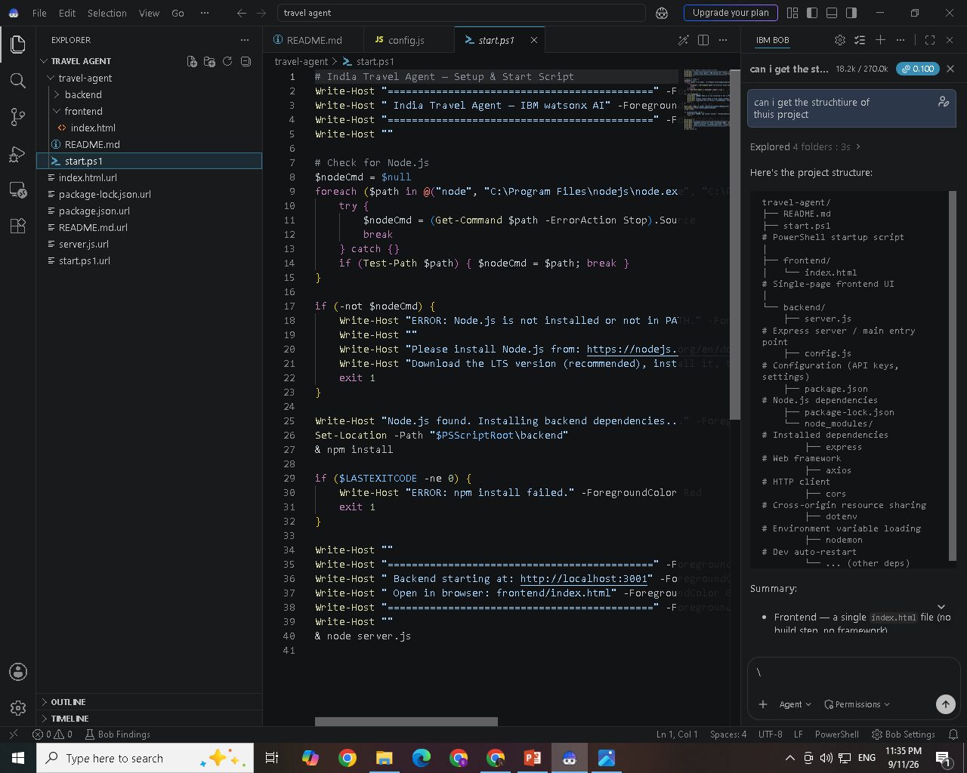

Slide 9
Architecture blueprint for IBM bob:
travel-agent/
├── README.md
├── start.ps1 # PowerShell startup script
│
├── frontend/
│ └── index.html # Single-page frontend UI
│
└── backend/
├── server.js # Express server / main entry point
├── config.js # Configuration (API keys, settings)
├── package.json # Node.js dependencies
├── package-lock.json
└── node_modules/ # Installed dependencies
├── express # Web framework
├── axios # HTTP client
├── cors # Cross-origin resource sharing
├── dotenv # Environment variable loading
├── nodemon # Dev auto-restart
└── ... (other deps)

Slide 10

Role of Agentic AI in the solution
Role of Agentic AI in Nutrition Agent
Agentic AI enables the Nutrition Agent to function as an intelligent, autonomous system rather than a simple chatbot. Using IBM watsonx.ai and IBM Granite models, it coordinates multiple specialized agents to deliver personalized nutrition guidance.
Each agent performs a specific role—such as retrieving nutritional data, generating diet plans, providing health advice, and analyzing food logs—while working collaboratively. This multi-agent approach ensures efficient task execution and accurate results.
Agentic AI also brings context awareness, understanding user details like age, health conditions, and fitness goals to generate tailored recommendations. It supports real-time adaptation, continuously updating suggestions based on user inputs like daily meals.
Additionally, agents communicate with each other, enabling better decision-making and improved outcomes.
Overall, Agentic AI makes the system proactive, personalized, and goal-driven, acting like a smart digital nutritionist that helps users maintain a healthy lifestyle.

Slide 11
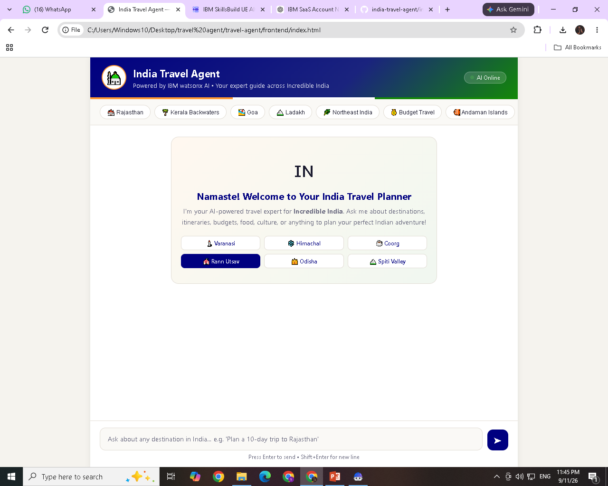
Project Output Screenshot
·
·
·

Slide 12
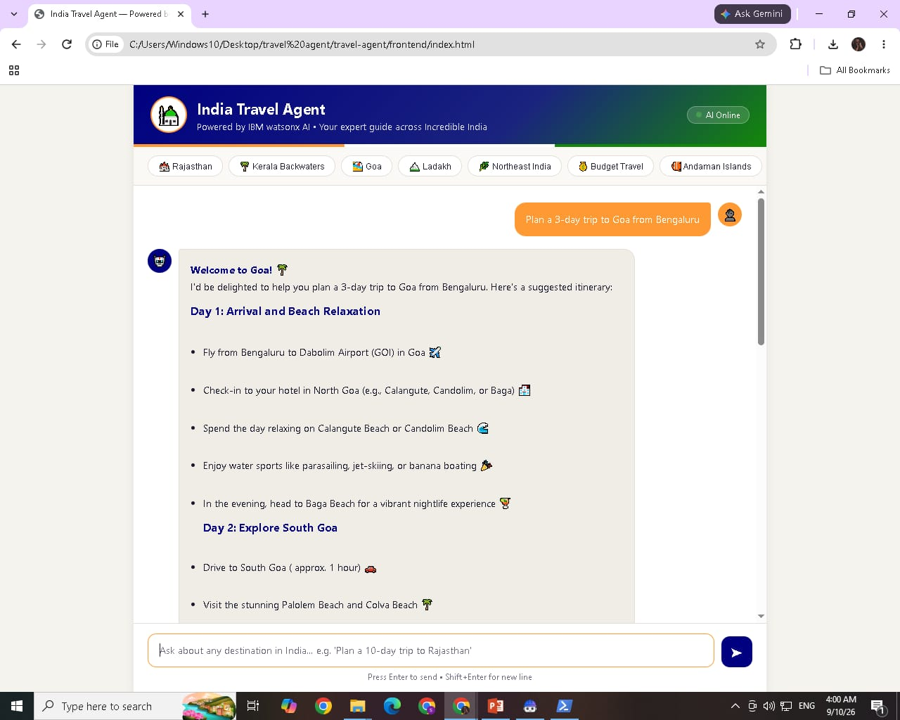
Project Output Screenshot
·
·

Slide 13
Novelty and Uniqueness
The proposed Travel Planner Agent stands out by combining Agentic AI, personalization, and intelligent travel planning into a single smart system.
Personalized Travel Planning – Creates customized travel plans based on the user's destination, budget, trip duration, and preferences.
Intelligent Itinerary Generation – Automatically generates organized day-wise itineraries, making trip planning easier and more efficient.
Conversational AI – Allows users to interact naturally with the travel agent and refine their plans through a web-based chat interface.
Smart Travel Recommendations – Suggests suitable destinations, activities, transportation, and accommodation options based on user requirements.
Budget-Aware Planning – Considers the user's budget while creating practical and affordable travel plans.
Interactive User Experience – Provides quick suggestions and supports multi-turn conversations for a more engaging planning experience.
IBM Granite-Powered AI – Uses IBM watsonx.ai and IBM Granite 3.3 8B Instruct to generate intelligent and context-aware travel recommendations.
This makes the solution a smart, personalized, and interactive travel planning assistant, rather than just a static travel information website.

Slide 14
Git Hub Link
Github URL – https://github.com/shiqrat/india-travel-agent
·
·
·

Slide 15
Future Scope
Integrate real-time weather and traffic information.
Add Google Maps/location services for better route planning.
Provide real-time flight, train, and hotel recommendations.
Add voice-based interaction for easier travel planning.
Support multiple languages for different users.
Add personalized recommendations based on user preferences and previous trips.
Enable budget tracking and travel expense estimation.
Add booking and change-alert features for flights, hotels, and activities.
·
·
·

Slide 16
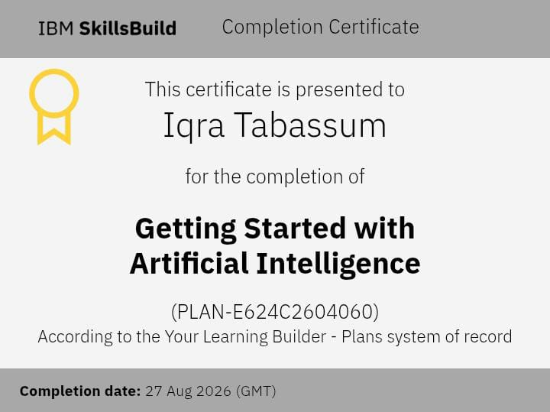
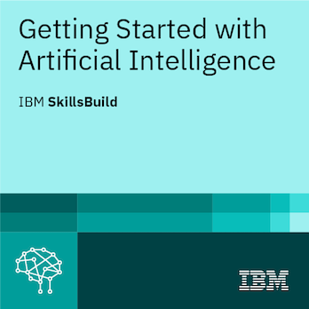
Certificates Earned:
Please add your credly certificate(Getting Started with Artificial Intelligence)

Slide 17
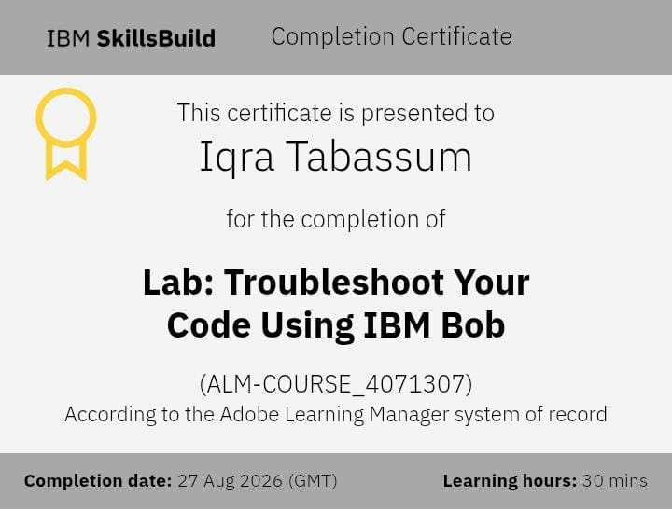
Certificates Earned:​

Slide 18


