Slide 1
實例
Example 1-1

Slide 2
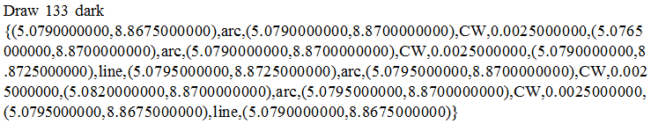
Example1-1
polygonset [ 0 ]
PolyNode
PE_cirLinkedList
command=“Draw”
id=133
str=“dark”
type=“0”
PELL
PEnode
❶
❷
❸
 | x=5.0790
 | y=8.8675
 | segment=0 (arc)
 | center_x=5.07900
 | center_y=8.87000
 | dir=0 (CW)
 | radius=0.00250
 | x=………..
 | y=………..
 | segment=0 (arc)
 | center_x=5.07900
 | center_y=8.87000
 | dir=0 (CW)
 | radius=0.00250
 | x=………..
 | y=………..
 | segment=1 (line)
 | center_x=0.0
 | center_y=0.0
 | dir=0
 | radius=0.0
❹
❺
❻
 | …
 | …
 | …
❸(5.0790,8.8725)
❹(5.0795,8.8725)
❷(5.0765,8.8700)
❺(5.0820,8.8700)
❶(5.0790,8.8675)
❻(5.0795,8.8675)

Slide 3
(Pt_LinkedList)
兩個單向串列: X軸(*XList) & Y軸(*YList)
Pt_LinkedList* XList
PtNode
PtNode
PtNode
PtNode
5.0765
N
5.0790
N
5.0795
N
5.0820
vertexHEAD
vertexHEAD
vertexHEAD
vertexHEAD
Pt_LinkedList* YList
PtNode
❸(5.0790,8.8725)
❹(5.0795,8.8725)
PEnode
hz
PEnode
8.8725
3
4
vertexHEAD
N
vt
vt
PtNode
❷(5.0765,8.8700)
❺(5.0820,8.8700)
8.8700
2
5
vertexHEAD
PEnode
hz
PEnode
N
PtNode
8.8675
1
6
vertexHEAD
PEnode
hz
PEnode
❶(5.0790,8.8675)
❻(5.0795,8.8675)

Slide 4
架構
Vector & CircularDoubleLinkedList

Slide 5
Vector<PolyNode*> polygonset
string command
int id
string str
string type
PE_cirLinkedList *PELL
→“Draw/Flash/Region”
→polygon的代號
→“dark/clear”
→“[0]/[1]/[2]/…..”的數值部分
→存放Circular DoubleLinkedList的指標: PE_cirLinkedList *
PolyNode

Slide 6
PE_cirLinkedList *PELL
(start) PEnode
PEnode
Data
Data
*P |  |  | *N
*vt |  | *hz
*P |  |  | *N
*vt |  | *hz
PEnode
PEnode
PEnode
PEnode
儲存頂點座標值(x, y)
double x | double y
bool segment
double center_x | double center_y
bool dir
double radius
segment=0, 代表是弧線; segment=1, 代表是直線.
segment=0(弧線), 存入圓心座標; 否則(直線), 預設值為(0.0 , 0.0).
順時針(dir=0)或逆時針方向(dir=1)
半徑長
PEnode.data

Slide 7
Pt_LinkedList
PtNode
PtNode
PtNode
X1
N
X2
N
X3
N
X4
vertexHEAD
vertexHEAD
vertexHEAD
5
vertexHEAD
PEnode
1
2
8
PEnode
PEnode
PEnode
PtNode
double value
PtNode *N
PEnode *vertexHEAD

Slide 8
輸出格式
Pt_LinkedList
Example 1-1~2-1 (以3種polygons為例)

Slide 9
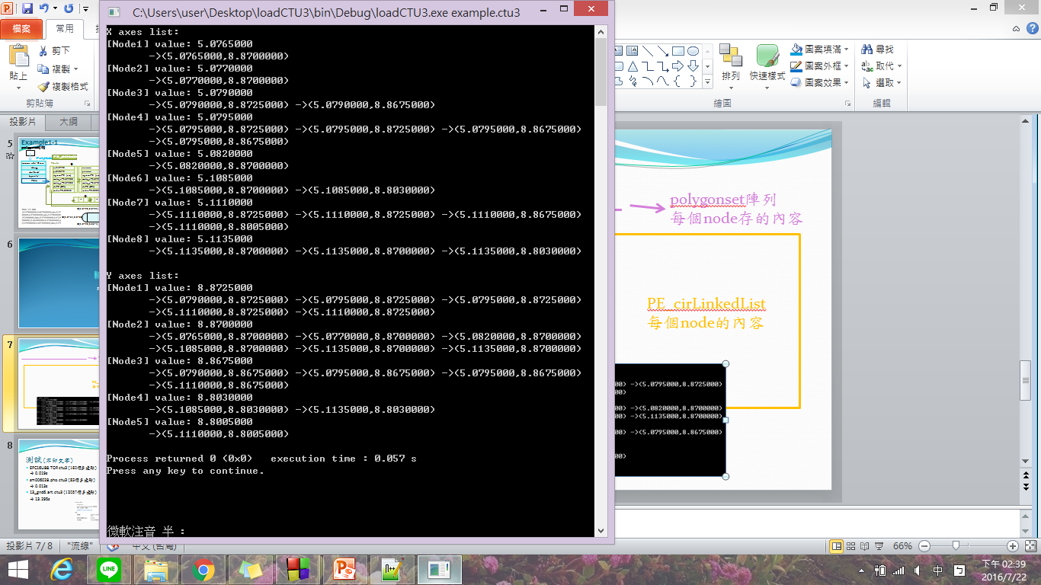
*XList 內容
*YList 內容

Slide 10
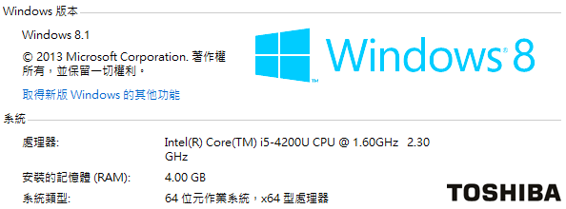
測試(不印文字)
EPC16U88.TOP.ctu3 (160個多邊形) → 0.019s
sm006028.pho.ctu3 (83個多邊形)
→ 0.013s
13_gnd6.art.ctu3 (12057個多邊形)
→ 13.295s

Slide 11
Problem
Same vertexs

Slide 12
X1
X2
X3
X4
Y2
5
頂點1,頂點6位置相等:value=(x2,y2)
1
2
6
Y3
8
Y4
7
Y5
4
3
這條linkedlist應該存成?(next page)

Slide 13
應為 case1 or case2 ?
Case1:
Case2:
X3
X3
存成重複value的2個nodes
已經存入 頂點1 node 後,
頂點6因為value與頂點1相同,
忽略不存。
value=(x2,y2)
1
value=(x2,y2)
6
1
value=(x2,y2)
6
4
4

