Slide 1
line-sweep-algorithms
Decrease y first,
and then Increase x.

Slide 2
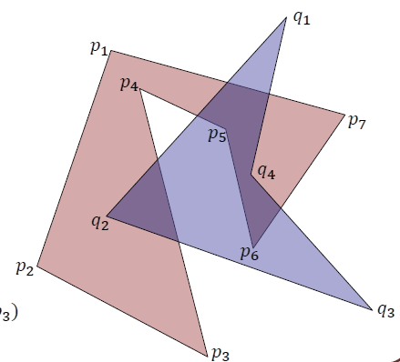
new_seg1 = q1->prev = q2 (seg: q2q1)
線段資訊存在起點
new_seg2 = q1 (seg: q1q4)
判斷新掃到的兩個線段起點 有沒有在seg_pool中:
沒有→計算與seg_pool集合 有無相交and交點
沒相交→存入seg_pool & union
seg_pool = [ ]
union = [ ]

Slide 3
new_seg1 = q1->prev = q2 (seg: q2q1)
線段資訊存在起點
new_seg2 = q1 (seg: q1q4)
判斷新掃到的兩個線段起點 有沒有在seg_pool中:
沒有→計算與seg_pool集合 有無相交and交點
沒相交→存入seg_pool & union
seg_pool = [ q2, q1 ]
union = [ q2, q1 ]

Slide 4
new_seg1 = p1->prev = p2 (seg: p2p1)
線段資訊存在起點
new_seg2 = p1 (seg: p1p7)
判斷新掃到的兩個線段起點 有沒有在seg_pool中:
沒有→計算與seg_pool集合 有無相交and交點
有相交
→求交點i, 加到union
seg_pool = [ q2, q1 ]
union = [ q2, q1 ]

Slide 5
new_seg1 = p1->prev = p2 (seg: p2p1)
線段資訊存在起點
new_seg2 = p1 (seg: p1p7)
判斷新掃到的兩個線段起點 有沒有在seg_pool中:
沒有→計算與seg_pool集合 有無相交and交點
有相交
→求交點i, 加到union
→兩個線段起點 存入seg_pool & union
seg_pool = [ q2, q1 ]
union = [ q2, q1, i1, i2 ]

Slide 6
new_seg1 = p1->prev = p2 (seg: p2p1)
線段資訊存在起點
new_seg2 = p1 (seg: p1p7)
判斷新掃到的兩個線段起點 有沒有在seg_pool中:
沒有→計算與seg_pool集合 有無相交and交點
有相交
→求交點i, 加到union
→兩個線段起點 存入seg_pool & union
seg_pool = [ q2, q1, p2, p1 ]
union = [ q2, q1, i1, i2, p2, p1 ]

Slide 7
new_seg1 = p7->prev = p1 (seg: p1p7)
線段資訊存在起點
new_seg2 = p7 (seg: p7p6)
判斷新掃到的兩個線段起點 有沒有在seg_pool中:
一條有→delete 該 seg in seg_pool
一條沒有→計算與seg_pool集合 有無相交and交點
seg_pool = [q2, q1, p2, p1, p5, p4 ]
union = [ q2, q1, i1, i2, p2, p1, i3, i4, p5, p4 ]

Slide 8
new_seg1 = p7->prev = p1 (seg: p1p7)
線段資訊存在起點
new_seg2 = p7 (seg: p7p6)
判斷新掃到的兩個線段起點 有沒有在seg_pool中:
一條有→delete 該 seg in seg_pool
一條沒有→計算與seg_pool集合 有無相交and交點
seg_pool = [q2, q1, p2, p1, p5, p4 ]
union = [ q2, q1, i1, i2, p2, p1, i3, i4, p5, p4 ]

Slide 9
new_seg1 = p7->prev = p1 (seg: p1p7)
線段資訊存在起點
new_seg2 = p7 (seg: p7p6)
判斷新掃到的兩個線段起點 有沒有在seg_pool中:
一條有→delete 該 seg in seg_pool
一條沒有→計算與seg_pool集合 有無相交and交點
沒有相交→剩下一個線段起點 存入seg_pool & union
seg_pool = [q2, q1, p2, p5, p4 ]
union = [ q2, q1, i1, i2, p2, p1, i3, i4, p5, p4 ]

Slide 10
new_seg1 = p7->prev = p1 (seg: p1p7)
線段資訊存在起點
new_seg2 = p7 (seg: p7p6)
判斷新掃到的兩個線段起點 有沒有在seg_pool中:
一條有→delete 該 seg in seg_pool
一條沒有→計算與seg_pool集合 有無相交and交點
沒有相交→剩下一個線段起點 存入seg_pool & union
seg_pool = [q2, q1, p2, p5, p4, p7 ]
union = [q2, q1, i1, i2, p2,
p1, i3, i4, p5, p4, p7 ]

Slide 11
同一個線段遇到第二次就會在seg_pool被刪除，
因此當seg_pool被清空時，
代表一個完整的union會產生(包含找到的交點)
此時掃描線到達最下面的頂點。
seg_pool = [ ]
union = [ q2, q1, i1, i2, p2,
p1, i3, i4, p5, p4, p7,
p6, i5, q4, i6, q3, p3 ]

Slide 12
目前進度
1. Gain and Sort union vertex.
2. Point of intersection about Arc.

Slide 13
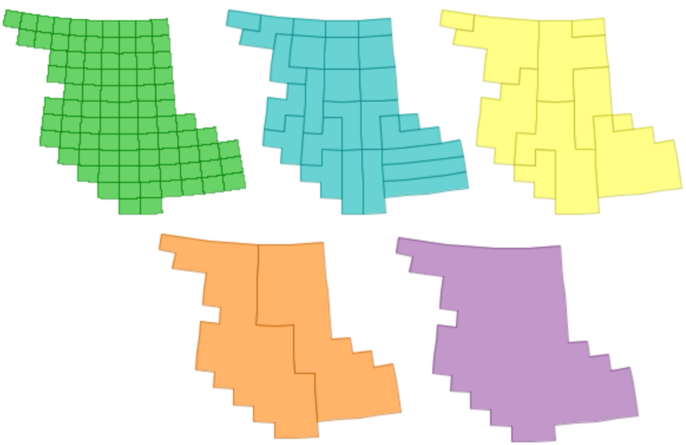
1. Gain and Sort union vertex
union為一個tree的結構，
Using Cascaded Union
http://lin-ear-th-inking.blogspot.tw/2007/11/fast-polygon-merging-in-jts-using.html
The idea is to union small subsets of the input together,
then union groups of the resulting polygons,
and so on recursively until the final union of all areas is computed.
This can be thought of as a post-order traversal of a tree,
where the union is performed at each interior node──2007

Slide 14
1. Gain and Sort union vertex
Other method:
Using Library──Boost
http://www.boost.org/doc/libs/master/libs/geometry/doc/html/geometry/reference/algorithms/union_.html
可能要更改polygon的儲存結構

Slide 15
2. Point of intersection about Arc.
https://accu.org/index.php/journals/345

