Slide 1
架構
Vector & CircularDoubleLinkedList

Slide 2
Vector<PolyNode*> polygonset
string command
int id
string str
string type
PE_cirLinkedList *PELL
→“Draw/Flash/Region”
→polygon的代號
→“dark/clear”
→“[0]/[1]/[2]/…..”的數值部分
→存放Circular DoubleLinkedList的指標: PE_cirLinkedList *
PolyNode

Slide 3
PE_cirLinkedList *PELL
(start) PEnode
PEnode
Prev
Data
Next
儲存頂點座標值(x, y)
long double x | long double y
bool segment
long double center_x | long double center_y
bool dir
long double radius
segment=0, 代表是弧線; segment=1, 代表是直線.
segment=0(弧線), 存入圓心座標; 否則(直線), 預設值為(0.0 , 0.0).
順時針(dir=0)或逆時針方向(dir=1)
半徑長
PEnode.data

Slide 4
實例
Example 1-1, 1-2 2-1, 2-2 3-1, 3-2

Slide 5
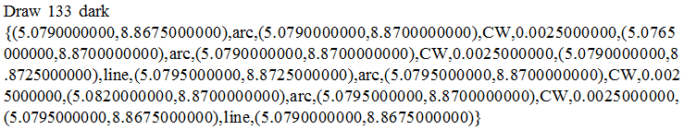
Example1-1
polygonset [ 0 ]
PolyNode
PE_cirLinkedList
command=“Draw”
id=133
str=“dark”
type=“0”
PELL
PEnode
❶
❷
❸
 | x=5.0790
 | y=8.8675
 | segment=0 (arc)
 | center_x=5.07900
 | center_y=8.87000
 | dir=0 (CW)
 | radius=0.00250
 | x=………..
 | y=………..
 | segment=0 (arc)
 | center_x=5.07900
 | center_y=8.87000
 | dir=0 (CW)
 | radius=0.00250
 | x=………..
 | y=………..
 | segment=1 (line)
 | center_x=0.0
 | center_y=0.0
 | dir=0
 | radius=0.0
❹
❺
❻
 | …
 | …
 | …
❸(5.0790,8.8725)
❹(5.0795,8.8725)
❷(5.0765,8.8700)
❺(5.0820,8.8700)
❶(5.0790,8.8675)
❻(5.0795,8.8675)

Slide 6
輸出格式
polygonset PE_cirLinkedList

Slide 7
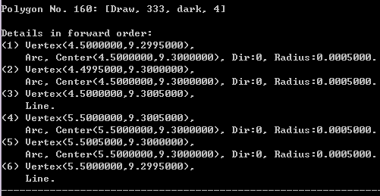
polygonset陣列 每個node存的內容
PE_cirLinkedList 每個node的內容

Slide 8
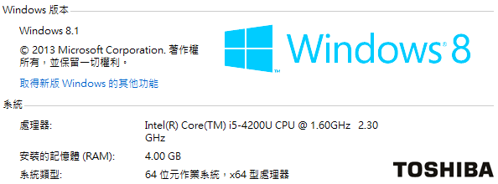
測試(不印文字)
EPC16U88.TOP.ctu3 (160個多邊形) → 0.031s
sm006028.pho.ctu3 (83個多邊形)
→ 0.016s
13_gnd6.art.ctu3 (12057個多邊形)
→ 2.147s

