Slide 1
מצגת 1 – Web Application Framework

Slide 2
Web Application Framework
Web Application Framework (WAF) is a software framework that provides a foundation and a set of tools for building web applications. It typically includes a collection of libraries, modules, and tools that facilitate the development of web applications by providing pre-written code and functionality for common tasks, such as handling HTTP requests and responses, managing user sessions, accessing databases, and rendering HTML templates.

Slide 3
אז באיזה WAF בחרנו?
Spring Framework

Slide 4
אז מהו spring?
The Spring Framework is a popular open-source Java framework that provides a comprehensive set of tools and features for building enterprise-grade Java applications. It follows the Model-View-Controller (MVC) architectural pattern and offers a wide range of modules and components that can be used to develop different aspects of a Java application.

Slide 5
אז מה spring מאפשר?
Inversion of Control (IoC): The Spring Framework implements the concept of Inversion of Control, where the control of creating and managing objects is shifted from the application code to the framework. This allows for loose coupling between components and promotes modular and maintainable code.
Dependency Injection (DI): Spring's DI is a key feature that allows developers to define dependencies between components in a configuration file or through annotations, and the framework takes care of injecting the dependencies at runtime. This helps to manage complex object dependencies and promotes code reusability.
Aspect-Oriented Programming (AOP): Spring provides AOP support, allowing developers to define and apply cross-cutting concerns, such as logging, security, and transaction management, separately from the core application logic. This promotes modularity and separation of concerns.
Spring MVC: Spring MVC is a powerful web framework that provides a model-view-controller architecture for building web applications. It includes features such as request handling, view resolution, data binding, and validation, making it a comprehensive solution for building web applications.

Slide 6
אז מה spring מאפשר?
Data Access: Spring offers various modules for data access, such as JDBC (Java Database Connectivity), JPA (Java Persistence API), and Spring Data, which simplify working with databases and other data sources in Java applications.
Security: Spring provides robust security features for securing Java applications, including authentication, authorization, and role-based access control (RBAC), which can be easily configured and integrated into an application.
Transaction Management: Spring supports declarative transaction management, allowing developers to define transactions using annotations or XML configurations. This simplifies managing database transactions in Java applications.
Testing: Spring provides extensive support for testing, including integration testing, unit testing, and mocking, making it easier to write tests for Spring-based applications.

Slide 7
איך תעזרו בסביבה הזאת בגרסה הבאה. ואילו התאמות אתם/ן תצטרכו לבצע כדי להשתמש בסביבה?

Slide 8
Web service
A web service is a standardized way for software applications to communicate and exchange data over the internet. It allows different applications, regardless of their programming languages or platforms, to interact with each other and share data in a machine-readable format, typically using the HTTP (Hypertext Transfer Protocol) protocol.

Slide 9
איזה Web service spring מספקת?
Spring supports both SOAP-based web services and RESTful web services.
ובמה נשתמש?
RESTful web services!
Spring provides support through the Spring MVC module, which is a part of the larger Spring Framework. Spring MVC allows developers to build RESTful web services by defining REST endpoints using annotations or XML configurations, and handling HTTP requests and responses in a RESTful manner. Spring MVC supports features such as content negotiation, URI pattern mapping, request and response handling, and data binding, making it a powerful tool for building RESTful web services.

Slide 10
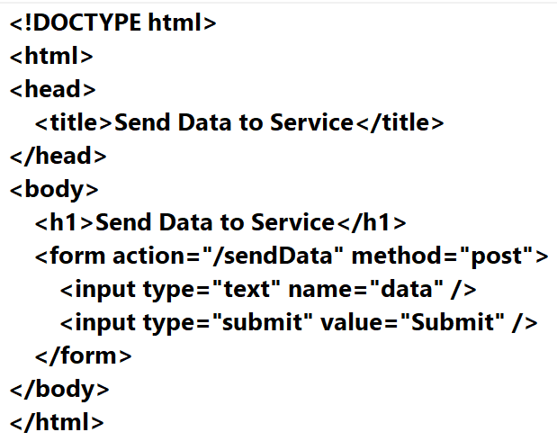
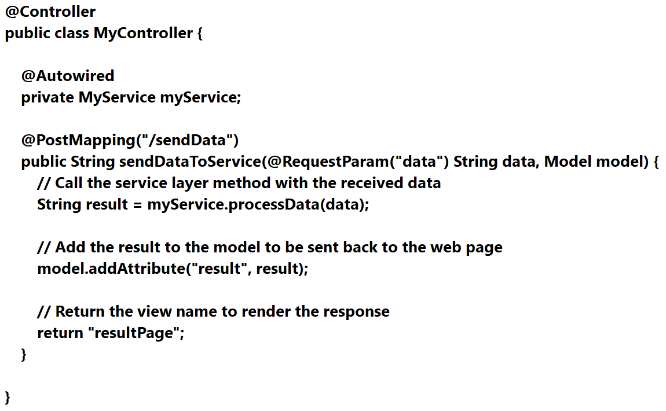
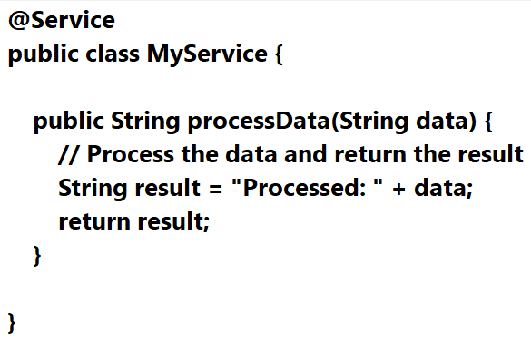
הדגם/ י בעזרת הכלי כיצד ניתן לממש דף web השולח מידע לשכבת השירות ומקבל ממנה מידע חזרה

Slide 11
איך spring עוזר בלשלוח התראות בזמן אמת למשתמש?
WebSocket: Spring provides built-in support for WebSocket, which is a protocol that allows for bidirectional communication between a client and a server in real-time. With Spring's WebSocket support, you can easily implement real-time messaging, notifications, and updates between clients and the server. You can use the Spring WebSocket API, along with a WebSocket-capable library such as SockJS or STOMP, to implement real-time communication between clients and the server.
Spring WebFlux: Spring WebFlux is a reactive web framework that is built on the Reactive Streams API and provides support for reactive programming in Spring applications. You can use Spring WebFlux to handle incoming requests and send real-time notifications to clients using reactive programming paradigms. For example, you can use Flux or Mono types from the Reactive Streams API to represent streams of data and push updates to clients in real-time.
Spring Integration: Spring Integration is a framework for building message-driven applications, which can be used to send notifications asynchronously in real-time. You can use Spring Integration's message channels, routers, and adapters to configure and route messages to different destinations, such as websockets, email, or SMS, to send notifications to clients in real-time based on events or triggers in your application.
Spring Cloud Stream: Spring Cloud Stream is a framework for building event-driven microservices that can be used to send and process events in real-time. You can use Spring Cloud Stream's bindings to send events to message brokers, such as Kafka or RabbitMQ, and configure consumers to process events and send notifications to clients in real-time based on the events received.
Push Notifications: Spring can be integrated with other third-party services, such as Firebase Cloud Messaging (FCM) or Apple Push Notification Service (APNS), to send push notifications to clients in real-time. You can use Spring's HTTP clients, such as RestTemplate or WebClient, to send requests to these services and trigger push notifications to be delivered to the clients' devices.

