Slide 1
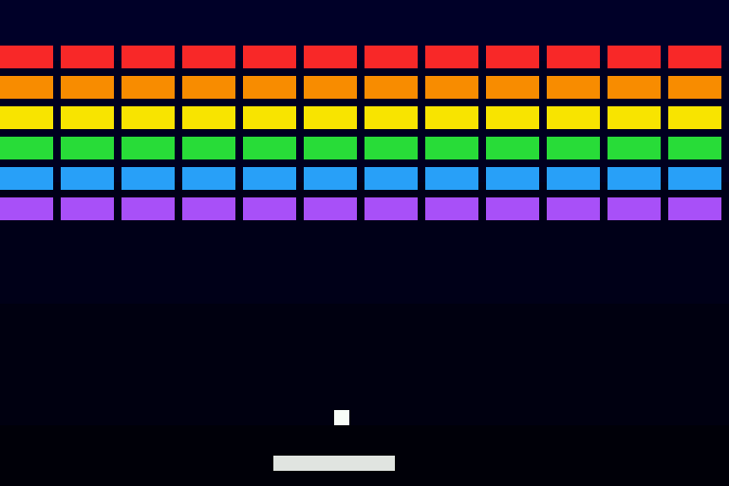
A pipelined RISC-V that plays Breakout
CG3207 Assignment 4, Group 39 (Friday)
5-stage pipeline + hazard unit, branch prediction, byte/half-word load/store, interrupts, and a live switch to turn the enhancements off
Rendered from simulation: what the OLED shows
Notes:
One program, one bitstream. The DIP switches change how the CPU behaves while the game runs, so the speed-up is shown live.

Slide 2
Five stages, no nops needed
F
D
E
M
W
PC, PC+4, BTB lookup
Decode, RegFile, Extend
ALU, MCycle, branch resolve
DMEM / MMIO, StoreAlign
LoadExtend, write back
Hazard | Handled by | Cost
ALU result used next | Forward M→E, W→E | 0
Written in W, read in D | RegFile write-through | 0
Load, then use | Stall F, D; bubble E | 1 cycle
Branch mispredicted, jalr, mret | Flush D, E | 2 cycles
mul / div (MCycle Busy) | Stall F, D, E; bubble M | ~33 cycles
Notes:
Followed the lab procedure: suffix every signal, pass-through first, then clocked registers. Forwarding is 5-bit equality compares only. MCycle takes forwarded operands in its first cycle.

Slide 3
Same program, switches flipped live
2.1×
faster with forwarding + prediction (CPI 1.05 vs 2.19)
BTB: 32 entries, 2-bit counters
Predict in F, resolve in E
CPU_CTRL (SW0, SW1) turns forwarding or prediction off; the setting travels with each instruction, so flipping it mid-run is safe
Notes:
The ball moves a fixed distance per frame, so the slower CPU is visibly slower on the OLED. The 7-segment shows the cycles per frame.

Slide 4
Byte stores and button interrupts
lb lh lbu lhu sb sh
Interrupts
StoreAlign (M): data repeated in every lane, byte enables pick the lane
LoadExtend (W): pick byte / half, sign- or zero-extend
Demo: bricks are a byte array (lbu, sb); pixels are sh to OLED_DATA
Wrapper: debounced button edge sets INT_FLAGS; INT_EN masks
Taken between instructions: flush F and D, EPC = PC_D, jump to 0x00400004
mret returns; the C handler (BTNC: launch / pause) ends in mret
Notes:
Precise interrupts: E, M, W finish, D and F are re-fetched after mret. Not taken during a stall or a redirect.

Slide 5
How we know it works
1000
60
12 / 13
random programs, every mode
programs hit by random interrupts
planted bugs caught (the 13th is harmless)
Every program runs on the RTL and on a reference model; registers, DMEM and every MMIO store must match
The unmodified A3 program still gives LED = 0xFF (mul/div 33 cycles)
Max frequency: ____ MHz (CLK_DIV_BITS = __), critical path: ________
Post-synthesis simulation (test_Wrapper): ________
Notes:
Fill in the max frequency and critical path from the Vivado timing report. The one uncaught mutant (no M bubble while Busy) is harmless: it only rewrites the mul destination with a value that is overwritten anyway.

