Slide 1
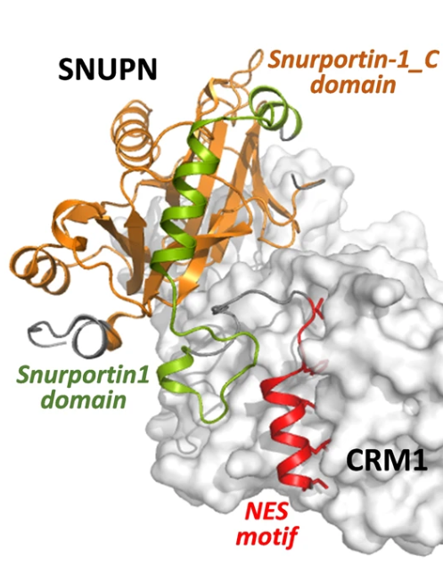
NES-Finder: A Transformer-classifier for Identifying Novel Nuclear Export Signals (project #3)
Team: Daniel Levin, Imri Shuval, Shira Gelbstein, Ron Levin

Slide 2
Introduction:
Proteins are transported between the nucleus and the cytoplasms through nuclear pore complexes (NPCs).
NESs are peptide signals recognized by the transport protein CRM1/XPO1 which allows the protein to pass through the NPCs.
NES motifs are diverse and hard to detect.
Project goal: develop a deep learning model to identify NES-containing proteins based only on their amino acid sequence.

Slide 3
Methods:
Used ESM-2 protein language model to generate embeddings from full protein sequences.
For training, we extracted sub-sequences:
- For positives: known NES motifs
- For negatives: random segments of non-NES proteins.
Trained a Transformer-based classifier using binary cross-entropy loss.
In test time, applied a sliding window (20 aa) over each sequence; final score = max window prediction.

Slide 4
Data:
Positive training samples: NES motifs from the NESsential database, matched to full-length human proteins from UniProt.
Initial negatives: Random bacterial peptide’s segments from PDB.
Secondary negatives: from Yoonji Lee, et al.
Final negatives: Human proteins experimentally shown not to bind CRM1 (from Kırlı et al).
Test Set: Labeled portion of human proteome (from Kırlı et al).

Slide 5
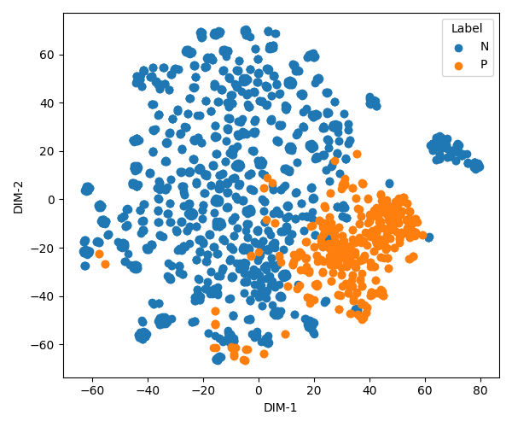
Result
Initial test: Human vs. Bacteria: Model achieved near-perfect accuracy,
We deemed the task too trivial, as it could be solved by separating human proteins from bacteria (validated with t-SNE).

Slide 6
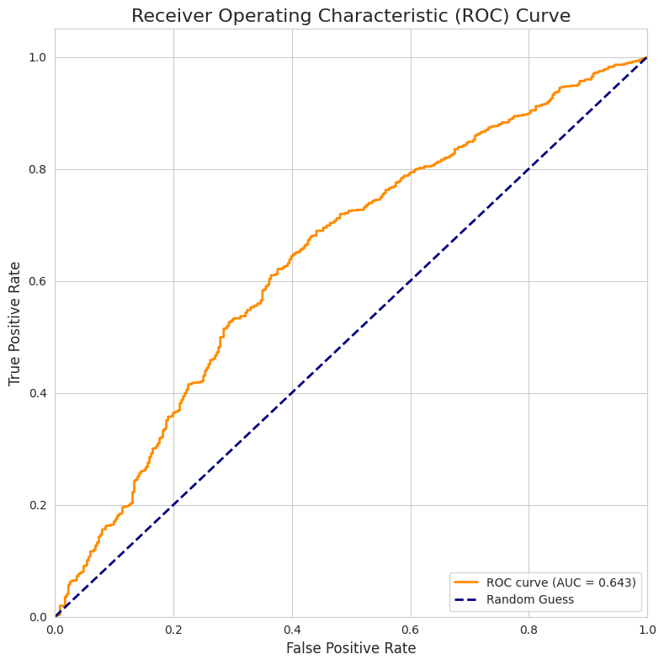
Results (cont.)
Secondary try: Generated harder negatives by mutating NES motifs at key CRM1-binding sites (2 sites).
Results were Poor results

Slide 7
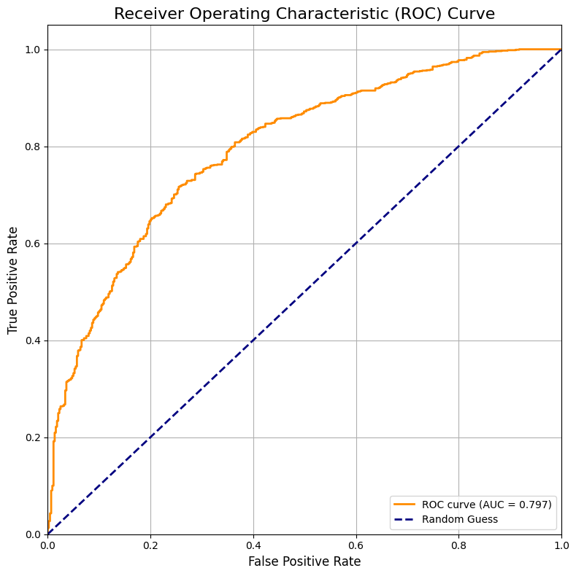
Results (cont.)
Final test: Model evaluated on human non-binders with AUC = 0.79, showing decent predictive ability.

Slide 8
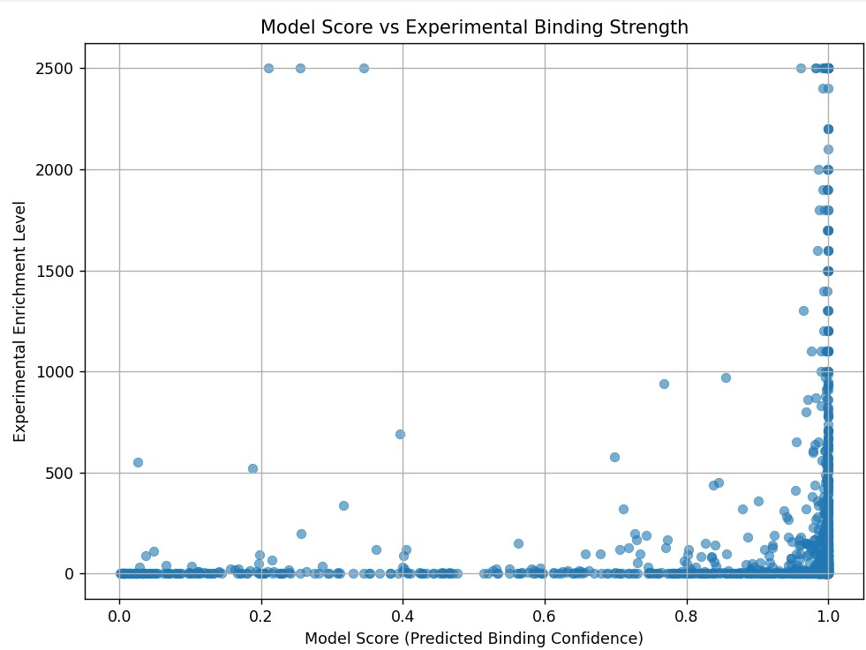

Results (cont.)
We examined the correlation between a protein's model score and the experimental binding strength.
The binding strength is measured by the ratio:
$$\frac{{iBAQ}^{∗}[CRM1+RanGTP]}{iBAQ\left[Input\right]}$$
* Intensity-Based Absolute Quantification

Slide 9
Future Work
We think the most critical part is collecting better data, especially negative samples for training.
One option is to look for human proteins which bind to different transporter proteins. *
* this would still require knowing the binding sites so that we can take those as our widow, as well as requiring the sites to not be any larger than our sliding window of size 20, so that the separation would not be trivial.

