Slide 1

Walchand College Of Engineering, Sangli (An Autonomous Institute) Mini-Project on Securing NGO Donations using Blockchain
Abhay Shirale (2018BTECS00021)
Manmath Bhale (2018BTECS00049)
Moreshwar Sonawale (2018BTECS00106)
Under the Guidance of
- Prof. A. R. Surve sir.

Slide 2
Problem Statement
Now a days, many NGOs are working for welfare and development of country. Being Non-government organization, the money needed for different development and welfare projects is to be funded by peoples. Trust is the important factor between NGO and donors. But due to lack of transparency and corruption issue, many people avoid to donate such NGOs. So we have to build a system that will provide transparency as well as immutability of data.

Slide 3

Objective
To build trust, transparency and immutability of transactions between donors and NGO by using different features of Blockchain technology.

Slide 4
Outcomes
Securing NGO donation system with following features :
Transparent donation tracking using Blockchain technology
Utilization of donation funds along with Notification to respective donar.
Both donation and utilization open on Blockchain
As record is stored on Blockchain, it is immutable.

Slide 5
Customers and Market Potentials
NGO’s , Donors (Person who donates money to NGO) and Recipients (those who receive money from NGO) etc. are customers.
1. Taking and transferring small donations without losing too much to PayPal or credit card transaction fees is a big potential.
2. The 2019 Global NGO Technology Report polled 5,721 charities and NGOs in 160 nations. It found that the number of organizations, which accept crypto currency donations has risen to 100%.
3. There are an estimated 10 million (non-governmental organizations) NGOs worldwide.
4. The number of people worldwide donating money to NGOs increased from 1.2 billion in 2011 to 1.4 billion in 2014. By 2030, the number is expected to grow to 2.5 billion.

Slide 6
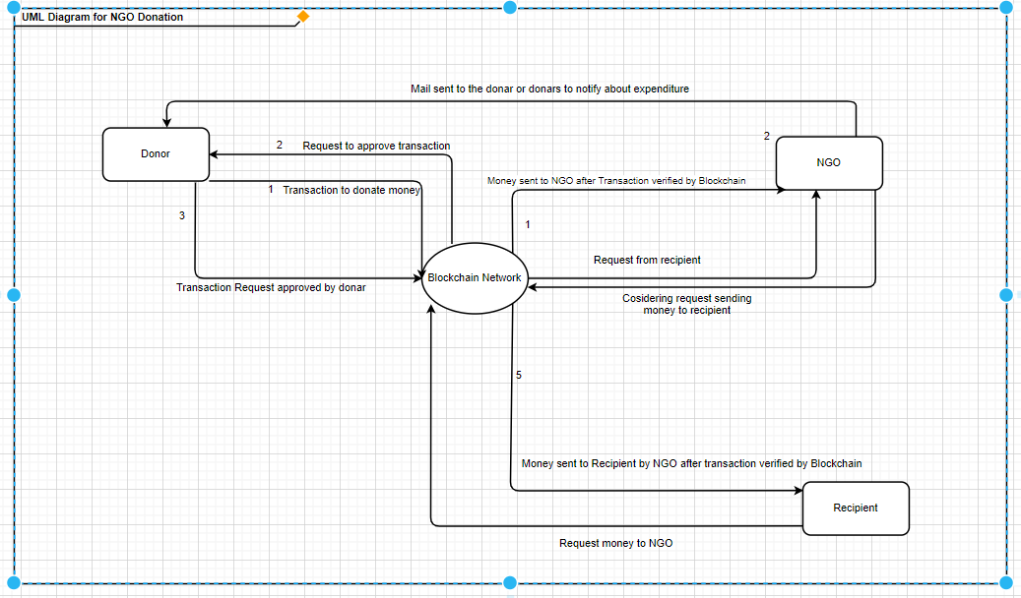
UML Diagram

Slide 7
Technology Stack
HTML , CSS , Bootstrap , JavaScript and Next Js
Node Js , MongoDB , Metamask , Web3 ,Ganache , truffle-hd-wallet provider and other required blockchain tools.

Slide 8
Project Plan
We have followed agile methodology for our project. We have completed below listed task in different phases and in each phase we have done Planning, Requirements Analysis, Design, Coding and Testing.
Writing the best suitable smart contract in solidity
Testing the contract using ganache
Deploying contract on a Blockchain network
Designing the front end with required functionalities using Next Js.
Integrating front end and deployed contract.

Slide 9
Thank you !

