Slide 1
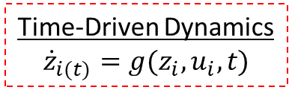
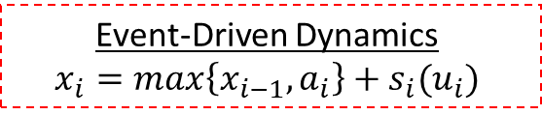


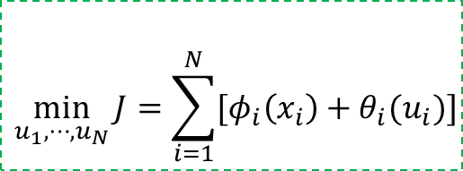
Event-Driven Dynamics
$$x_{i}=\max\left\{x_{i−1},a_{i}\right\}+s_{i}(u_{i})$$
Arrival
Times
Departure
Times
$$∼a_{i}$$
$$∼x_{i}$$
Objective
$$\min_{u_{1},⋯,u_{N}}{J=\sum_{i=1}^{N}{[φ_{i}\left(x_{i}\right)+θ_{i}(u_{i})]}}$$
Time-Driven Dynamics
$${\dot{z}}_{i(t)}=g(z_{i},u_{i},t)$$

Slide 2
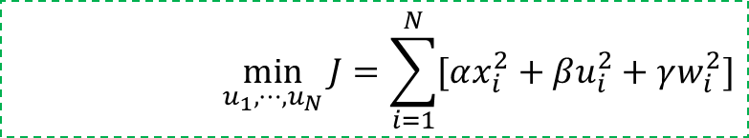
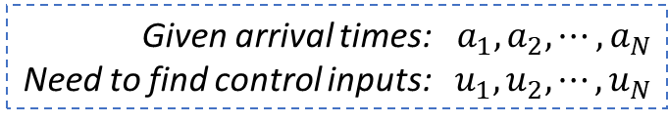
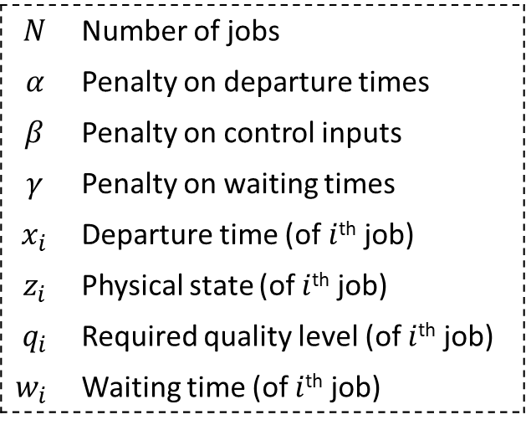
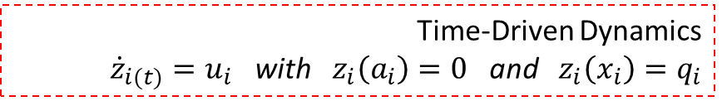
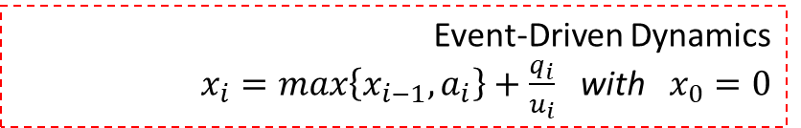
Given arrival times: $a_{1},a_{2},⋯,a_{N}$
Need to find control inputs: $u_{1},u_{2},⋯,u_{N}$
$$N$$ | Number of jobs
$$α$$ | Penalty on departure times
$$β$$ | Penalty on control inputs
$$γ$$ | Penalty on waiting times
$$x_{i}$$ | Departure time (of $i$^{th} job)
$$z_{i}$$ | Physical state (of $i$^{th} job)
$$q_{i}$$ | Required quality level (of $i$^{th} job)
$$w_{i}$$ | Waiting time (of $i$^{th} job)
$$\min_{u_{1},⋯,u_{N}}{J=\sum_{i=1}^{N}{[αx_{i}^{2}+βu_{i}^{2}+γw_{i}^{2}]}}$$
Such that:
Event-Driven Dynamics
$x_{i}=\max\left\{x_{i−1},a_{i}\right\}+\frac{q_{i}}{u_{i}}$ with $x_{0}=0$
Under:
Time-Driven Dynamics
${\dot{z}}_{i(t)}=u_{i}$ with $z_{i}\left(a_{i}\right)=0$ and $z_{i}\left(x_{i}\right)=q_{i}$
and:

