Slide 1
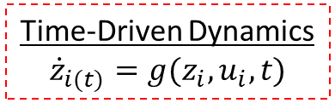
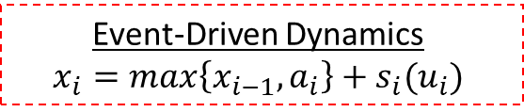


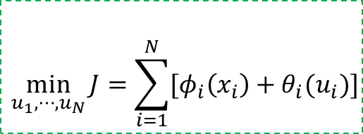
Event-Driven Dynamics
$$x_{i}=\max\left\{x_{i−1},a_{i}\right\}+s_{i}(u_{i})$$
Arrival
Times
Departure
Times
$$∼a_{i}$$
$$∼x_{i}$$
Objective
$$\min_{u_{1},⋯,u_{N}}{J=\sum_{i=1}^{N}{[φ_{i}\left(x_{i}\right)+θ_{i}(u_{i})]}}$$
Time-Driven Dynamics
$${\dot{z}}_{i(t)}=g(z_{i},u_{i},t)$$

Slide 2
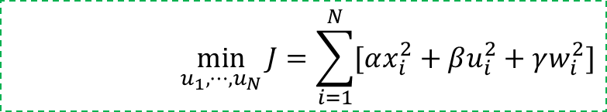
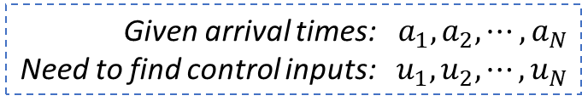
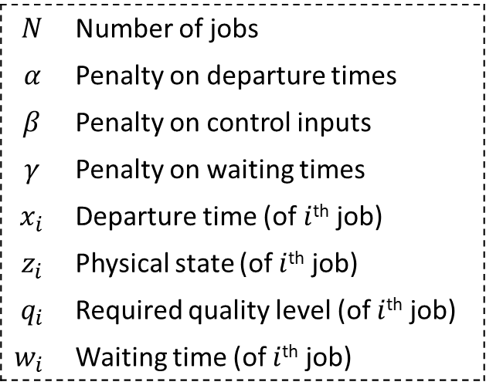
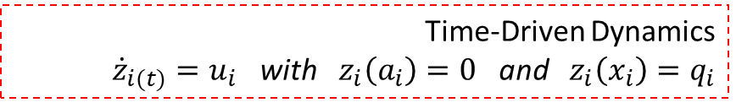
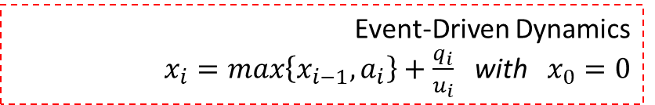
Given arrival times: $a_{1},a_{2},⋯,a_{N}$
Need to find control inputs: $u_{1},u_{2},⋯,u_{N}$
$$N$$ | Number of jobs
$$α$$ | Penalty on departure times
$$β$$ | Penalty on control inputs
$$γ$$ | Penalty on waiting times
$$x_{i}$$ | Departure time (of $i$^{th} job)
$$z_{i}$$ | Physical state (of $i$^{th} job)
$$q_{i}$$ | Required quality level (of $i$^{th} job)
$$w_{i}$$ | Waiting time (of $i$^{th} job)
$$\min_{u_{1},⋯,u_{N}}{J=\sum_{i=1}^{N}{[αx_{i}^{2}+βu_{i}^{2}+γw_{i}^{2}]}}$$
Such that:
Event-Driven Dynamics
$x_{i}=\max\left\{x_{i−1},a_{i}\right\}+\frac{q_{i}}{u_{i}}$ with $x_{0}=0$
Under:
Time-Driven Dynamics
${\dot{z}}_{i(t)}=u_{i}$ with $z_{i}\left(a_{i}\right)=0$ and $z_{i}\left(x_{i}\right)=q_{i}$
and:

Slide 3
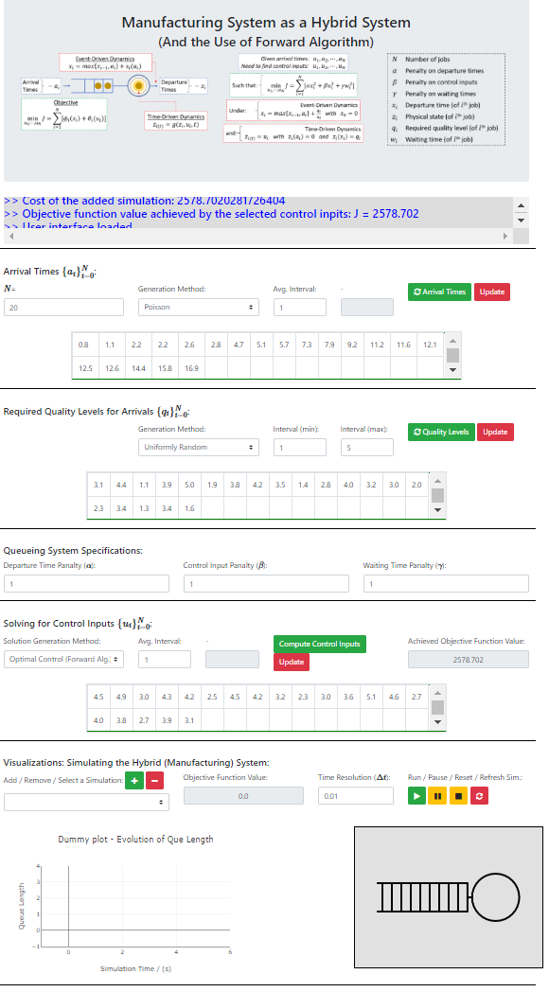
Title and Information Box
Title and a summary of the related theory
Console Display
(See for useful messages related)
Console Display
Arrival Time Menu
Quality Level Menu
Penalty Parameter Menu
Control Input Menu
Simulation Menu

Slide 4
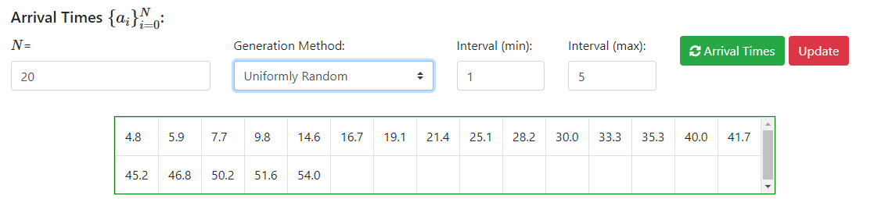
Arrival time generation methods:
Deterministic
Uniformly Random
Poisson Distributed
Custom
Number of arrivals
Parameters of the arrival time generation method
Re-generate a set of arrival times
Generated arrival time values (Also editable)
Update the custom entered arrival times from the table

Slide 5
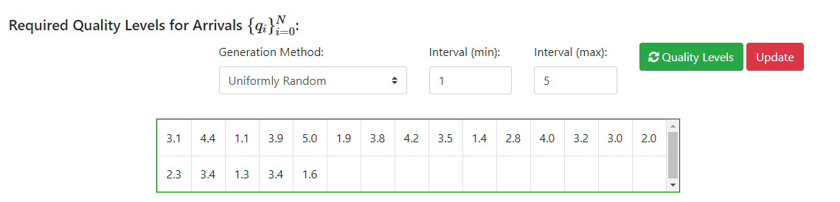
Required quality level of a job generation methods:
Deterministic
Uniformly Random
Custom
Parameters of the required quality level generation method
Re-generate a set of quality level values
Generated quality level values (Also editable)
Update the custom entered quality levels from the table

Slide 6
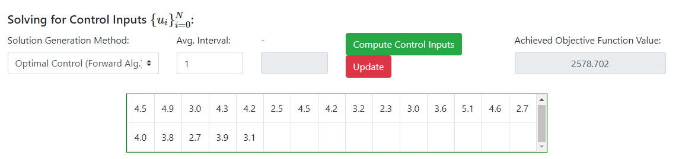
Control input generation methods:
Optimal control (By Forward Algorithm)
Deterministic
Uniformly Random
Custom
Parameters of the arrival time generation method
Re-generate/compute a set of control input values
Generated control input values (Also editable)
Update the custom entered control input values
The objective function value achieved by the control input values generated

Slide 7
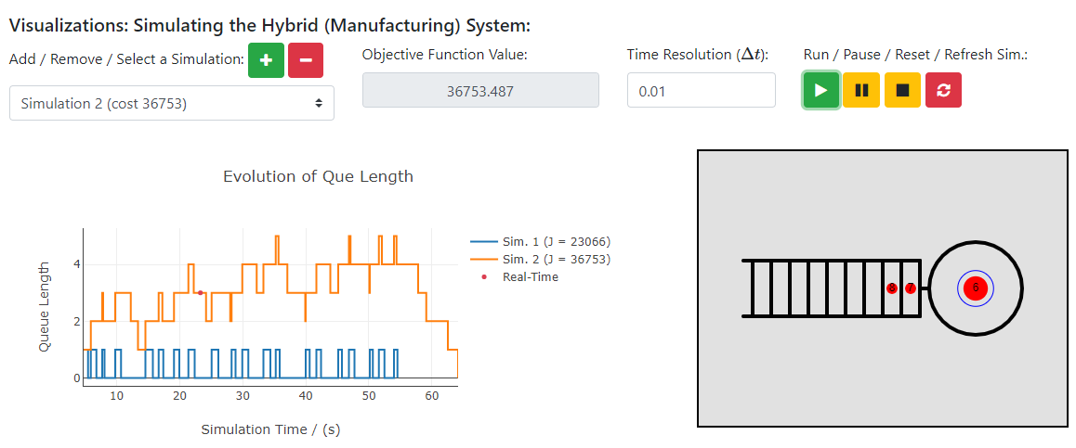
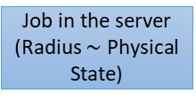
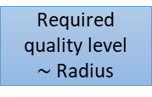
Add the current simulation parameters to the memory (For graphing and real-time simulation purposes)
Time resolution of the real-time illustration
Selection dropdown menu to select one of the already added simulations
Delete the data related to the selected simulation
Objective function value of the selected simulation
Run / Pause / Restart / Refresh all Menu for the real-time illustration of the selected simulation
Graph generated for each simulation: Queue Length Vs Simulation Time
Real-time illustration of the selected simulation
Jobs in que
Job in the server (Radius $\sim$ Physical State)
Required quality level $\sim$Radius

