Slide 1
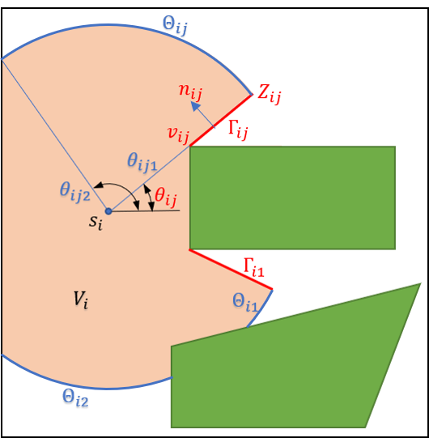







Visibility Region
$${V(s}_{i})$$
Location of Agent $i$ :
Obstacle 1
$${\tilde{M}}_{1}$$
$$s_{i}$$
$$δ$$
Obstacle 2
$${\tilde{M}}_{2}$$
Mission Space
$$Ω$$

Slide 2
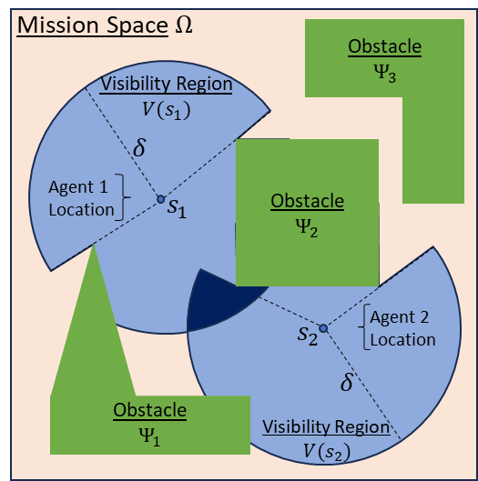











Mission Space$Ω$
Obstacle
$$Ψ_{3}$$
Visibility Region ${V(s}_{1})$
$$δ$$
Obstacle
$$Ψ_{2}$$
Agent $1$ Location
$$s_{1}$$
Obstacle
$$Ψ_{1}$$
$$s_{2}$$
Agent 2 Location
$$δ$$
Visibility Region ${V(s}_{2})$

