Slide 1
Quora Insincere Questions Classification
By
Hooman Shiranimehr

Slide 2
The Problem:
Identifying and removing toxic content from Quora

Slide 3
The Solution:
Reduce monitoring costs by applying classifier to tag inappropriate questions

Slide 4
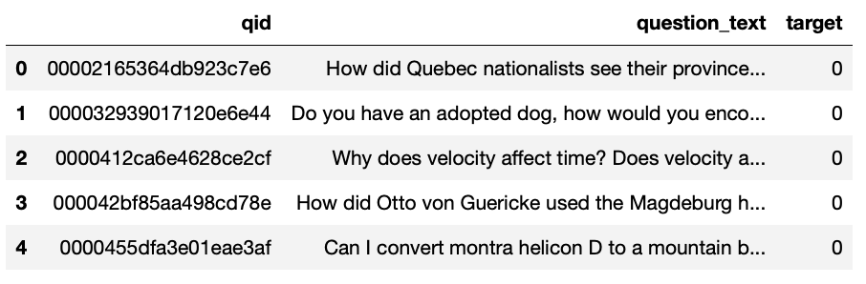
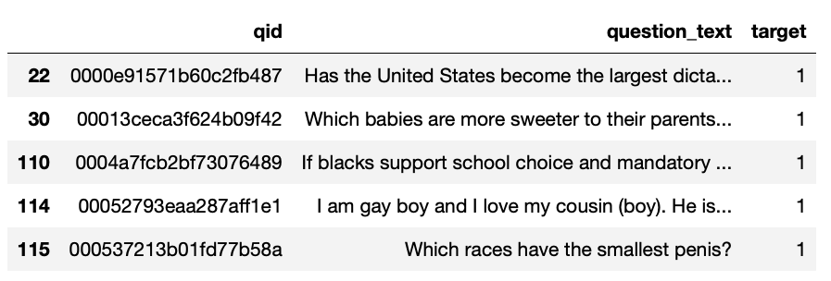
The Data
Data Source: https://www.kaggle.com/c/quora-insincere-questions-classification
Notes:
Dataset has 1,306,122 rows with 3 columns.
We only consider 20% of data (261224 rows)

Slide 5
Data Wrangling
Only consider 20% of data (261224 rows)
No null
No duplicate
Data is not balanced (96% sincere and 4% insincere)
Random stratified sampling
Original dataset has 1,306,122 rows with 3 columns.
We only consider 20% of data (261,224 rows)

Slide 6
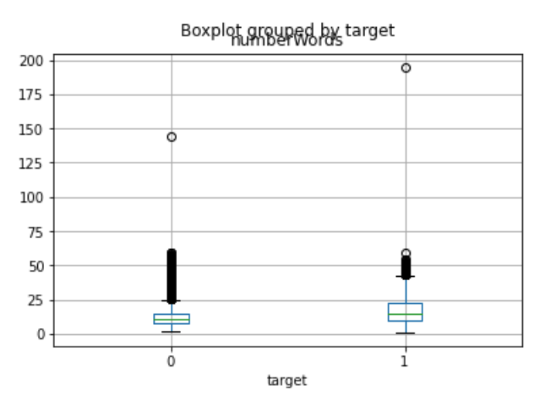

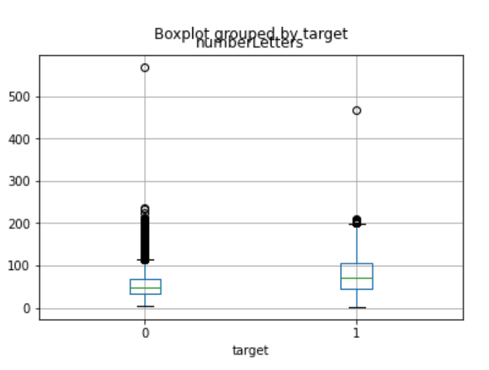
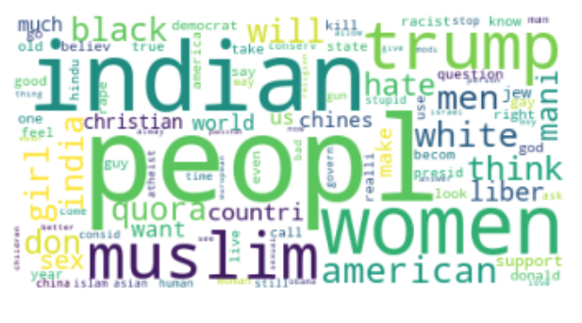
Exploratory
Data Analysis
Notes:
Top left: Comparing two classes based on number of words.
Bottom left: Comparing two classes based on number of characters.
Top right: Word cloud for sincere questions.
Bottom right: Word cloud for insincere questions.

Slide 7
Model Selection
Logistic Regression
SVM
Naïve bayes

Slide 8
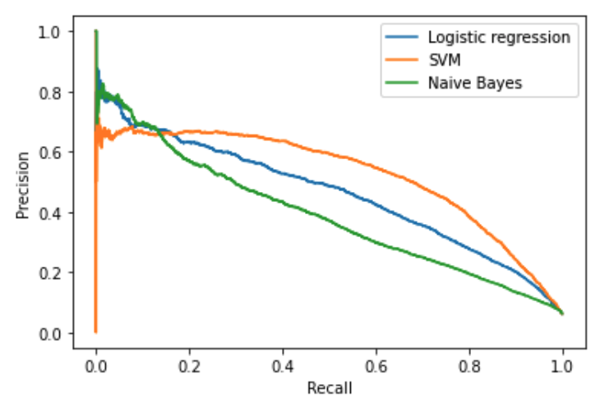
Precision Recall

Slide 9
Hyperparameter Tuning
We used 5-fold cross validation and perform grid search to find optimal set of parameters for each model.
Compare models based on their average precision.
Grid Search Cross Validation

Slide 10
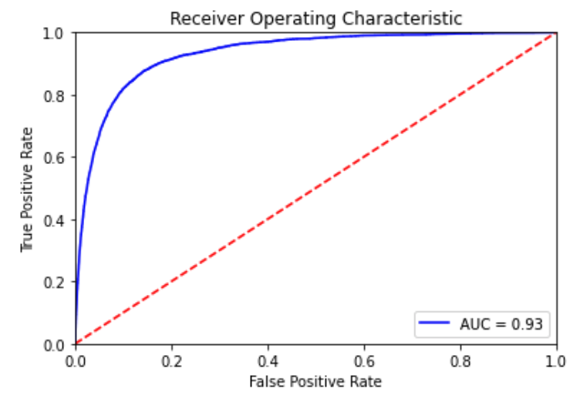
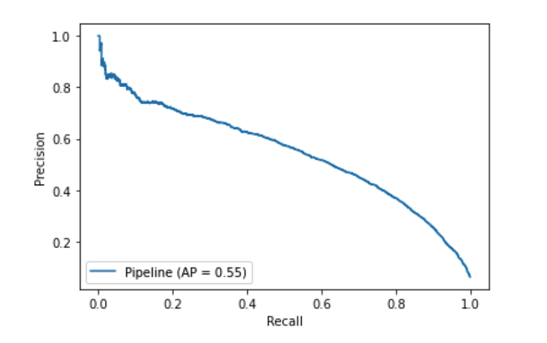
ROC and Precision-Recall Curves

Slide 11
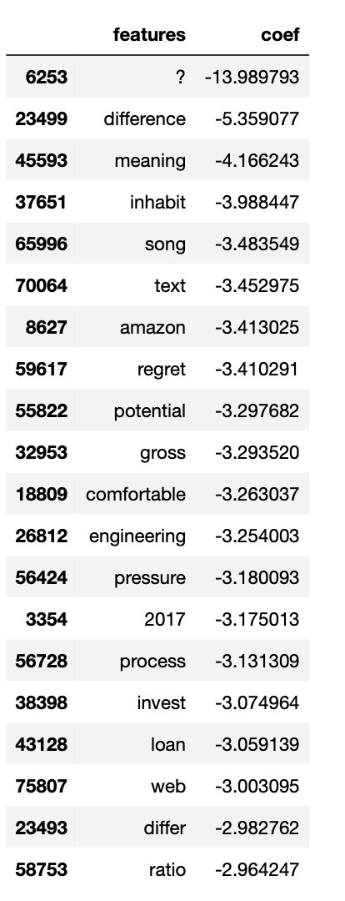
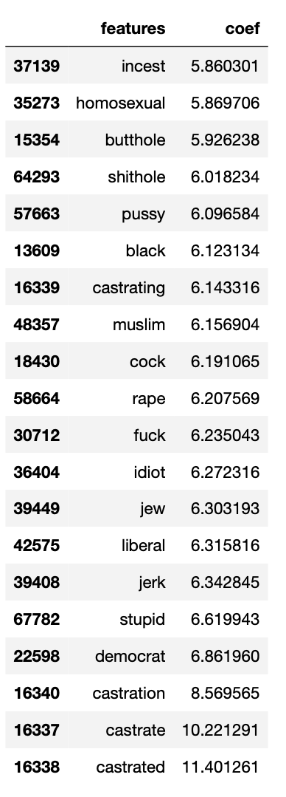
Top features
Top features for sincere questions.
Top features for insincere questions.

Slide 12
Takeaways
One can use logistic regression classifier with a certain threshold to achieve the optimal precision-recall tradeoff.
It can be a challenging task to find the optimal operating point (threshold).
Other factors such as user experience, business and finance need to be considered in order to make the best decision.

Slide 13
Future Research
Investigate other classifiers such as tree-based methods.
Consider other metrics such as F1-score.
Study further optimizing hyper-parameters.

Slide 14
Thank You!
Kaggle and Quora for providing data
Lucas Allen for guidance during project

Slide 15
Questions?

