Slide 1
Quora Insincere Questions Classification
By
Hooman Shiranimehr

Slide 2
The Problem:
Identifying and removing toxic content from Quora

Slide 3
The Solution:
Reduce monitoring costs by …

Slide 4
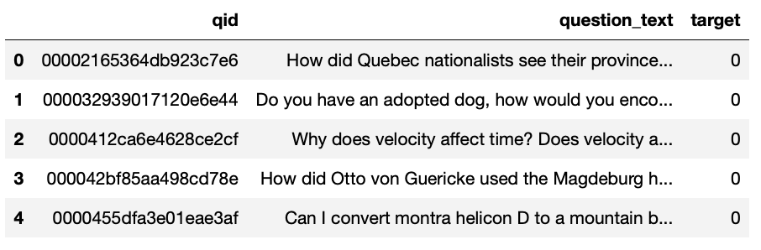
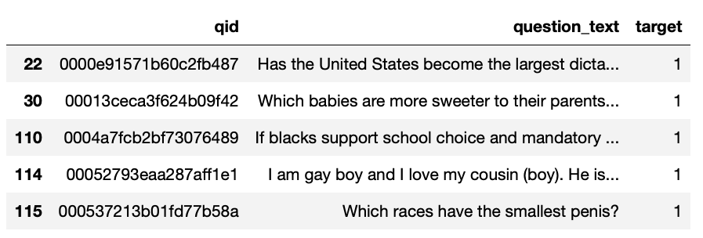
The Data
Data Source: https://www.kaggle.com/c/quora-insincere-questions-classification
Notes:
Dataset has 1,306,122 rows with 3 columns.
We only consider 20% of data (261224 rows)

Slide 5
Data Wrangling
Only consider 20% of data (261224 rows)
No null
No duplicate
Data is not balanced (96% sincere and 4% insincere)
Random stratified sampling
Original dataset has 1,306,122 rows with 3 columns.
We only consider 20% of data (261224 rows)

Slide 6
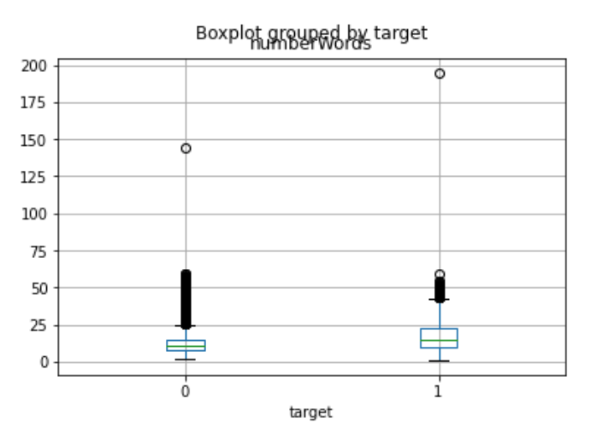

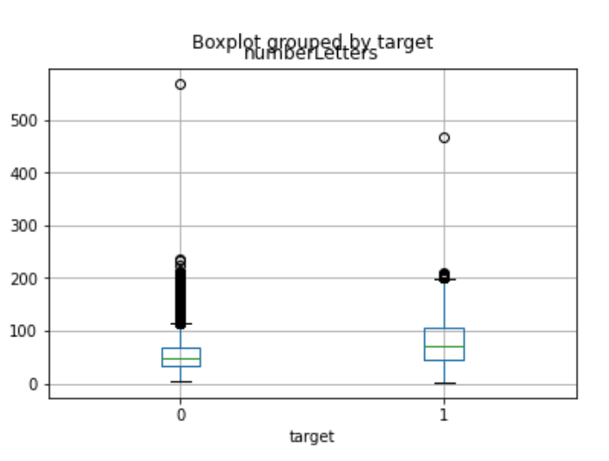
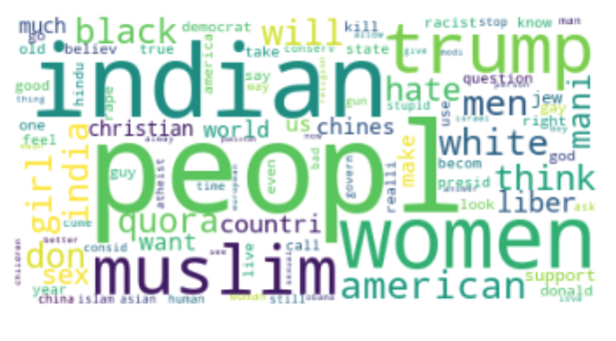
Exploratory
Data Analysis
Notes:
Top left: …
Top right: …
Bottom left: …
Bottom right: …

Slide 7
Model Selection
Logistic Regression
SVM
Naïve bayes

Slide 8
Precision Recall

Slide 9
Hyperparameter Tuning
…
Grid Search Cross Validation

Slide 10
Takeaways
…

Slide 11
Future Research
…

Slide 12
Thank You!
…

Slide 13
Questions?

