Slide 1
Research Workshop presentation
2023-2024 1st & 2nd semester
Shira Evron

Slide 2
Lab meeting presentation

Slide 3
The hypothesis

Slide 4
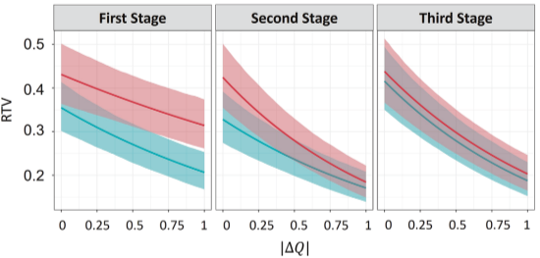
Why should we care about RTV change?
Each stage duration is approximately 10 minutes, do we believe a person with ADHD has the same RTV during this time?
If so, great.
But If not... What can we learn from finding a change in RTV over time?
Maybe we can find sub-groups of ADHD types defined by RTV change rate.
Is there a loss of information?
What do you think?
(Katabi and Shahar, 2024)

Slide 5
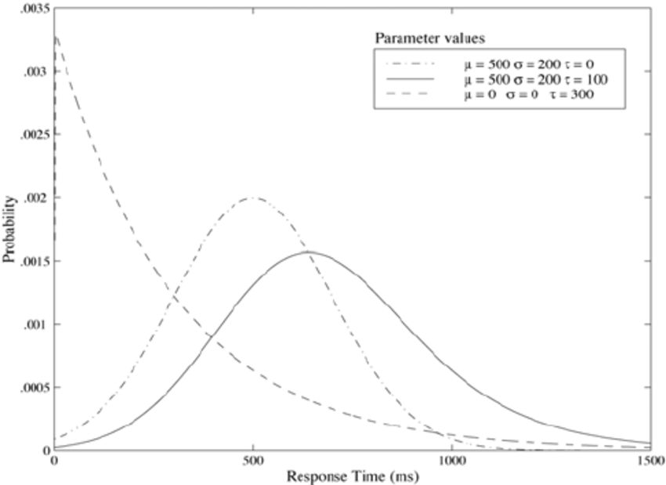
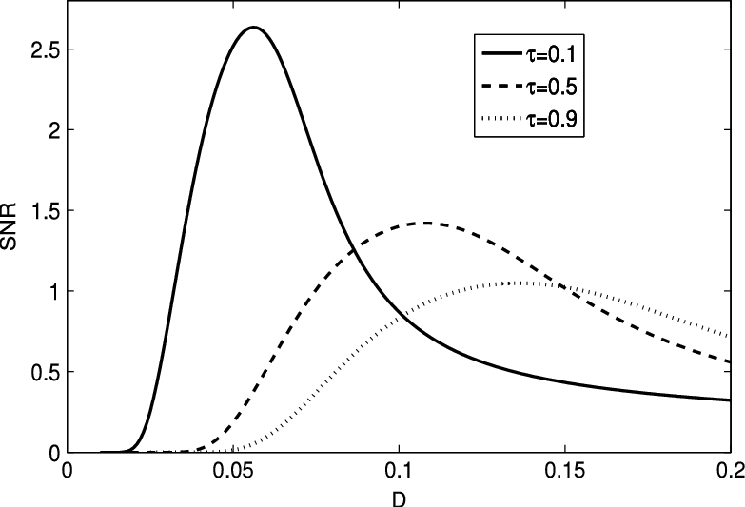
Visualization of the hypothesis
The hypothesis = a participant in the experiment experience a change in the RTV value over time during the experiment.
p(x)
RT
Demo: https://www.desmos.com/calculator/0dsckbi0tx

Slide 6
Why an ML model

Slide 7
Why do we need here a ML solution?
We don’t have any direct statistics or mathematic tool to solve the problem we want to solve.
An ML model can find patterns and teach itself in minutes what would take us years.

Slide 8
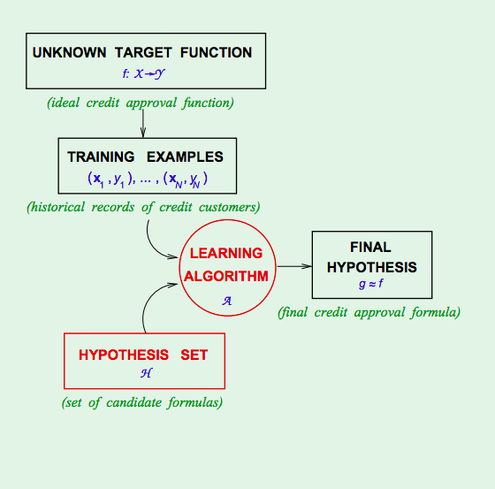
So, how does it work?
ML model learns what we teach.
The data we use to “Teach” (train) it with, will define the problem we want it to solve.
Although we don’t know how or what it learn, we can still use it to solve problems for us (BLACK BOX).
Example: cats and dogs tagging.

Slide 9
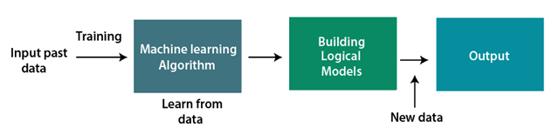
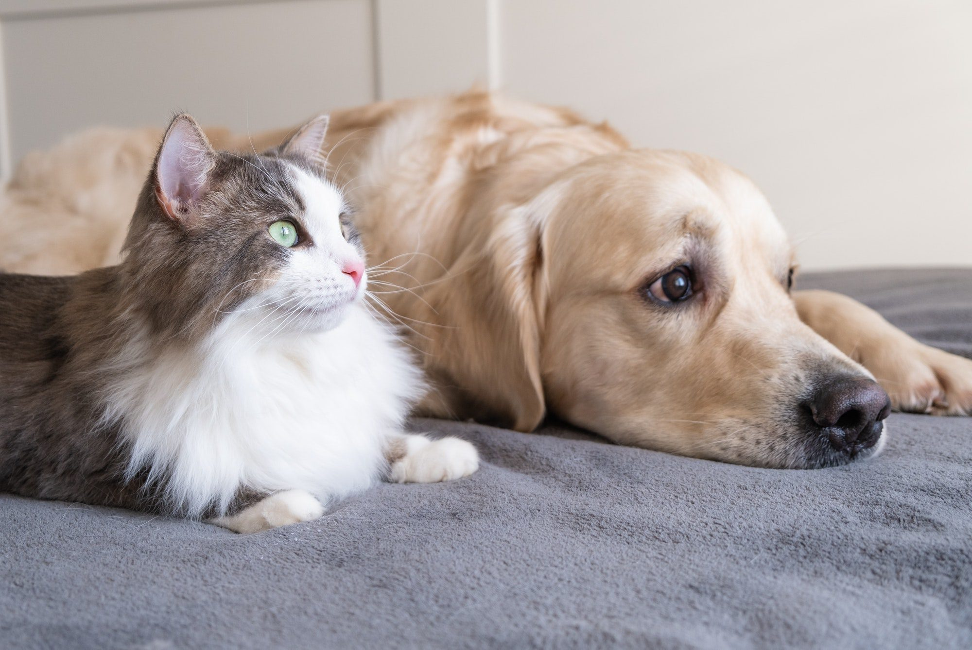
So, how does it work?
The typical process of Machine Learning looks like this:
Input training data

Slide 10
The working (research) process

Slide 11
The developing process principles we followed
Define the problem
Input
Output
Method
Start small and simple and grow
Work in stages
Each stage solve a bigger problem closer to the original problem
Adjust process after each stage

Slide 12
Define the problem

Slide 13
Define the problem
Trial | RT
1 | 0.0312
2 | 0.0433
3 | 0.0211
4 | 0.0354
5 | 0.0400
6 | 0.0311
7 | 0.0339
8 | 0.0324
9 | 0.0410
10 | 0.0511
11 | 0.0339
12 | 0.0354
13 | 0.0291
14 | 0.0255
…
200 | 0.0339
What do we have now?
~200 trials RT of a participant in some stage of the experiment.
~200 trials over ~10 minutes (a stage).
Taking all RT in stage, and extract Tau value using a regression model.
Τ = 0.3

Slide 14
Define the problem
Method
Trial | RT
1 | 0.0312
2 | 0.0433
3 | 0.0211
4 | 0.0354
5 | 0.0400
6 | 0.0311
7 | 0.0339
8 | 0.0324
9 | 0.0410
10 | 0.0511
11 | 0.0339
12 | 0.0354
13 | 0.0291
14 | 0.0255
…
200 | 0.0339
What do we have now?
~200 trials RT of a participant in some stage of the experiment.
~200 trials over ~10 minutes (a stage).
Taking all RT in stage, and extract Tau value using a regression model.
Τ = 0.3
Input
Output

Slide 15
Define the problem
Trial | RT
1 | 0.0312
2 | 0.0433
… | 0.0211
40 | 0.0354
41 | 0.0400
42 | 0.0311
43 | 0.0339
44 | 0.0324
45 | 0.0410
46 | 0.0511
… | 0.0339
125 | 0.0354
126 | 0.0291
127 | 0.0255
…
200 | 0.0339
Trial | RT
1 | 0.0312
2 | 0.0433
3 | 0.0211
4 | 0.0354
5 | 0.0400
6 | 0.0311
7 | 0.0339
… | 0.0324
130 | 0.0410
131 | 0.0511
132 | 0.0339
133 | 0.0354
134 | 0.0291
135 | 0.0255
…
200 | 0.0339
What do we want?
Τ = 0.3
Τ = 0.4
Τ = 0.25
Τ = 0.2
Τ = 0.27

Slide 16
Define the problem
Output
Method
?
Trial | RT
1 | 0.0312
2 | 0.0433
… | 0.0211
40 | 0.0354
41 | 0.0400
42 | 0.0311
43 | 0.0339
44 | 0.0324
45 | 0.0410
46 | 0.0511
… | 0.0339
125 | 0.0354
126 | 0.0291
127 | 0.0255
…
200 | 0.0339
Trial | RT
1 | 0.0312
2 | 0.0433
3 | 0.0211
4 | 0.0354
5 | 0.0400
6 | 0.0311
7 | 0.0339
… | 0.0324
130 | 0.0410
131 | 0.0511
132 | 0.0339
133 | 0.0354
134 | 0.0291
135 | 0.0255
…
200 | 0.0339
What do we want?
Τ = 0.3
Τ = 0.4
Τ = 0.25
Input
Τ = 0.2
Τ = 0.27

Slide 17

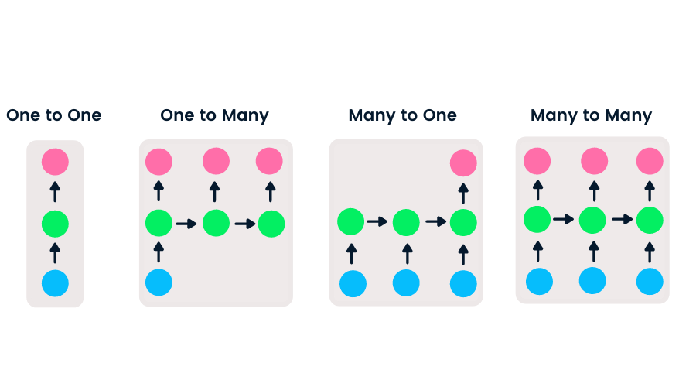
Define the problem
To define our input-output properly we had some challenges to overcome.
Question: Many-to-many or one-to-many?

Slide 18
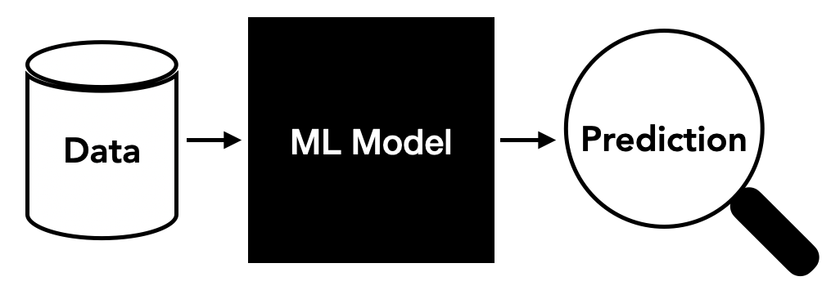
Define the problem
Input/ Data:
RT series of participant in experiment (one) ⇒ example: [0.11, 0.13, …, 0.132]
Output/ Prediction:
τ series per participant (many)
⇒ example: [0.3, 0.25, 0.2, 0.1]
Method:
ML model, but which?

Slide 19
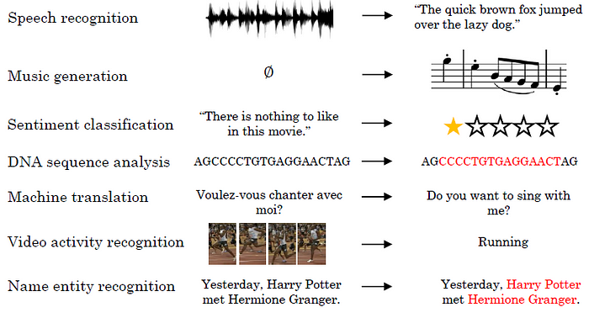
Define the problem
Which model should we work with?
Guidelines:
Able to predict continuous number.
We need memory ability (sequenced data).
https://towardsdatascience.com/recurrent-neural-networks-explained-ffb9f94c5e09

Slide 20
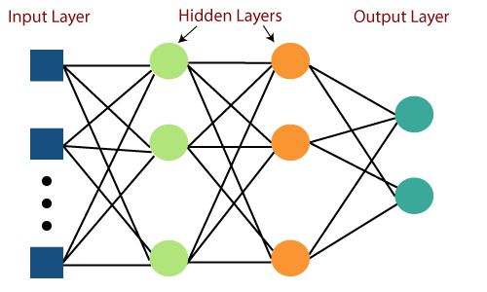
Define the problem
Current solution:
RNN Model
A type of neural network that is specifically designed to process sequential data.
Bi-directional ANN.
with LSTM (long-short-term-memory) layers.
Why?
Can learn complex problems.
Able to directly get as input CN and predict CN.
Has memory ability - needed in a sequential data problem.

Slide 21
Work in stages

Slide 22
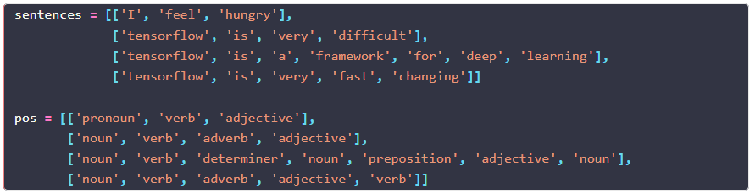
Work in stages
Stage 1:
Work with a simple classification model based on RNN to warm up, Based on code I found online.
Part of Speech (POS) problem:
Notes:
למה זה קרוב לבעיה - סיקוונס

Slide 23
Work in stages
Stage 1:
“Dust off” ML knowledge.
Classification model dive deep.
Intro to TensorFlow.
Torch vs. TensorFlow
Study the problem.
Building the code environment infrastructure.
Python, virtualenv, git, packages pinning, etc.

Slide 24
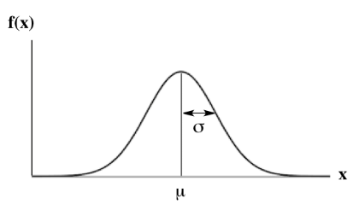
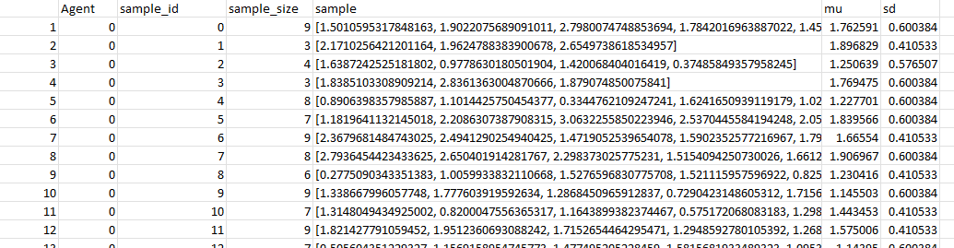
Work in stages
Stage 2:
Write a model that can predict1 σ (sd) from a sample taken from a normal distribution.
Sample [0.01, 0.031 … 0.0144] ⇒ model ⇒ σ (sd)

Slide 25
Work in stages
Stage 2:
Writing a model that can overcome the continuous numbers issue.
RNN Layers types:
LSTM, Dense, Flatten.
Moving to one-to-many approach.
Yoav’s project dive deep.
Working RNN model that gets and predicts continuous numbers.
Modifiable Datasets creation script.

Slide 26
Work in stages
Stage 3:
Write a model that can predict 3 σ (sd) of 3 different normal distribution from a series of numbers.
With bug
sα = sample α (where α is ~25)
dβ = distribution β (where β is 1, 2 or 3)
Sample size ~10
[(s1 of d2), … (s30 of d1), (s1 of d2) … (s28 of d2), (s1 of d3) … (s25 of d3)]
After Bug “fix”
xα = α (where α is from 1 to ~200) -> the sample
dβ = distribution β (where β is 1, 2 or 3)
[x1d1, x2d1, …, x200d1, x1d2, x2d2, …, x200d2, x1d3, x2d3, …, x200d3]

Slide 27
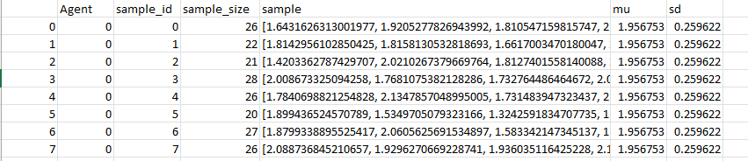
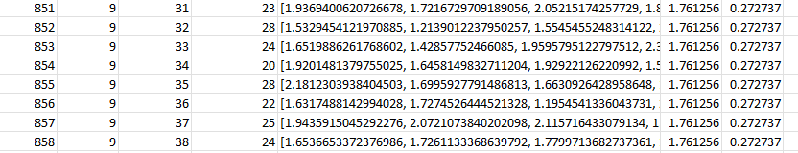
Work in stages
Stage 3: Datasets Examples

Slide 28
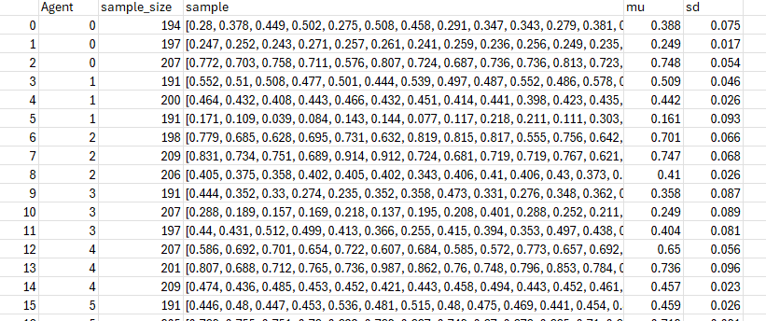
Work in stages
Stage 3: Datasets Examples

Slide 29
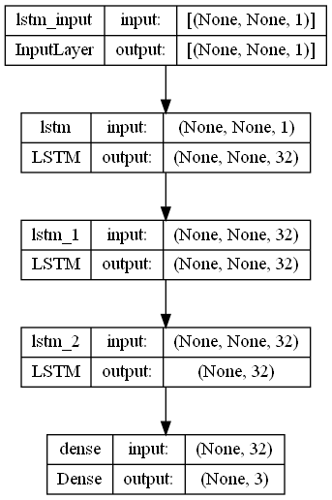
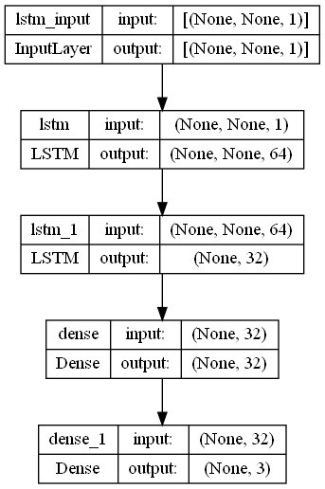
Work in stages
Stage 3: Model architecture

Slide 30
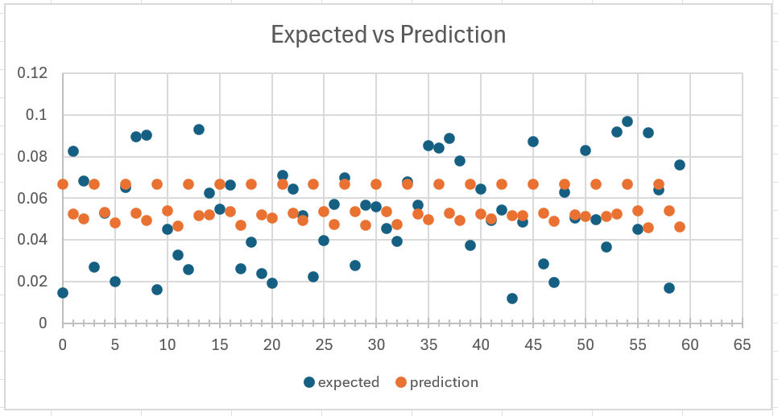
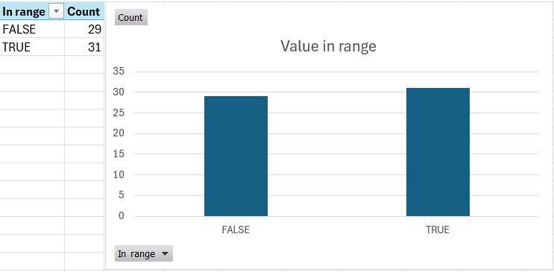
Work in stages
Stage 3: Prediction outcome example
51.67% of predictions were in the range of 20%
above or below expected value.

Slide 31
Work in stages
Stage 3:
More advanced model architecture.
Bug-solving approach when working with ANN.
Accuracy assessment methods.
Current goal:
Improving the success rate and accuracy.

Slide 32
Work in stages
Stage 3: Ideas for improvement
Binning
Features
Timestamp
Id
Etc.
Combine regression layers

Slide 33
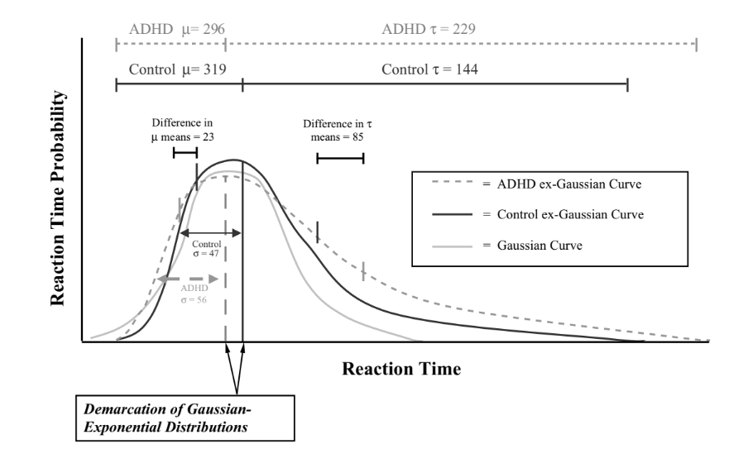
Future Stages
Stage 4:
Write a model that can predict 3 τ (tau) of 3 different ex-gaussian distribution from a series of numbers:
[x1d1, x2d1, …, x200d1, x1d2, x2d2, …, x200d2, x1d3, x2d3, …, x200d3]

Slide 34
2nd Semester

Slide 35
Table of content
The feature model
Binning
Learning Function
Optimization Attempts
Multi vs. Feature Models
Github

Slide 36
The Feature model
The model is designed to improve the performance of the multi model which currently failed to solve the problem satisfactorily.
In addition to the data described previously (stage 3) that the multi model receives, this model receives for each reaction time a timestamp that represents the time when the subject reacted (this is different from the reaction time itself).
This model is a 3D model, so it supports adding features to data, and in this case the feature we added is a timestamp.
Notes:
למה זה קרוב לבעיה - סיקוונס

Slide 37
The Feature model
A model that can predict 3 σ (sd) of 3 different normal distribution from a series of numbers.
Input:
Reaction Time:
xα = α (where α is from 1 to ~200) -> the sample
dβ = distribution β (where β is 1, 2 or 3)
[x1d1, x2d1, …, x200d1, x1d2, x2d2, …, x200d2, x1d3, x2d3, …, x200d3]
Timestamps:
tα = α (where α is from 1 to ~600) -> One timestamp representing when each Reaction time happen over approximately 45 minutes of an “experiment”.
[t1, t2, .., t600]

Slide 38
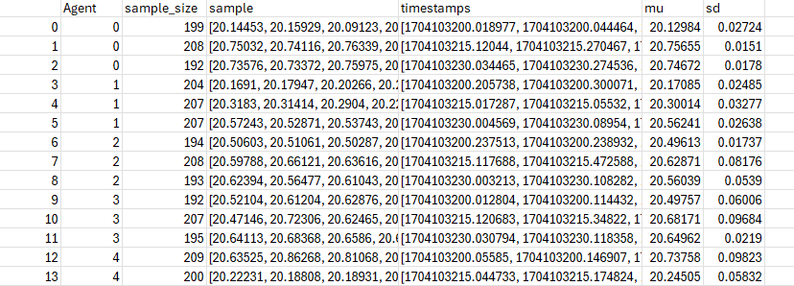
The Feature model
Dataset Example

Slide 39
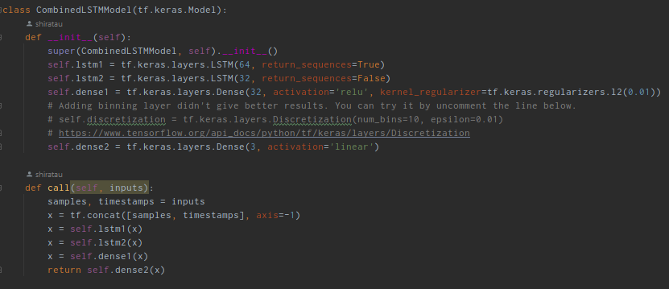
The Feature model
Notes:
למה זה קרוב לבעיה - סיקוונס

Slide 40
Binning
A binning layer in an RNN model is a preprocessing step where continuous input data is divided into discrete bins or intervals. This transformation helps in reducing the complexity of the data, making it easier for the RNN to learn patterns by handling categorical data instead of continuous values.
Unfortunately, attempting to use binning, which currently appears in the code as comments, only further reduced the predictive capability. The values concentrated in the middle bins, and the variance between the values decreased even more compared to the multi model. I tried several combinations of this with various additional layers, but it did not significantly impact the results.
Notes:
למה זה קרוב לבעיה - סיקוונס

Slide 41
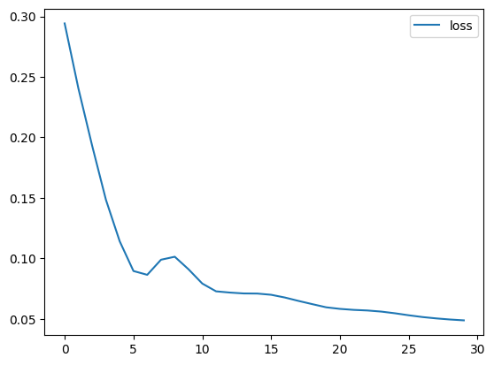
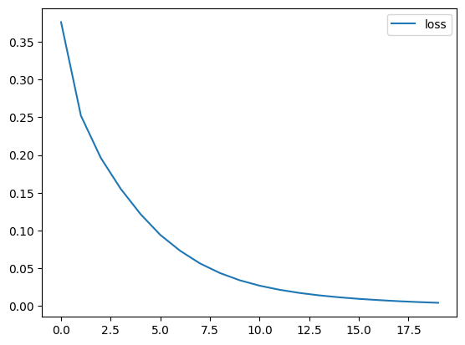
Learning Function
I wrote an optimizer for the learning function that normalized the loss function, which previously had fluctuations during learning. Now, I have set a constant learning rate function, which has helped to slightly improve the results.
Notes:
למה זה קרוב לבעיה - סיקוונס

Slide 42
Optimization Attempts
I experimented with the number of epochs to improve the quality of learning and help slightly enhance the variance of the predicted values.
I tried various other things, that didn’t improve the results:
Configuration changed in the model.
Configuration changed in data creation.
Notes:
למה זה קרוב לבעיה - סיקוונס

Slide 43
Multi vs. Feature model

Slide 44
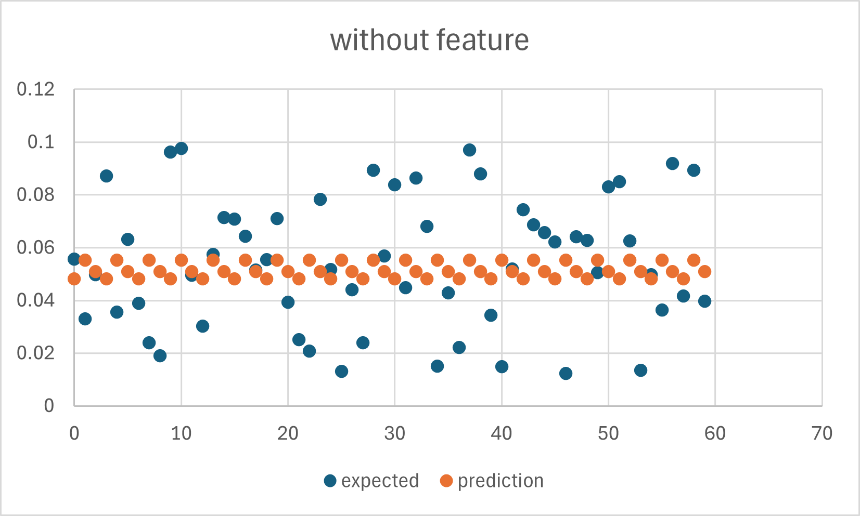
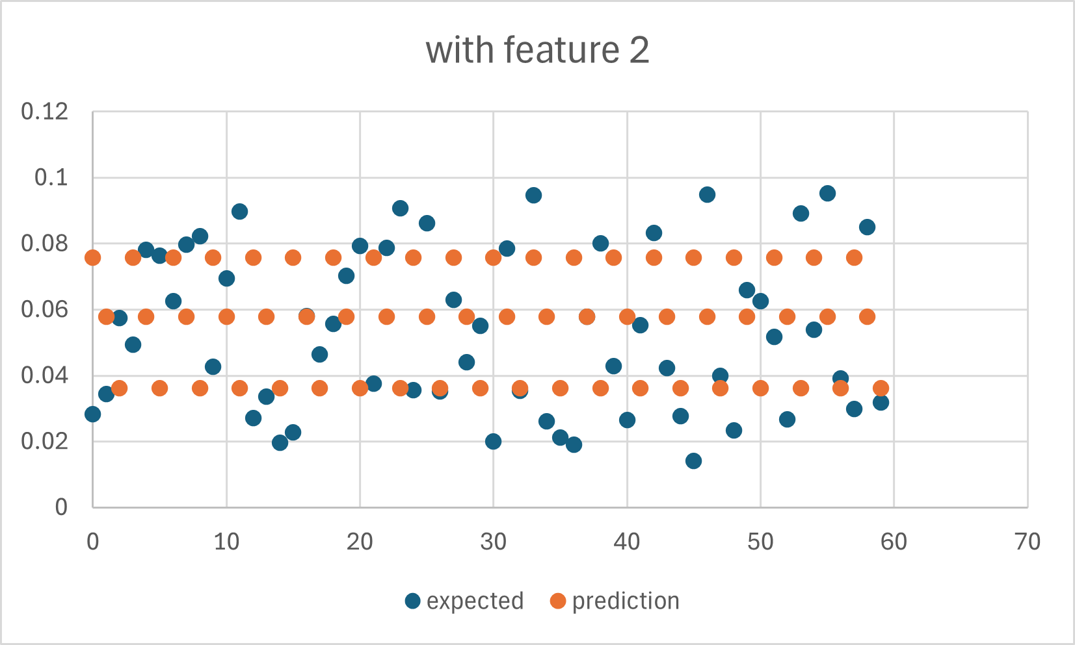
Multi vs. Feature model
After improving the learning function in both models, I ran the same dataset on both models and compared results:
Multi model
Feature model
Notes:
למה זה קרוב לבעיה - סיקוונס

Slide 45
Multi vs. Feature model
We can see that the change of adding the timestamp helped to expand the range of predicted values, but it's evident that the predictions stabilizes around three values in both models.
The expected value are different since each model sample randomly 80% for learning and 20% for prediction – but it is the same dataset.
In other words, the models are not really working – they didn’t learn the problem.
Notes:
למה זה קרוב לבעיה - סיקוונס

Slide 46
Github

Slide 47
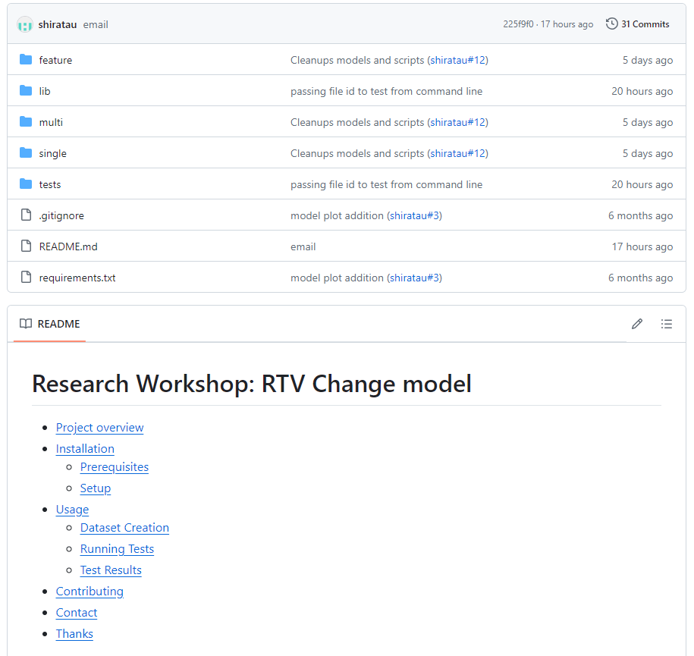
Github
Supply a detailed Github repository with usage and future development instruction was also a big part of this project.
Link to it can be found here.
Notes:
למה זה קרוב לבעיה - סיקוונס

