Slide 1


or die
Vi Improved
Mohammad Shiravand

Slide 2
A Brief History
Vim is a clone of Bill Joy's vi editor for Unix
It was written by Bram Moolenaar in 1991
GUI features were added in 1996, gVIM

Slide 3
Features
Vim has almost full compatibility with vi + extra features:
An integrated help system
Support for extended regular expression
Support for almost all programing languages
Support for plug-ins and GUI (gVim)
Limited IDE features and mouse interaction
Almost every where

Slide 4
Why to use Vim?
You never need not use the mouse or arrow keys!
Make you faster
Keyword Completion
Customize vim as you like it
You can use it every where(ide, browser, …)
You can bind your shortcuts everywhere just like vim

Slide 5
How to get VIM?
www.vim.org
Ubuntu:
apt install vim
apt install gvim
Arch:
pacman -S vim
pacman -S gvim

Slide 6
How to Learn Vim?
vimtutor
Vim Adventures
A byte of vim
Practical Vim
vimcasts

Slide 7
Configuring Vim
:set incsearch
:set hlsearch
:set tabstop=4
:set number
:set autoindent
:syntax on
~/.vimrc

Slide 8
Vim Script and Plug-ins
Early versions add common control flow.
Since version 7:
List
Dictionaries
Object-oriented programing

Slide 9
Vim Script and Plug-ins
Everything for functional programing like built-in map and filter but vim does not have lambda.
Almost all extensions (called plugins or more commonly scripts) of the core Vim functionality are written in Vim script, but plugins can also utilize other interpreted languages like Perl, Python, Lua, or Ruby.

Slide 10
How to Install Plug-ins?
A single .vim file (.vim/plugin)
A vimball file (:source %)
A set of files in directories that follow an expected structure
Plug-in managers:
Vundle
Pathogen

Slide 11
Where to Get Plug-ins?
www.vimawesome.com

Slide 12
What Are The Best Plug-ins and Color-Schemes?
YouCompleteMe
NERDTree
Solarized
Syntastic
surround.vim
Vim-javascript
SuperTab
Emmet.vim

Slide 13

Neovim is a project that seeks to aggressively refactor Vim in order to:
Simplify maintenance and encourage contributions
Split the work between multiple developers
Enable the implementation of new/modern user interfaces without any modifications to the core source
Improve extensibility with a new plugin architecture

Slide 14
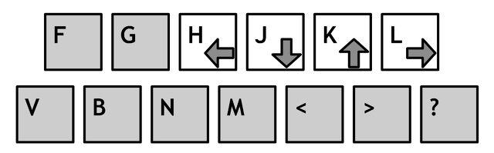
Vim Basic

Slide 15
Vim Basic
normal mode(command mode)
insert mode
visual mode

Slide 16
Vim Basic
i | Insert
a | Append
Esc | Command mode

Slide 17
Vim Basic
x | Delete character
dd | Delete line
:w | Write
:q | Quite
:wq | Save and quite

Slide 18
Vim Basic
/pattern | Search for pattern
/ | Do previous search again
n | Next search result
N | Previous serach result
:%s/vim/Vim/g | Substitute

Slide 19
Vim Basic
:q! | Force quite
:wq! | Force wq
:w filename | Write on filename
o | Insert blank line under current cursor position
O | Insert blank line under current cursor position

Slide 20
Vim Basic
dw | Delete character
db | Delete line
f<char> | Find next <char> in current line
F<char> | Find previous <char> in current line
df<char> | Delete until <char>

Slide 21
Vim Basic
0 | Beginning of line
$ | End of line
v | Visual mode
y | Yank (copy)
p | Paste

Slide 22
Map Caps Lock to Esc
setxkbmap -option “caps:escape”
setxkbmap -option “caps:swapescape”

Slide 23
Free Books
A Byte of Vim
Learn Vimscript the Hard Way
Learn Vim Progressively

Slide 24
Sources
www.tldp.org
www.wikipedia.com
www.slant.co
www.slideshare.net
www.stackexchange.com

Slide 25

Any Question?

