Slide 1

Analyzing and Predicting Water Quality in Israel’s Streams Using Machine Learning
Industrial Engineering, Ariel University
Team Members: Shiraz Hemo, Daniel Yesharim
Lecturer: Mr. Chen Hajaj

Slide 2

The Challenge of Water Quality in Israel’s Streams
Streams in Israel are vital but vulnerable to pollution and degradation. Maintaining water quality is crucial for public health, biodiversity, and agriculture.
Data-driven approaches can provide insights to monitor and improve water quality.

Slide 3
Key Objectives
Analyze water quality trends over time and across regions.
Assess compliance of streams with predefined quality standards.
Build predictive models to classify stations as compliant or non-compliant.
Cluster stations to identify patterns in water quality characteristics.

Slide 4

Dataset Description
Size: 48,798 rows, 11 columns
Features: Chloride (Cl), Nitrate (NO3), Sulfate (SO4), Calcium (CA), Magnesium (Mg), Bicarbonate (HCO3), Potassium (K), Sodium (Na).
Metadata: Station names, sampling dates, and geographic identifiers.
Dataset: "Water Quality Sampling Stations“

Slide 5
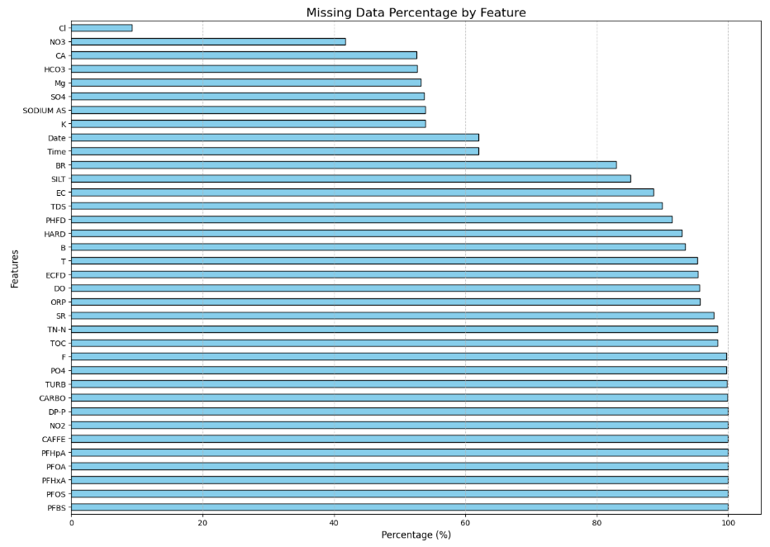
Handling Missing Values and Transformations
Dropped columns with > 80% missing values.
Imputed key columns using contextual data.
Created a pivot table for streamlined analysis.
Engineered the Station_Compliance target variable.
This chart shows the percentage of missing data per feature, with some parameters nearly 100% missing, while key features like Cl and NO3 have minimal gaps.

Slide 6
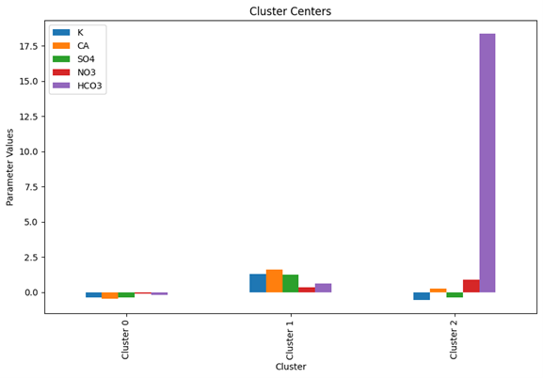
Techniques and Algorithms
Supervised Learning: Logistic Regression, Random Forest, Gradient Boosting, etc.
Unsupervised Learning: K-Means, Hierarchical Clustering.
Normalization with StandardScaler.
Dimensionality reduction using PCA for clustering visualization.
This chart illustrates the average parameter values at the center of each cluster, reflecting distinct water quality profiles

Slide 7
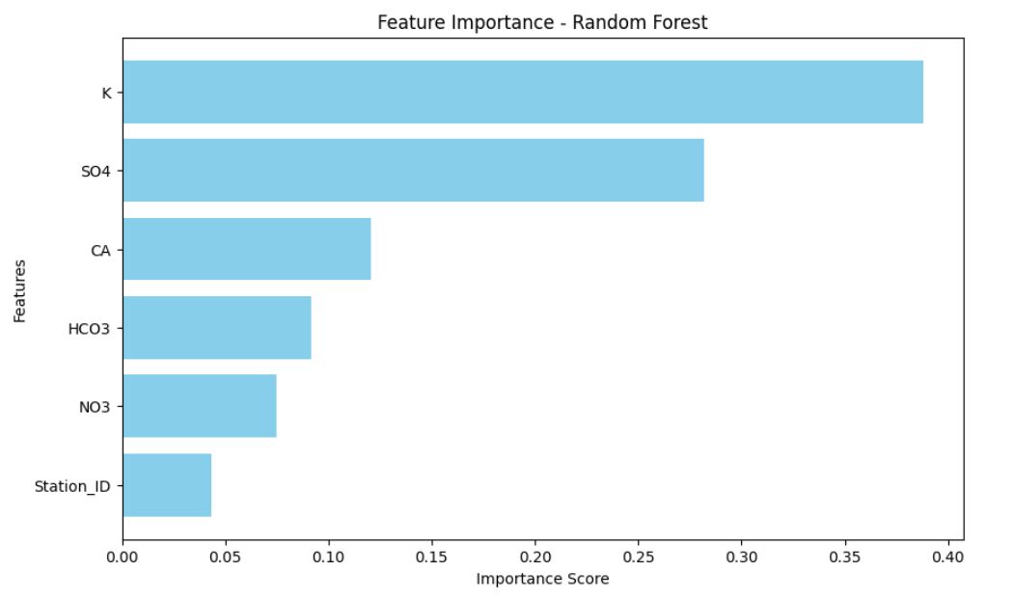
Evaluation Design
Metrics: Accuracy, Precision, Recall, F1-Score.
Cross-validation ensured model consistency.
Feature importance analysis revealed that Calcium (CA) and Potassium (K) were the most influential parameters for predicting compliance
This chart highlights the feature importance from the Random Forest model, showing that potassium (K) and sulfate (SO4) are the most influential factors in predicting station compliance.

Slide 8
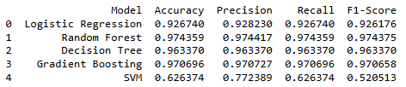
Performance of Models
Random Forest achieved the best results with 97.4% accuracy.
Gradient Boosting and Decision Tree also performed well.
Support Vector Machine (SVM) underperformed due to high-dimensionality.

Slide 9
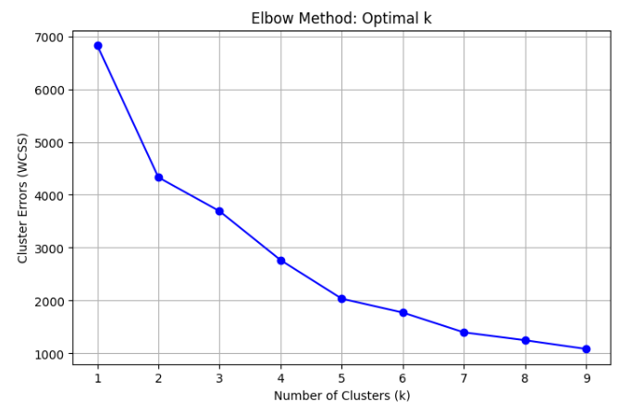
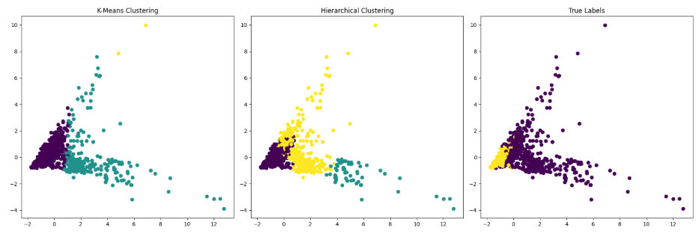
Grouping Stations by Characteristics
Optimal clusters: 3 (via Elbow Method).
Clear separations in water quality patterns among groups.

Slide 10
Key Takeaways and Future Work
Identified key factors affecting water quality compliance.
Demonstrated the utility of machine learning in stream analysis.
Future Directions:
Incorporating external data like rainfall or land use.
Exploring advanced clustering techniques (e.g., DBSCAN).
Deploying real-time monitoring systems.

