Slide 1
Import Export Website Tracking Result -First
https://Importexport3.com

Slide 2
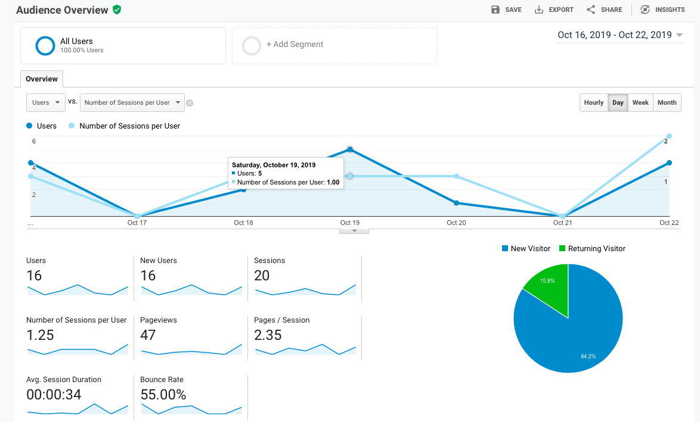
Audience Overview

Slide 3
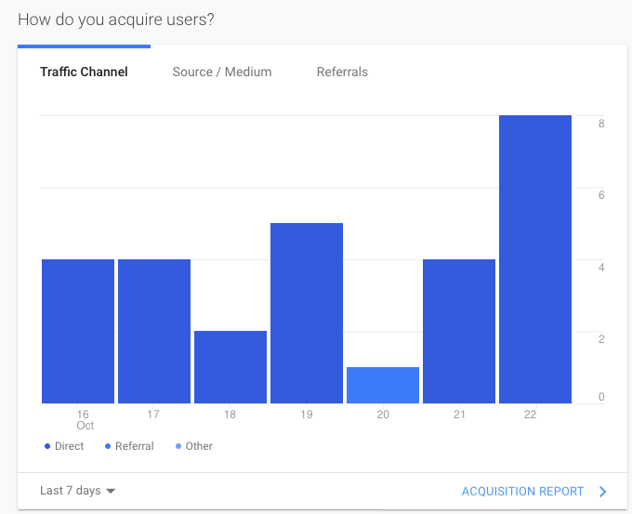
Users Sources
Direct
Referral
other

Slide 4
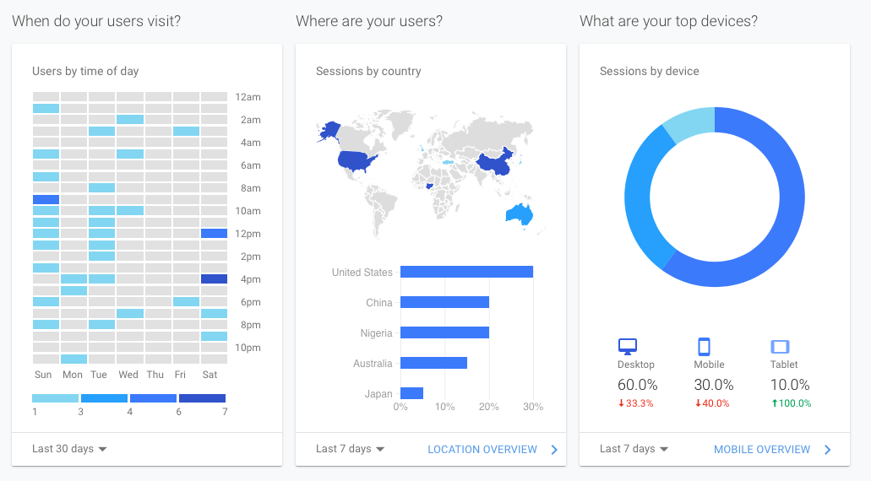

Slide 5
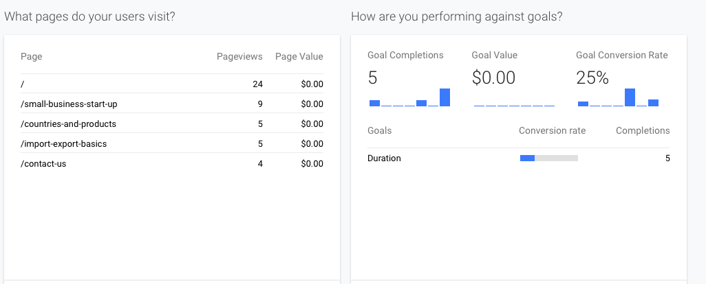
Goals and Conversion Rate
Performance

Slide 6
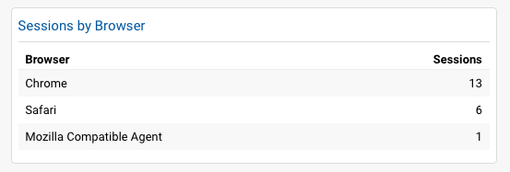
Browser Trend

Slide 7
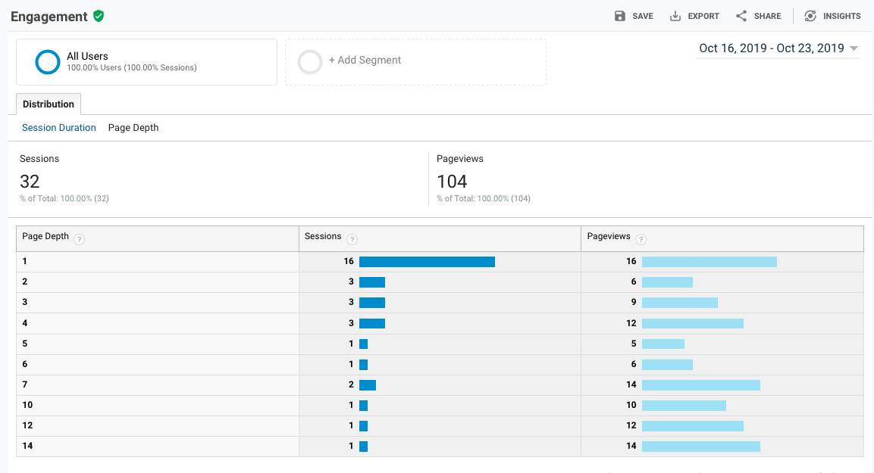

Slide 8
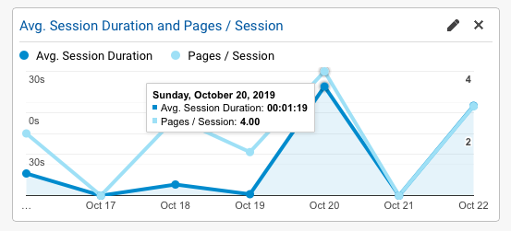
Page Depth
Pages/session

Slide 9
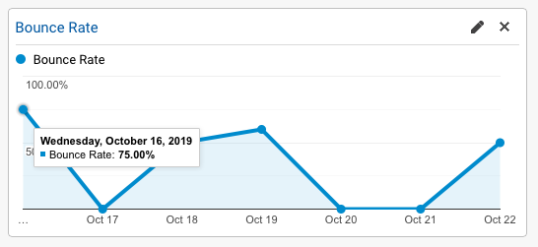
Bounce Rate

Slide 10
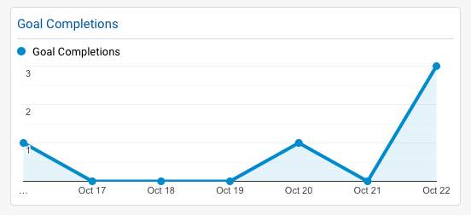
Goal Achievement

Slide 11
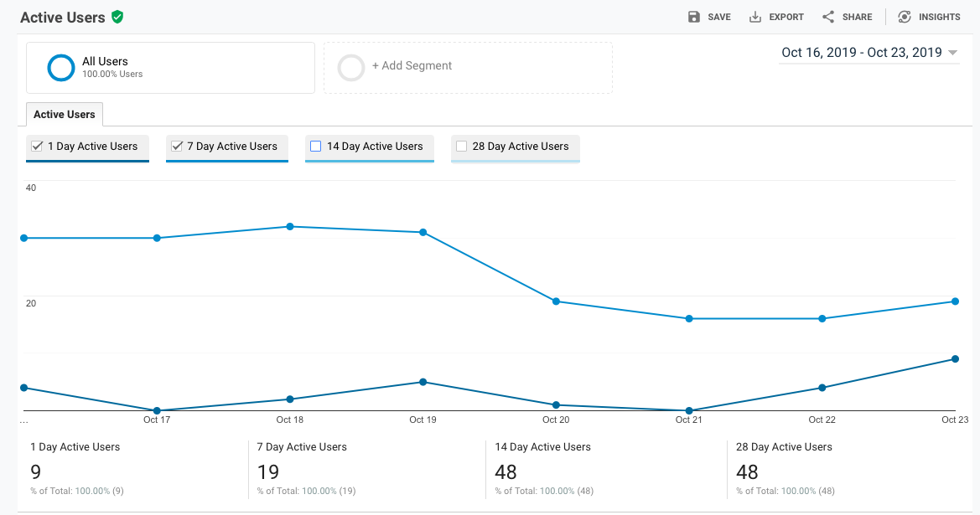
1 Day Active Users vs 7 days Active Users

Slide 12
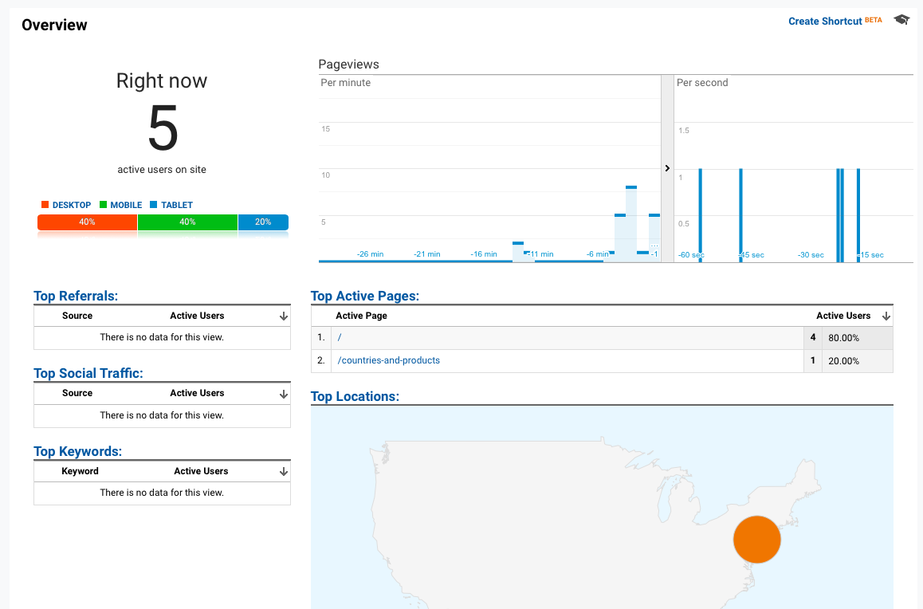
Real Time Traffic Overview
Users
Pageviews

Slide 13
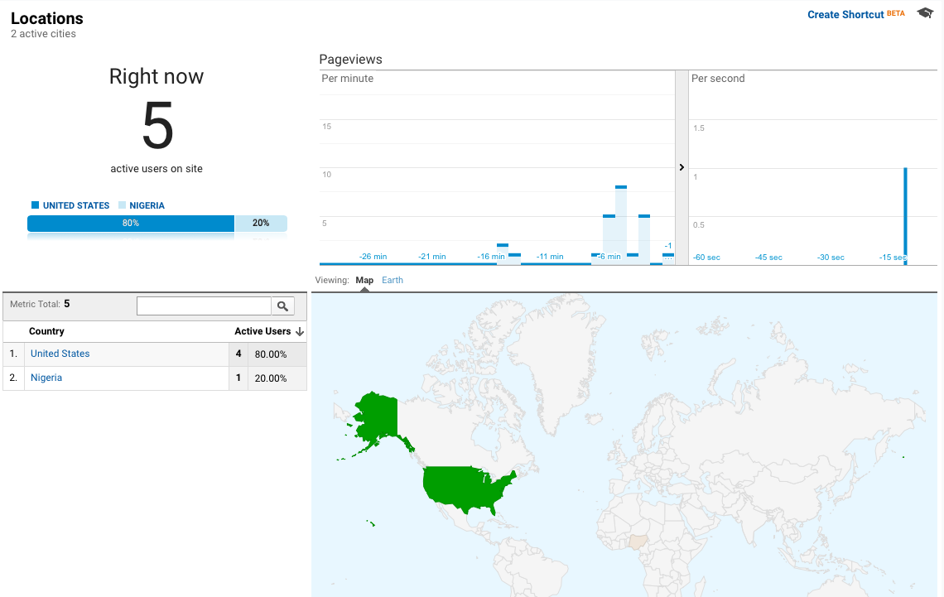
Real Time User Location

Slide 14
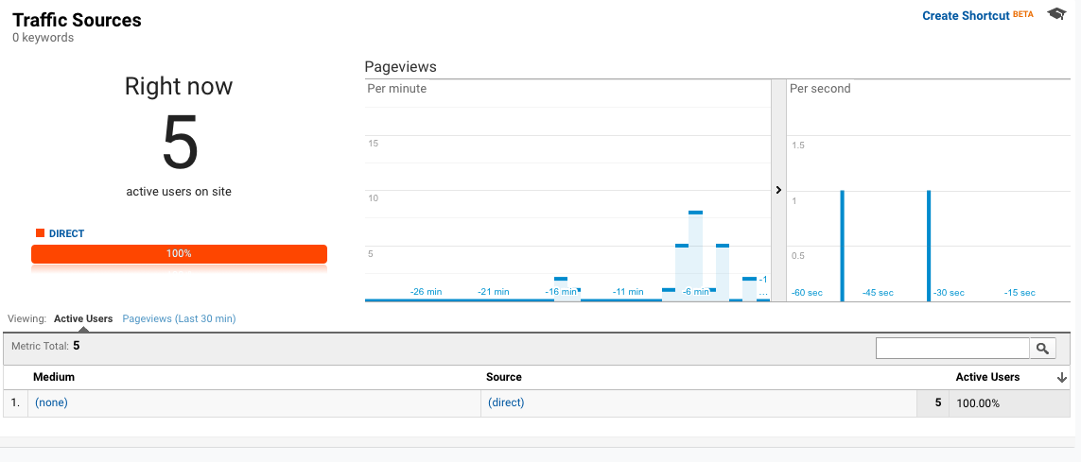
Traffic Source
Direct

Slide 15
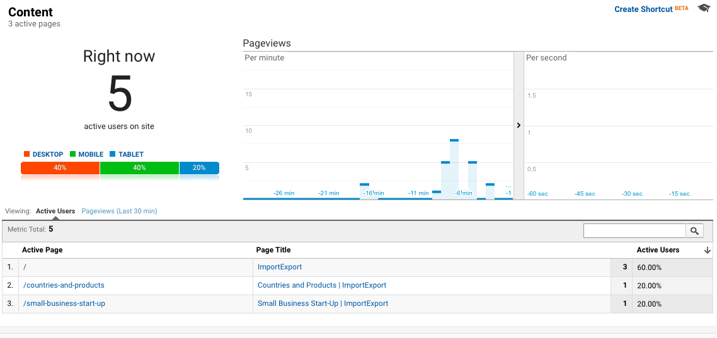
Content
Active user
Pageviews

Slide 16
Increase Referral user sources Addition of more KEYWORDS Content detail optimization
Improvements Required

