Slide 1

Rubby Ibe-Ikechi
(Web Insight Analyst)
Shirazi A. Siddiqui
(Web Intelligence Analyst)
Samsung career site
Analytics Proposal

Slide 2
introduction
Importance
Hypothesis
What we do

Slide 3
Goals
Increase Organic Search
Make Website user friendly
Attract Best Talent across the Globe.

Slide 4
Website design review https://www.samsung.com/us/careers

Slide 5
Website design review
Accessibility and Visual Assessment
Job Match based on individual introduction is not present
Artificial intelligence is missing
No option to forward jobs and make it favorite
Recommendation
Research and implementation of AI
Improvement of existing features.

Slide 6
Website design review
Functional Logic
Sorting jobs based on basic criteria like most recent, deadline date, relevance, etc.
Recently viewed job options
Save search option is not available. Lots of manual back and forth
Recommendation
Site’s visitor scope, page scope and session scope
Web usage and pattern
Analyze website’s traffic pattern:
Exit and bounce
Keywords used by visitors.

Slide 7
Website design review
Content Review
The font size is small. Its readability is poor.
Some jobs’ skills and qualifications are missing.
No benefits mentioned in the job description
Language filter doesn’t seem working
Jobs descriptions formatting are not consistent.
Mobile version Compatibility is not effective.
Recommendation
Pageviews/Session’s duration
Page wise Bounce rate
Page Depth

Slide 8
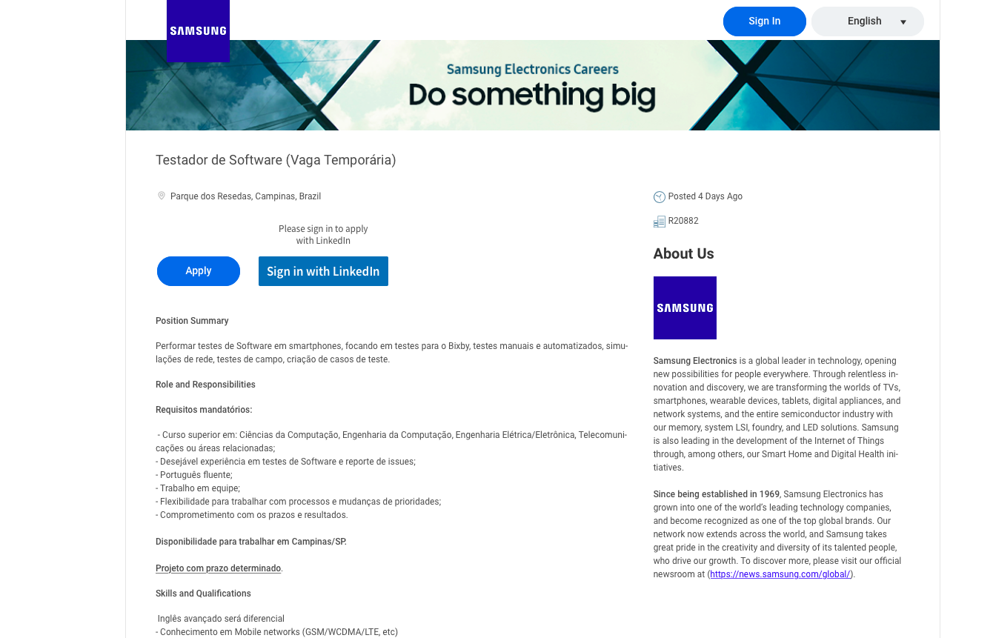
Language Filter Issue

Slide 9
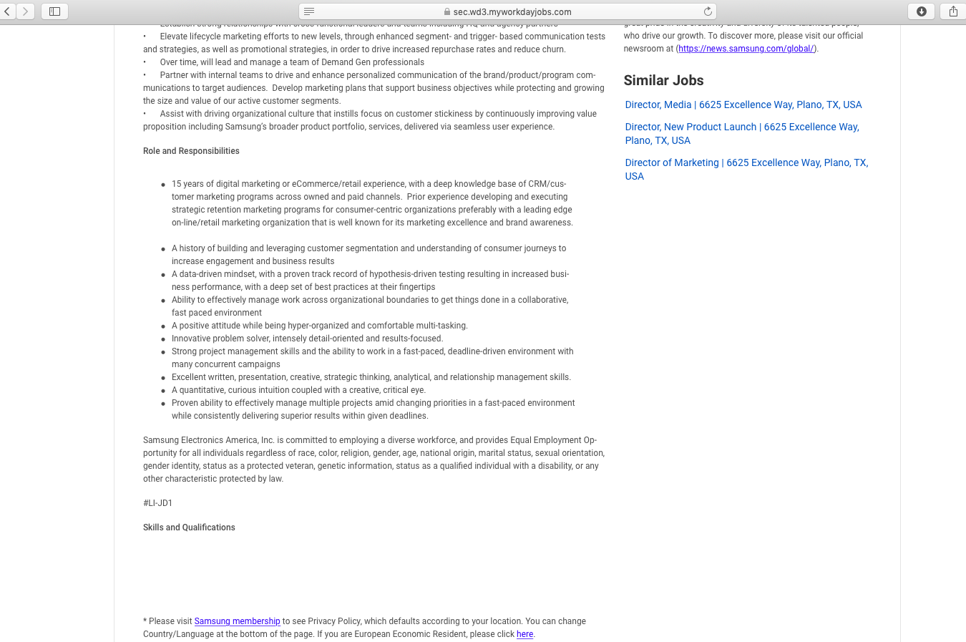
Some jobs’ skills and qualifications are missing

Slide 10
Methodology and Best design
Google Analytics design and methods
Business objectives definition
Strategies and Tactics that support the objectives.
Key performance indicators/targets for each KPI
Measurement planning (Actionable Metrics)
Collect, analyze and test the website data
Cost-efficient, Optimized, and User-friendly method

Slide 11
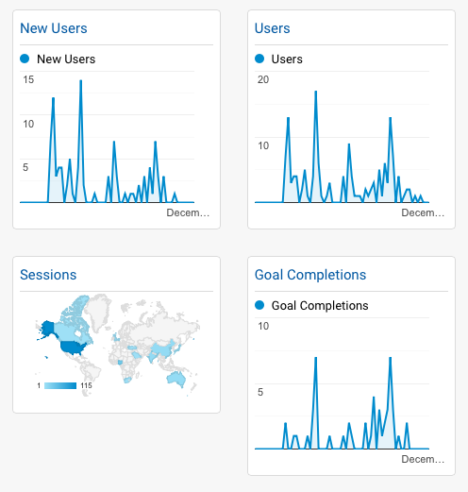
oUR ImplementationS SO FAR

Slide 12
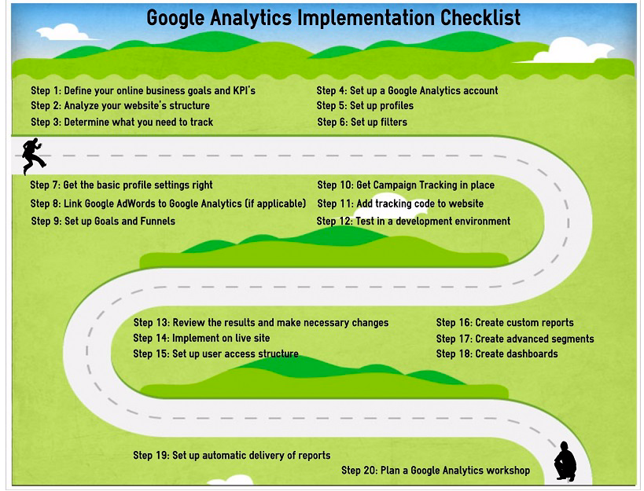
Project Timelines

Slide 13

Conclusion
Can Web Analytics help attract global best talents to Samsung ??
Estimated Timelines : Between 3 to 6 months.
Estimated cost : $100,000

Slide 14
Thank YOU
Our Work is Our Bond and Trust

