Slide 1
Final Project - Introduction to Deep Learning
Noa Halali & Shiraz Khalepari

Slide 2
Problem & Dataset
Task: Image classification on a custom dataset (same as Exercise 1).
Dataset: ~1,000 images, split into train/validation sets.
Preprocessing: Resize to 224×224 and ImageNet normalization.
Main challenge: Small dataset → high overfitting risk → need regularization and transfer learning.

Slide 3
Part 1 — Training a CNN from Scratch
Step 1 — Architecture & Optimization

Slide 4
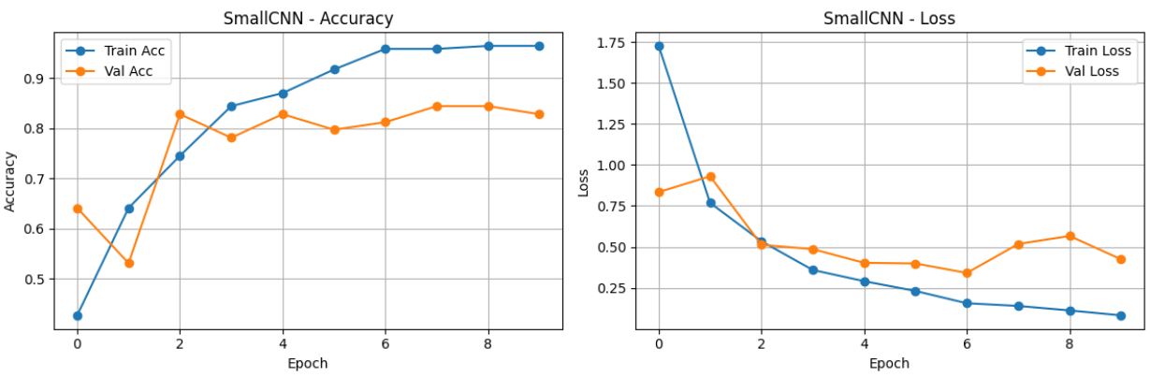
Experiment 1 - SmallCNN + Adam
Result: Validation accuracy exceeds 80%, indicating successful learning.
Observation: Performance stalled after Epoch 8, with a widening gap between training and validation metrics (Overfitting).
Conclusion: The SmallCNN provides a strong and stable baseline for this dataset, motivating a comparison with a deeper architecture to study the effect of increased model capacity.

Slide 5
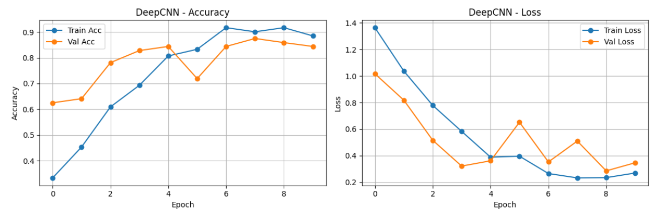
Experiment 2 - DeepCNN + Adam
Result: Achieved ~87.5% Peak Validation Accuracy, slightly improving on the baseline.
Observation: Training is significantly slower per epoch compared to SmallCNN, reflecting the higher computational cost of the deeper architecture.
Peak validation accuracy is similar to that of SmallCNN, but the training process is less stable, with notable drops in validation performance during early epochs.
Training accuracy consistently exceeds validation accuracy, suggesting increased susceptibility to overfitting.
Conclusion: Increasing model depth does not immediately improve validation performance on this dataset and introduces training instability, motivating further investigation into optimization strategies.

Slide 6
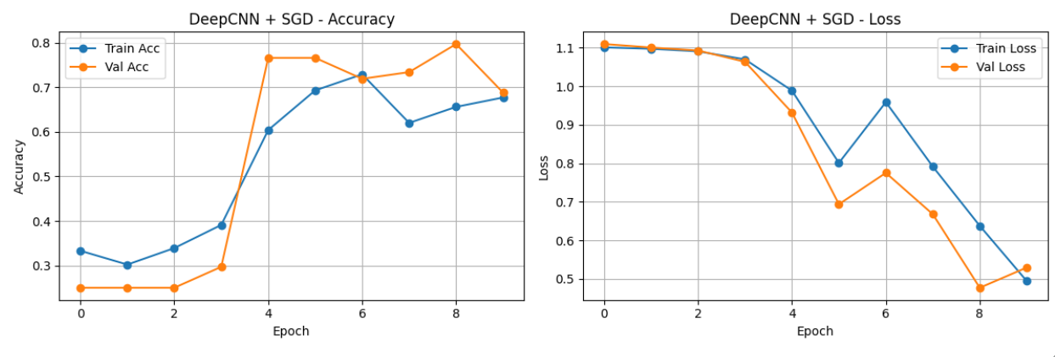
Experiment 3 - DeepCNN + SGD (momentum)
Result: Reached ~79.7% val Accuracy, but required the full 9 epochs to get there.
Observation: Although high validation accuracy is occasionally reached, it is not maintained consistently.
Comparison: Training converges significantly more slowly compared to Adam.
Conclusion: Adam is the superior optimizer for this task, offering faster convergence and better immediate stability.

Slide 7
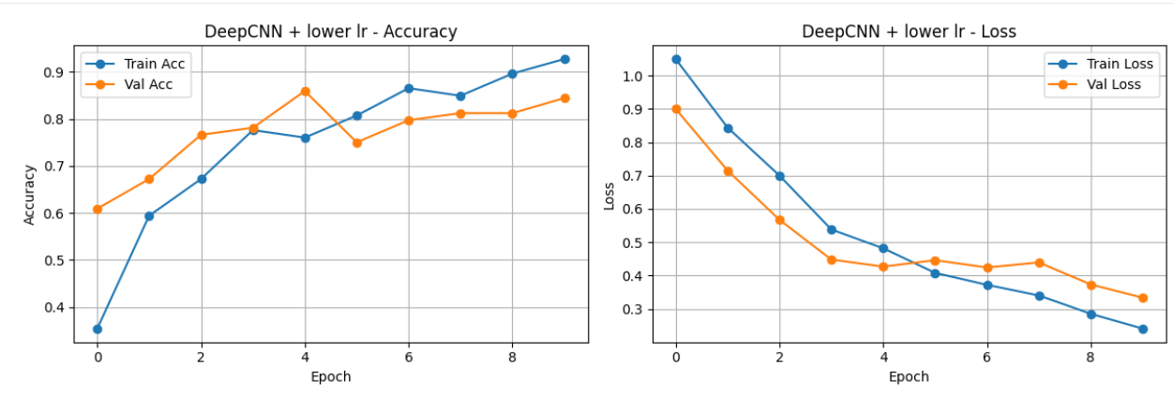
Experiment 4 - Hyperparameter Tuning (Learning Rate)
Result: Achieved ~85.9% Peak Accuracy
Observations:
- Reducing the learning rate resulted in slower but more stable convergence. Training loss decreased smoothly across epochs, and training accuracy improved steadily.
- Validation performance also improved gradually, with reduced fluctuations compared to the higher learning rate setting.
- the final validation accuracy was lower than that achieved with the baseline learning rate, and more epochs were required to reach peak performance.
Takeaway:
While a lower learning rate improved training stability, it also slowed convergence and limited the final validation performance.
For this dataset and architecture, a learning rate of 1e-3 provided a better trade-off between convergence speed and validation accuracy and was therefore selected for subsequent experiments.

Slide 8
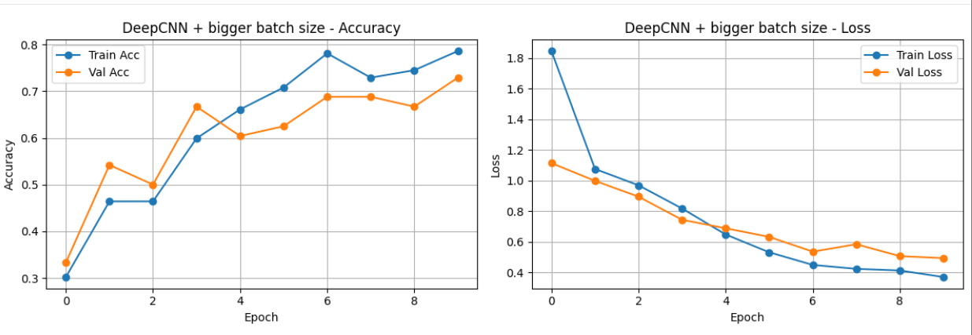
Experiment 5 - Hyperparameter Tuning (Batch Size)
Result: Achieved ~72.9% Peak Accuracy.
Observation: Training progressed more slowly in the early epochs, with lower training accuracy compared to the baseline setting. Validation performance improved gradually but remained noticeably lower overall.
Takeaway:
- Increasing the batch size to 64 reduced the overall validation performance and slowed convergence for this dataset.
- For DeepCNN + Adam with this dataset size, batch size 32 appears to provide a better trade-off between convergence speed and validation accuracy.

Slide 9
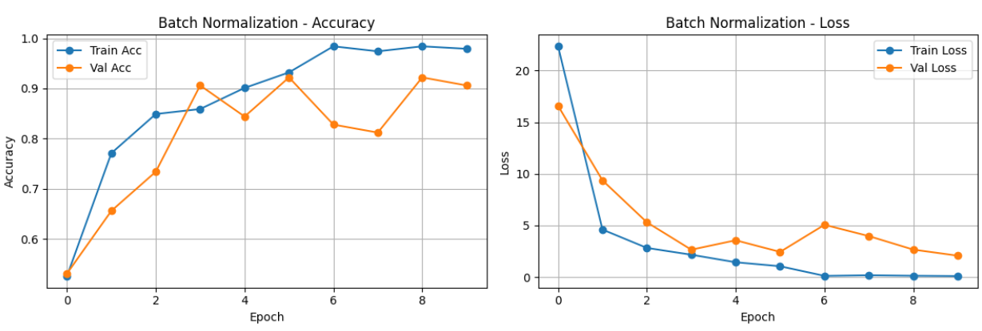
Experiment - DeepCNN + Adam + Batch Normalization
Step 2 — Add Batch Normalization
Result: Achieved ~92.2% Peak Accuracy, significantly beating the baseline.
The Problem: Extreme Instability. The loss curve is "jagged" and unpredictable (e.g., Val Loss jumps from 2.4 to 5.0).
Key Insight: Deep networks with Batch Norm learn fast but are prone to high variance. They need a "brake" (Regularization) to stop them from memorizing noise.

Slide 10
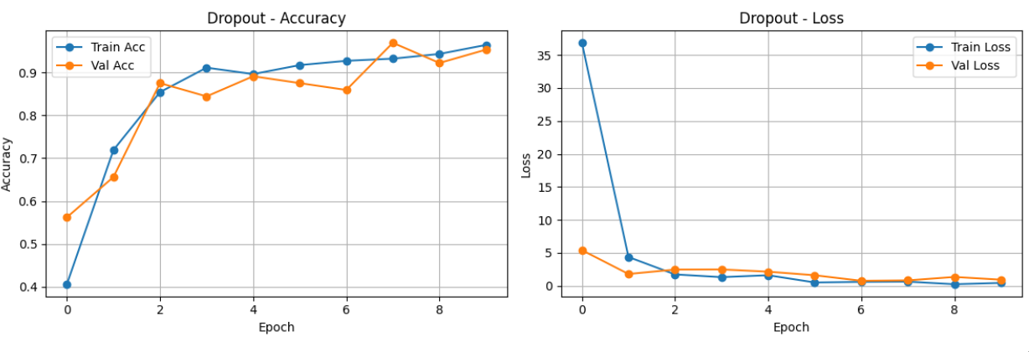
Experiment R1: Dropout
Step 3 — Add Regularization
Result: Achieved ~95.3% Peak Accuracy, the winner of the "Training from Scratch" phase.
The Fix: Randomly disabling neurons (Dropout) forced the network to learn redundant, robust features.
Observation: Excellent generalization. The model performed almost as well on unseen data as it did on training data (Train 96% vs Val 95%).
The "Hiccup": The spike at Epoch 7 shows that even with regularization, deep learning can be volatile.

Slide 11
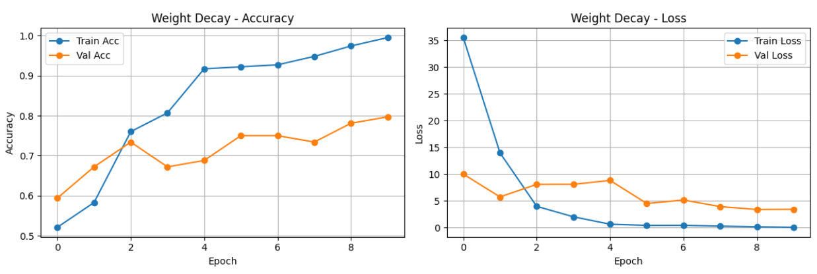
Experiment R2: Weight Decay (L2 Regularization)
Result: Achieved ~79.7% Peak Accuracy.
The Comparison: Worse than Dropout.
Dropout: ~95% Acc (Strong Generalization)
Weight Decay: ~80% Acc (Moderate Generalization)
Dynamics: The model fought against the penalty early on (instability in Epoch 1-3) before settling.
Takeaway: For this small dataset, randomly dropping neurons (Dropout) is more effective than penalizing large weights (L2).

Slide 12
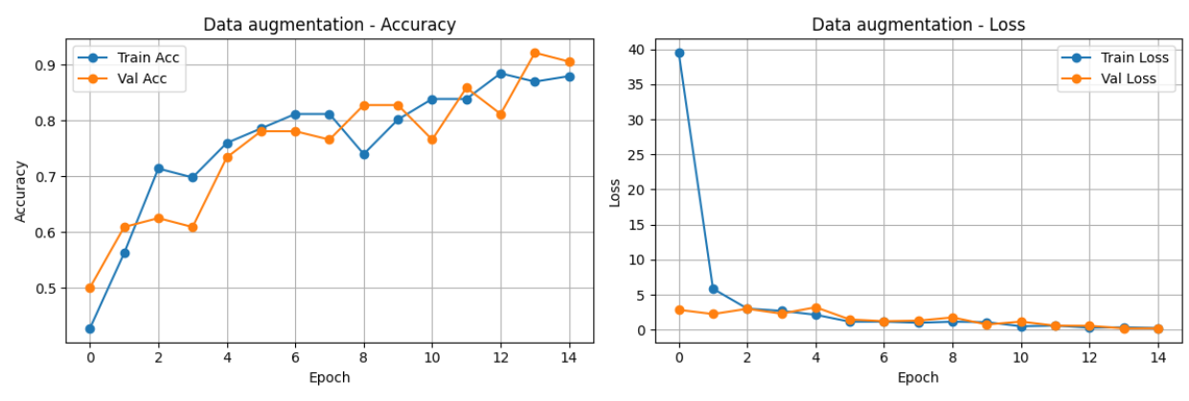
Experiment R3: Data augmentation
The Idea: We artificially expanded our small dataset by randomly rotating, flipping, and adjusting the brightness of images during training.
The Result: Training became "harder" (accuracy rose slower), but the final model was much more robust.
Key Metric: Reduced the Generalization Gap. The model stopped memorizing the exact position of the banana and started learning the features of the banana.

Slide 13
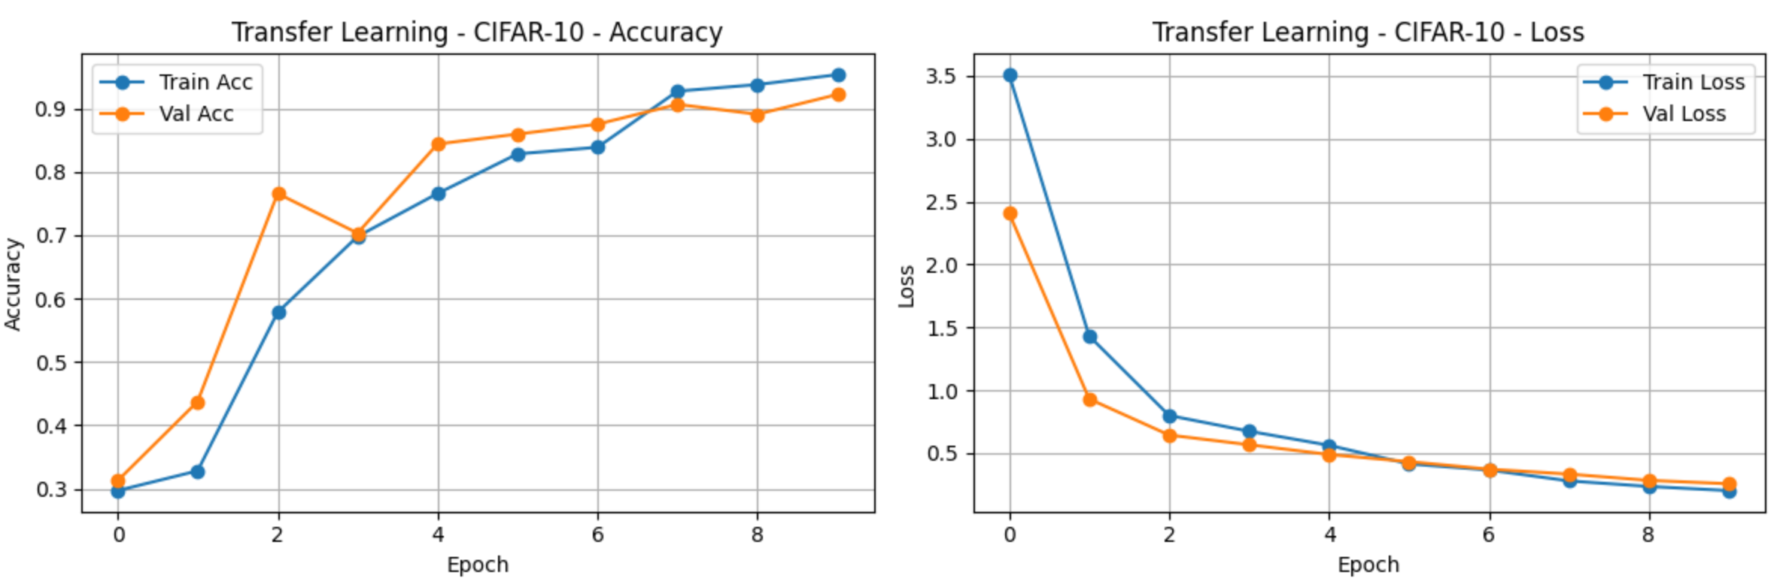
Step 5 — Pretrain on CIFAR-10 and Fine-Tuning on your dataset
Part 2 — Transfer Learning
Result: Achieved ~92.2% Accuracy.
Dynamics: Experienced initial "Transfer Shock" (Epoch 1-2) while adapting to the new classes, followed by rapid convergence.
Why it worked: The model didn't have to learn "how to see edges" from scratch—it only had to learn "which edges make a banana."
Comparison:
- From Scratch: ~84% Acc (Unstable).
- Pretrained: ~92% Acc (Stable).

Slide 14
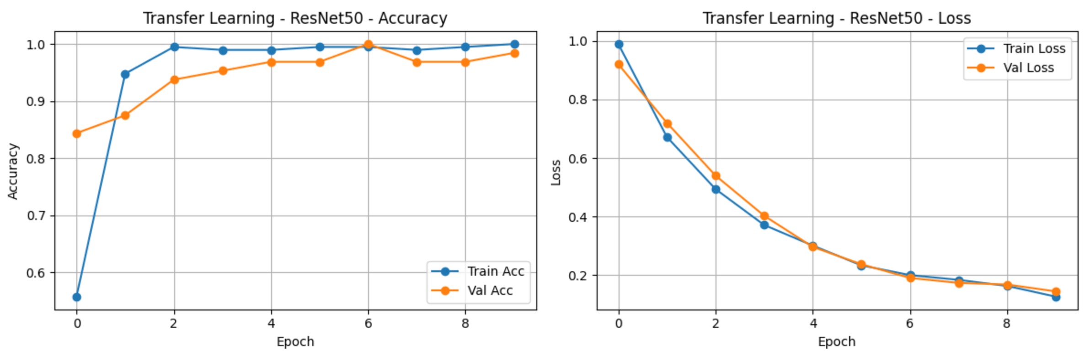
Step 6 — Adapting a Pretrained Model
Part 3 — Transfer learning with ResNet50
Result: 100% Peak Accuracy (Epoch 7).
The Difference:
- Custom Models: ~85-95% Acc (Struggled to learn features).
- ResNet50: 100% Acc (Already knew the features).
Efficiency: Reached 95% accuracy in just 4 epochs.
Takeaway: For small datasets like this, Transfer Learning is not just an option; it is the optimal solution.

Slide 15
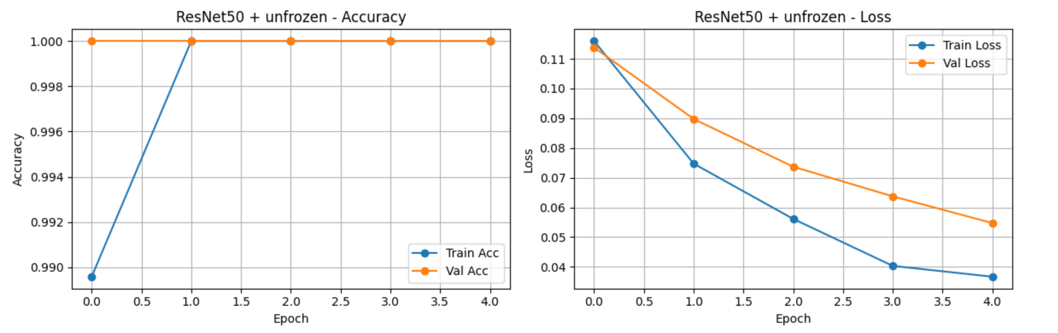
Step 7 — Training and Fine-Tuning
Result: 100% Accuracy with 0.05 Loss.
The Strategy: Unfrozen layers + Low Learning Rate (1e-5).
Why we did it: To increase Model Confidence.
Frozen Model: "I'm 80% sure this is a ripe banana."
Unfrozen Model: "I'm 99.9% sure this is a ripe banana."
Visual Proof: The Validation Loss dropped by ~60% (0.14 to 0.05), proving the model learned the specific nuances of our dataset.

Slide 16
Final Reflection
1. What architectural choices mattered most?
Batch Normalization was the "Stabilizer":
Evidence: In Experiment 2 (DeepCNN without BN), the model was highly volatile and struggled to converge.
Impact: Adding Batch Normalization accelerated learning and raised peak accuracy to ~92%, but left validation highly volatile.
Dropout was the "Generalizer":
Evidence: The DeepCNN with BN alone showed signs of overfitting and extreme validation instability
Impact: dding Dropout (Experiment R1) successfully smoothed the validation curve and closed the generalization gap.
Depth alone is dangerous:
Insight: Simply adding layers (SmallCNN to DeepCNN) without regularization actually hurt stability. Depth requires control mechanisms (BN/Dropout) to be effective.

Slide 17
2. Which optimization strategies worked best?
Adam vs. SGD:
Winner: Adam.
Reason: Adam converged significantly faster (2-3 epochs) compared to SGD (which stagnated for the first 4 epochs). For a small dataset where we want quick feedback, Adam's adaptive learning rates were superior.
Learning Rate Sensitivity:
Critical Moment: In Step 7 (Unfreezing ResNet), lowering the learning rate to 1e-5 was the deciding factor. It allowed us to refine the weights to 100% accuracy without triggering "Catastrophic Forgetting" (which would have destroyed the pre-learned features).

Slide 18
3. When did transfer learning help?
The "Small Data" Problem:
Context: With only ~1000 images, our custom models had to learn everything (edges, textures, shapes) from scratch. This is inefficient.
The "Knowledge" Advantage:
Impact: Transfer Learning (ResNet50) brought in "knowledge" from 1.2 million ImageNet images. The model didn't have to learn how to see; it just had to learn what to look for (yellow vs. green).
Result: It reached 100% accuracy and 0.05 loss, a level of perfection that our custom models (stuck at ~95%) likely could never reach without massive data augmentation.

Slide 19
4. What would you do differently with more time or data?
Hyperparameter Tuning:
Plan: We used standard values (Dropout=0.5, LR=1e-3). A Grid Search (testing Dropout=0.3 vs 0.5, LR=1e-4 vs 1e-3) could squeeze out the final 1-2% of performance from the custom models.
Early Stopping:
Plan: instead of training for fixed 10 epochs, we would implement Automatic Early Stopping to save the model exactly when validation loss peaks (e.g., Epoch 6 for DeepCNN), preventing the overfitting we saw in later epochs.

